Slide 1
Static analysis for .NET & CodeContracts
M. Barnett, M. Fahndrich, F. Logozzo
RiSE, Microsoft Research

Slide 2
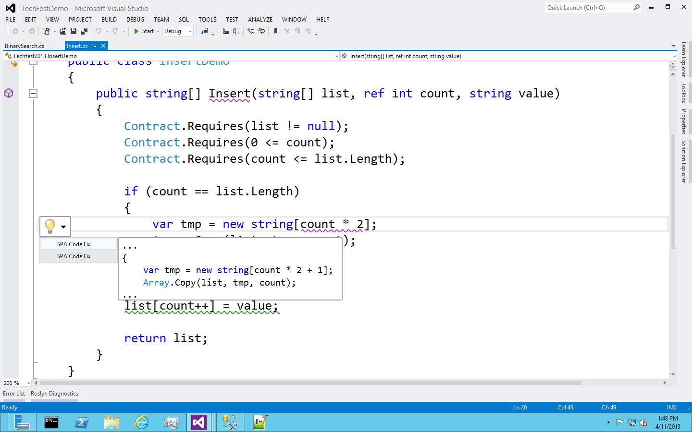
The future: SPA Demo

Slide 3
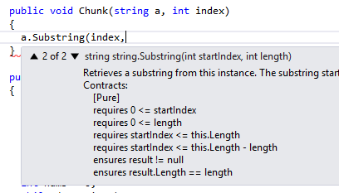
The present: CodeContracts Tools
Contract API part of .NET (since v4)
Author Preconditions, postconditions, object invariants
Tools available for free download on VS gallery
Automatic documentation generation
Augmented Intellisense
Runtime checking
Static checking
So far ~80,000 downloads
Devlabs + VS Gallery

Slide 4
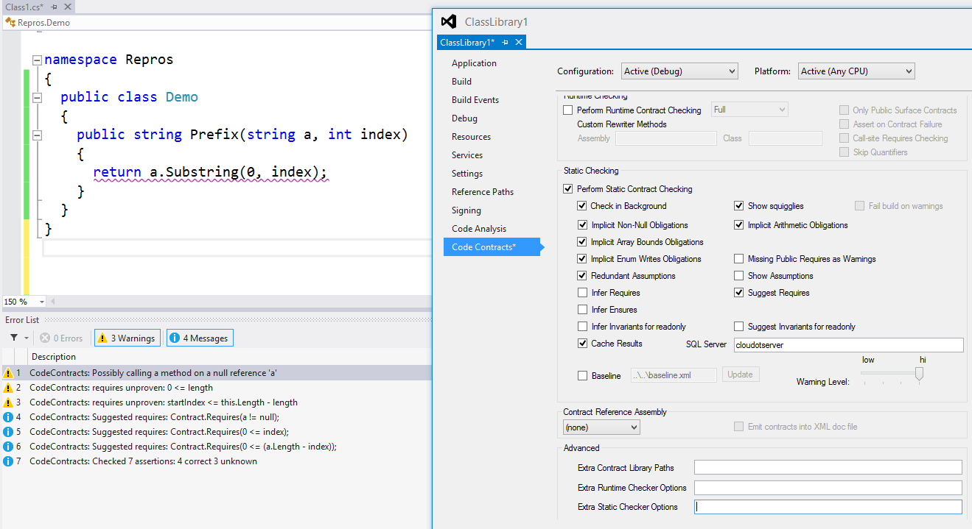
The present: CodeContracts Static checker
Scalability
Checks
Inference
Warning management

Slide 5
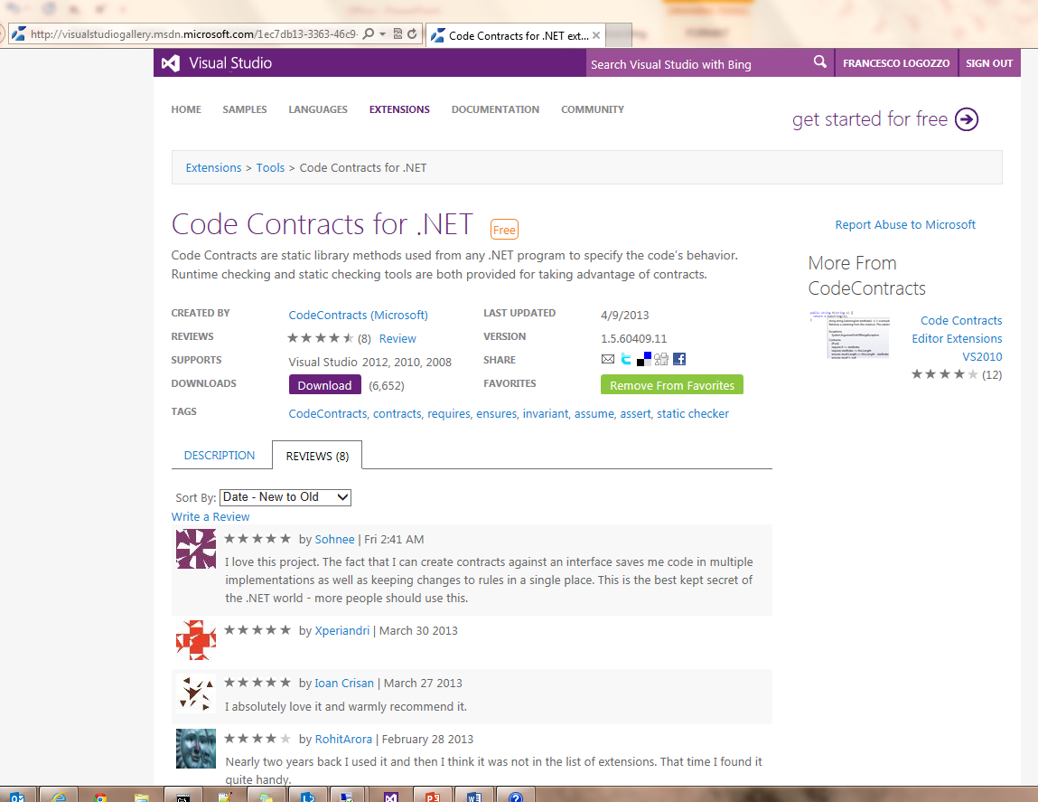
Download’em now!

