Slide 1
Notes:
Overview | CCDoc | Adornments | Conclusion

Slide 2
Code Contracts Documentation
Daryl Zuniga

Slide 3
Overview
Overview | CCDoc | Adornments | Conclusion
CCDoc
Generating documentation with contracts
Contract Adornments
Exposing inherited contracts in the VS IDE

Slide 4
CCDoc
Overview | CCDoc | Adornments | Conclusion
Getting contract information (requires, ensures, ensuresOnThrow, invariants) into documentation
Using an API
Knowing what to give it
API
Knowing what to expect from it

Slide 5
Demo
Overview | CCDoc | Adornments | Conclusion

Slide 6
CCDoc
Overview | CCDoc | Adornments | Conclusion
XML Injector
Sandcastle Patch
Documentation!
Contract Extractor

Slide 7
Contract Adornments
Overview | CCDoc | Adornments | Conclusion
For implementing an override or interface method
What are their contracts?
Contracts?
override int M(int input){
…
}

Slide 8
Demo
Overview | CCDoc | Adornments | Conclusion
Did it work? Yes | No

Slide 9
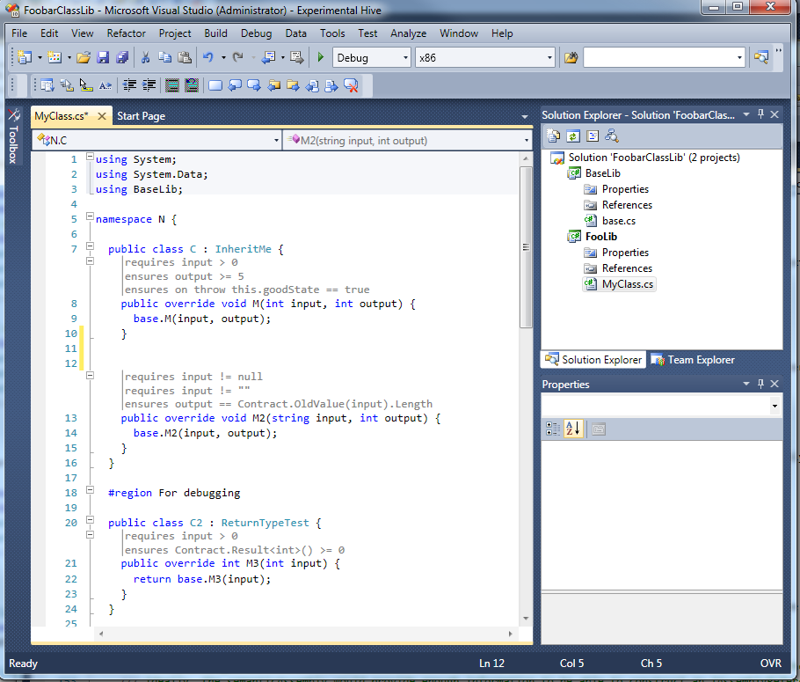

Slide 10
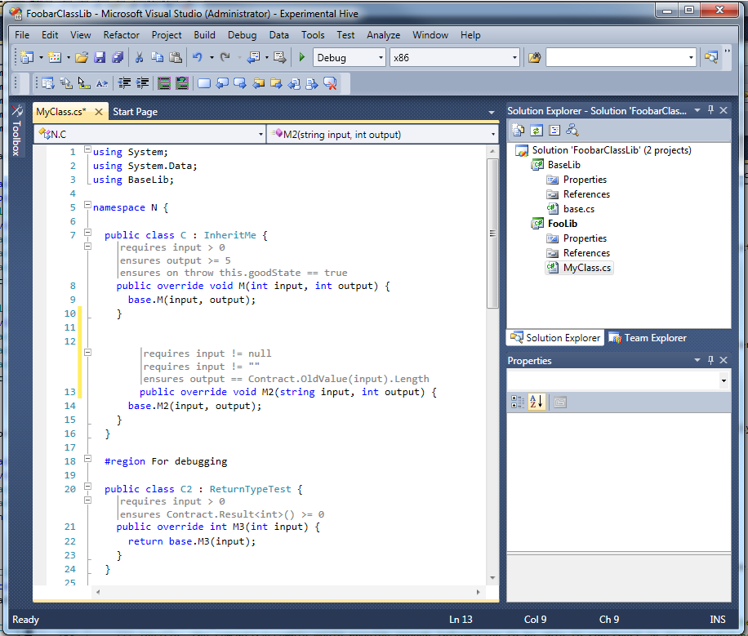

Slide 11
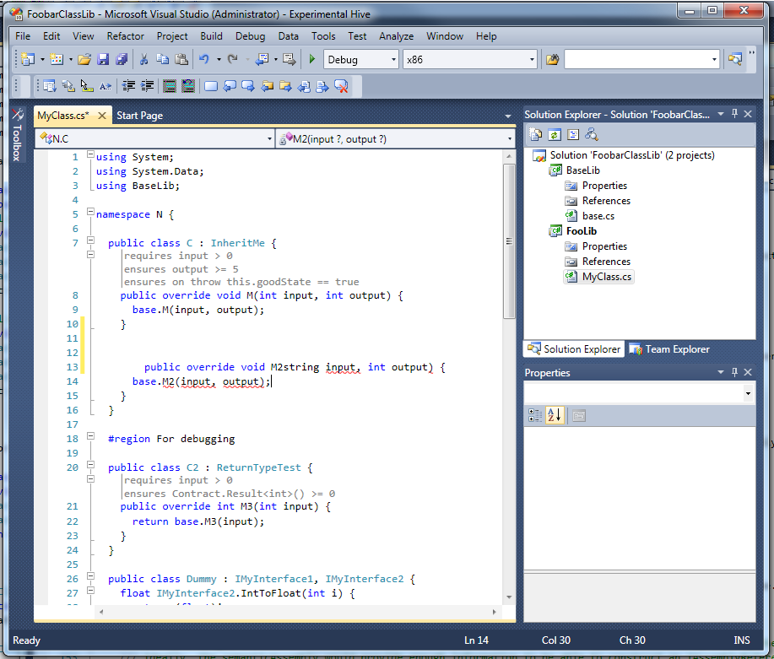

Slide 12


Slide 13
Contract Adornments
Overview | CCDoc | Adornments | Conclusion
Visual Studio
VS
Code Model
CCI2
Code Model
Visual
(Text Adornment)
Contract Provider

Slide 14
Conclusion
Overview | CCDoc | Adornments | Conclusion
CCDoc
Help use an API
Contract Adornments
Help developing with contracts

Slide 15
Questions?
Overview | CCDoc | Adornments | Conclusion

