Slide 1
Ethan and the incredibly, monstrously, arduous maze!
Guide Ethan as he tries to find his way to his home, an island paradise.

Slide 2
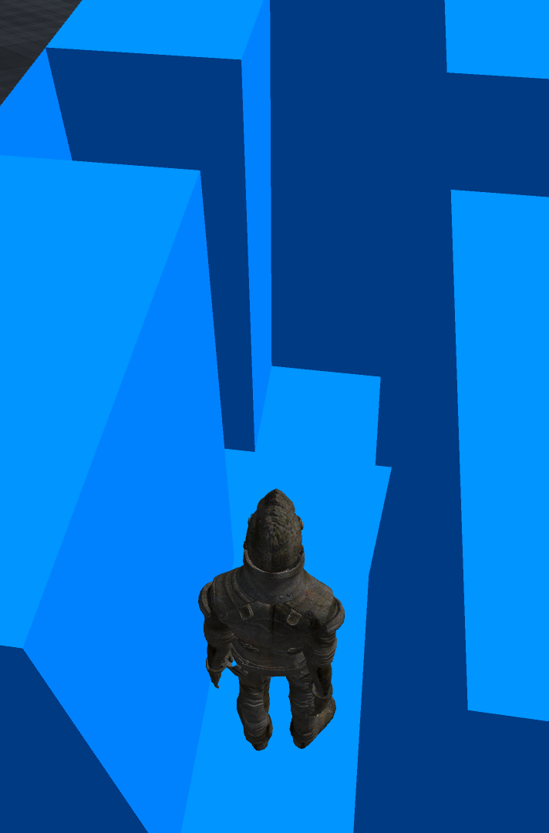
Level One
Here, Ethan navigates a simple blue maze. The difficulty of the game here is easy.
Due to a bug, the controls in this level are directionally fixed, while the camera moves with Ethan. Thus, “w” is always north, even when Ethan faces east.

Slide 3
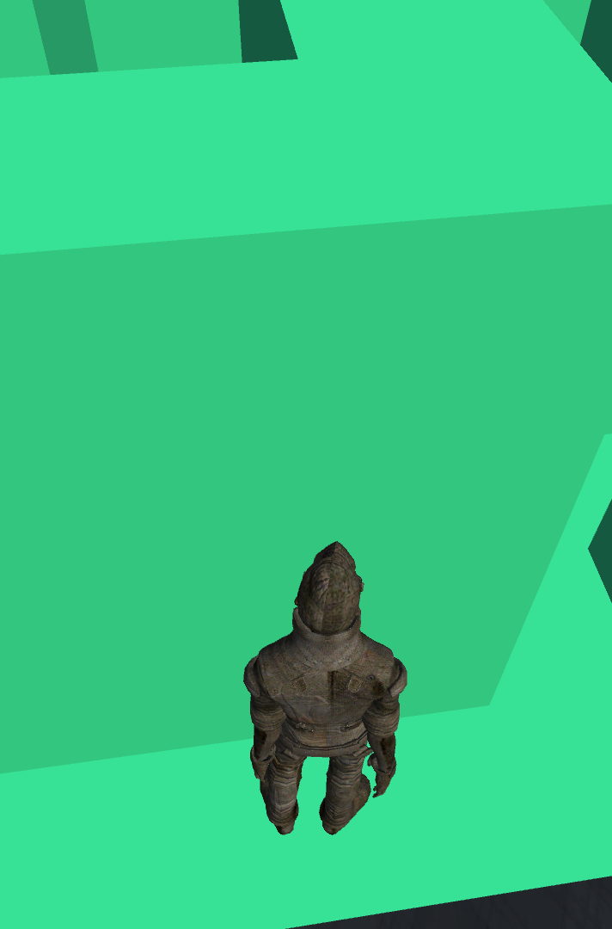
Level Two
The difficulty of the maze is much higher than the previous level. Here, the control scheme changes. “corresponds to moving forward, while “a” and “d” correspond to turning anti-clockwise and clockwise respectively.

Slide 4
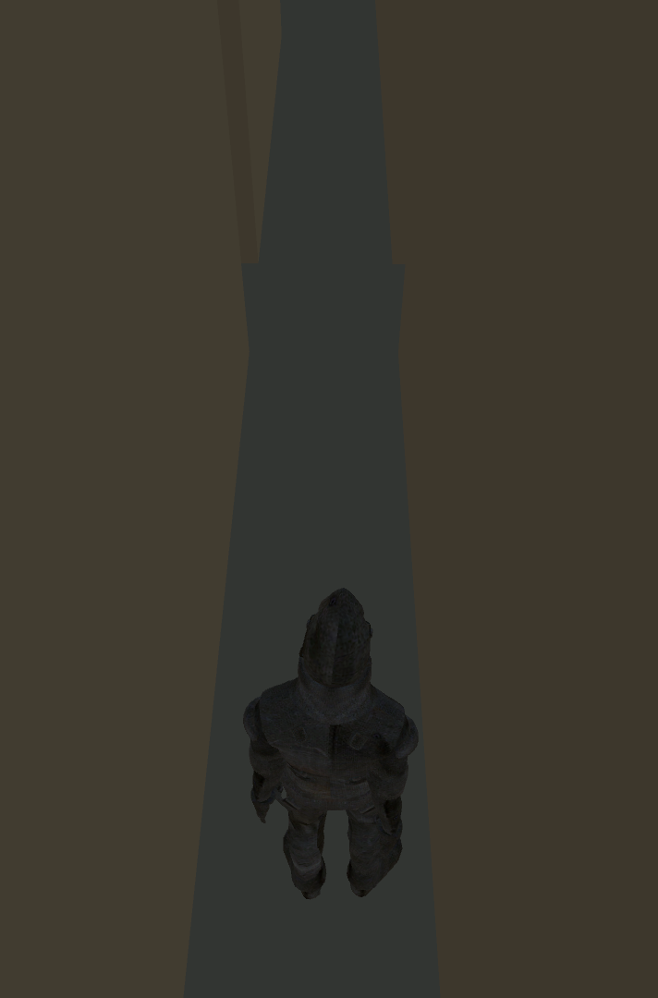
Level 3
Here, the control scheme remains the same as the previous level. The difficulty is raised exponentially, and the walls are raised to make it even harder to know where Ethan is in the bigger scheme of the map.

