Slide 1
The 1st Session Topics :
We will discuss through this Session :
What is http protocol and http-client and http-server ?
how web-servers work ? , what is the different between client and server ?
What is the rule of backend developers ?
What,s the two backend-stacks paths Which will be introduced By GDSC Backend-Development Team ?
Nodejs Stack Will Produced By Eng. Eslam Muhammed
PHP Stack Will Produced By Eng. Hagar Mahmoud

Slide 2
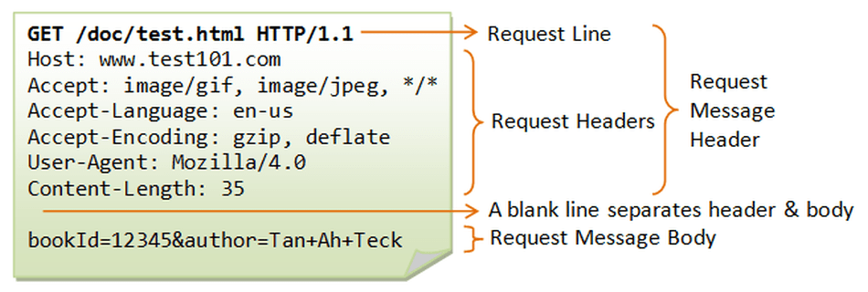
It stands for Hyper Text Transfer Protocol It Used in Web-Communtication between a web-client & web-Server. The Following is An Example of HTTP-client Request :
What is Http Protocol ?

Slide 3
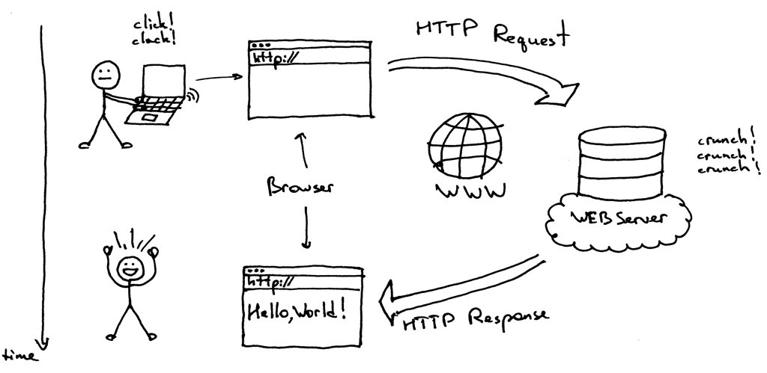
What is Http-Client & Http-Server ? & How Server-Side Work ?

Slide 4
What is The Rule Of Backend Developers ?
Back-end developers are the experts who build and maintain the mechanisms that process data and perform actions on websites. Unlike front-end developers , who control everything you can see on a website, back-end developers are involved in data storage, security, and other server-side functions that you cannot see.

Slide 5
What,s The Main two Stacks Which Will Produced By GDSC Backend-Development Team ?
Nodejs [ Expressjs , PostgreSQL DB , MongoDB, Jasmine ]
PHP [ PHP ,MySQL DB , Laravel ]

Slide 6
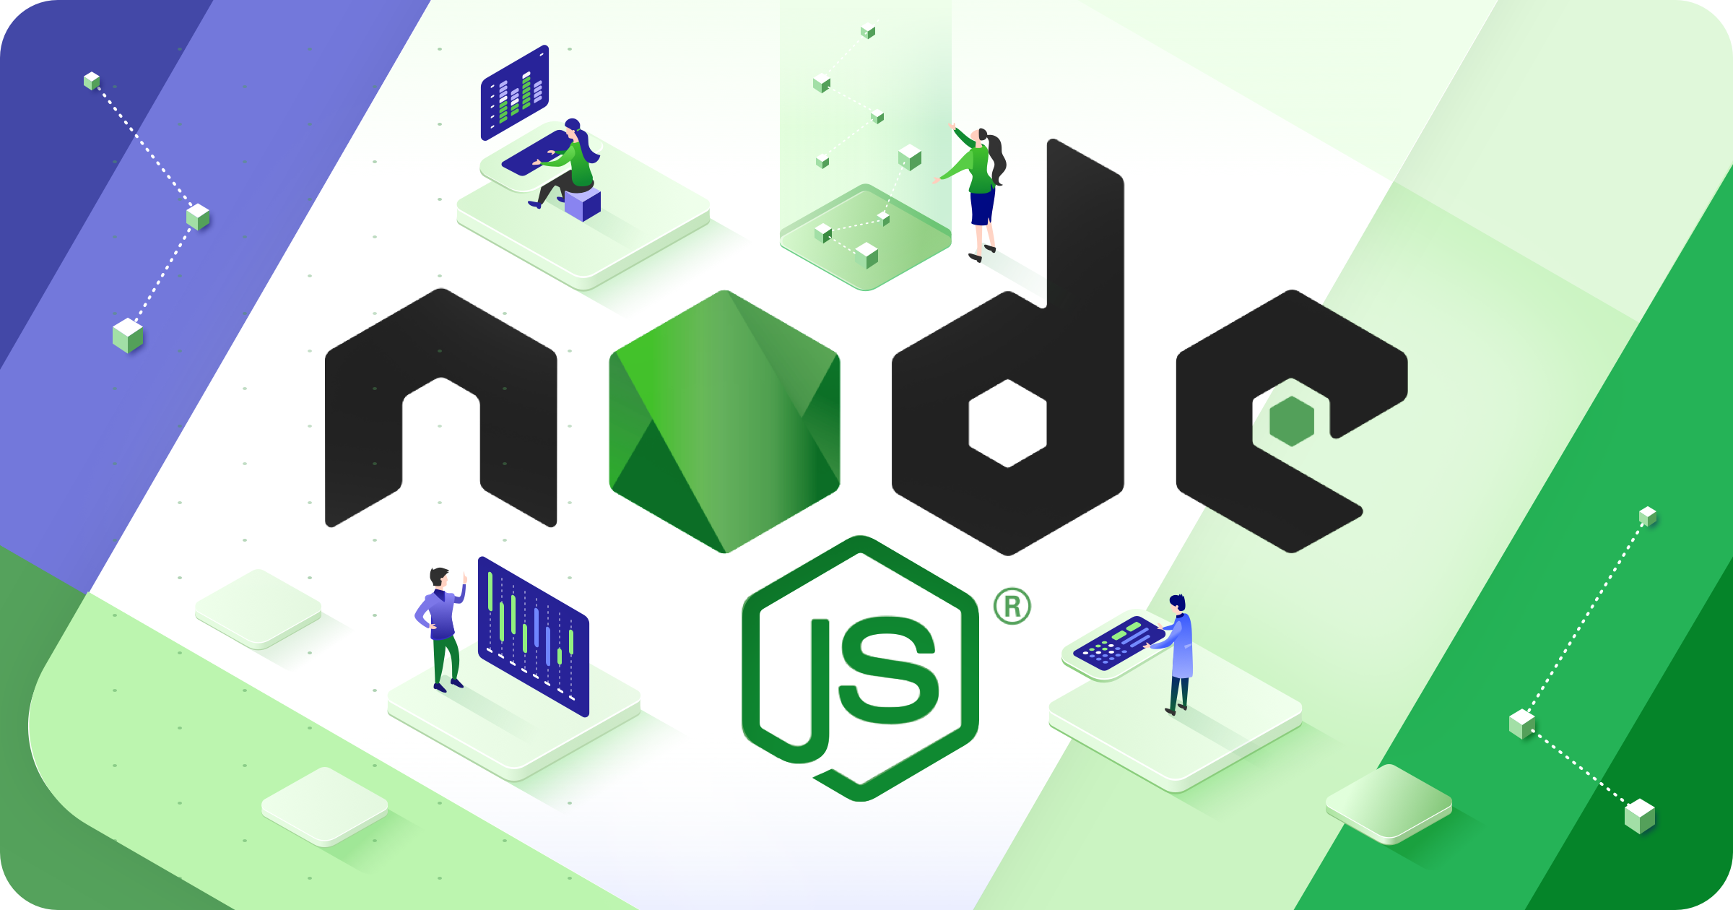

Slide 7
Introduction
As you might have heard about JavaScript, it is one of the most preferred and commonly used backend technology.
JavaScript has shown a significant rise in its usage, since it speeds up the development, making it more time and cost-effective by unifying the codebase.
Node.js is a JavaScript runtime environment that runs JavaScript code outside the web browser.
JavaSript is a programming language that drastically changed web development and has been in use by IT specialists worldwide since 1995.
Even though JavaSript has been around for a longtime and has great frameworks and libraries, but it never had any backend platforms for hosting application, that could compete with other languages.
Currently, we have Node.js that can solve this issue. Many startups and enterprise-level projects use Node.js for various reasons, which we are going to cover later in the article.
The research shows that developers use Node.js for their application’s backend and other tasks to enhance their performance.

Slide 8
What is Node.js used for?
Node.js belongs to the software category that allows developers to code applications and simultaneously run them. The principal characteristics of Node.js are:
It is a server framework.
It is open-source.
It is suitable for different platforms.

Slide 9
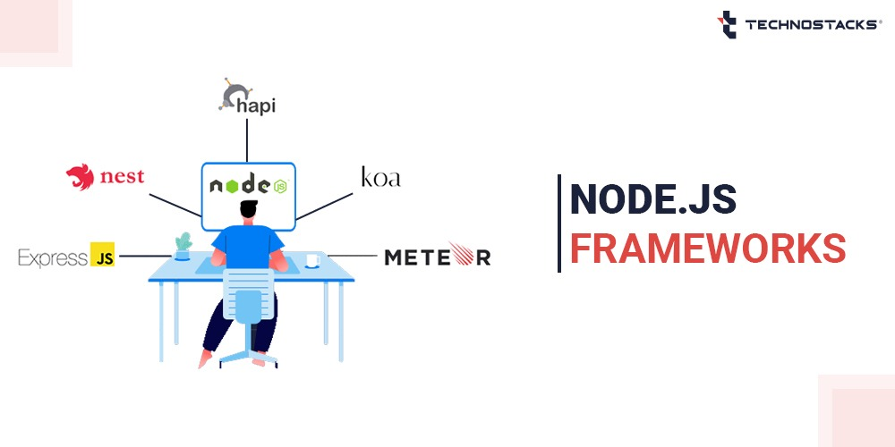
Top Nodejs Frameworks :

Slide 10
Why Node.js is good for the backend?
In web development, the backend of any application is the most crucial part. Thus, developers pay attention to it and utilize the best solutions and technology to work correctly.
Node.js works well with a real-time handling large amount of information. Node.js enables the collection and visualization of data to be presented as dashboards.
Node.js backend development is concise, as it provides many features that can be impossible to have with any event-based environments.
Node.js is fast as it stores its data in native JSON.
It is supported by a large community of developers that are constantly work on improving it.
It is also suitable for developing software for different platforms regardless of the underlying operating system.
Node.js handles simultaneous tasks, since it is non-blocking and supports async functions. They help speed up the server activities because the processes are usually handled in a single thread instead of queuing.
Applications developed in Node.js can be scaled and offers relatively higher performance.
Node.js is easy to learn. the number of developers who use Node.js is growing significantly, reducing development costs when hiring them.

Slide 11
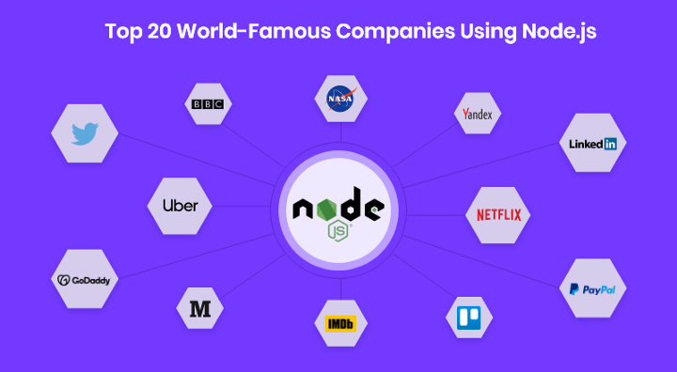
Top Famous Companies Using Nodejs

Slide 12
What They Gained When They Used Nodejs ?
Netflix lowers startup time with Node.js.
NASA improved database access time with Node.js.
Trello achieved quick prototyping with Node.js.
PayPal decreased its loading time with Node.js.
Linkedin improved its app performance with Node.js.
Walmart improved website experience with Node.js
Uber eases ride processing with Node.js.
Twitter achieves 5 seconds loading speed with Node.js.
Yahoo simplified feature releases with Node.js.
eBay reduced resource utilization with Node.js.
GoDaddy showed 4x higher end-user performance with Node.js.
Groupon achieved scalability with Node.js.
Medium speeds up content processing with Node.js.
Yandex created numerous APIs with Node.js.
Citibank achieved 50% lower latency with Node.js.

Slide 13


Slide 14



Slide 15


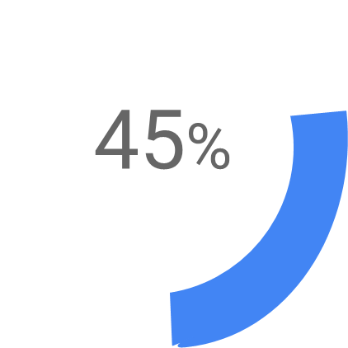

Slide 16

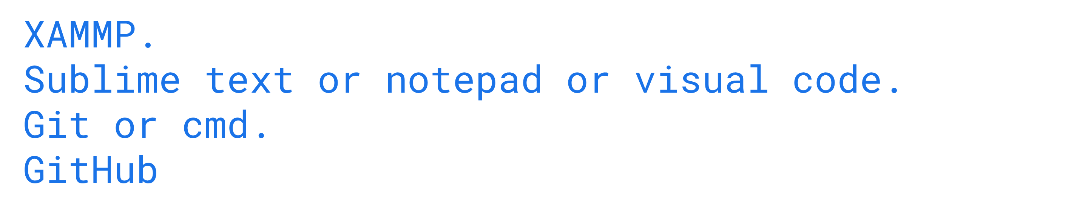


Slide 17



