Slide 1
Demystifying RSS
Staking Rewards
The Good, the Bad and the Ugly

Slide 2
DISCLOSURES AND AFFILIATIONS
DeMISTYFYING REWARD SHARING SCHEMES
I am not a mathematician (but studied algebra, -calculus and -statistics in the universities).
Bear in mind, I could easily misinterpret how RSS works or intended to work.
I am an SPO and ADA holder, therefore I might biased, though I am aware of it. ;)
I have no any affiliates with any entities relating to Cardano Blockchain.
I am not a member of any pool alliances (SPOCRA etc.). I am only member of the TG guild and the Official Cardano forum and TG channels.
I think, my moral incentives are a little bit stronger (to a certain threshold:)) than my financial ones.

Slide 3

Agenda
DeMISTYFYING REWARD SHARING SCHEMES
There a 3 main parts of the RSS:
Rewards Sources (Tx Fees, Monetary policy, decayed deposits), which are used for calculating the total epoch reward (WON'T BE DISCUSSED HERE).
Reward Sharing Scheme (RSS) for calculating (from the above total epoch reward) and distributing pool rewards. (for simplicity, the unclaimed rewards and some other which irrelevant to the topic I would like to explain, won't be discussed here)
Ranking, which is acting as an additional incentive for stake holders (operators and delegators) to have the system to reach the expected equilibrium for long term. (WON'T BE DISCUSSED HERE)

Slide 4
The basics
DeMISTYFYING REWARD SHARING SCHEMES
Formulas are scary, hard, confusing and probably have no meaning for the general ppl in our case to us the SPOs and to the delegators.
My aim is to give some meanings to the formulas required to understand the fundamentals of the reward calculation and distribution, by trying to provide some ELI5 like explanations and simple visual representations of the formulas.
The aim of having SPOs in the Cardano, is to have a sustainable and secure Cardano blockchain. I can see (end expect) a future when SPOs are no longer needed to achieve this.

Slide 5
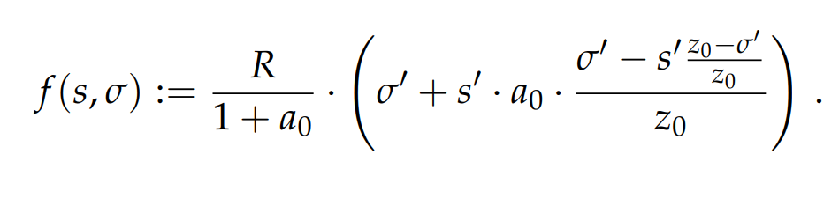
The GOOD
DeMISTYFYING REWARD SHARING SCHEMES
What is the main function of the RSS reward calculation?

Slide 6
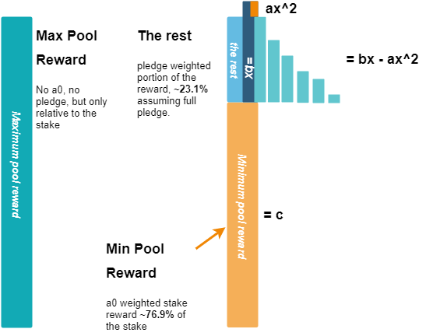
The GOOD
DeMISTYFYING REWARD SHARING SCHEMES
What is the main function of the RSS reward calculation?
Simply, just calculate a
pool's epoch reward.

Slide 7
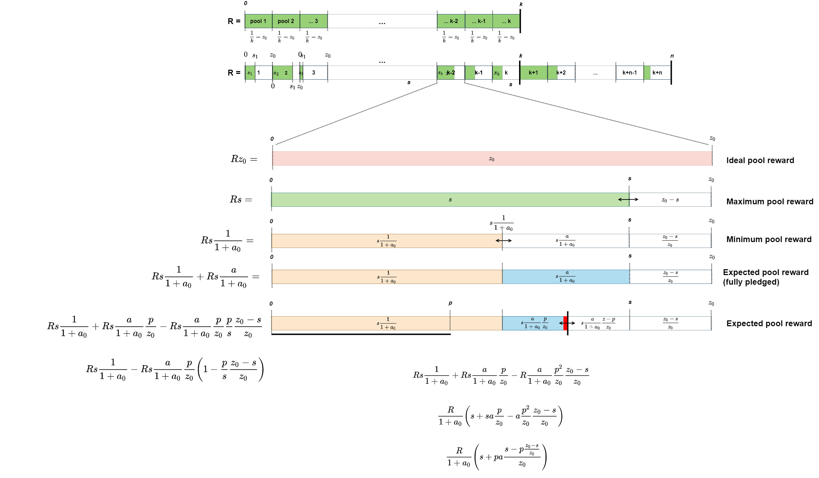
The GOOD
DeMISTYFYING REWARD SHARING SCHEMES
In ideal case, we would have k number of fully saturated fully pledged pool

Slide 8
The GOOD
DeMISTYFYING REWARD SHARING SCHEMES
In real life, we have k + n number of pools.
Note: The total delegated stakes cannot exceed the Total supply (currently ~31.9bn)

Slide 9
The GOOD
DeMISTYFYING REWARD SHARING SCHEMES
Ideal and maximum pool reward

Slide 10

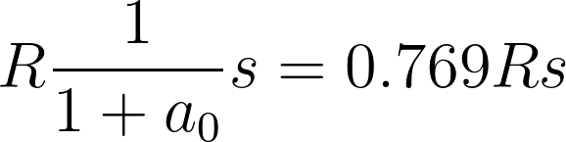

The GOOD
DeMISTYFYING REWARD SHARING SCHEMES
Min stake cannot reach 0 if s>0.
Orange is the base with what a0 is calculated.
i.e. orange * (1+a0) = green the 100%
Minimum pool reward

Slide 11
The GOOD
DeMISTYFYING REWARD SHARING SCHEMES
Expected reward, relative to the pledge. I.e. min + pledge weighted part
But pledge is relative to s and not to that blue box, cos pledge can be 0 or max s
Note: The 0 pledge is not considered here for the sake of simplicity

Slide 12
The GOOD
DeMISTYFYING REWARD SHARING SCHEMES

Slide 13
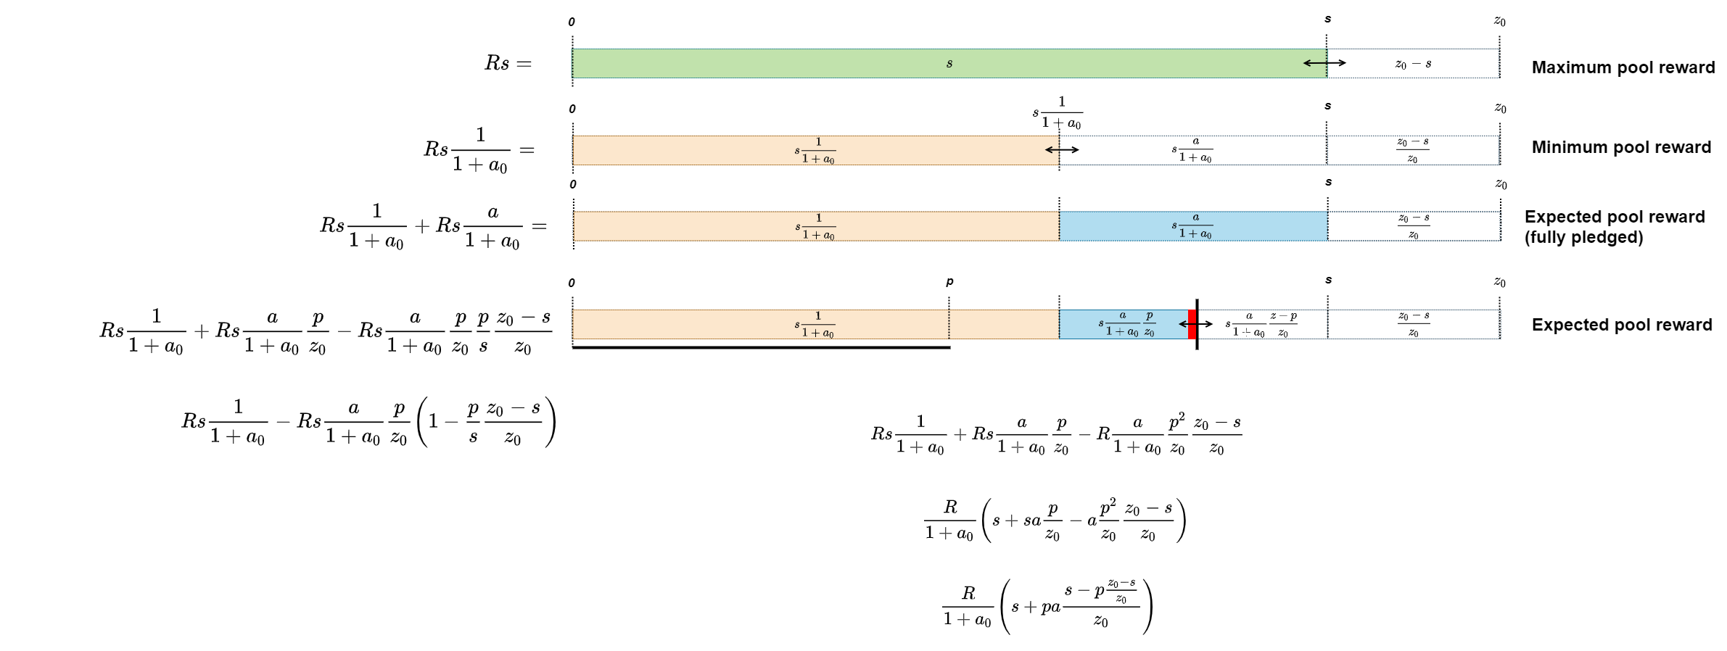
The GOOD
DeMISTYFYING REWARD SHARING SCHEMES

Slide 14
The GOOD
DeMISTYFYING REWARD SHARING SCHEMES

Slide 15

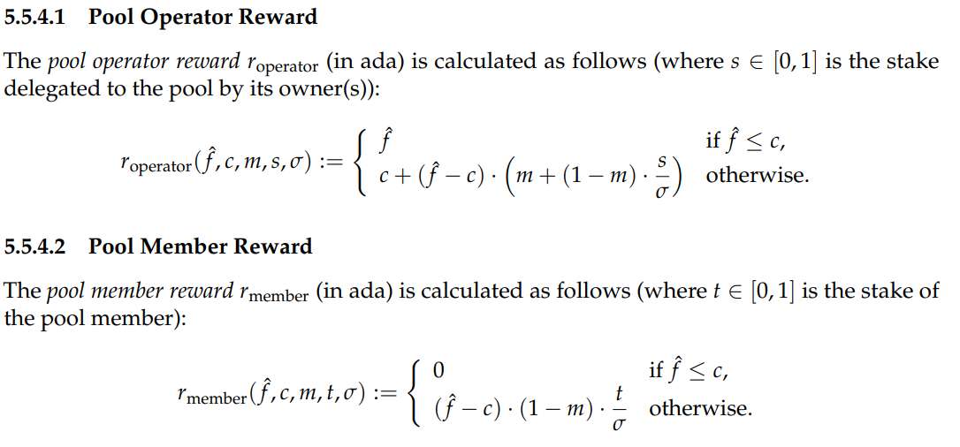
The BAD
DeMISTYFYING REWARD SHARING SCHEMES
Pool Operator and Member Reward functions
What are the reward distribution functions?
What are their purpose?
Introducing cost for the operator
Introducing margin for the operator
Split the rest between the operator and pool members

Slide 16
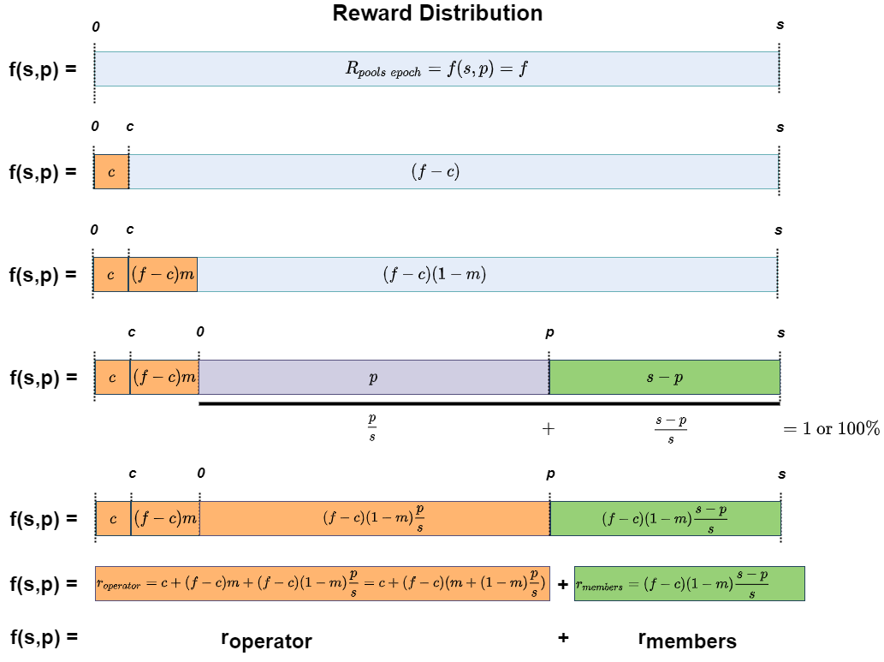
The BAD
DeMISTYFYING REWARD SHARING SCHEMES
What are the reward distribution functions?
What are their purpose?
Introducing cost for the operator
Introducing margin for the operator
Split the rest between the operator and pool members
Simply just split a pool's calculated epoch reward between the operator and pool members.

Slide 17
The BAD
DeMISTYFYING REWARD SHARING SCHEMES
What are the reward distribution functions?
What are their purpose?
Introducing cost for the operator
Introducing margin for the operator
Split the rest between the operator and pool members

Slide 18
The BAD
DeMISTYFYING REWARD SHARING SCHEMES
What are the reward distribution functions?
What are their purpose?
Introducing cost for the operator
Introducing margin for the operator
Split the rest between the operator and pool members

Slide 19
The BAD
DeMISTYFYING REWARD SHARING SCHEMES
What are the reward distribution functions?
What are their purpose?
Introducing cost for the operator
Introducing margin for the operator
Split the rest between the operator and pool members
c+(f-c)m
(f-c) => (f-c)*1=(f-c)*(m+1-m) =>(f-c)m+(f-c)(1-m)

Slide 20
The BAD
DeMISTYFYING REWARD SHARING SCHEMES
What are the reward distribution functions?
What are their purpose?
Introducing cost for the operator
Introducing margin for the operator
Split the rest between the operator and pool members
(s-p), what I use here for the sake of simplicity, means all members of that pool.
In the RSS, they use t for representing the individual member's reward, which is simply a portion of that whole (s-p).
This, can be interpreted as a slider inside the green box, for a user's delegated stake.

Slide 21
The BAD
DeMISTYFYING REWARD SHARING SCHEMES
What are the reward distribution functions?
What are their purpose?
Introducing cost for the operator
Introducing margin for the operator
Split the rest between the operator and pool members

Slide 22
The BAD
DeMISTYFYING REWARD SHARING SCHEMES
What are the reward distribution functions?
What are their purpose?
Introducing cost for the operator
Introducing margin for the operator
Split the rest between the operator and pool members

Slide 23
The BAD
DeMISTYFYING REWARD SHARING SCHEMES
What are the reward distribution functions?
What are their purpose?
Introducing cost for the operator
Introducing margin for the operator
Split the rest between the operator and pool members

Slide 24
And The UGLY
DeMISTYFYING REWARD SHARING SCHEMES
What is the issue /w the RSS and/or RSS distribution functions?
We can have consensus that the 1st and 2nd points are achieved by
- RSS, the k and the a0 parameters (i.e. oversaturation) and
the fact that Cardano blockchain is based on the Cardano's intrinsic value a.k.a ADA which has limited supply.
deposit etc.
But, the 3rd one is tricky
The Cardano protocol should offer Sybil protection to prevent:
having only very few nr. of pools that controls total delegated stakes.
generating as many pools as the adversaries can.
power accumulation of multiple pools owned by one entity.
The 3rd one is tricky, because what if an operator decide to offer some StaaS (Staking as a Services)
- Staking as a Service
- Grouping to a fully pledged Pool
Cardano needs 24/7/365
1 Sinmple rewards
Driven by two main incentives
- financial and
- moral/ideological.
Ideal but no funancial (only moral/ideological) incentives for stake holders of owning/operating a pool for securing the network.
As it simply much more easy just delegate the bp right to pool CLARIFYING.
What I meant by securing is constantly online for validating block and transactions (full-node wallets, relays, and core nodes) and
- produce the blocks when it's scheduled (core nodes).
Shawn CIP
The main charactheristic of the reward distributions is that it must satisfy this equation.
Umed asked me in the past about this but I was hesitant to answer as I would need to explain the lot of underlying details about it.
And as Shawn only modify the pledge it won't satisfy the reserving the value requirements.
f(x,y) = r_operator(x,y) + r_member(x,y)

Slide 25
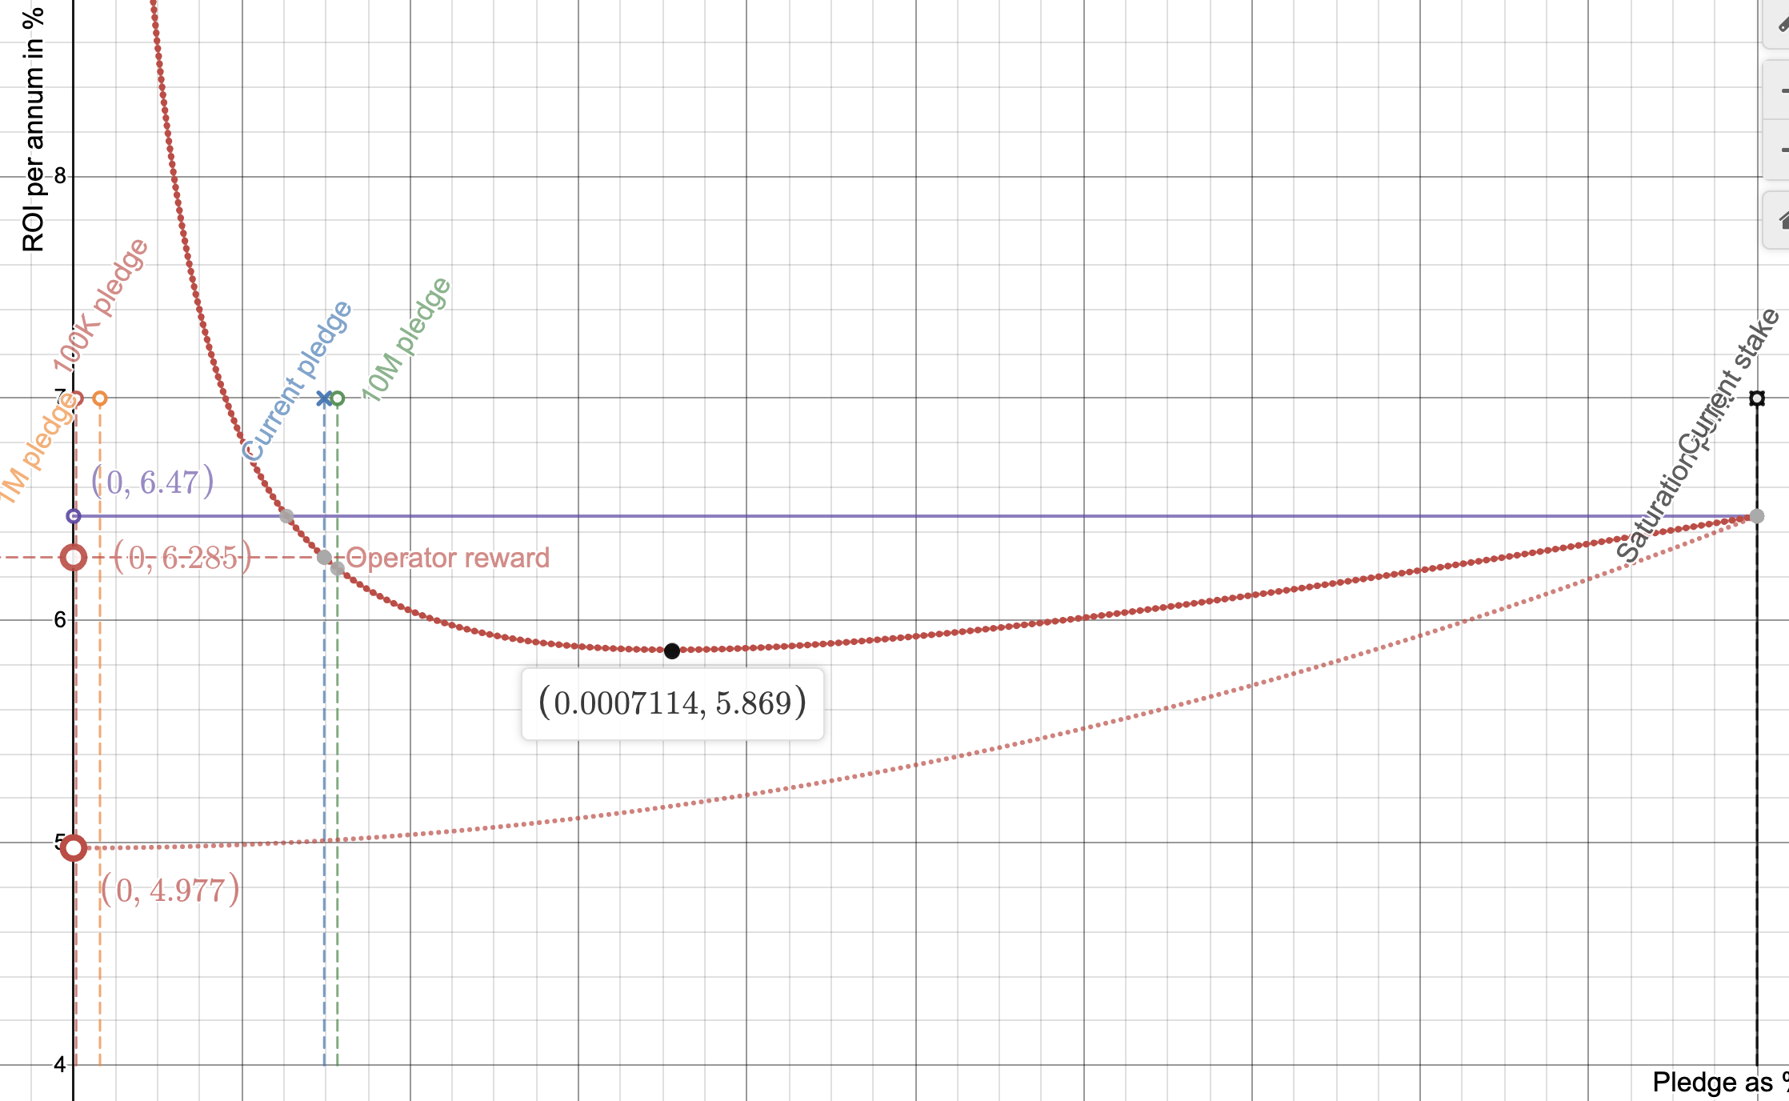
And The UGLY
DeMISTYFYING REWARD SHARING SCHEMES
What is the issue /w the RSS and/or RSS distribution functions?
The 3rd one is tricky, because what if an operator decide to offer some StaaS (Staking as a Services)
- Staking as a Service
- Grouping to a fully pledged Pool
Cardano needs 24/7/365
1 Sinmple rewards
Driven by two main incentives
- financial and
- moral/ideological.
Ideal but no funancial (only moral/ideological) incentives for stake holders of owning/operating a pool for securing the network.
As it simply much more easy just delegate the bp right to pool CLARIFYING.
What I meant by securing is constantly online for validating block and transactions (full-node wallets, relays, and core nodes) and
- produce the blocks when it's scheduled (core nodes).
Shawn CIP
The main charactheristic of the reward distributions is that it must satisfy this equation.
Umed asked me in the past about this but I was hesitant to answer as I would need to explain the lot of underlying details about it.
And as Shawn only modify the pledge it won't satisfy the reserving the value requirements.
f(x,y) = r_operator(x,y) + r_member(x,y)

Slide 26
Discussion
DeMISTYFYING REWARD SHARING SCHEMES
Is there any solution at all?
Simple distribution
Shawn's CIP proposal
Other proposals?
Each of the public pools should be operated and/or owned by one entity.
Although, one entity can own multiple private pools based on their total privately owned stakes.
Ideally, we would like to have
k number of nearly fully saturated pools (both public and private)
and some tails (pools /w small stakes)

Slide 27
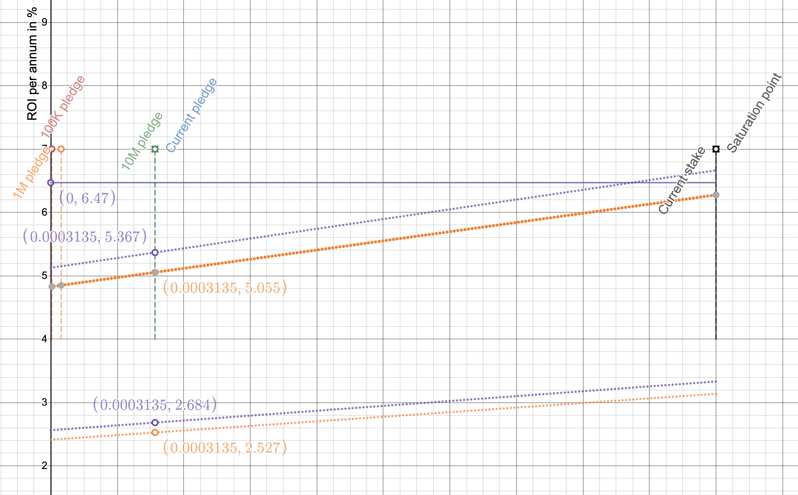
Discussion
DeMISTYFYING REWARD SHARING SCHEMES
Is there any solution at all?
Simple distribution
Shawn's CIP proposal
Other proposals?
f(s,p)(1-m)
f(s,p)(1+m)
Each of the public pools should be operated and/or owned by one entity.
Although, one entity can own multiple private pools based on their total privately owned stakes.
Ideally, we would like to have
k number of nearly fully saturated pools (both public and private)
and some tails (pools /w small stakes)

Slide 28
Discussion
DeMISTYFYING REWARD SHARING SCHEMES
Is there any solution at all?
Simple distribution
Shawn's CIP proposal
Other proposals?
f(s,p)(1-m)
f(s,p)(1+m)
f(s,p) = f(s,p)(1-m) + f(s,p)(1+m)
= f(s,p)(1-m+1+m)=2f(s,p)
Each of the public pools should be operated and/or owned by one entity.
Although, one entity can own multiple private pools based on their total privately owned stakes.
Ideally, we would like to have
k number of nearly fully saturated pools (both public and private)
and some tails (pools /w small stakes)

Slide 29
Discussion
DeMISTYFYING REWARD SHARING SCHEMES
Is there any solution at all?
Simple distribution
Shawn's CIP proposal
Other proposals?
f(s,p)(1-m)
f(s,p)(1+m)
f(s,p) = f(s,p)(1-m) + f(s,p)(1+m)
= f(s,p)(1-m+1+m)=2f(s,p)
Each of the public pools should be operated and/or owned by one entity.
Although, one entity can own multiple private pools based on their total privately owned stakes.
Ideally, we would like to have
k number of nearly fully saturated pools (both public and private)
and some tails (pools /w small stakes)

Slide 30
Discussion
DeMISTYFYING REWARD SHARING SCHEMES
Is there any solution at all?
Simple distribution
Shawn's CIP proposal
Other proposals?
Each of the public pools should be operated and/or owned by one entity.
Although, one entity can own multiple private pools based on their total privately owned stakes.
Ideally, we would like to have
k number of nearly fully saturated pools (both public and private)
and some tails (pools /w small stakes)

Slide 31
And..... FINALLY
DeMISTYFYING REWARD SHARING SCHEMES
ThankS

Slide 32
References
DeMISTYFYING REWARD SHARING SCHEMES
The Reward Sharing Schemes for Stake Pools: https://arxiv.org/ftp/arxiv/papers/1807/1807.11218.pdf
Design Specification for Delegation and Incentives in Cardano: https://hydra.iohk.io/job/Cardano/cardano-ledger-specs/delegationDesignSpec/latest-finished
A Formal Specification of the Cardano Ledger: https://hydra.iohk.io/job/Cardano/cardano-ledger-specs/shelleyLedgerSpec/latest-finished/download/1

