Slide 1
D
RedBoard
Denison University Women's Basketball
One platform. Coach content. Player focus.
CONFIDENTIAL — INTERNAL USE ONLY

Slide 2
THE PROBLEM
Coaching ran on group chats, shared drives, and printed binders.
• Film buried in Hudl links scattered across text threads
• Stat sheets emailed as Excel attachments — no version control
• Wellness check-ins done verbally or forgotten entirely
• Playbook PDFs printed, lost, or outdated
• No single source of truth for players or staff

Slide 3
THE SOLUTION
RedBoard replaces the chaos with one mobile-first platform.
Film
Stats
Wellness
Playbook
Hudl clips & video shared instantly
CSV upload → published with trend analysis
Daily check-in forms build player data
Virtual binder with folders & files

Slide 4
TECHNOLOGY
Built on a modern, serverless stack.
Frontend
React 18 (TypeScript) · Vite 5 · Tailwind CSS 3
Routing
React Router v6
Backend
Supabase — Auth, PostgREST, Realtime, Storage
Database
PostgreSQL with Row Level Security (RLS)
File parse
SheetJS (xlsx) — client-side CSV/XLSX parsing
Deploy
Static Vite build → any CDN or hosting platform

Slide 5
ARCHITECTURE
No custom server. All security lives in the database.
Browser (React App)
supabase-js · anon key · HTTPS
▼
Supabase Platform
Auth (JWT) · PostgREST · Storage · Realtime
▼
PostgreSQL + RLS
Row Level Security enforces all access rules
Every query carries the user's JWT. auth.uid() is evaluated by Postgres at query time — players can never read another player's data.

Slide 6
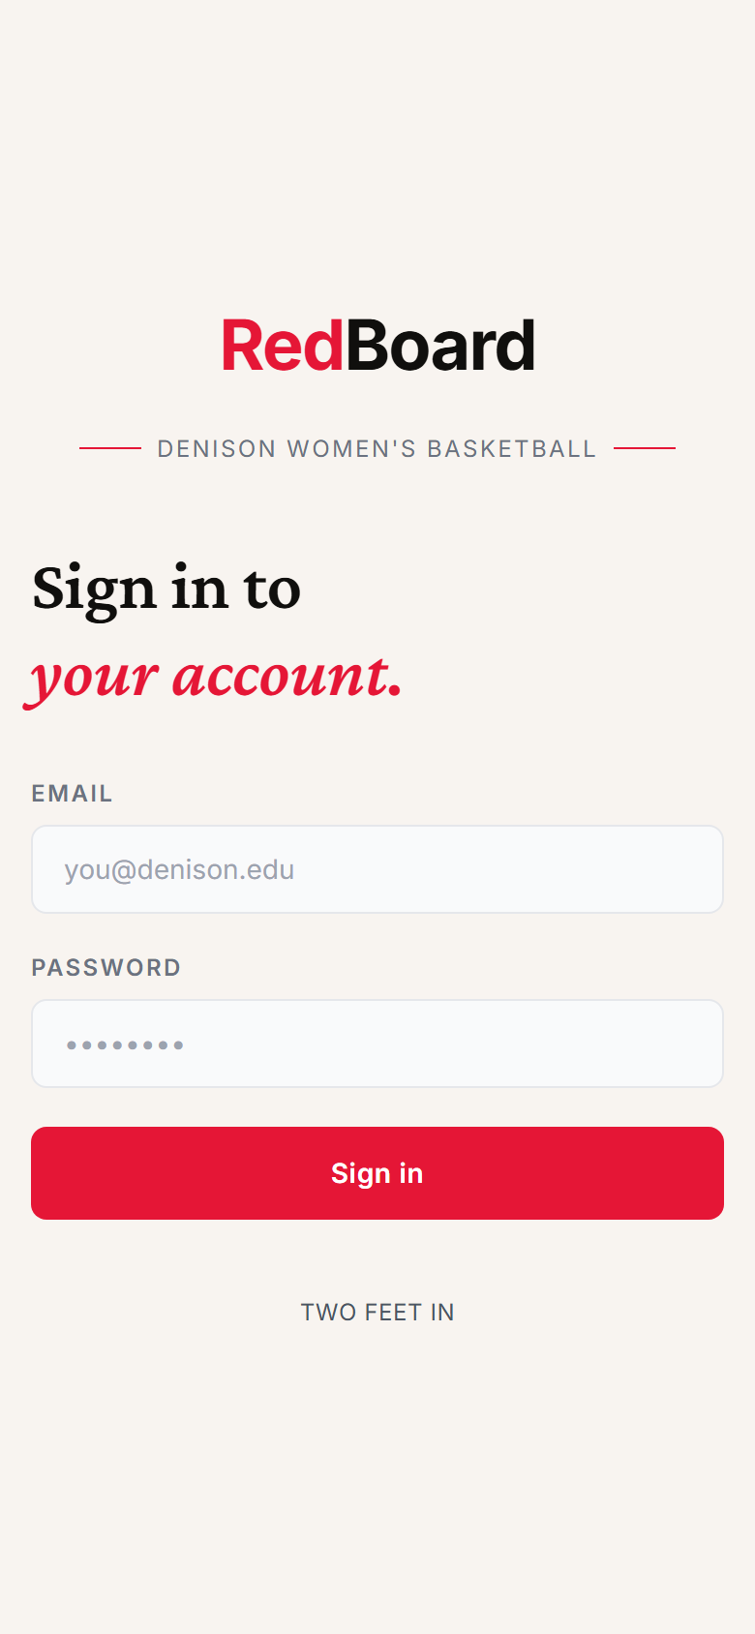
AUTHENTICATION
Secure email + password login routes each user to their role.
• Supabase Auth issues a JWT on sign-in
• AuthContext reads role from the profiles table
• Admins land on /admin · Players land on /app/feed
• AuthGuard + AdminGuard enforce routing — no URL bypass

Slide 7
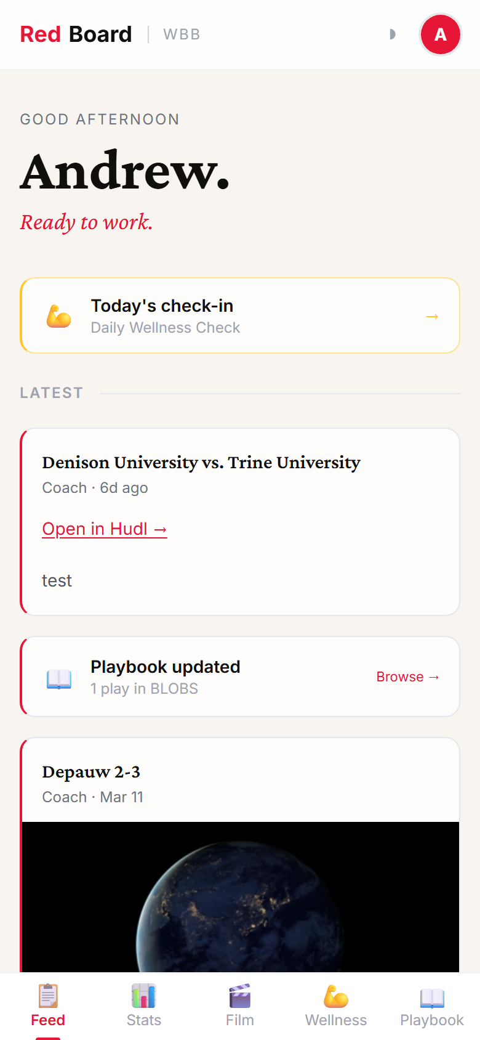
PLAYER FEED
Every piece of coach content in one chronological timeline.
• Time-based greeting with the player's first name
• Wellness nudge card when a check-in is due
• Stat snapshot — latest week vs prior, latest game vs career avg
• Unified feed: film clips, stat uploads, playbook additions
• Real-time updates via Supabase Realtime — no page refresh

Slide 8
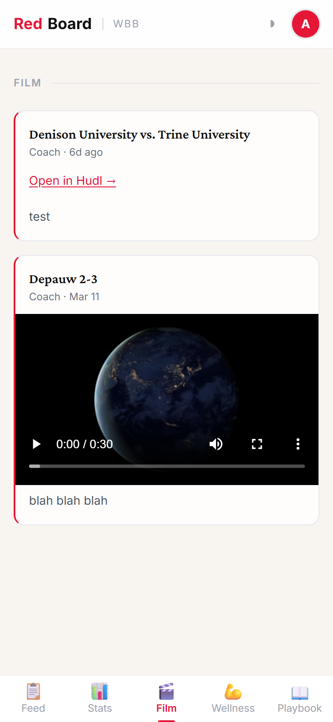
FILM — PLAYER VIEW
Hudl clips and video files delivered directly to players.
• Coaches target Team or Individual recipients
• "Just for you" badge on personal clips
• Unread red dot badge clears on page visit
• Hudl embedded inline · uploaded files via signed URL

Slide 9
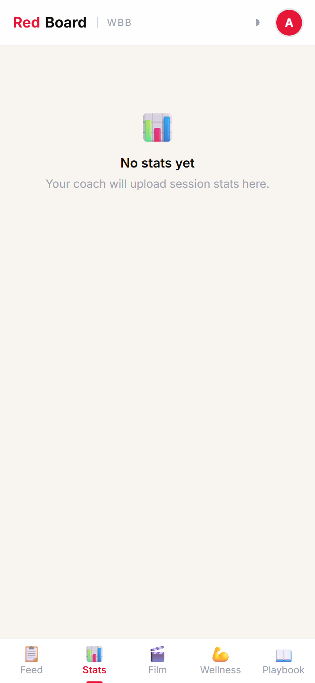
STATS — PLAYER VIEW
Personal performance trends, hero stats, and coach goals.
• Practice stats grouped by week with Δ vs prior week
• Game stats per game with Δ vs career average
• Four hero stats: Points · Rebounds · Assists · Steals
• Coach-set goals shown with progress bar
• All standard stats in expandable table

Slide 10
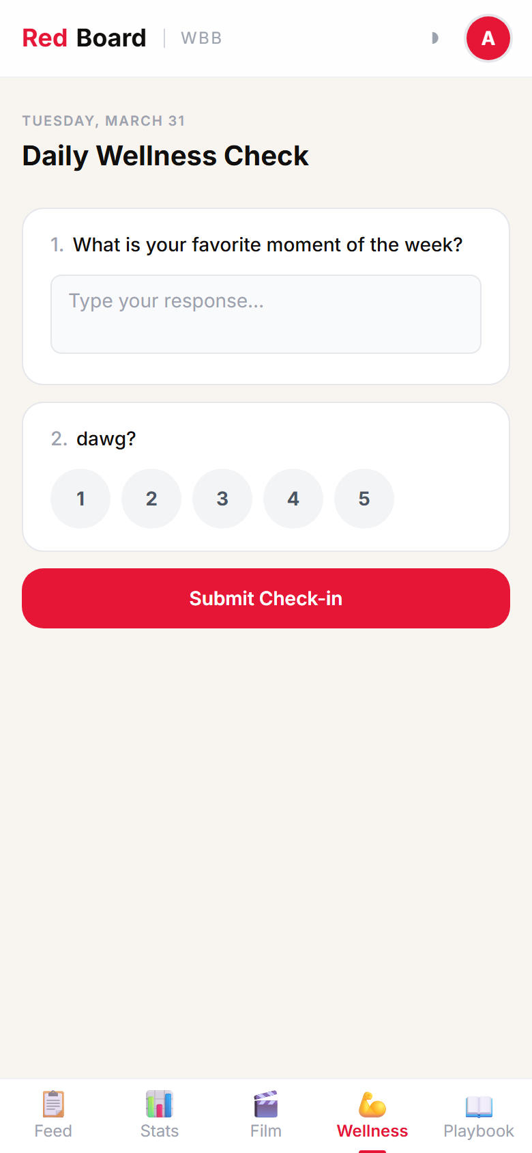
WELLNESS — PLAYER CHECK-IN
One form per day. Three question types.
• Rating (1–5 stars) · Yes/No toggle · Free-text response
• Active form shown only if player hasn't submitted today
• After submission: read-only review of answers
• Wellness nudge on Feed disappears on submission

Slide 11
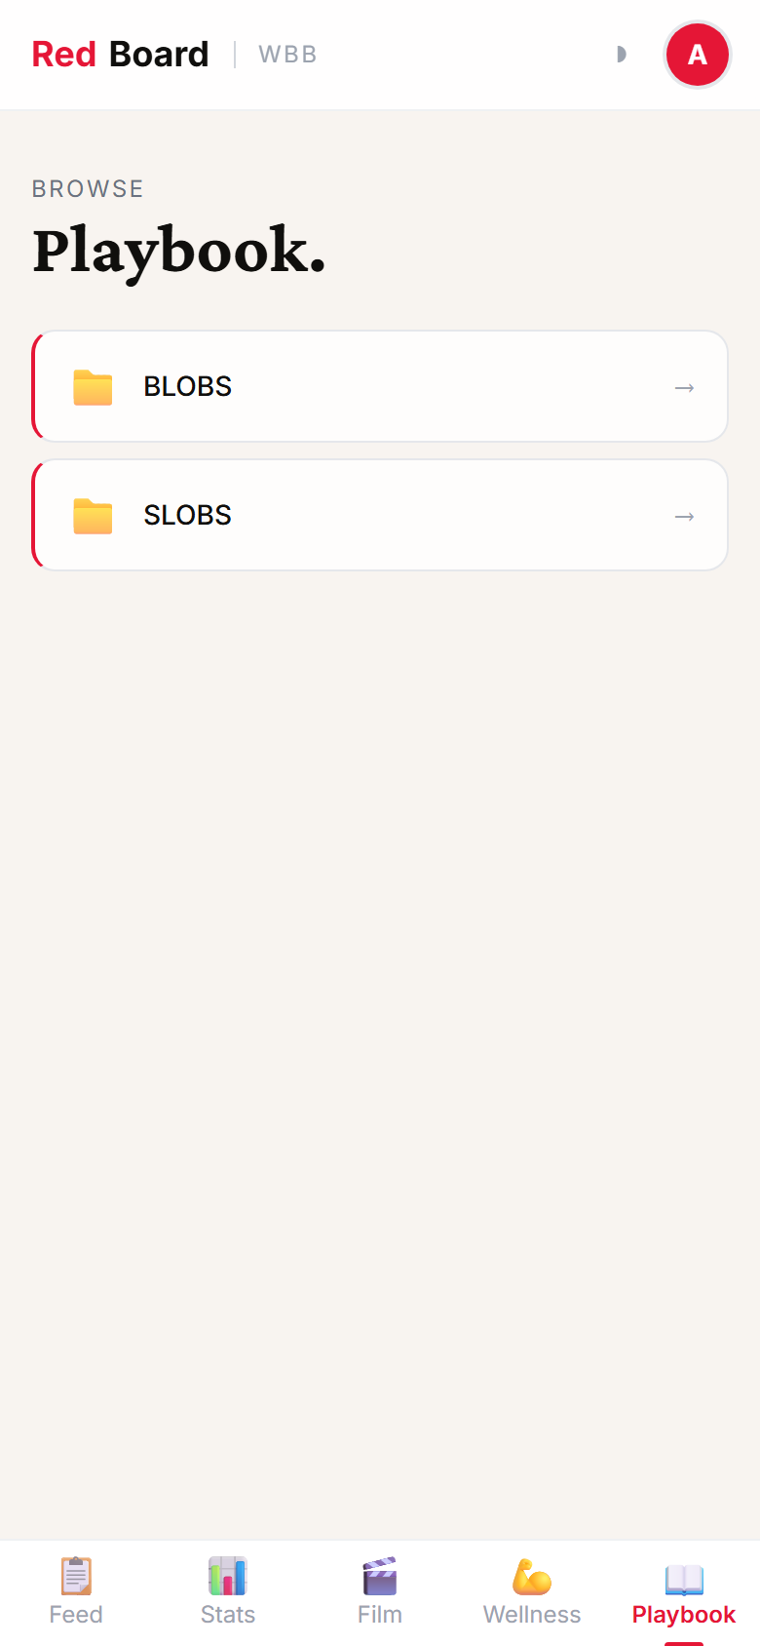
PLAYBOOK — PLAYER VIEW
Virtual binder — browse folders, tap to open full-screen.
• Folders expand to show file thumbnails
• Full-screen lightbox viewer for images
• PDFs render in-browser via iframe
• Coach controls folder and file sort order

Slide 12
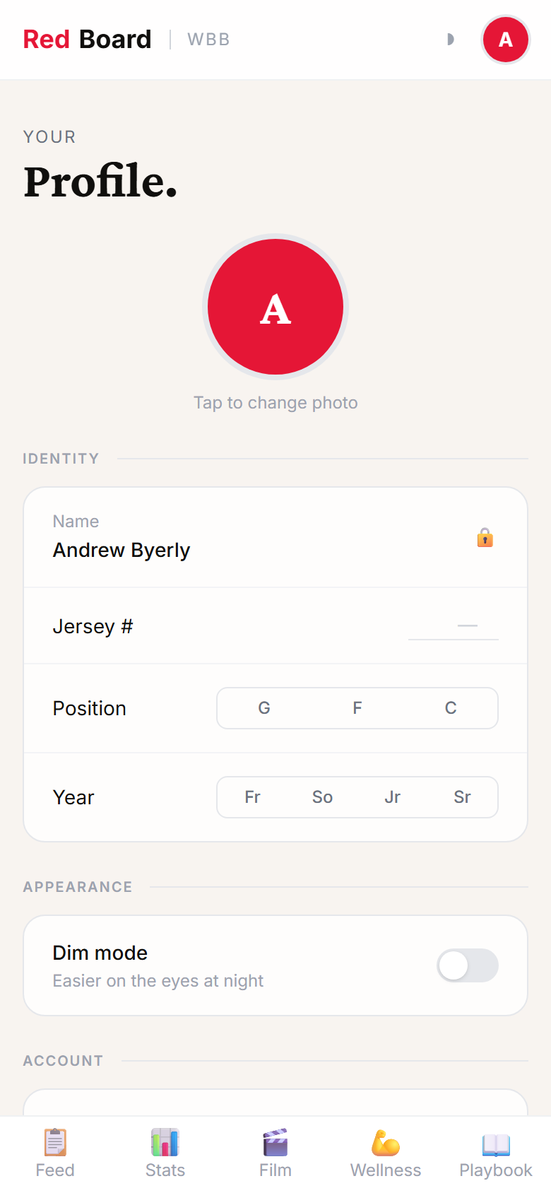
PLAYER PROFILE
Players manage their own identity within the platform.
• Upload a profile photo (stored in Supabase Storage)
• Set jersey number, position, class year
• Toggle dim (dark) mode — persisted to localStorage
• Sign out

Slide 13
COACHING STAFF VIEW
Admin Features
Every feature has a coach-facing management interface.

Slide 14
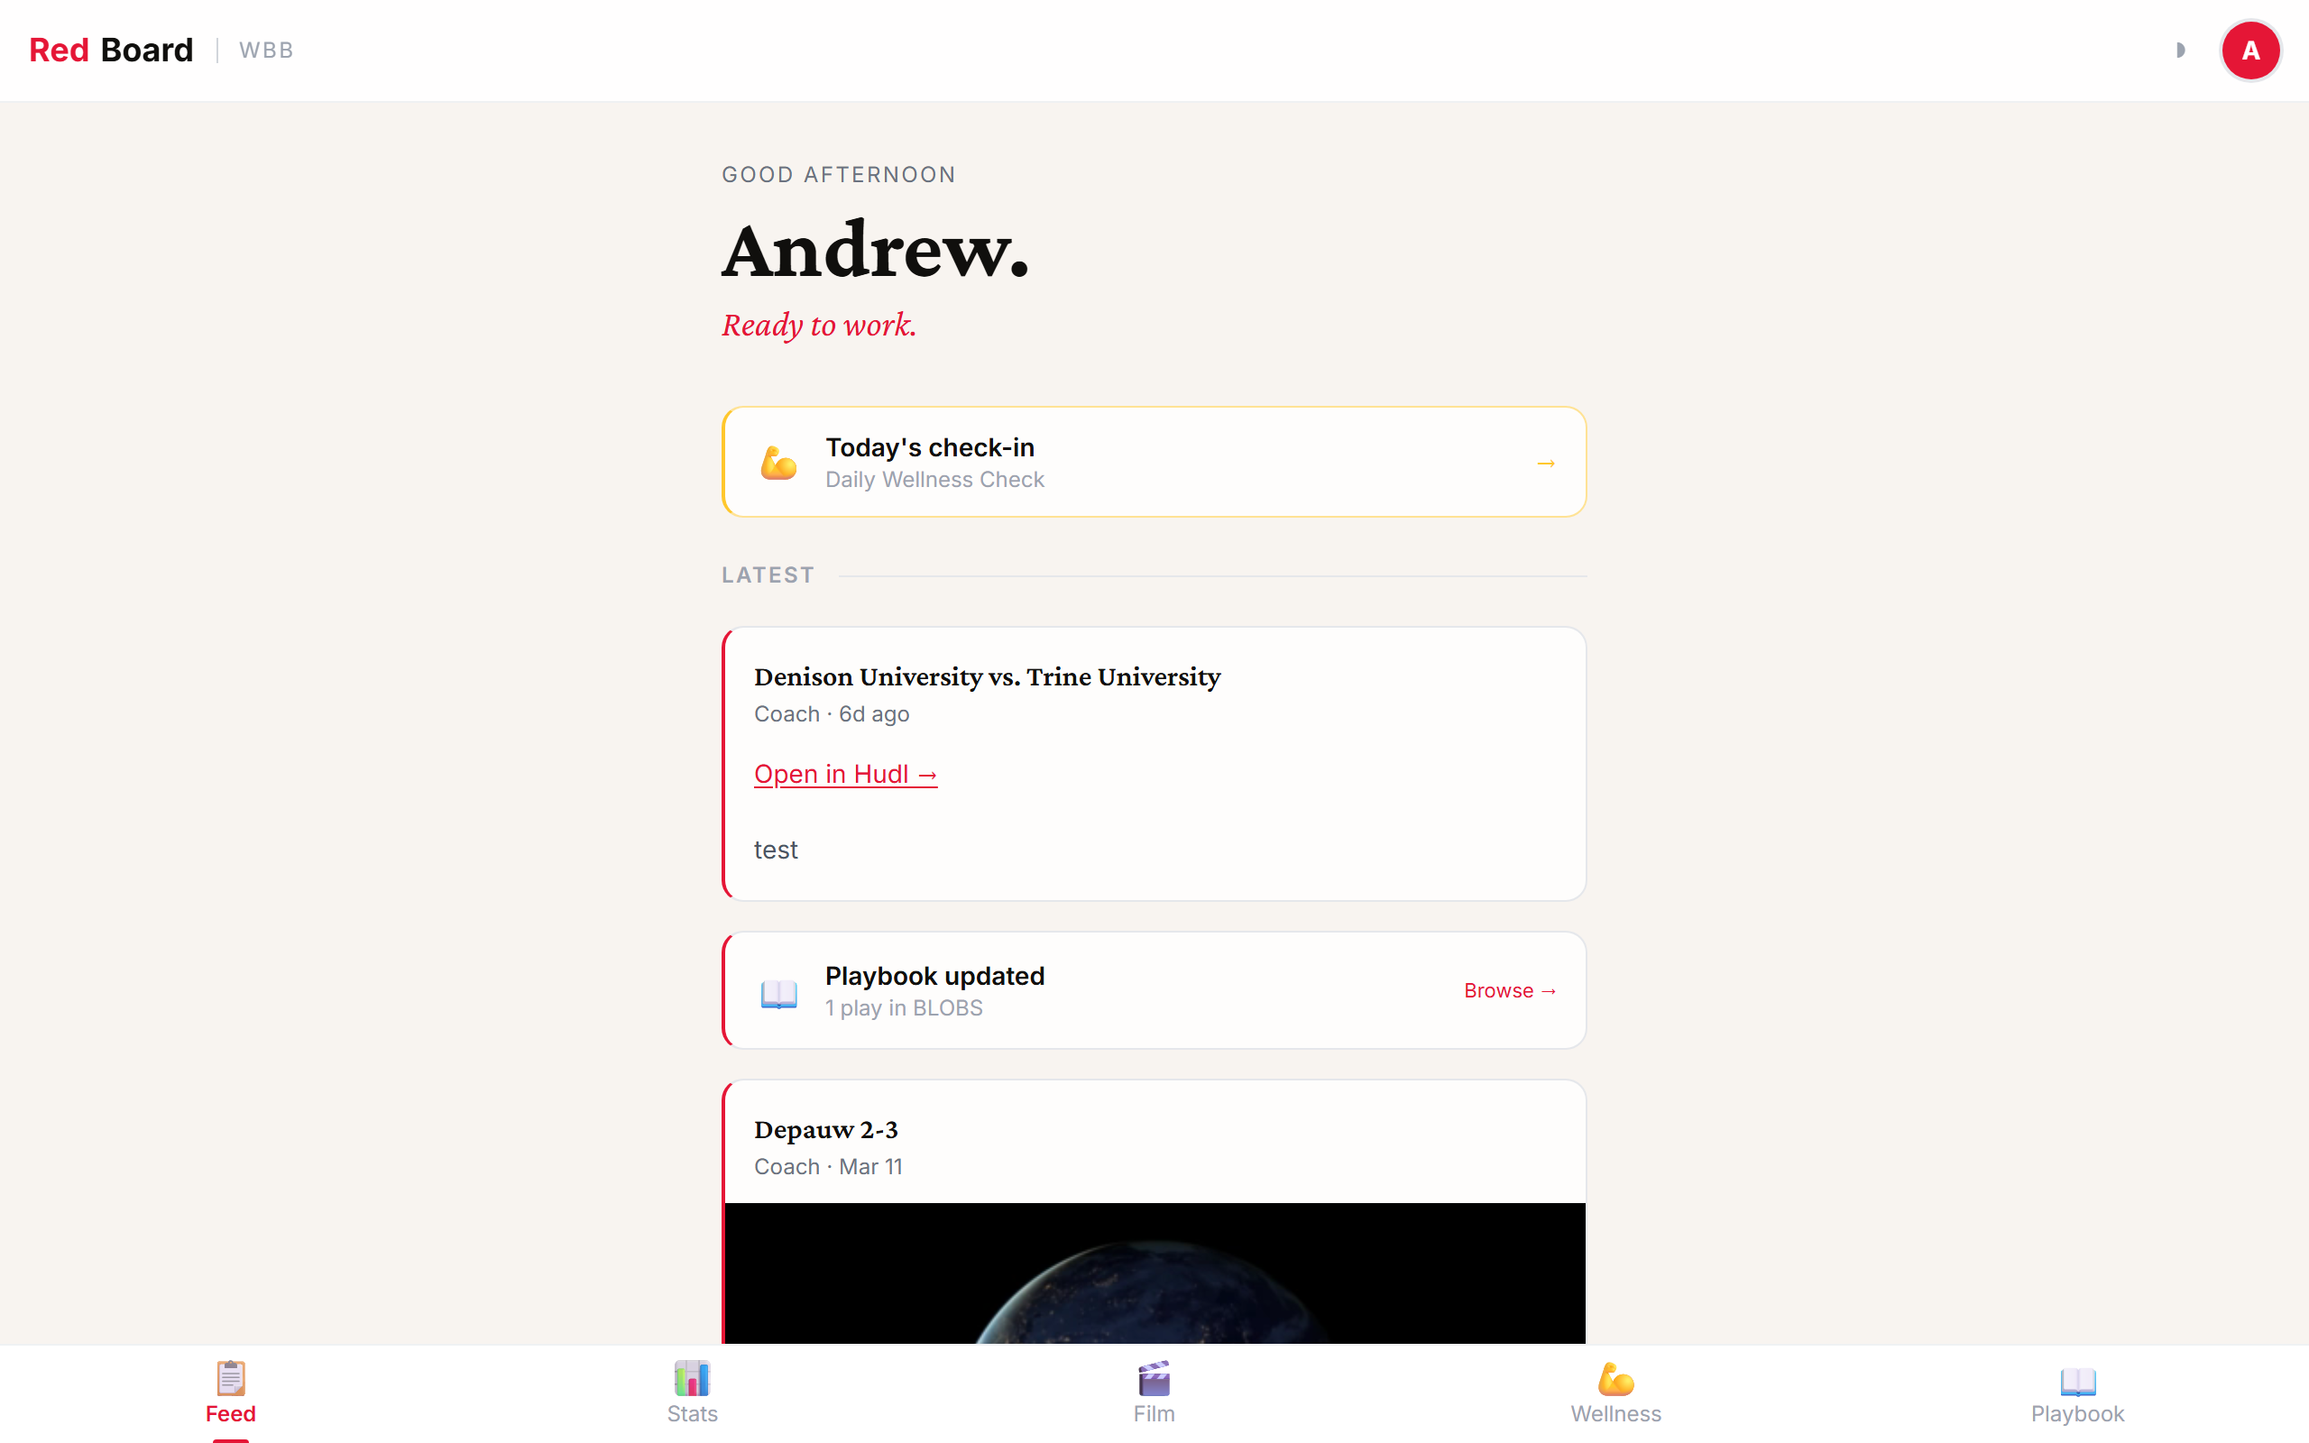
ADMIN DASHBOARD
Roster management and platform overview.
Create & manage user accounts · Assign roles (admin / player) · View profile completion

Slide 15
ADMIN — FILM
Post Hudl links or upload video files to the whole team or individual players.
Paste Hudl URL or upload file · Team or Individual visibility · Select recipients from roster

Slide 16
ADMIN — STATS
Upload CSV/XLSX → fuzzy-match roster → publish when ready.
Client-side parsing via SheetJS · Auto column detection + manual override · Draft → Publish flow · Player annotations · Goal setting

Slide 17
ADMIN — WELLNESS
Build forms, schedule them in advance, and see today's responses at a glance.
Drag-and-drop form builder (Rating / Yes-No / Text) · Calendar scheduling — auto-activate at midnight · Today's dashboard: per-player status + team aggregates

Slide 18
ADMIN — PLAYBOOK
Create folders, upload files, drag to reorder.
Named folders with sort order · Upload images or PDFs to any folder · Drag-to-reorder within folders

Slide 19
SECURITY
Default-deny RLS. Every row protected at the database layer.
Table
Player Access
Admin Access
profiles
Own row only
All rows
film_posts
Posts targeted to them
All posts
stat_uploads/entries
Published uploads · own entries
All uploads & entries
wellness_forms
Active form only
All forms
wellness_responses
Own responses
All responses
playbook_folders/files
All (read-only)
Full CRUD

Slide 20
D
RedBoard
One platform — built for the Big Red.
5 Features
Film · Stats · Wellness · Playbook · Feed
2 Roles
Admin (coaching staff) · Player (roster)
0 Servers
Fully serverless — Supabase + static hosting
RLS
Every row protected — no client-side security holes
CONFIDENTIAL — INTERNAL USE ONLY

