Slide 1
Homelessness
James Macgillivray

Slide 2
Demographics
8000 people sleep currently sleep rough in Australia
Two thirds male
One fifth Aboriginal compared to one thirtieth in the wider population
Half have mental health issues
A third have drug addictions

Slide 3
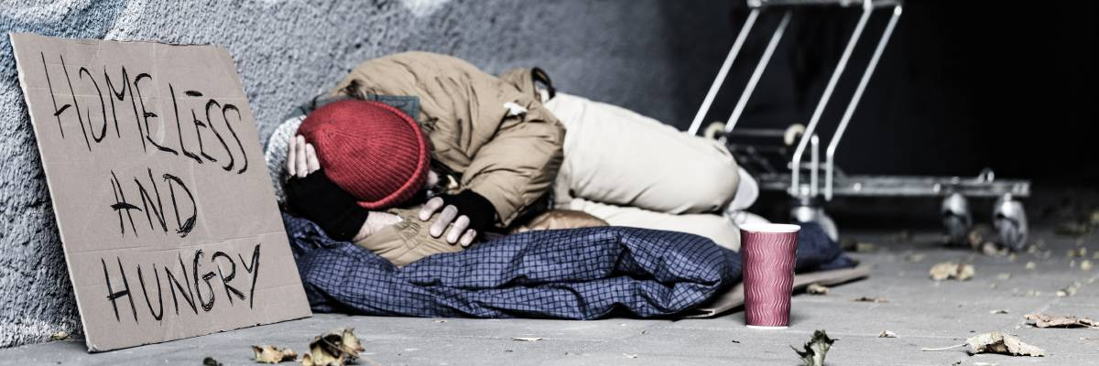
Effects on the broader community
Community safety
Increased burden on welfare

Slide 4
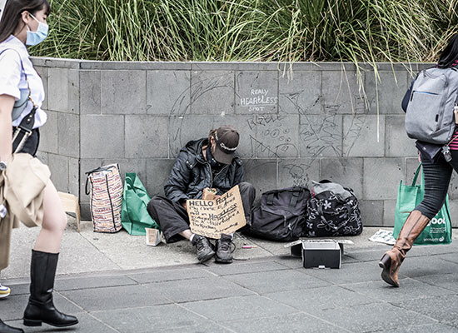
Causes
Poverty
Drug use
Domestic Violence

Slide 5
END

