Slide 1


HEALTH HUB
HEALTH HUB
01
Patient Care - Decentralized.
Made by –
Aman Anand (19BCE0521)
Lokesh Mishra (19BCE2672)

Slide 2
HEALTH HUB
Introduction to Health Hub
The Why Behind Health Hub
How Health Hub Operates
Technology Behind Health Hub
Code Implementation
Output Screenshots
02
Table of Contents
Presentation Outline

Slide 3
HEALTH HUB
03
Introduction to Health Hub

Slide 4
HEALTH HUB
Health Hub is a project aimed at eradicating the existing red tape in the process of retrieval and sharing of essential medical personnel files between parties that need quick access.
04
This system is intended to be built centric to three major features and attributes:
A trusted directory of patient data in Electronic Health Records (EHRs) which guarantees access as well as the integrity of the data itself
Strengthened security in dealing with patient data by utilizing a particular encryption scheme and providing a transparent and undeniable audit trail based on an immutable access log
Providing scalability to cover multiple existing EHRs of regional or core hospitals with the least modification and availability of the system without relying on a centralized supervisory system.

Slide 5
HEALTH HUB
05
The Why Behind Health Hub

Slide 6
HEALTH HUB
45%
45% of the entire population of medical patients undergoing severe medical treatment prefer to have a change in their medicare providers or would rather get a second/third opinion on their diagnosis, prognosis, and course of treatment.
06
of the patients currently undergoing severe medical conditions and treatments prefer a change in their medicare provider or prefer to get a second opinion

Slide 7
HEALTH HUB
78%
Medical documents relevant to the patient are required for verification and validation for not only hospitals but for third part services as well, e.g. insurance claims, personal uses, etc. 78% of today's patients feel that there is too much red tape in the way to obtaining specific documents relevant to specific needs such as insurance claims.
07
of the patients currently enrolled in the medicare industry feel that there is too much of a hassle when it comes to getting medical documents from one party to another.

Slide 8
HEALTH HUB
96
HOURS
4 Days. 96 Hours. 5760 minutes.
The average amount of time it takes to transfer a patients records from one place to another.
The difference between life and death is only:
1 minute. 60 seconds.
08
is the average amount of time it takes to get medical personnel files from one party to another, due to the red tape in the process.

Slide 9
HEALTH HUB
200%
One of the biggest problems that a patient faces these days when they want to make a shift form one medicare provider to another is the amount of time it takes to get their medical personnel files transferred. Over the past year the time duration has increased by 200%
09
increase in the amount of time it takes patient data to be transferred from medical center to medical center over the past year

Slide 10
HEALTH HUB
10
How Health Hub Operates

Slide 11
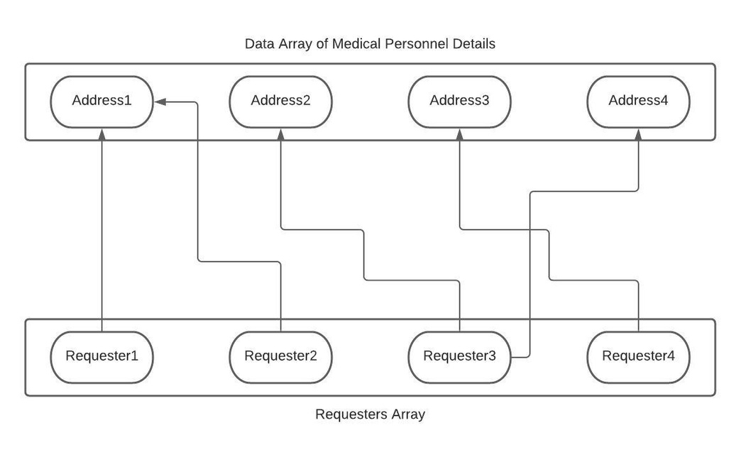
HEALTH HUB
Health Hub will provide the facility for patients to cut done on the "red tape" by visiting the website and uploading all relevant medical personnel files to the Health Hub Blockchain. This data can now be requested by several parties that are existing on the blockchain.
11

Slide 12
HEALTH HUB
Data will be uploaded and stored on the public blockchain, the security of which will be entirely in the hands of the uploader. The privacy of the data is solely in the hands of the owner of the data which enforces security with respect to data breaches.
12

Slide 13
HEALTH HUB
13
Technology Behind Health Hub

Slide 14
HEALTH HUB
For Blockchain:
Solidity to write the code,
Rinkeby to deploy it on a test network
For Frontend:
HTML5,
CSS,
JavaScript.
14
For Frontend Integration and Interaction:
JavaScript,
Web3,
Mocha,
Ganache-CLI, etc.

Slide 15
HEALTH HUB
15
Code Implementation

Slide 16
HEALTH HUB
Functions executed through our code:
createData: lets user upload their data onto the network
makeRequest: make request to access someone else's data
finalizeRequest: approve the request and make data visible to the requester
displayData: displays the data of a particular user
removeRequest: remove the access from requester to view data
16

Slide 17
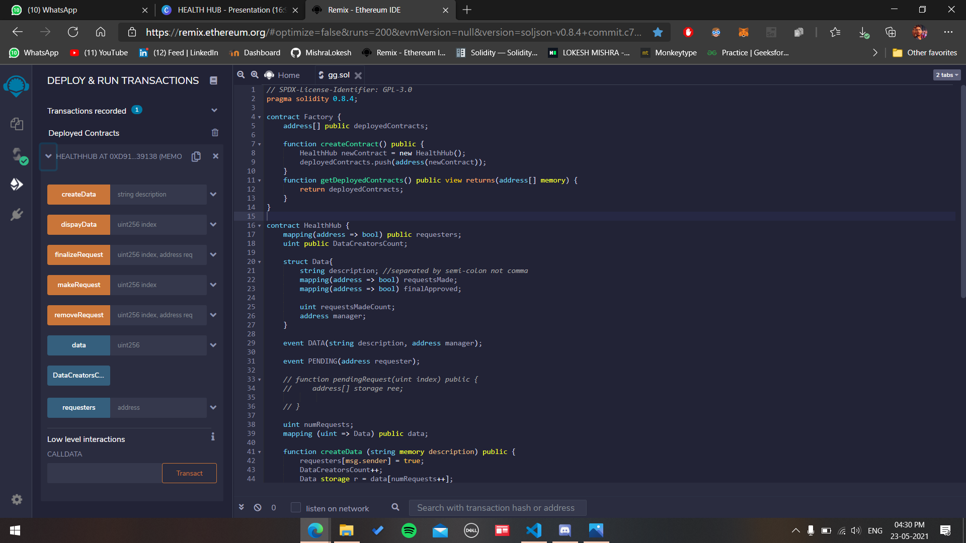

Slide 18
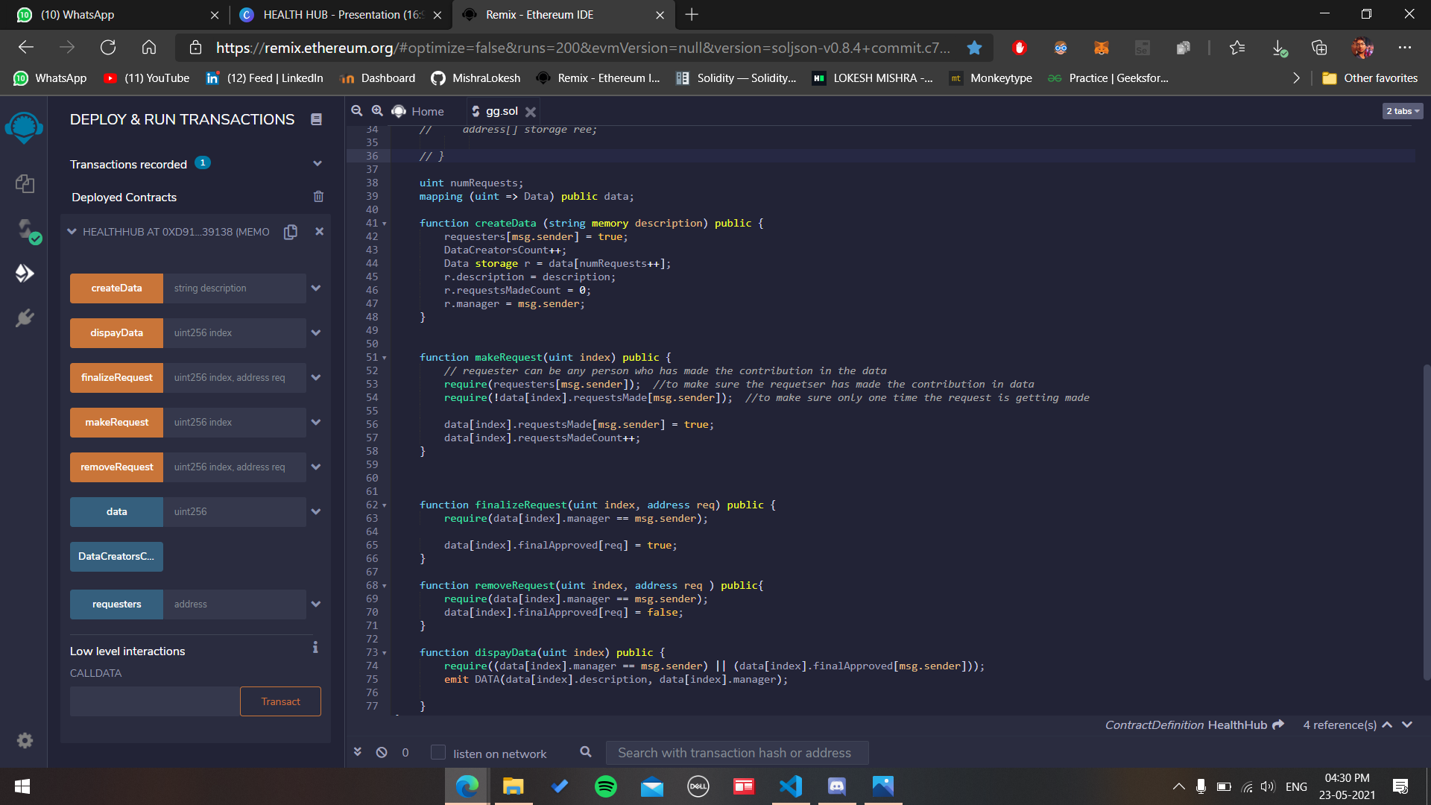

Slide 19
HEALTH HUB
19
Output Screenshots

Slide 20
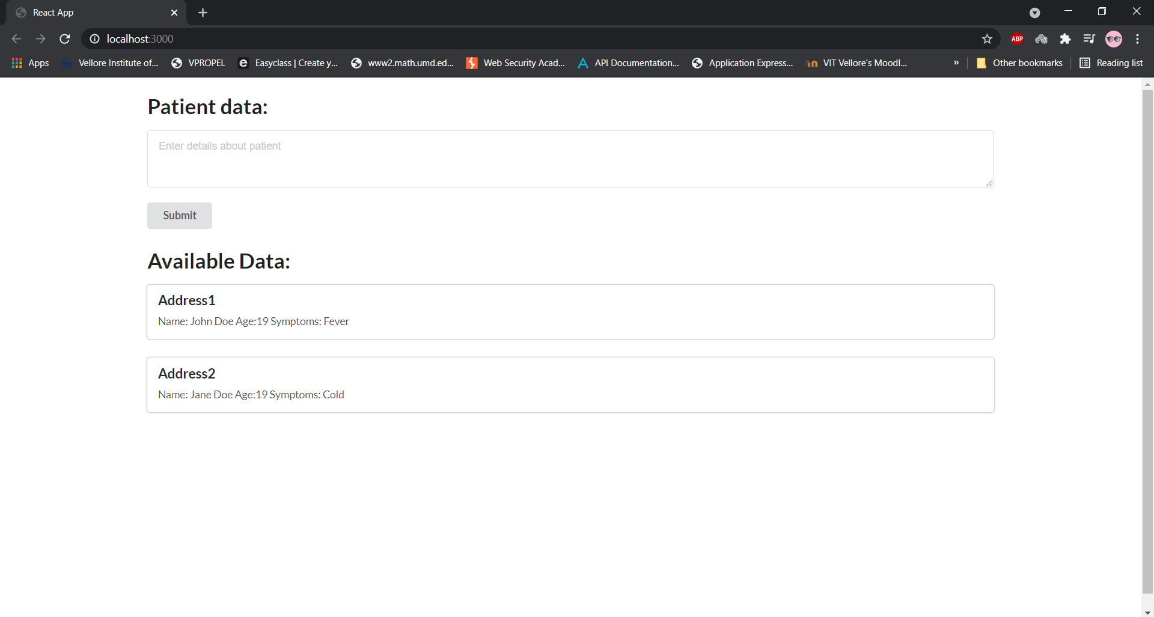

Slide 21
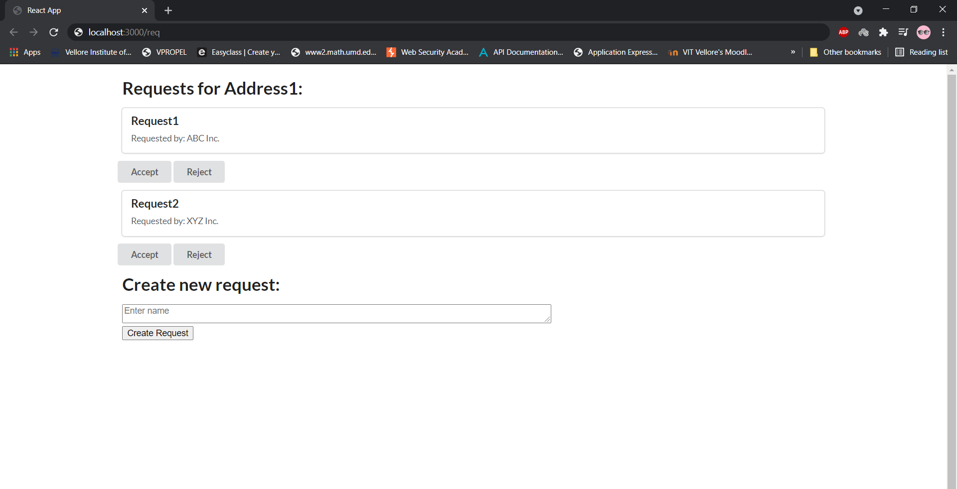

Slide 22
HEALTH HUB
Google Drive Link for Student Presentation and relevant documents
22
http://bit.ly/Health-Hub-BnCDA

Slide 23
HEALTH HUB
23
Thank You!

