Slide 1

DG INTERNS HUB
C Y B E R S E C U R I T Y I N T E R N S H I P
WEEK 4 — NETWORK SECURITY LAB
Network Setup · Apache · Nmap · Wireshark
Student Name: Arumugapandi K
Course: B.E. CSE (Cyber Security)
Intern ID: DG/SEPTEMBER/CYBER/177
Date: 30 September 2026
01

Slide 2
WEEK 4 ASSIGNMENT
Objectives & Assessment Workflow
The practical was completed as a single, evidence-driven workflow.
01
02
03
04
05
Network
Service
Scan
Capture
Document
→
→
→
→
Check interface, route and connectivity
Install and verify Apache on TCP/80
Use Nmap to identify open ports and versions
Observe ICMP, HTTP and DNS in Wireshark
Correlate results, observations and limitations
Scope
One Kali Linux VM was available. Apache, Nmap and Wireshark ran on the same machine; the service test used 127.0.0.1.
This is a local self-scan, not a two-machine attacker/target assessment.
DG Interns Hub · Cybersecurity Internship · Week 4
Source: Week 4 practical report
2

Slide 3
LAB ENVIRONMENT
VM, Network & Topology
Component
Detail
Single-VM lab architecture
Virtualization
Oracle VirtualBox
KALI LINUX VM
Guest OS
Kali Linux
eth0: 10.0.2.15/24
Interface
eth0 · 10.0.2.15/24
Gateway
10.0.2.2
Apache
TCP / 80
Nmap
Scanner
Wireshark
Capture
Loopback
127.0.0.1/8
Web server
Apache HTTP Server 2.4.68
127.0.0.1 ↔ Apache
lo used for local ICMP + HTTP captures
eth0 used for DNS capture
DG Interns Hub · Cybersecurity Internship · Week 4
No second VM was available in this practical
3

Slide 4
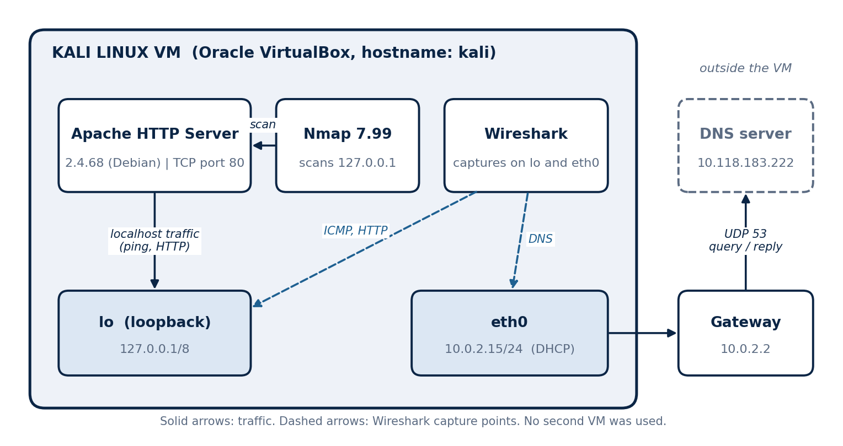
SETUP
Network Configuration & Toolset
Network checks
Tools used
• ip addr → eth0 UP, 10.0.2.15/24
• ip route → default via 10.0.2.2
• ping -c 4 127.0.0.1 → 4/4 replies, 0% loss
Tool
Purpose
Kali Linux
Lab operating system
Apache
Web service under test
Nmap 7.99
Port + service detection
Wireshark
Packet capture + filters
Firefox / curl
HTTP request generation
VirtualBox
Virtualization
DG Interns Hub · Cybersecurity Internship · Week 4
Evidence: ip addr, ip route and ping screenshots
4

Slide 5
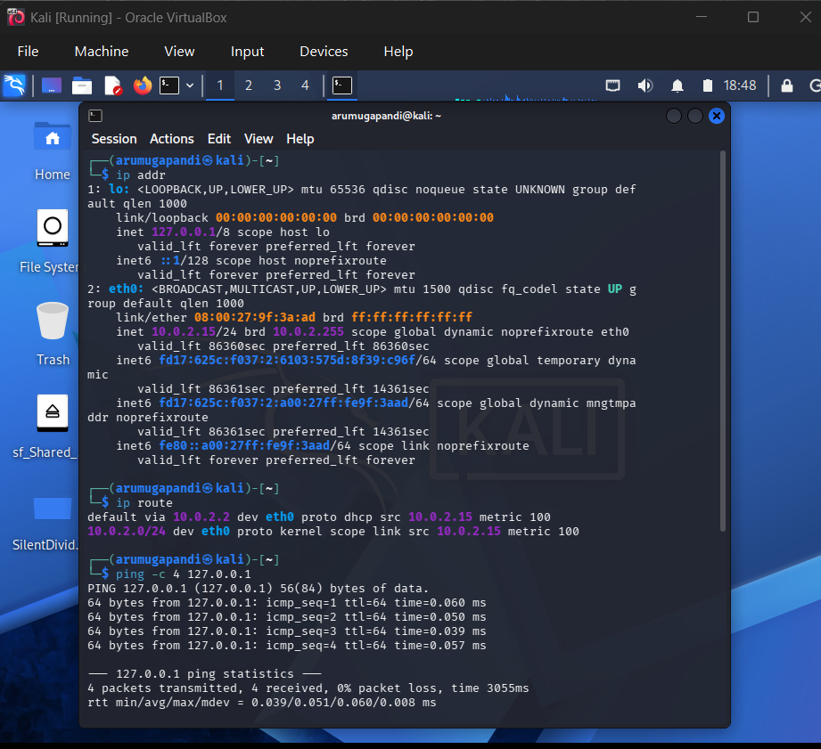
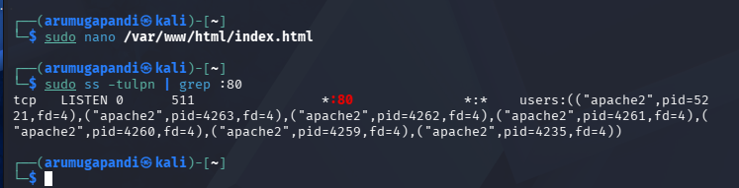
SERVICE SETUP
Apache Web Server
From installation to a recognizable test service
APACHE 2.4.68
TCP / 80
ACTIVE (RUNNING)
What was verified
• Apache service started successfully with systemctl.
• ss confirmed a TCP listener on *:80 owned by apache2.
• The default Debian page was replaced with a custom lab page.
• The custom page identifies Kali, Apache and authorized security testing.
DG Interns Hub · Cybersecurity Internship · Week 4
Evidence: Apache status, ss output and custom page
5

Slide 6
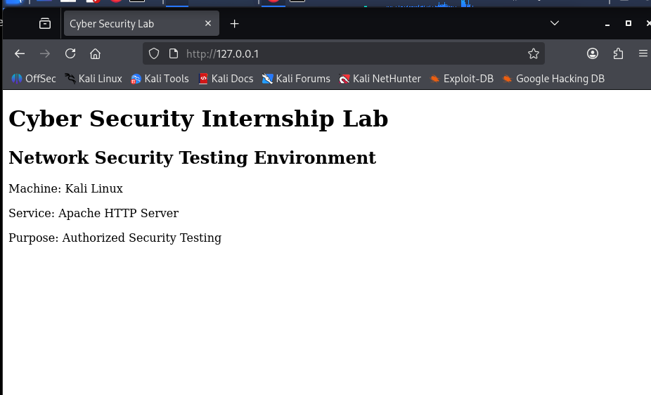
SCANNING
Nmap Methodology
Scan
Command
Purpose
Default
nmap 127.0.0.1
First view of common TCP ports
Version
nmap -sV 127.0.0.1
Identify service + version
Scripts
nmap -sC -sV 127.0.0.1
Collect HTTP title / header
Evidence
… -oN nmap_scan.txt
Save normal-format output
Coverage
nmap -p- -oN nmap_all_ports.txt 127.0.0.1
Check all 65,535 TCP ports
The scans answer progressively narrower questions: what is open → what is running → what extra HTTP details are exposed → is anything else listening?
Custom Apache page
DG Interns Hub · Cybersecurity Internship · Week 4
All Nmap scans in this practical targeted 127.0.0.1
6

Slide 7
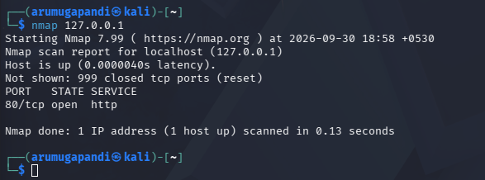
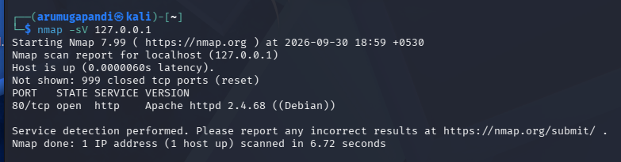
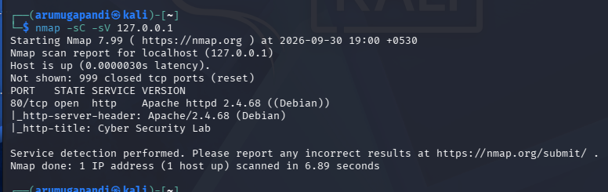
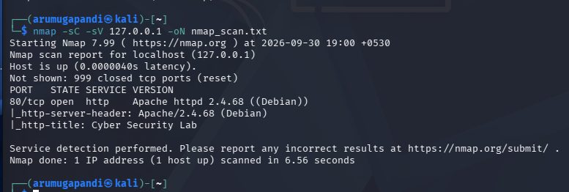
NMAP RESULTS
Open Port, Service & Version
01
80/tcp
OPEN · HTTP
Apache httpd 2.4.68
(Debian)
Only open TCP port in the full -p- scan.
Default scan: 999 closed + 1 open.
This is exposure information, not a vulnerability claim.
Default scan
-sC -sV
-sV
Saved output
DG Interns Hub · Cybersecurity Internship · Week 4
7

Slide 8
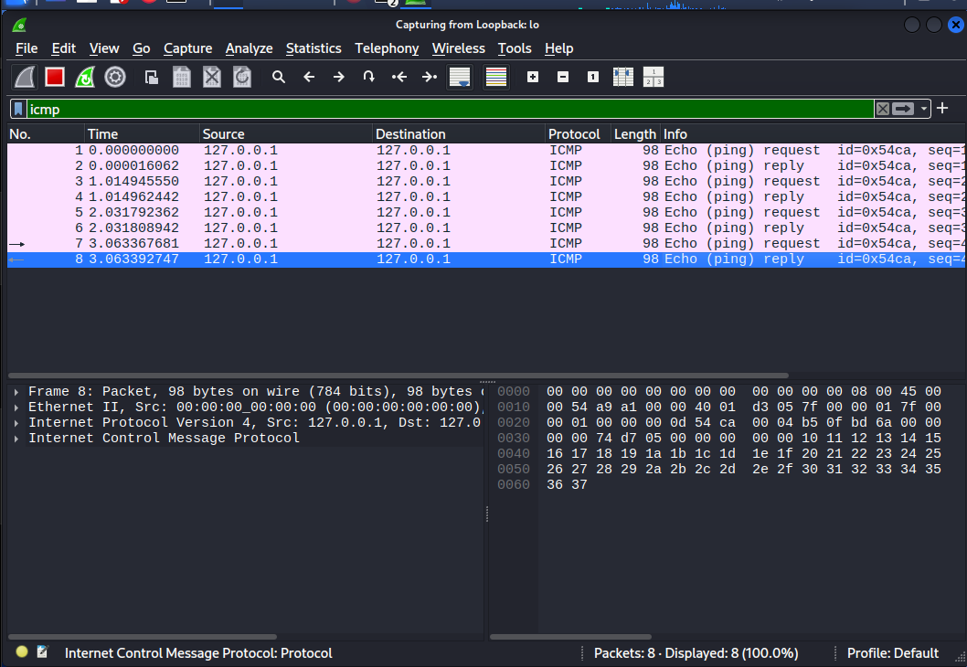
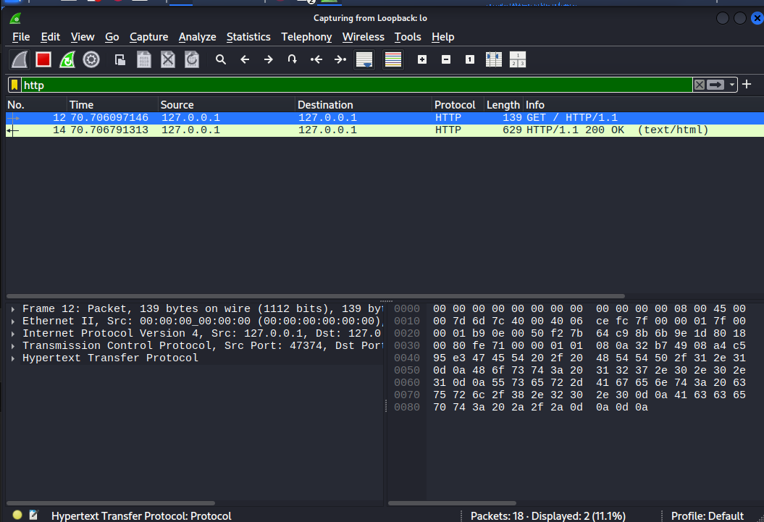
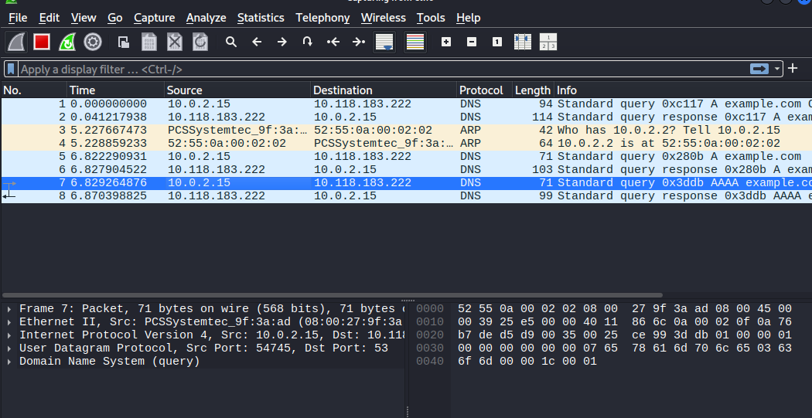
TRAFFIC ANALYSIS
Wireshark — ICMP, HTTP & DNS
ICMP
HTTP
DNS
lo · filter: icmp
lo · filter: http
eth0 · filter: dns
8 packets shown
4 request / reply pairs
GET / → 200 OK
Apache on TCP/80
example.com queries
UDP destination port 53
DG Interns Hub · Cybersecurity Internship · Week 4
Nmap identifies the exposed service; Wireshark shows the traffic exchange
8

Slide 9
FINDINGS
Security Observations & Limitations
Evidence
Classification
Interpretation
TCP/80 only
Observation
Small TCP footprint on 127.0.0.1
Apache banner visible
Possible risk
Information disclosure; no advisory check performed
HTTP readable
Context-dependent
Safe on loopback; plain HTTP would be readable on a real path
DNS readable
Observation
Standard DNS/UDP 53 exposes queried names to the network path
Apache on *:80
Observation
Only 127.0.0.1 was scanned, so 10.0.2.15 reachability was not tested
Important limitation: one VM only. The results describe the local lab and should not be treated as evidence about another machine or a real network.
DG Interns Hub · Cybersecurity Internship · Week 4
No vulnerability was found or claimed in this practical
9

Slide 10
CONCLUSION
Learning Outcomes & Key Takeaway
What I learned
KEY TAKEAWAY
• Read ip addr / ip route and distinguish loopback from eth0.
• Install, start and verify a web service with systemctl and ss.
• Choose Nmap options for discovery, version detection and coverage.
• Capture and filter ICMP, HTTP and DNS traffic in Wireshark.
• Connect scanner output with packet-level evidence.
• Document results so each statement can be traced to evidence.
Nmap told me what was exposed.
Wireshark showed how the traffic looked.
Next step
Repeat the same workflow with a separate target VM to observe scanning and traffic across an actual virtual network.
Thank You
DG Interns Hub · Cybersecurity Internship · Week 4
10

