Slide 1
CYBER SECURITY INTERNSHIP | WEEK 9
SOC Introduction and Setup
Kali Linux
sends ping and HTTP GET
Ubuntu + Snort 3
passive IDS on enp0s8
Network intrusion detection with Snort 3 on Ubuntu Server
DG Interns Hub
Alerts
SID 1000001 and 1000002
Arumugapandi K | Intern ID DG/SEPTEMBER/CYBER/177

Slide 2
SOC Fundamentals
What is a SOC?
L1
L2
L3
A team that watches an organization's systems and network day and night to detect, investigate and respond to cyber attacks.
Triage analyst
Incident responder
Threat hunter
Reviews alerts, closes false alarms, escalates
Investigates and contains attacks
Hunts hidden threats, tunes rules
People | Process | Technology
SIEM
IDS
IPS
Collects and correlates logs from many sources
Watches a copy of traffic and alerts only
Sits inline: detects and blocks attacks
e.g. Splunk, Wazuh, ELK
e.g. Snort (detection mode)
e.g. Suricata, Snort inline

Slide 3
Lab Architecture
Windows host - Oracle VirtualBox
Key details
Kali Linux
traffic generator
eth1 192.168.100.4
ping | curl (HTTP GET)
Ubuntu Server 26.04.1 LTS
soc-server
Ubuntu enp0s8
192.168.100.3
enp0s8 192.168.100.3
monitored by Snort
Snort++ 3.12.4.0
passive IDS on enp0s8
Kali eth1
192.168.100.4
traffic source
Ubuntu enp0s3
ICMP and HTTP requests
10.0.2.15
NAT, Internet and SSH
VirtualBox NAT Network SOC-LAB-NET | 192.168.100.0/24
Snort runs on the server and inspects traffic arriving on enp0s8. It only observes; nothing is blocked.

Slide 4
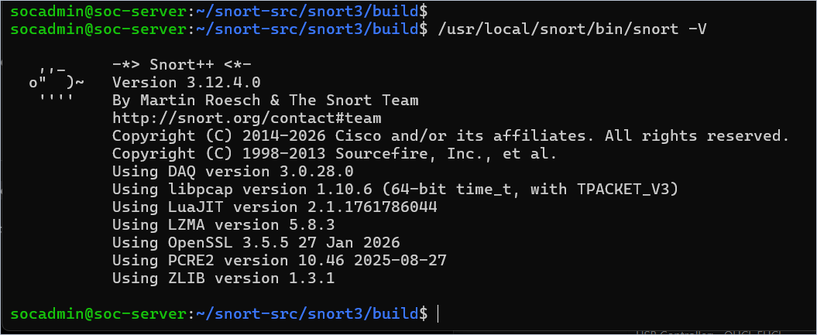
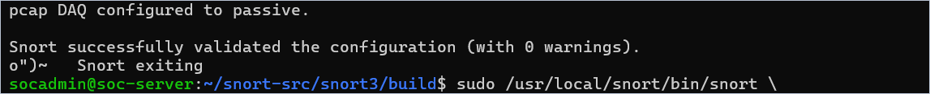
Ubuntu and Snort Setup
26.04.1 LTS
3.12.4.0
Ubuntu Server, hostname soc-server
Snort++ built from source (no apt package)
3.0.28.0
0 warnings
snort -V: Snort++ 3.12.4.0 with DAQ 3.0.28.0
LibDAQ, built first and verified
Snort configuration validated
Configuration test: validated with 0 warnings; pcap DAQ passive
Installed under /usr/local/snort. Custom rules go in etc/snort/rules/local.rules.

Slide 5
Custom Detection Rules
local.rules on soc-server (final version)
ICMP Ping Detection
HTTP GET Detection
SID 1000001 | rev 1
SID 1000002 | rev 2
alert icmp any any -> any any
itype:8 matches ICMP Echo Request (ping)
Echo replies (type 0) are not matched
alert tcp any any -> any 80
flow:to_server,established: client requests only
http_method + content:"GET": GET method only
Rule anatomy: header (action, protocol, addresses, ports, direction) followed by options in brackets (msg, flow, content, sid, rev).

Slide 6
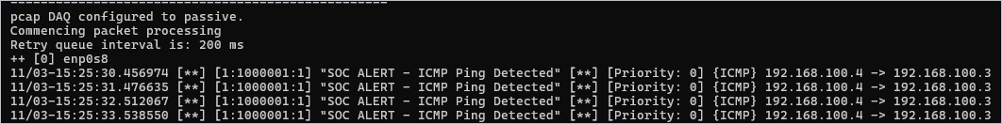
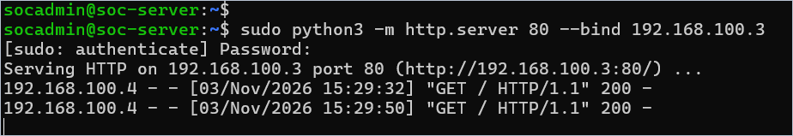
Practical Detection Results
ICMP ping: rule SID 1000001
192.168.100.4 (Kali)
to 192.168.100.3 (Ubuntu)
25 alerts in the capture
Snort start-up output and first ICMP alerts
HTTP GET: rule SID 1000002
192.168.100.4:33958
to 192.168.100.3:80
Server replied 200
Python server on 192.168.100.3:80 returns HTTP 200
Snort alert, 15:29:50: [1:1000002:2] from 192.168.100.4:33958 to 192.168.100.3:80

Slide 7
Learning Outcomes and Conclusion
SOC concepts
Linux and virtualization
Technical observations
Snort had no apt package on Ubuntu 26.04.1, so it was built from source
Passive IDS: alerts are raised, nothing is blocked
The HTTP rule reached rev 2 and matched in the http_method buffer
Both tests produced alerts with the correct source and destination
L1, L2 and L3 roles; SIEM, IDS and IPS
VM setup, hostname, networking, SSH, source build
Network monitoring
Rules and verification
Snort on enp0s8 and the fast alert format
Wrote two rules and matched alerts to real traffic
Conclusion: a working Snort IDS detected real ICMP and HTTP traffic, showing how a SOC gets its first alerts.

