Slide 1
CryptoTracker
LeetCode Bootcamp
2024-10-28

Slide 2
CONTENTS
Abstract
Functions
Authentication
Feasibility Study
Modeling
Conclusion

Slide 3
01
Abstract

Slide 4

Abstract
Crypto Tracker is a web application designed for anyone interested in keeping up with cryptocurrency trends. The main goal of this project is to provide users with an easy way to track cryptocurrency prices, view market trends, and stay updated on the latest news. Using data from the CoinGecko API, the app lets users search for specific cryptocurrencies, check real-time market info, and view historical price charts. It also includes a news feed section for recent crypto updates. Users can create accounts, save their favorite cryptocurrencies, and even set up price alerts with Firebase authentication. Additionally, Crypto Tracker has a portfolio tracker, allowing users to add their holdings and see their total investment value in one place.

Slide 5
02
Functions

Slide 6
Functions
2.1 Log in and Register
2.2 Cryptocurrency Price Search & Historical Data
2.3 Market Trends & News Feed
2.4 User Accounts
2.5 Portfolio Tracker

Slide 7

2.1 Log in and Register
Allows users to create an account and securely log in to access personalized features, such as saving favorite cryptocurrencies and setting price alerts.

Slide 8
2.2 Cryptocurrency Price Search & Historical Data
Provides a search function for users to look up specific cryptocurrencies by name or symbol and view current price and market information. Offers charts and historical data, allowing users to analyze the performance of cryptocurrencies over time.

Slide 9
2.3 Market Trends & News Feed
Displays real-time trends in the cryptocurrency market, including information on price fluctuations, trading volumes, and market capitalization. Integrates a news section to show the latest news and updates related to the cryptocurrency market, helping users stay informed.

Slide 10
2.4 User Accounts
Enables users to create personal accounts through Firebase authentication, where they can save their favorite cryptocurrencies and set alerts for specific price points.

Slide 11
2.5 Portfolio Tracker
Allows users to add their cryptocurrency holdings, track their investments, and see the total value of their portfolio in real-time.

Slide 12
03
Authentication

Slide 13
Authentication
We will use Firebase Cloud Firestore rather than other relational database by the need for real-time synchronization, scalability, and flexibility with a schema-less data structure. It also simplifies development with its built-in features like serverless architecture, authentication integration, and offline support.

Slide 14
3.1 Firebase Firestore: Advs
When choosing Firebase Firestore over a relational database like MySQL for our project, the decision is driven by several key advantages. First, Firestore’s flexible NoSQL structure allows us to adapt easily as our data evolves, without the rigid schemas and complex migrations MySQL requires. Second, it offers real-time synchronization, so our users can see cryptocurrency price changes and portfolio updates instantly, without the need for additional infrastructure. Firestore is also serverless, meaning it scales automatically without us worrying about managing databases or performance tuning as we grow. Moreover, it seamlessly integrates with Firebase Authentication, simplifying user management and security. Finally, Firestore’s offline support lets our users access and update data even when they're disconnected, with automatic syncing when they're back online. In short, Firestore provides a scalable, flexible, and real-time solution that is ideal for modern applications focus on real-time like ours.

Slide 15



3.2 Database Schema
Since Firestore is a NoSQL database and essentially stores documents in collections, I structure the schema in following way.
We have two main collections: Users and Portfolios. The Users collection will store user-related data, while the Portfolios collection will handle the user’s cryptocurrency holdings and transactions. Let's break it down:

Slide 16
1. Users Collection
The Users collection stores user-specific data, primarily managing the user's profile and preferences. The document ID for each user corresponds to their Firebase Authentication UID.

Slide 17
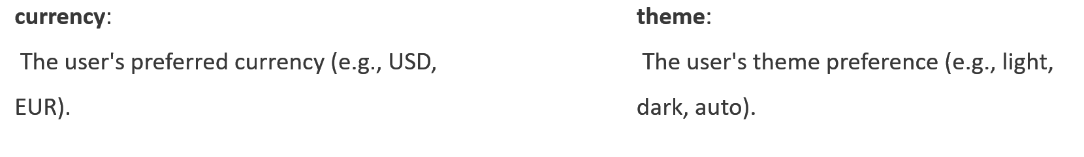
Fields:
userId: The Firebase Authentication UID that uniquely identifies the user.
email: The user's email address.
firstName: The user's first name.
lastName: The user's last name.
createdAt: Timestamp indicating when the user account was created.
preferences: An object storing user-specific settings such as:

Slide 18
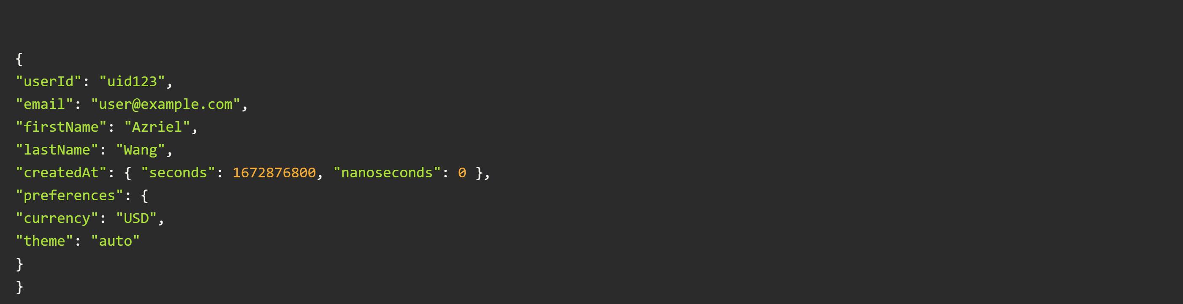
Example Document:

Slide 19
2. Portfolios Collection
Each user has a corresponding portfolio document within the Portfolios collection, which tracks their cryptocurrency holdings and related financial data.

Slide 20
Portfolio Fields:
portfolioId: Unique ID for the portfolio.
userId: The ID of the user owning the portfolio, serving as a reference to the Users collection.
cryptocurrency: An array that stores information about the user's current holdings, including:
revenue: The total revenue for the portfolio (calculated based on transactions).

Slide 21
cryptocurrency
symbol: Cryptocurrency symbol (e.g., BTC, ETH).
amount: The total quantity of the cryptocurrency owned.
averagePrice: The average price the user paid for the cryptocurrency (based on their buy transactions).

Slide 22
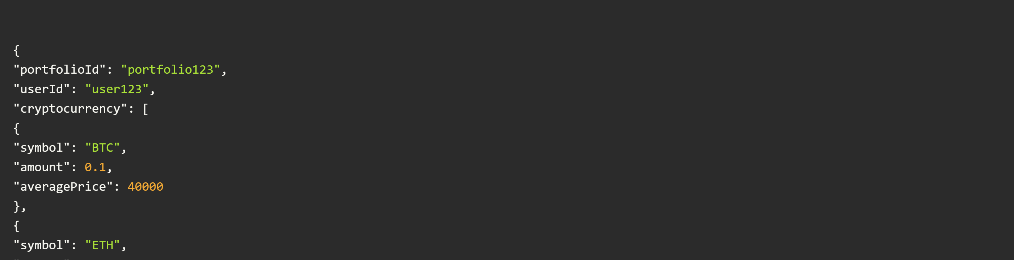
Example Portfolio Document:

Slide 23
Transactions Sub-Collection
Each portfolio document contains a Transactions sub-collection to track the user's buy, sell, and transfer activities. Every transaction is stored as a separate document inside this sub-collection.
Transaction Fields:
Example Transactions:

Slide 24
Transaction Fields:
transactionId: Auto-generated unique identifier for each transaction.
type: The type of transaction (e.g., "buy", "sell", or "transfer").
cryptocurrency: The cryptocurrency involved in the transaction (symbol).
amount: The amount of cryptocurrency transacted.
price: The price per unit at the time of the transaction (for buy/sell transactions).
transferType: For transfers, indicates whether it's a transfer "in" (deposit) or "out" (withdrawal).
date: Timestamp representing the date and time of the transaction.
fees: (Optional) Transaction fees associated with the trade or transfer.
notes: (Optional) Additional notes about the transaction.

Slide 25
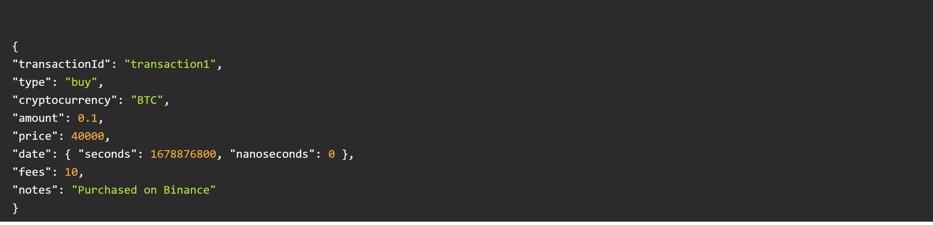
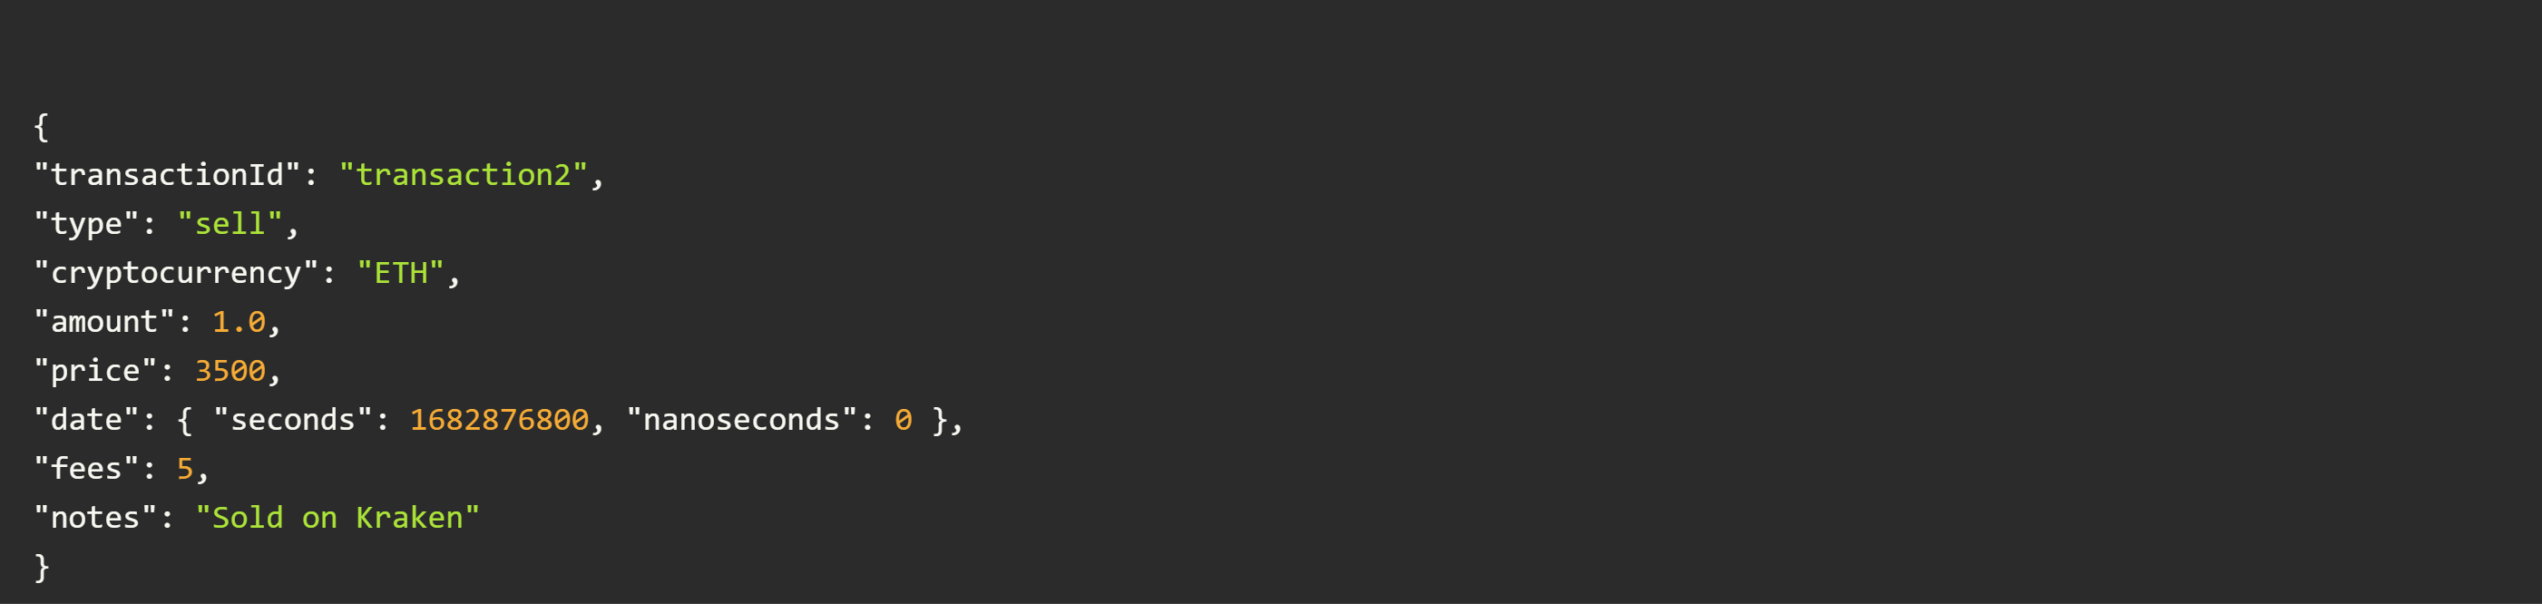
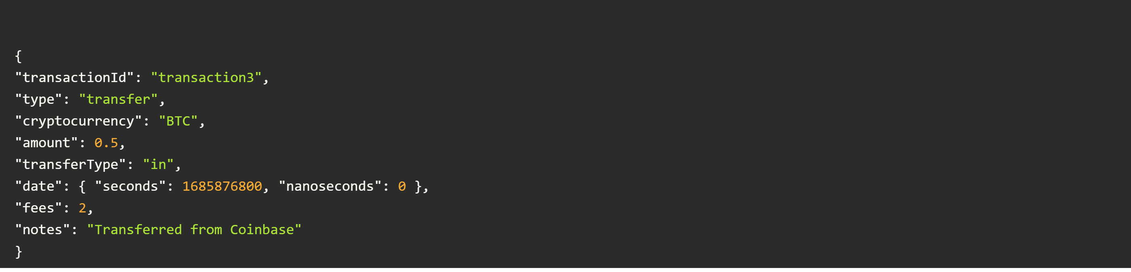
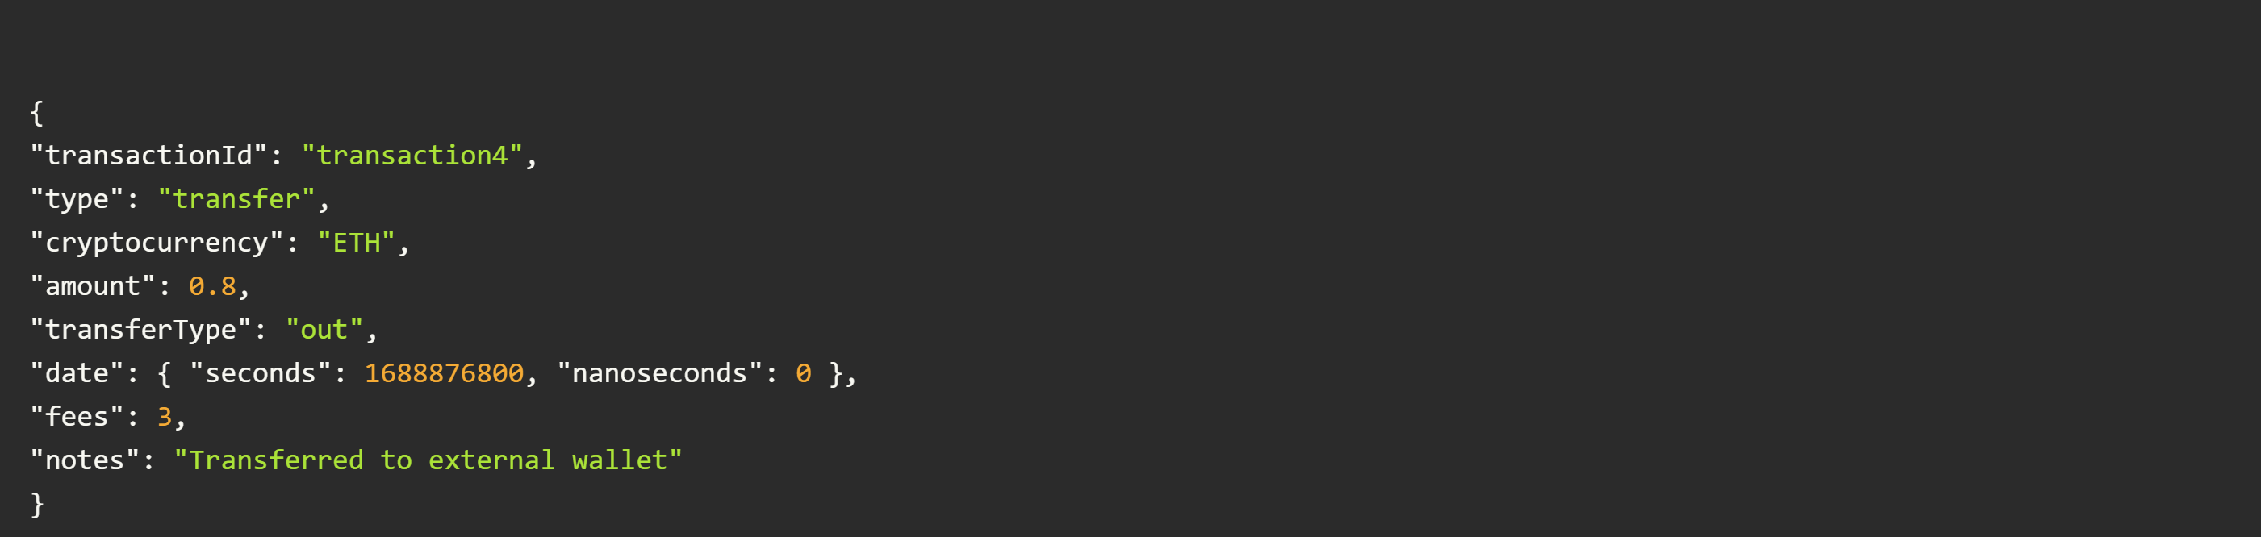
Example Transactions:
1. Buy Transaction:
2. Sell Transaction:
3. Transfer Transaction (In):
4. Transfer Transaction (Out):

Slide 26
Example Transactions:
3. Transfer Transaction (In):
4. Transfer Transaction (Out):

Slide 27

Summary
Users Collection stores basic user information and preferences.
Transactions Sub-Collection within each portfolio tracks individual transactions (buy, sell, transfer) with relevant details such as amounts, dates, and fees.
Portfolios Collection stores each user’s cryptocurrency holdings and revenue.

Slide 28
04
Feasibility Study

Slide 29





Feasibility Study
4.3 Legal (L)
4.2 Economic (E)
4.4 Operational (O)
4.1 Technological (T)
4.5 Schedule (S)

Slide 30

4.1 Technological (T)
Front-end: React is used to build an intuitive user interface, providing a smooth and responsive user experience. This choice supports faster learning and deeper understanding of front-end development for future enhancement.
Data API: CoinGecko API provides all the necessary cryptocurrency market data, including real-time prices, historical data, and market trends. This API is freely accessible and well-documented, ideal for learning integration and data processing.
Back-end: The back-end is built with Node.js, using Express as the primary framework. This setup facilitates efficient API communication with the CoinGecko API for cryptocurrency data, ensuring quick data retrieval and processing.
Caching: Redis can be used for caching frequently accessed cryptocurrency data, enhancing performance by reducing repeated API calls and allowing faster retrieval for popular queries.
Database: Firebase serves as the primary database for user authentication and account management, providing secure storage and reliable user data handling.
Containerization: Docker may be used to deploy the application in a containerized environment, ensuring consistent operation across different systems and simplifying the deployment process.

Slide 31












4.2 Economic (E)
Hosting Costs: Estimated cloud hosting costs for the Crypto Tracker application are around $50 to $100 per month, depending on user demand and storage needs.
Database Costs: Firebase provides flexible pricing for authentication and database services, with a free tier for small-scale applications and affordable rates for additional usage.
API Usage: CoinGecko API is free for non-commercial use, making it an economical choice for tracking cryptocurrency data.
Software: React, Node.js, and Firebase are all open-source or free to use, which reduces development costs as there are no software licensing fees.
Additional Costs: Domain registration and SSL certificate fees may apply, generally around $30 annually for domain registration, with free SSL options available.

Slide 32

4.3 Legal (L)
Data Privacy & Protection: The system will comply with GDPR and CCPA for user data protection, using encryption for sensitive information, especially around user accounts and portfolios.
API Usage Agreement: CoinGecko's API Terms of Use will be followed to ensure lawful data usage.
Licensing Compliance: All open-source software, such as React, Node.js, and Firebase, will be used in compliance with their respective licenses.
Intellectual Property: Proper measures will be in place to protect custom-developed code, UI elements, and trademarks associated with Crypto Tracker.

Slide 33
4.4 Operational (O)
Scalability: The app is designed to be scalable, leveraging cloud services and Firebase's flexibility to handle increasing numbers of users as interest in cryptocurrency grows.
Maintenance: Regular maintenance will ensure the app’s performance, security, and functionality, including updates to dependencies and frameworks.
Backup & Disaster Recovery: Firebase and cloud services provide built-in backup options to maintain data integrity and recovery in case of unexpected downtime.
Training: Basic tutorials and documentation will be available to help users understand the app's features and use it effectively.
Security: Regular security reviews and best practices in coding, authentication, and data handling will be implemented to maintain system security.

Slide 34
4.5 Schedule (S)
Week 1: Setup
Week 2: Initial Development
Weeks 3-4: Backend Development
Week 5: Mid-Checkpoint Presentation
Week 6: Frontend Development and Integration
Week 7: Finalizing Features and Testing
Week 8: Deployment and Final Presentation Preparation
Week 9: Final Presentation

Slide 35
05
Modeling

Slide 36
Modeling
5.1 Use Case Diagram
5.2 ER Diagram

Slide 37
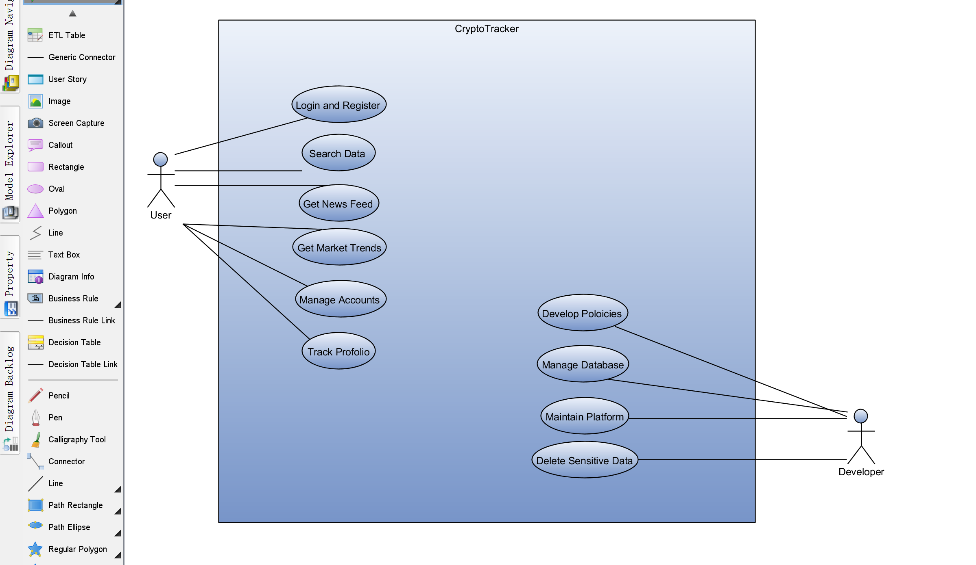
5.1 Use Case Diagram

Slide 38
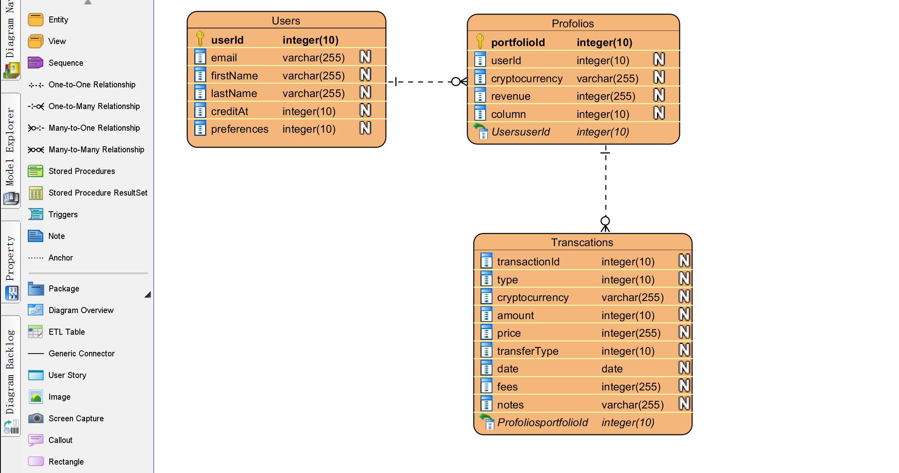
5.2 ER Diagram

Slide 39
06
Conclusion

Slide 40
Conclusion
In summary, Crypto Tracker aims to be a helpful tool for anyone interested in tracking cryptocurrency markets in a simple and accessible way. By combining real-time data from the CoinGecko API with Firebase’s efficient database and authentication features, we provide users with a platform that’s not only easy to use but also highly responsive. From tracking price changes and viewing market trends to managing personal portfolios, the app covers a range of essential features for cryptocurrency enthusiasts.
Overall, Crypto Tracker is a practical project that has helped us apply various technical skills, and we hope it will offer valuable insights for users as they explore the ever-evolving world of cryptocurrency.

Slide 41
THE END
THANKS

