Slide 1
CDI 1.1
Context Dependency Injection 1.1
Stefan Chuklev

Slide 2
What is DI?
Objects don’t create their dependencies
Factory pattern
Constructors
Setters
Someone else care for dependencies
Dependency injector
Container
Provider

Slide 3
What is container?
Runtime environment
Components
Provides services
Inversion of control
Managed environments
Managed beans
Notes:
The container provide all these services and the component should not be aware of how they are implemented. It just uses them. This is called Inversion of control.
The container provides managed environment which is holding and caring for the managed beans.

Slide 4
What is CDI?

Slide 5
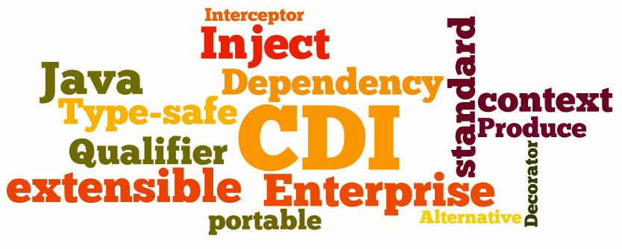

Slide 6

What is CDI?
Runtime environment
CDI beans
CDI services
DI
Interceptors
Decoration
Event handling
Context management
Notes:
CDI DI service provides concept for loose coupling and strong typing.
The decoupling of the components is extended by Interceptors, Decorators, Event handling system and context management

Slide 7
History of CDI
Martin Fowler - Inversion of Control Containers and the Dependency Injection pattern
Commercial and open source projects
Spring, Seam, Guice
Succesfull
Not standardized
CDI 1.0 – 2009 (Java EE 6)
CDI 1.1 – 2013 (Java EE 7)
CDI 1.2 – 2014 (Java EE 7)
CDI 2.0 – Java EE 8
Notes:
CDI 1.0 was built on the pricipes of Jboss Seam
CDI 1.1 was released with some improvements.
CDI 1.2 is maintanace release
CDI 2.0 – Java EE 8 – major improovements

Slide 8
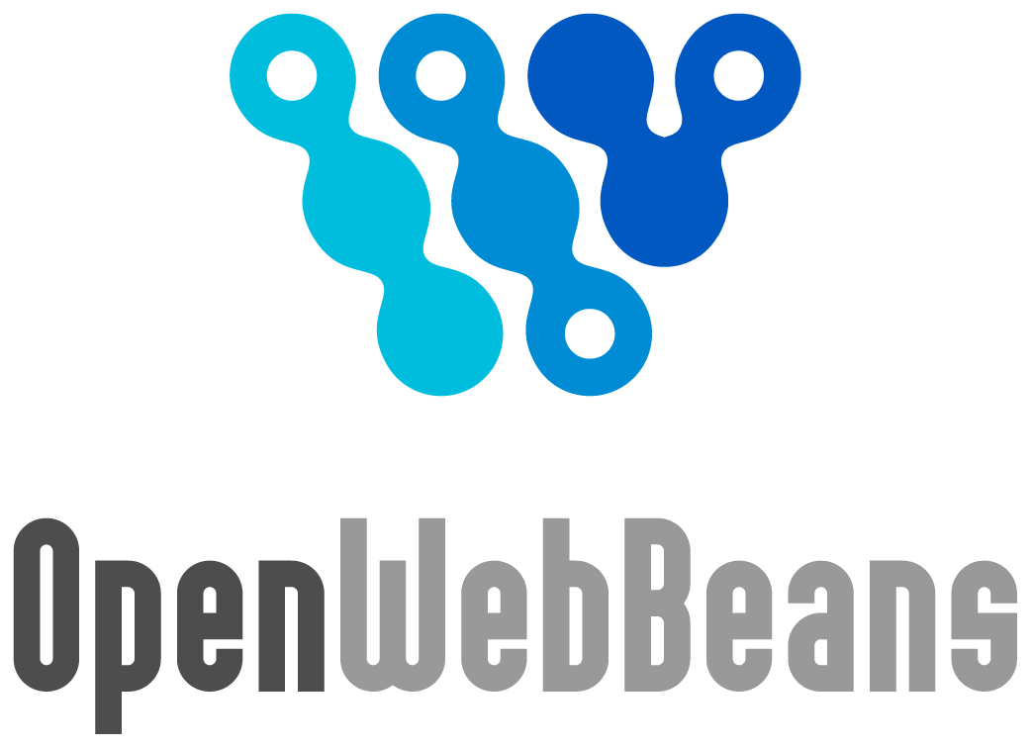



CDI Implementations
Notes:
JSR 346

Slide 9
CDI Packages
javax.inject
Core dependency injection API
javax.eneterprise.inject
Core CDI API
javax.eneterprise.context
Scopes and contextual API
javax.eneterprise.event
Events and observers APIs
javax.interceptor
Interceptor API
javax.decorator
Decorators APIs
javax.eneterprise.util
CDI utility package

Slide 10
Cdi Components
CDI Beans
Almost every java object
Simple POJOs with Default constructor
Can but does not to implement or extend specific classes and interfaces
Deployment Descriptor
beans.xml
src/main/resources/META-INF
<beans xmlns="http://xmlns.jcp.org/xml/ns/javaee"
xmlns:xsi="http://www.w3.org/2001/XMLSchema-instance"
xsi:schemaLocation="http://xmlns.jcp.org/xml/ns/javaee http://xmlns.jcp.org/xml/ns/javaee/beans_1_1.xsd"
version="1.1" bean-discovery-mode="all">
</beans>
Notes:
CDI beans could almost every java object if the beans discovery mode is on.
Deployment descriptor is used to activate CDI container and to specify injection alternatives intereptors and so on.

Slide 11
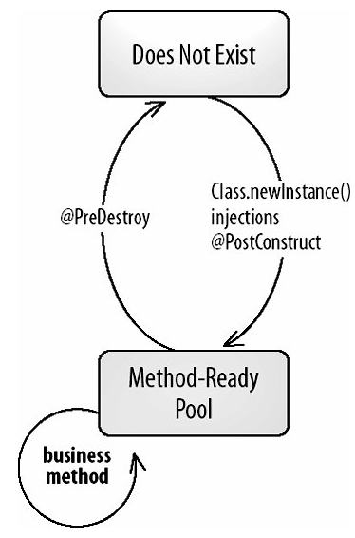
Cdi Bean lifecycle
DI Injections
Callback annotations
@PostConstruct
@PreDestroy
Throw unchecked exceptions

Slide 12
CDI Bean Discovery
App is started
Search for beans
Bean archives
Application’s calss path
Detect Definition erors
Exception cancel the deployment
Up and Runing
Web app
Standard JAVA SE APP
Injection points are referenced
Application is not available

Slide 13
Bean ARCHIVE
A.Jar
B.Jar
C.Jar
D.Jar
Anotatedbean.jar
NoAnnotatedBean.class
Beans.xml = ALL
No annotated beans
No bean.xml
AnnotatedBean.class
Beans.xml = none

Slide 14
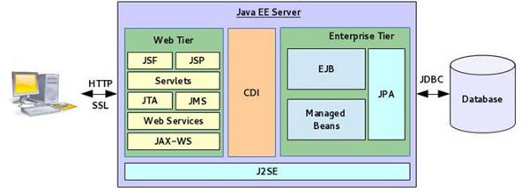
Where we can use CDI
Notes:
Bussiness model – this is the place were our data is represented as model which is directly communicating with the Enterprise information system – DB. Here is the place where JPA entites live and are mapped to DB.
JPA entitites cannot be treated as CDI Beans.
JPA Entitiy listeners are considered to be CDI beans – validation beans
Bean validation uses CDI.
Bussiness layer is the most common place for CDI Usage. It can be used for injections decoration, interceptions and so on.
Presentation layer- JSF is backend technology that use baked beans to render HTML. The baked beans are bounded into the JSF pages with CDI annotations
On client side CDI cannot be used unless it is a native application.
Interoperability layer – JAX-WS –SOAP and JAX-RS REST both can use CDI.

Slide 15

CDI Injection overview
Simple CDI Injection
Ambiguous CDI injections
@Default and @Alternative
@Qualifier
Multiple @Qualifier - s
Advanced @Qualifier
@Vetoed

Slide 16
CDI Injection
Injection point
@Inject – javax.inject.Inject
Field
Public
Private
Constructor
Setter method
Deployment descriptor
Bean-discovery-mode
All
None
Annotated

Slide 17
Simple CDI Injection

Slide 18
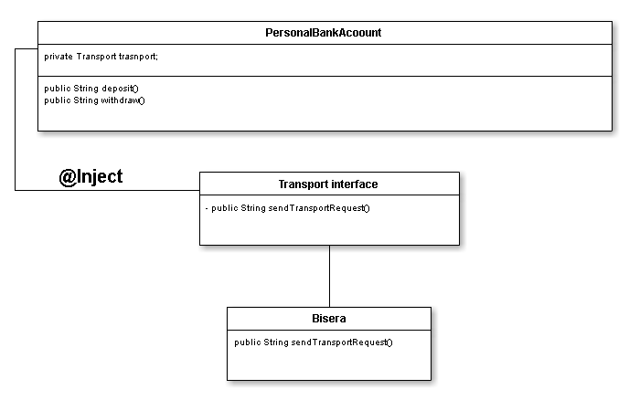
CDI Injection

Slide 19
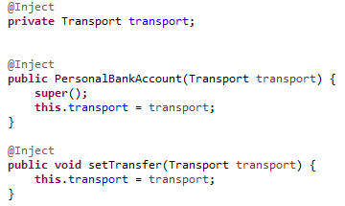
CDI Injection

Slide 20
Ambiguous CDI Injection

Slide 21
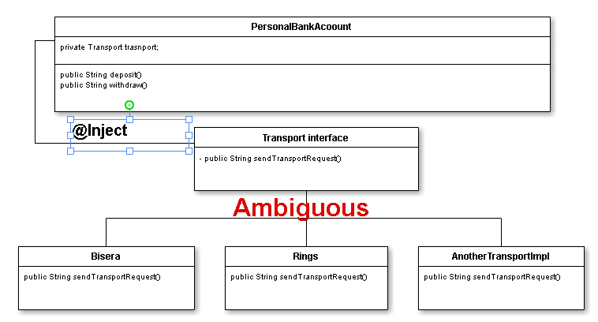
CDI Injection

Slide 22
CDI @Default and @Alternative

Slide 23
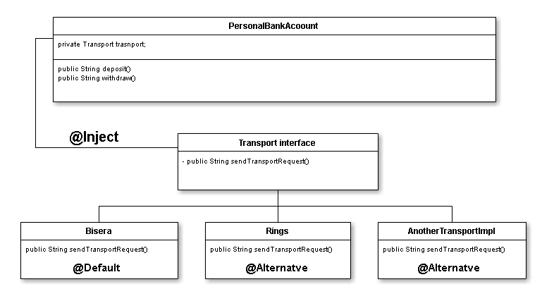
CDI @Default and @Alternative

Slide 24
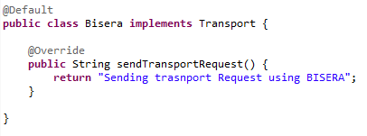
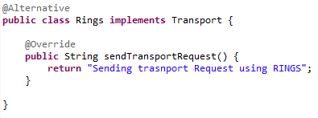
CDI @Default and @Alternative

Slide 25
CDI @Qualifier

Slide 26
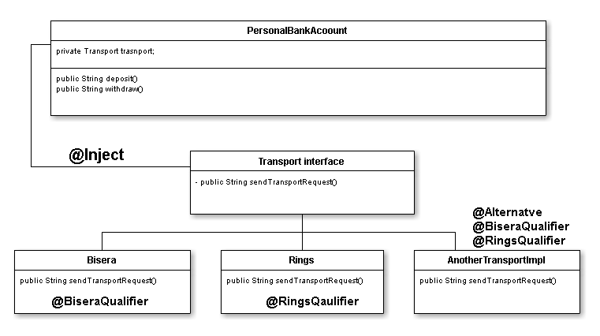
CDI @Qualifier
Notes:
Qualifiers are created as standard Java annotations using java.lang.annotation package with the additional Qualifier annotation.

Slide 27
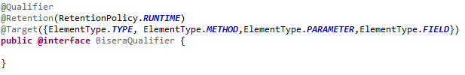
CDI @Qualifier
javax.inject.Qualifier;
Notes:
Qualifiers are created as standard Java annotations using java.lang.annotation package with the additional Qualifier annotation.

Slide 28
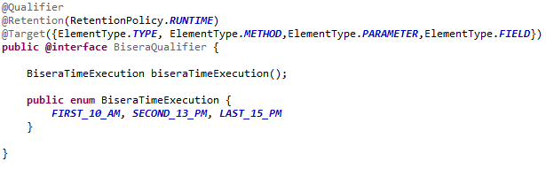
CDI ADVANCED @Qualifier
Notes:
Qualifiers are created as standard Java annotations using java.lang.annotation package with the additional Qualifier annotation.

Slide 29
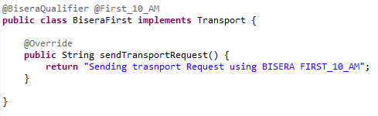
CDI MUlTIPLE @Qualifier
Notes:
Qualifiers are created as standard Java annotations using java.lang.annotation package with the additional Qualifier annotation.

Slide 30
CDI @vetoed

Slide 31
CDI Injection overview
Simple CDI Injection
Ambiguous CDI injections
@Default and @Alternative
@Qualifier
Multiple @Qualifier - s
Advanced @Qualifier
@Vetoed

Slide 32
CDI - DEPENDENCY INJECTION DEMO

Slide 33
CDI – Producers

Slide 34

CDI – Producers
Producers – provide CDI functionality to:
Third party POJOs
Datatypes (String, int, log, byte etc.)
Can be used on fields
Can be used on method
@Produces
@Qualifiers
Injection point API

Slide 35
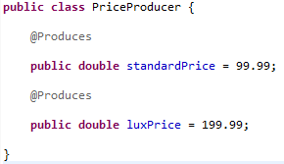

CDI – @Produces
Strongly
Typed
Per data type

Slide 36
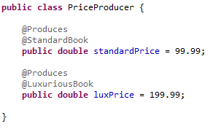

CDI – @Produces with @QUALIFIER

Slide 37
Bean ARCHIVE
A.Jar
B.Jar
log4j.Jar
Anotatedbean.jar
NoAnnotatedBean.class
Beans.xml = ALL
No annotated beans
No bean.xml
log4j

Slide 38
@Produce & Injection point API
CDI can be used to provide CDI services to third party classes
Injection point API
Producers may need to change their behavior depending on the injection point
Give access to injection point metadata
No need additional annotations in the injection point

Slide 39


@Produce & Injection point API
Injection point API

Slide 40
CDI Producers DEMO

Slide 41
CDI – DISPOSES

Slide 42

@DISPOSES
@Disposes
Some objects require explicit destruction
JDBC connection
Entity manager
JMS Session
Strongly typed per data type
@Qualifiers

Slide 43
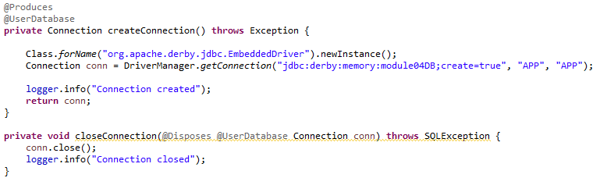
@DISPOSES
Strongly
Typed
Per data type

Slide 44
CDI @DISPOSES DEMO

Slide 45
CDI – INTERCEPTORS

Slide 46
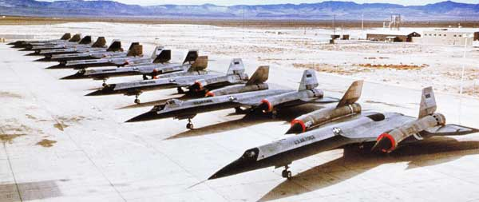

CDI – INTERCEPTORS
Interpose on method invocation
Help to remove boilerplate or repeatable code
Technical (Interceptors)
Logging
Security
Transactions
Business (Decorators)
Additional checks
Both lives and are managed by the CDI container

Slide 47
CDI – INTERCEPTORS
We can have different separators
We can have different separators on one and the same bean
We can have different Decorators
We can have chain interceptors and decorators

Slide 48
CDI – INTERCEPTORS
Call
Bean
Another Bean
Call
Someone

Slide 49
CDI – INTERCEPTORS
Call
Intercept
Bean
Another Bean
Call
Intercept
Someone

Slide 50
CDI – INTERCEPTORS
Call
Interceptor A
Bean
Another Bean
Call
Intercept B
Someone
Decorator A
Decorator C

Slide 51

CDI – INTERCEPTORS
Cross-cutting technical concerns
Transactions
Security (Authentication, Authorization)
Logging
Types of interceptors
Business interceptors
@ArroundInvoke
Life Cycle Interceptors
@PostConstruct
@PreDestroy
Notes:
Once we know how to log a method entry we can isolate the code into an interceptor and enable this interceptor for different beans.

Slide 52
CDI – INTERCEPTORS
Creating an interceptor
Interceptor Binding
Annotation
@InterceptorBinding
Interceptor
Class
Annotated with:
@Interceptor
Already created interceptor binding
The interceptor methods must be annotated with @Around Invoke annotation
InvocationContext as a parameter
The interceptor should return Object
Notes:
Interceptor binding is just an annotation. It is similar to the Qualifiers.
The interceptor itself is a simple class which is annotated with @Interceptor annotation and predefined interceptor binding annotation.
The interceptor are CDI beans and can take advantage of CDI.
The same Invocation Context is passed through all the chain of interceptors.

Slide 53
CDI – INTERCEPTORS
Invocation Context
passed through all the chain of interceptors
Provide information for:
Target class
Target method
Method parameters
PROCEED
Notes:
With IC API each interceptor could get information for the call such as
Target class
Target method
Method parameters
Interceptors have to proceed the invocation to the next interceptor in the chain.

Slide 54
CDI – INTERCEPTORS
Beans.xml and Interceptors
By default all Interceptors are disabled
<interceptors>
<class>Interceptor</class>
</interceptors>
We can order interceptors in beans.xml
@Priority
Takes integer

Slide 55
CDI – INTERCEPTORS
Life Cycle Interceptors
CDI beans life cycle is managed by the container
@PostConstruct
@PreDestroy
Life Cycle Interceptor creation
Create normal interceptor
Create methods for post construct and predestroy and annotate them with @PostConstruct and @PreDestroy
The methods should return void

Slide 56
CDI – INTERCEPTORS DEMO

Slide 57
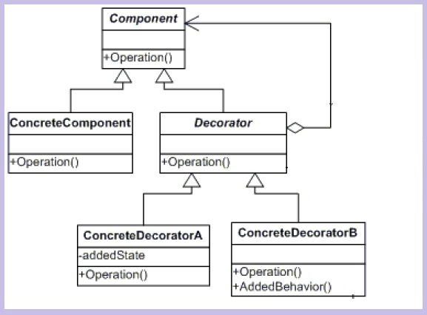
CDI – DECORATOR
Similar to interceptors but related to business concerns
GoF design pattern
Wrap a class around another one
Add additional business logic
@Decorator
@Delegate
Interceptors are always called before decorators
Disabled by default
Should be enabled by beans.xml
Ordering
@Priority
Notes:
The idea is to take a class and wrap it around another class. In this way when you call a particular class you are always passing through the wrapper one (@decorator) before passing to the target one (@delegate)

Slide 58
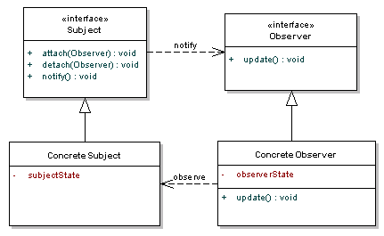
CDI – EVENTS
Provides better loose coupling
Beans can interact with no compile time dependency
Fire an event
Observe an event
Location independent
Different bean archive
Different tier
GoF pattern
@Inject Event <fire bean>
@Observes annotation
Placed before the arguments of a method
Can use @Qualifier
Notes:
The idea is to take a class and wrap it around another class. In this way when you call a particular class you are always passing through the wrapper one (@decorator) before passing to the target one (@delegate)

Slide 59
CDI – EVENTS
Purchase order service
Inventory service
Shipping
service
Statistic service
Payment
Service
@Inject
Notes:
When Purchase Order is created it call all the other services in order to inform them and call some methods in them.
If we want to add another service or change the logic of some of the existing ones we should change the code of Purchase order too.
DI Decouples by allowing the functionality of the injected bean to vary, but on the price of compile dependency.

Slide 60
CDI – EVENTS
None of the participants
is not aware for the others
Purchase order service
Inventory service
Shipping
service
Statistic service
Payment
Service
Purchase Order
fire events
CDI events are
NOT
ASYNCHRONOUS !!!
CDI Container deliver
the events to observers
Notes:
We can decouple the services with no com-pile time dependency.
PurcahseOrder Service fire an Event. It is not aware of woo will observe the event.
Other services can observe for the event and perform some business logic.
It is important to know that CDI events are not Asynchronous. That means they are partially blocking operation and when an event is fired the fire method should wait for all the observers to receive that event.
If an exception occurs in some of the observers the exception is rethrown by the fore method.
Another important thing is that there is no order.
Ordering is on the road map for CDI 2.0.

Slide 61
Any Questions ?

Slide 62
THANK YOU !

