Slide 1
Class 3:
y² = x³ + 7
Cryptocurrency Café
cs4501 Spring 2015
David Evans
University of Virginia

Slide 2
Plan for Today
Bitcoin Wallets and Passwords
Asymmetric Cryptography Recap:
Transferring a Coin
Bitcoin’s Asymmetric Signatures
Double Spending: Introducing the Blockchain

Slide 3
Using Asymmetric Crypto: Signatures
Anyone
Bob
Get KU_{B} from trusted provider
Generates key pair: KU_{B}, KR_{B}
Publishes KU_{B}
Verified
Message
E
Signed Message
D
Message
Insecure Channel
KU_{B}
KR_{B}

Slide 4

Transferring a Coin
Notation:

Slide 5
Elliptic Curves

Slide 6
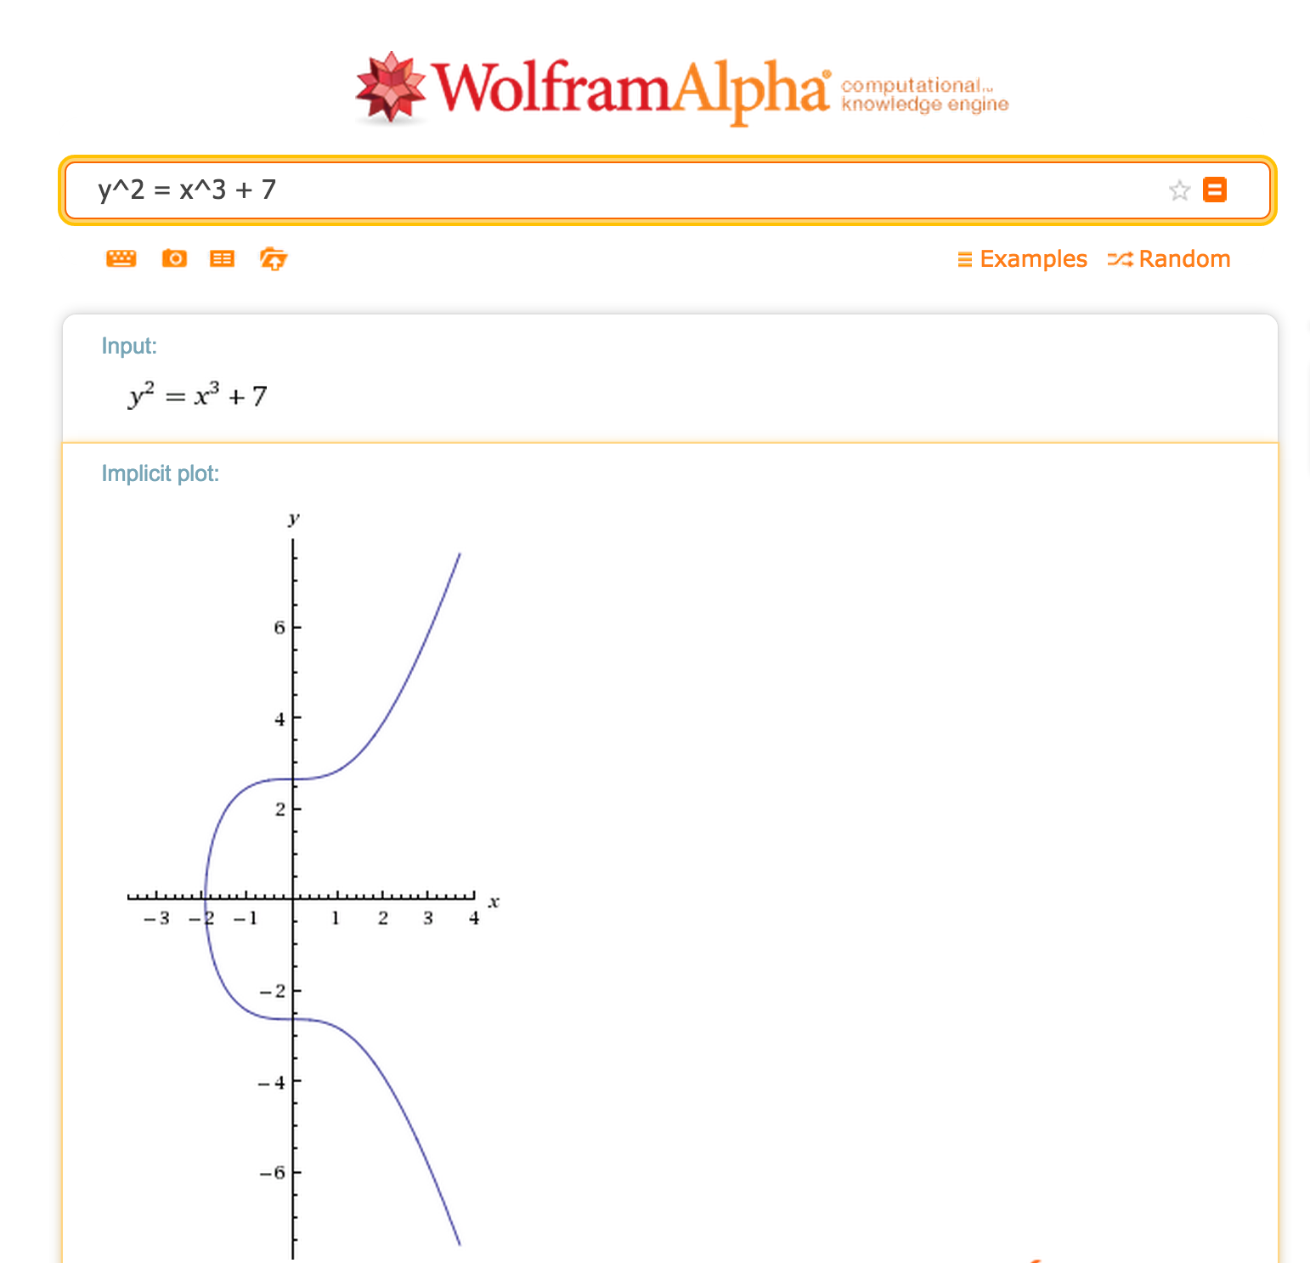
Real numbers are useless!

Slide 7
Finite Fields
0
Operations:
addition, subtraction
multiplication, division (except by zero)
6
1
5
2
GF(7)
3
Z mod 7
4

Slide 8
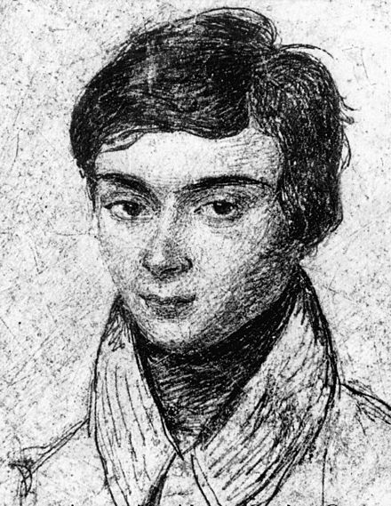
0
6
1
5
2
GF(7)
4
3
Évariste Galois
Killed in duel at 20

Slide 9
Elliptic Curves in Finite Fields
y² = x³ + 7 in GF(3)

Slide 10
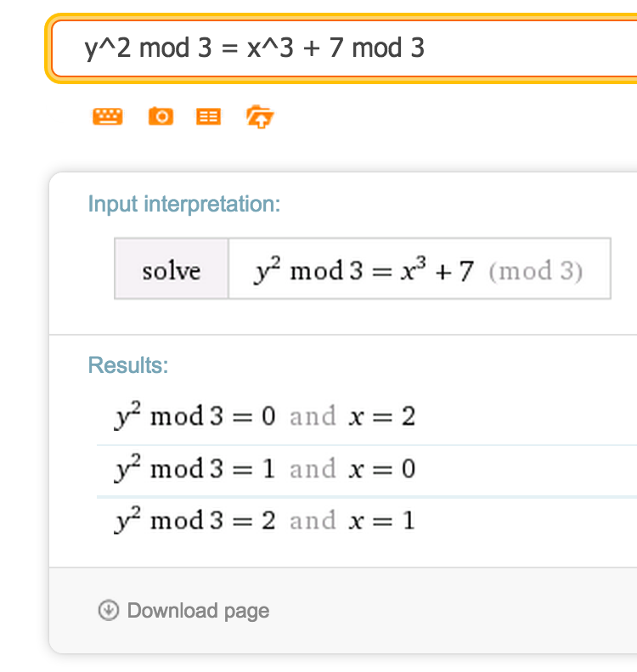
Elliptic Curves in Finite Fields
y² = x³ + 7 in GF(3)

Slide 11
Elliptic Curves in Finite Fields
y² = x³ + 7 in GF(2²⁵⁶ - 2³² - 2⁹ - 2⁸ - 2⁷ - 2⁶ - 2⁴ - 1)

Slide 12
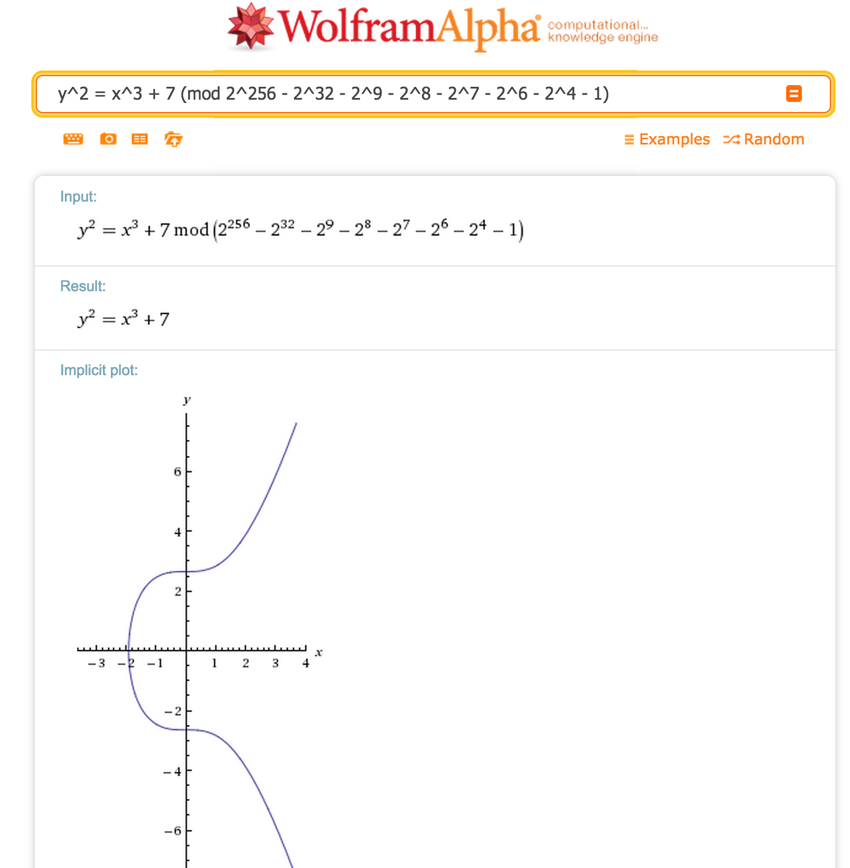
y² = x³ + 7 in GF(2²⁵⁶ - 2³² - 2⁹ - 2⁸ - 2⁷ - 2⁶ - 2⁴ - 1)
115 quattuorvigintillion 792 trevigintillion 89 duovigintillion 237 unvigintillion 316 vigintillion 195 novemdecillion 423 octodecillion 570 septendecillion 985 sexdecillion 8 quindecillion 687 quattuordecillion 907 tredecillion 853 duodecillion 269 undecillion 984 decillion 665 nonillion 640 octillion 564 septillion 39 sextillion 457 quintillion 584 quadrillion 7 trillion 908 billion 834 million 671 thousand 663
(0.0012 × the number of atoms in the visible universe)

Slide 13
Charge
Achieving scarcity is a hard problem!
No class Monday (Martin Luther King Day)
See notes for readings
Project 1 will be posted in a few days

