Slide 1
HorsEther
Created by Kevin Aiken, Alex Mitchell, Jenny Choi, Aarohi Savaliya, and Kevin Luna

Slide 2

What is HorsEther and why?
What
Ethereum based horse race betting system
Why
Ability to transfer funds with ease
Less legal restrictions in regards to gambling

Slide 3







Technology Stack
Frontend
React
Reactstrap
Drizzle
Blockchain
Truffle
Ganache
Metamask
Solidity

Slide 4
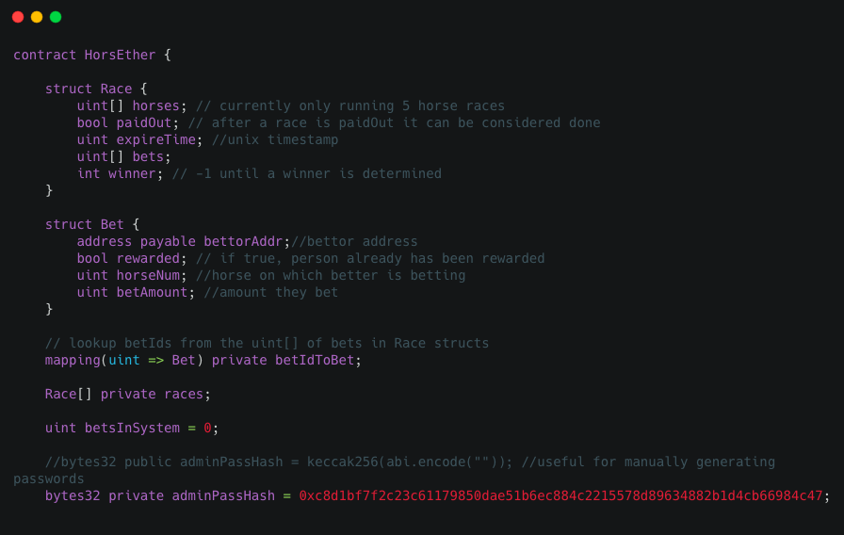
Contract (part 1)

Slide 5
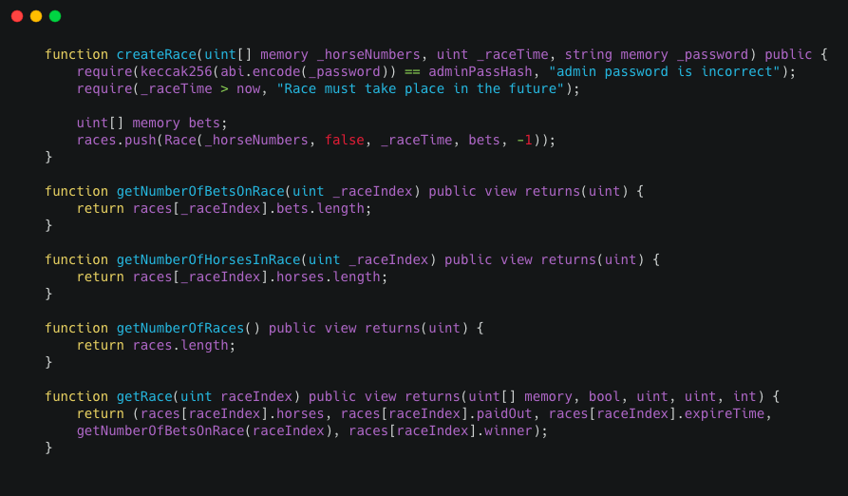
Contract (part 2)

Slide 6
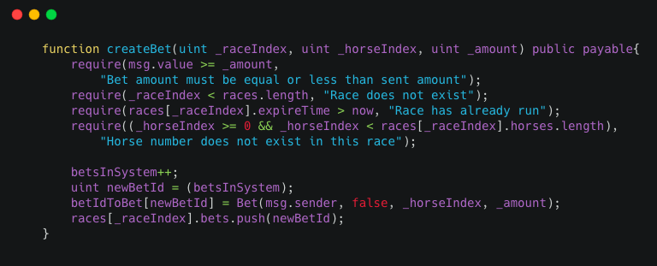
Contract (part 3)

Slide 7
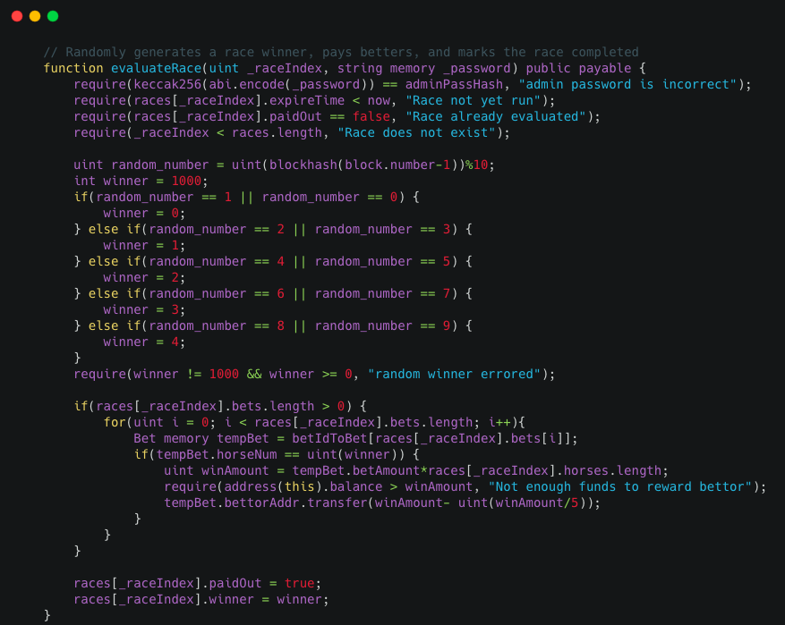
Contract (part 4)

Slide 8
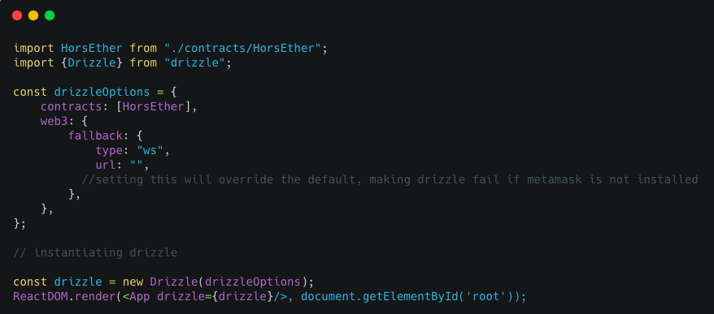
Front-End: Instantiating web3

Slide 9
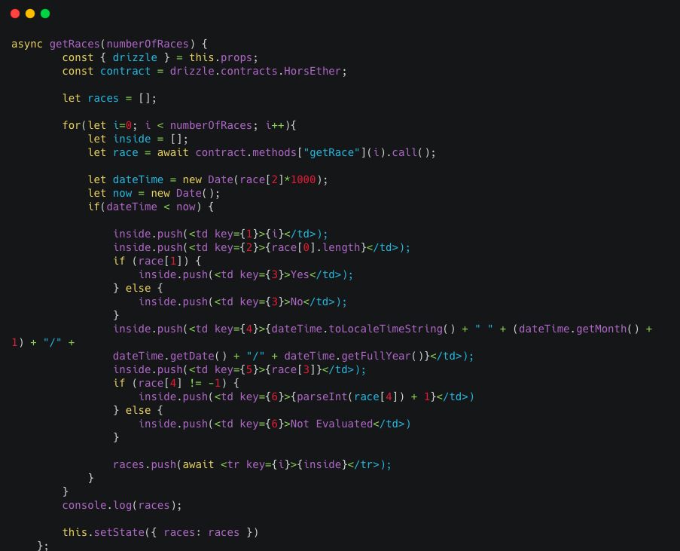
Front-End: Calling Contracts

Slide 10
Challenges we faced

Slide 11
Challenges
Learning new technology stack
Finding resources that have not become obsolete

Slide 12
Demo time!

