Slide 1
Title
DNA along with Genetic algorithm for encryption and decryption

Slide 2
TEAM MEMBERS
Nitya sree.P 17mis1007

Slide 3
Summary of the project
In this project we implement a DNA-Genetic Encryption Technique (D-GET) in order to make the technique more secure and less predictable.
In this technique,we take binaries of any type of digital data and convert it to DNA sequencing, reshape, encrypt, crossover, mutate and then reshape. The main stages of D-GET are repeated three times or more. Transmit the encrypted data in text/image format file. In other side, the receiver uses the D-GET to decrypt the received data and reshape it to original format. This Technique multiple key sequences to increase the degree of diffusion and confusion, which makes resulting cipher data difficult to decipher and makes to realize a perfect secrecy system. Experimental results demonstrate that proposed technique has multilayer protection stages against different attacks and higher level of security based on the multi-stages and genetic operations. Decrypted data are acceptable because of there is absolutely difference between it and secret data

Slide 4
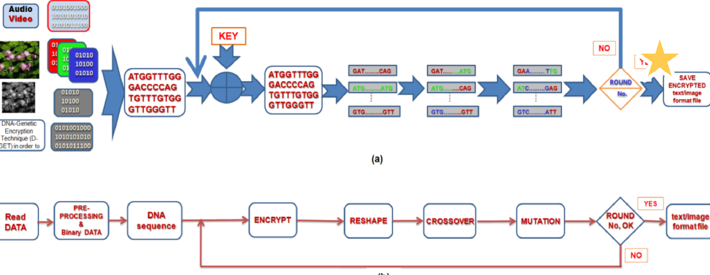
Summary of the project
Block diagram

Slide 5
Steps
Pre-processing Stage
After reading secret data, this data must be preparing depending into its type. In case text file, it is converted into ASCII values. Group them into 8-bits Binary data. Every two adjacent bits are transferred to the four bases; adenine (A), cytosine (C), guanine (G) and thymine (T), found in DNA
Encryption stage:
After conversion binary data to DNA sequencing then encrypt using key. The key may be DNA sequence or binary string. The key has variable length. If one or both of data and DNA sequence key DNA sequence, it will convert to binary form then, perform an exclusive OR operation on the corresponding elements of them and convert back to DNA sequence.

Slide 6
Steps
Reshaping Stage
After Encryption, A basic genetic algorithm is
composed of three operators; reproduction, crossover and mutation. To produce genetic material that pass to the next operation and iteration in the form of chromosome population, the Reshaping stage is used. In this stage, first number and length of chromosome are determined. These values may be constant are varied for every round. Reshape it by align the DNA sequence into rows to construct parents’ chromosomes (chromosome population) with pre-defined length.
Crossover Stage
After constructing parents’ chromosomes, the next operation is crossover. There are two types of crossover. These may be sequentially used in technique rounds. In the first one, the parents are selected in the mating pool. A single-point crossover point is selected between the first and last bits of the parents’ chromosomes then, creating two new offspring by exchanging the heads of parent1 and parent2. Consequently the offspring containportions of the DNA codes of both parents

Slide 7
Steps
Mutation Stage
After crossover process, the chromosomes are
subjected to mutation. Mutation is the alteration of string elements. Two types of mutation are used. In the first one, convert data to binary vector and define two mutation points between the first and last bits then complement bits in between i.e. single point mutation changes a 1 to a 0, and vice versa. In the second mutation type, convert each four bits to two bases of DNA (1010 -> CG). After conversion, reshape it to DNA bases vector and define two points between the first and last bases then alter DNA bases to another one (i.e., C -> G).

Slide 8
Tools used
Python

Slide 9
Modules
Pre processing
Encryption
Re shaping
Cross over
Mutation

Slide 10
Output
Encryption and decryption of data using DNA-Genetic Encryption Technique

