Slide 1

QR ID™ is a replacement for OTP (One Time Password) schemes
No user-ID to remember, it's all in the certificate. Yes, it is based on PKI
128+ versus 40-bit entropy, no need for "login throttling" or account lockout
No counter/time-stamp per user state-holding needed in the server, a root certificate + OCSP/CRL suffice
No guesswork regarding token to use, credential filtering does it automatically and displays an associated logotype as well
No fuzzy inputting of ever-changing digits, a static PIN will do
Designed for mobile phones and on-line provisioning

Slide 2
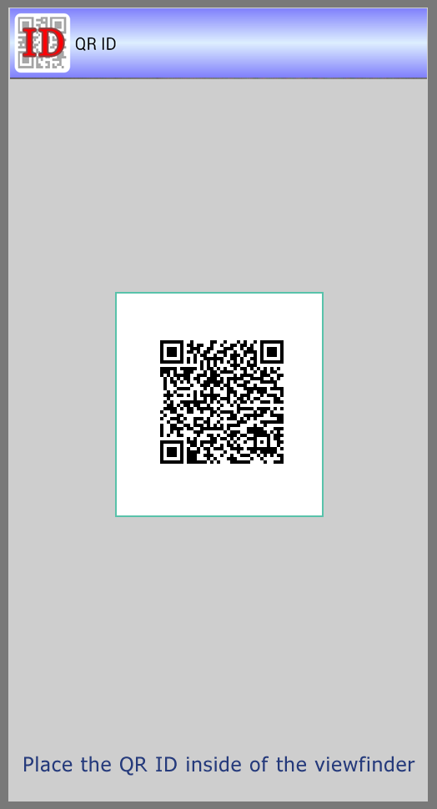
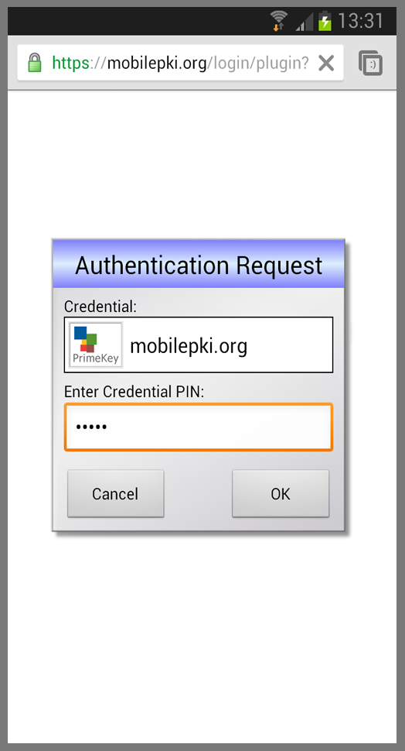
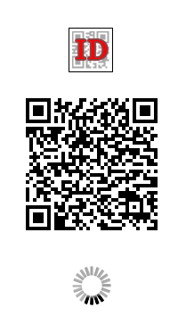
QR ID™ from a user’s perspective - Login
②
Automatic step
③
①
Web Service
Login
The user wants to login to a service from a PC or similar. The service responds with a QR ID display and asks the user to open the QR ID app.
The user opens the QR ID app and points to the web page. When the QR ID is recognized the app automatically invokes the authentication app.
The user is presented with a login app and responds with a PIN to activate the credential. After that the user should be able to use the service from the PC (not shown here).

Slide 3


QR ID™ - How does it actually work?
Web Service
1
User wants to login to the service
2
Service responds with a QR ID
3….
AJAX-based login status service
9
Logged in to the Service!
4
5
Authentication trigger
6
Authentication request
The Authentication request message contains a challenge and optional credential filters in JSON format.
The Authentication response contains the challenge signed by the private key + the associated X.509 certificate using a JSON signature.
7
Authentication response
QR
8
Local confirmation page
The QR code contains an URL with a random session ID used in #5 as well as an application indicator since QR ID can be used to start other local applications like enrollment.
V0.5, AR 2013-07-03

