Slide 1

DP World Docs &
This presentation outlines governance, legal frameworks, and operational standards for DP World's documentation centre. Key topics include UAE law dispute resolution, website policies, IP guidelines, user责任, 和
Notes:
This slide establishes the scope of the DP World Documentation Centre presentation, emphasizing governance frameworks, legal compliance under UAE law, and user responsibilities for accessing resources. It sets the stage for discussing operational standards, dispute resolution mechanisms, and contractual obligations.

Slide 2



Legal Framework
The DP World Documentation Centre operates under UAE law for dispute resolution. Users must comply with the Acceptable Use Policy, prohibiting unauthorized linking/content use. Legal IP
Dispute Resolution
Policy Compliance
UAE
Mand
Notes:
This slide outlines critical legal requirements for DP World users. Emphasize UAE law's role in dispute resolution, the mandatory Acceptable Use Policy compliance, and strict enforcement of intellectual property rights. Highlight the need for user acknowledgment of ownership and prohibition against unauthorized content use.

Slide 3
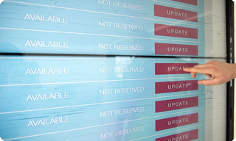
WebsiteOperations
1
Website Updates &
1
Website Updates &
Website updates, suspensions, and content availability may change without prior notice. Users assume responsibility for any中断
Website updates, suspensions, and content availability may change without prior notice. Users assume responsibility for any中断
1
Website Updates &
1
Website Updates &
Website updates, suspensions, and content availability may change without prior notice. Users assume responsibility for any中断
Website updates, suspensions, and content availability may change without prior notice. Users assume responsibility for any中断
Notes:
This slide outlines key website policies: 1) Unannounced updates may affect service availability 2) Printing restrictions apply to single-page documents 3) Service terms can be modified at any time 4) No liability is assumed for user disruptions

Slide 4
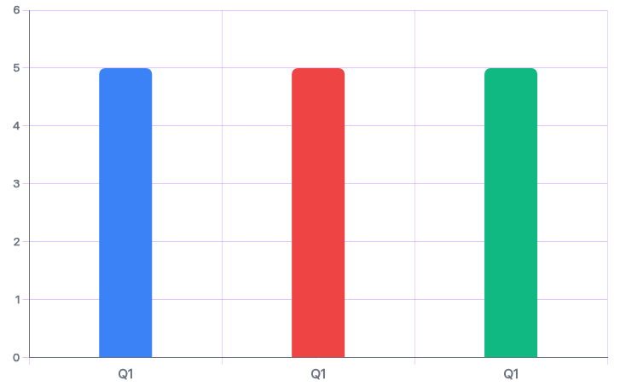
Intellectua
DP World retains ownership of all intellectual property on the Documentation Centre. User-submitted content remains the user
Ownership Policy
DP World retains ownership of all intellectual property on the Docs
User Rights Notice
User-submitted content remains the user’s property but grants DP W
Indemnification Clause
Users must indemnify DP World against losses from breaches
Notes:
This slide establishes IP ownership framework for Documentation Centre. DP World maintains ownership of all content, while users retain rights to their submissions. Key protections include non-exclusive usage rights for DP World and user liability for breaches of terms, including unauthorized distribution or third-party infringement.

