Slide 1

DP World Digital
This presentation outlines the DP World Documentation Centre's resources, legal framework, website accessibility, and IP policies. The centre provides Terms & Conditions, tools, and insights to streamline全球贸易.
Notes:
This slide introduces the DP World Documentation Centre, emphasizing its role as a global trade facilitation hub. Presented by [Presenter Name] on July 11, 2026, it covers core resources, legal compliance, digital accessibility, and IP protections for business operations.

Slide 2




Legal &合规
Usage Governance
Dispute Resolution
The DP World Documentation Centre governs website usage through legally bound
All disputes are subject to UAE law and resolved in UAE courts per terms
Support Contact
Content Standards
Users must contact [email protected] for content usage inquiries and policy
Acceptable Use Policy applies to user-generated content ensuring DP World's
Notes:
This slide outlines DP World's legal framework for website use. Key points include Terms & Conditions governing usage, UAE law for disputes, contact procedures for content inquiries, and the Acceptable Use Policy ensuring compliance with company standards. Emphasize the importance of legal adherence and user responsibility.

Slide 3
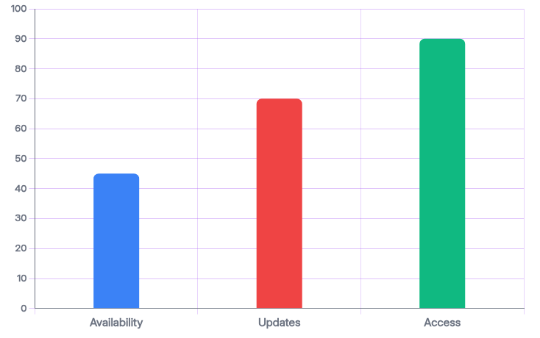
Website Av
The DP World Documentation Centre website may experience suspensions or restrictions without guaranteed uptime. Major update
Website Availability
Website Availability: May experience suspensions or restrictions at
Major Updates
Major Updates: Communicated in advance to ensure user preparedness
Free Access for Users
Free Access: Available to registered users for all content and
Notes:
The DP World Documentation Centre website may experience suspensions or restrictions without guaranteed uptime. Major updates are communicated in advance to ensure user preparedness. Free access to all content and tools is available to registered users. This slide highlights website availability, update communication, and access details for registered users.

Slide 4

Intellectual Prop
1
Ownership & Licen
1
Ownership & Licen
DP World retains ownership or licensing rights for all intellectual property on the platform. Users may print or download c
DP World retains ownership or licensing rights for all intellectual property on the platform. Users may print or download c
1
Ownership & Licen
1
Ownership & Licen
DP World retains ownership or licensing rights for all intellectual property on the platform. Users may print or download c
DP World retains ownership or licensing rights for all intellectual property on the platform. Users may print or download c
Notes:
This slide outlines DP World's intellectual property policies: 1) They retain ownership of all platform content, 2) Users may print/download for personal use, 3) Uploaded content is non-confidential, and 4) Users retain ownership but must agree to DP World's public usage terms.

