Slide 1

DP World DocsHub
Central hub for trade compliance and operational guidelines, enhancing global logistics and supply chain efficiency through standardized resources accessible via DP World’s digital platforms.
Notes:
This slide introduces the DP World Documentation Centre as a central hub for trade compliance and operational guidelines. It supports global logistics and supply chain efficiency through standardized resources accessible via DP World’s digital platforms. The presentation covers its role, legal framework, access policies, and user guidelines for compliance and operational efficiency.

Slide 2



Legal Framework &
Term
Description
Legal Basis
Contact
Dispute Resolution
UAE Law Applies
UAE Law
External Content Use
Prior Approval Required
Contractual Obligations
Licensing Inquiries
Email: [email protected]
Legal Terms
Compliance Note
Review Terms Before Use
Legal Agreement
Users must adhere to UAE legal framework for dispute resolution and contractual obligations. External content use requires prior approval. Licensing inquiries should be directed to the specified email for full
Notes:
This slide outlines the legal framework governing the DP World Documentation Centre. Emphasize key points: UAE law for disputes, prior approval for external content, and email contact for licensing. Highlight compliance requirements for users to avoid contractual violations.

Slide 3
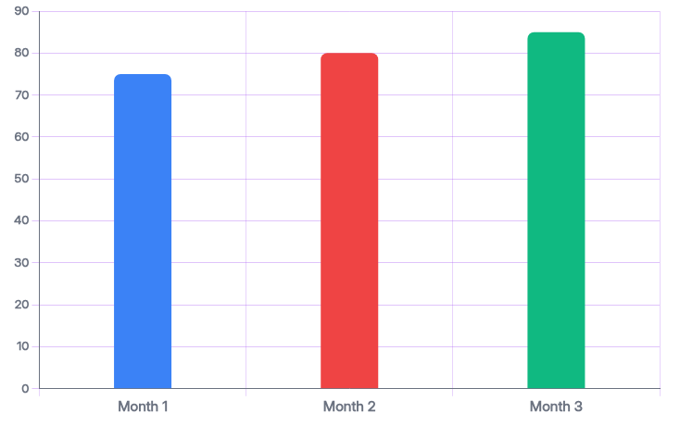
Website A
The platform offers free, dynamic access with periodic updates to ensure relevance. However, service suspensions or r
Access Notice
Service availability may change without prior notice.
Data Retention
Content retention is not guaranteed.
Platform Updates
Periodic updates ensure relevance.
Notes:
This slide outlines the platform's access policy, emphasizing free dynamic access with periodic updates, potential service disruptions without prior notice, and the lack of guaranteed content retention. Visuals support key data points about access rates and service notices.

Slide 4

User Guidelines &
1.
Personal Use Per
1.
Personal Use Per
Users may print, download, or share extracts for personal use only.
Users may print, download, or share extracts for personal use only.
1.
Personal Use Per
1.
Personal Use Per
Users may print, download, or share extracts for personal use only.
Users may print, download, or share extracts for personal use only.
Notes:
Emphasize compliance requirements: personal use limits, prohibition on commercial reuse, user accountability for content, and retention of intellectual property rights by DP World.

