Slide 1

Global Standards
This presentation outlines DP World's global standard conditions covering website use terms, jurisdictional frameworks, content policies, compliance requirements, and service availability. Key topics include:
Notes:
Presenter Name: [Presenter Name] | Date: 2026-07-11. This slide introduces the framework for DP World's global standard conditions, emphasizing legal compliance, user responsibilities, and service availability. Key elements include website terms, jurisdictional considerations, content policies, and compliance protocols across international operations.

Slide 2

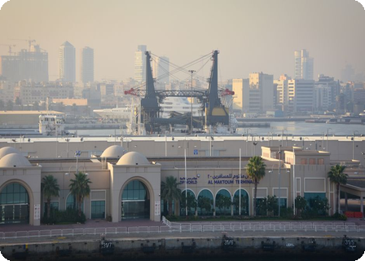
DPWorld
These terms govern website usage, apply to all users, and resolve disputes under UAE law, aligning with local regulations иt
UAE Law
Dispute resolution follows UAE law, ensuring compliance with local regulations and consumer right
Standard
Global terms apply uniformly to all users, maintaining consistency across international platforms
Notes:
This slide outlines DP World's global terms and conditions registered in the UAE. Key points: Terms govern website usage for all users, disputes resolved under UAE law, and alignment with local regulations. Contact details are provided for user inquiries. The visual reinforces DP World's international business presence.

Slide 3



Website Use & Jurison
Website access is subject to these terms, outlining user responsibilities and dispute resolution. For additional requests, contact [email protected]. UAE law governs all legal matters,包括
User Respns
Dispute Reso
Mndt
UAE
Notes:
This slide outlines the terms and jurisdiction for website access, emphasizing user responsibilities, dispute resolution processes, and the applicability of UAE law to ensure compliance with regional standards. Contact [email protected] for additional requests.

Slide 4
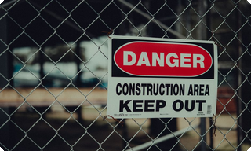
Website & Third-
1
Website Avail
1
Website Avail
Website availability may be suspended or restricted without notice.
Website availability may be suspended or restricted without notice.
1
Website Avail
1
Website Avail
Website availability may be suspended or restricted without notice.
Website availability may be suspended or restricted without notice.
Notes:
Slide content: Website availability may be suspended or restricted without prior notice. Third-party links are provided for informational purposes only. DP World disclaims liability for external content, emphasizing that users assume responsibility for verifying external sources.

