Slide 1
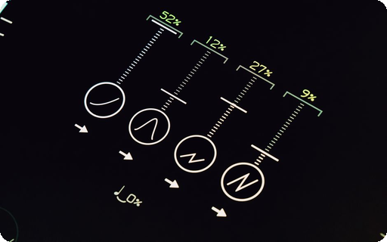
Direct API Probe
This session validates the end-to-end workflow from creation to export. Key objectives: demonstrate API functionality, ensure data accuracy, and confirm export reliability. Automated steps ensure consistency &
Notes:
This slide introduces the Direct Presenton API Probe, validating the end-to-end workflow from creation to export. Key objectives include demonstrating API functionality, ensuring data accuracy, and confirming export reliability. All steps are automated to ensure consistency and efficiency in content generation. Presenter: [Your Name], Date: 2026-07-11

Slide 2


Workf
1. Create: Input data is structured and validated. 2. Prepare: Content is formatted and optimized. 3. Generate: Slides are 4
Generate
Automated content placement with styling ensures visual consistency across all stages
Export
Export final output in PDF/PPTX formats while preserving metadata integrity
Notes:
This slide demonstrates an automated workflow with four interconnected stages. The system validates input data, formats content, produces slides with automated styling, and exports final outputs in multiple formats. All stages operate seamlessly without manual intervention, ensuring consistency and efficiency in the production process.

