Slide 1

Hello fromDirect
This presentation validates the Create->Prepare->Generate->Export pipeline workflow through API probe engagement, setting stage for technical demonstrations and workflow validation
Notes:
This slide introduces the API probe's role in validating the full pipeline workflow. Emphasize the technical demonstration aspect and pipeline validation objectives. Keep explanation concise to maintain slide brevity.

Slide 2
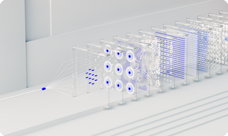
Pipeline Valid
1
Create Data
1
Create Data
Establishes data sources, ensuring accuracy and compliance with system standards
Establishes data sources, ensuring accuracy and compliance with system standards
1
Create Data
1
Create Data
Establishes data sources, ensuring accuracy and compliance with system standards
Establishes data sources, ensuring accuracy and compliance with system standards
Notes:
This slide outlines the four-phase pipeline validation process. Each stage—from data creation to system export—is rigorously tested for accuracy, efficiency, and compliance. The workflow ensures seamless integration while maintaining technical standards across all system interactions.

