Slide 1


Digital Forensics [Braindump]
Presented by CryptoJones
Taken from
CYBER502x @

Slide 2





CryptoJones (aaronkclark)
CSE II@ AWS Startup in Florida
Graduate Student at RIT & WGU
KernelCon 2019 was my first Hacker Convention!
aaronkclark
aaronkclark
CryptoJones
cryptojones@owasp.org

Slide 3
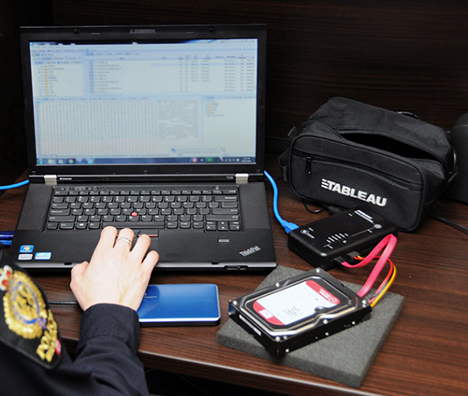
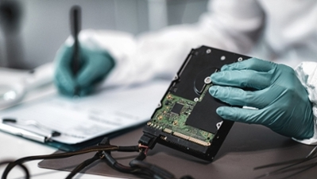

Forensics Introduction:
What, Who, How, & Why

Slide 4
What is forensics?
• “Gathering and analyzing data in a manner as free from distortion or bias as possible to reconstruct data or what has happened in the past on a system”
--Farmer and Venema, 1999**
• A science and process of collecting, preserving, analyzing and reporting legally admissible evidence to court

Slide 5
Four steps in Digital Forensics?
Collect
Preserve
Analyze
Present (report)

Slide 6
Types of Digital Forensics
Computer Forensics (*nix, Windows, etc.)
(Includes Memory Forensics)
Mobile Device Forensics
Network Forensics

Slide 7

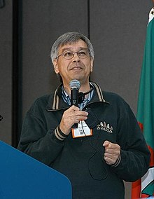
Who does forensics?
Tools Pioneered by Dan Farmer and Wietse Venema
They first released “The Coroner’s Toolkit” (TCT) for a Computer Forensics Analysis class in August 1999

Slide 8

Who does forensics now?
Computer Security experts who serve as “expert witnesses”:
• follow the procedures of the court
• testify on the scientific basis of findings, analyses, and conclusions
• demonstrate the scientific knowledge associated within DF

Slide 9
How
Document everything (establish chain of custody)
Use write-blockers *legal evidence is required to be tamper-free*
Acquire VOLITILE Forensic Data
Acquire NON-VOLITILE Forensic Data
Preserve Forensic Data
Analyze the copy of Forensic data, original goes into evidence storage
Write the report (If it was fun, everyone would do it)
Testify in court

Slide 10
How (Continued?
We use MULTIPLE hashes to verify evidence matches forensic copy
(Non-repudiation)
Multiple Software Tools:
SANS SIFT, FTK Imager, dd, Volatility Framework, E-Fense Live Response, F-Response, LiME, SluethKit + Autopsy, Foremost, Helix Pro, Volatility, MoonSols’ Dumpit, Winen, Redline (FireEye), Rekall Memory Forensics Framework

Slide 11
Why is it done?
“[Computer Security] isn’t all sunshine and […] rainbows” ~Aaron G.
As evidence for non-electronic crimes
As evidence in civil litigation
Computer Hacking (malware, backdoors)
Child Sexual Exploitation Material (digitized images, audio files)

Slide 12
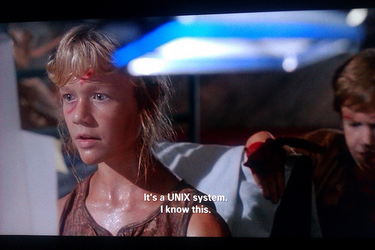

Linux/Unix Forensics:

Slide 13

Rules of Acquisitions
Volatile First ->
Non-Volatile Second ->
Everything Else Last (CD-ROMs, physical print outs, etc,)

Slide 14
Acquire RAM with physical access
Memdump for Linux, Unix, BSD
Linux Memory Extractor (LiME)
Fmem
Kernel module fmem.ko that creates device /dev/fmem
sudo dd if=/dev/fmem of=mem.dd

Slide 15
F-Response for remote acquisition
F-Response from https://www.f-response.com/
Use dual-dongle to conduct remote forensic acquisition of memory and disks
One dongle for subject system
One dongle for examiner system

Slide 16
More volatile data
In addition to RAM contents volatile information includes current open files, network connections, logged in users, etc.

Slide 17
Network connections
Netstat (network statistics)
Lsof (list open files)

Slide 18
netstat (network statistics)
netstat -pt : To display the PID and program names.
# netstat -pt : To display the PID and program names.
netstat –at (all tcp ports listening)
netstat –au (all udp ports listening)
netstat –l (all listening connections)
netstat –tp (show pid / process name)

Slide 19
lsof (list open files)
(Includes regular files, directories, block file, etc.)
lsof (list all open files)
lsof –i [ip address] (internet connections belonging to ip)
lsof /dev/hda3 (all open files on this device)
lsof /home/cryptojones/malware_injector.sh (all proceses that have this file open)

Slide 20
More non-volatile data
In addition to RAM contents volatile information includes current open files, network connections, logged in users, etc.

Slide 21
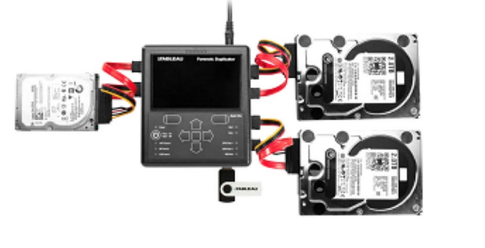
Write Blockers to prevent modification of subject data
Software Write Blocker
EnCase FastBloc SE
SAFE Block Win8
Unix utility dd
Hardware Write Blocker
H/W Bridge that connects evidence disk with Forensics WS
fastBloc, UltraBlock
Guidance Software Forensic Bridge (T8u, T35u, T6es, etc.)

Slide 22
Hard Drive Imaging
Bitstream copy gets every single bit on Hard disk
FTK Imager
High-Speed Hardware Imagers (The best) Tableau series for example[1]
Unix utility dd
[1] TD2u Informational and Setup (opentext.com)

Slide 23

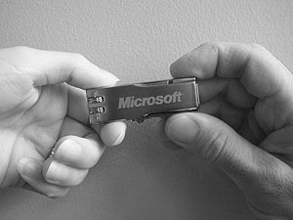
Windows Forensics

Slide 24
Volatile Data
For RAM use tools (Helix Pro, MemoryDD, FTK Imager, Live Ram Capture, WindowsScope)
Network connections (Netstat,
Processes (Psinfo, Pstools)
Loaded DLLs
Windows Registry

Slide 25

Anti-Digital Forensics

Slide 26
Anti-Digital Forensics
Designed to thwart discovery of information about activities on system or network
Manipulate, erase, or obfuscate digital data
Make its examination difficult, time consuming, or practically impossible

Slide 27
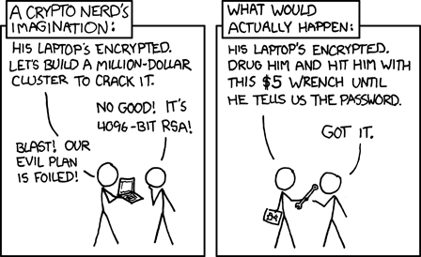
Full Disk Encryption (FDE)
Makes entire drive practically unreadable outside the system
Cold-boot attack can potentially extract encryption keys from memory
Not Foolproof

Slide 28
Changing Timestamps
Timestomp – Change MACE values
Touch (*nix)
SetMACE
Disable Timestamps (Prefetch) Windows
Disable Timestamps (Last Access Time) Windows

Slide 29
Onion Routing / VPNs
Used to counter ISP network forensics/history
Not fool proof (outside the scope of this course)

Slide 30
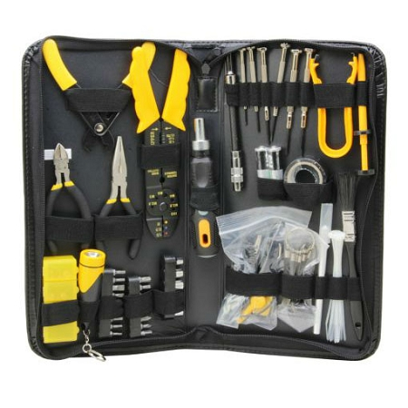
Software Tools Recap

Slide 31
SIFT Workstation (SANS)
Live distro based on Ubuntu
Contains:
The Sleuth Kit (file system analysis tools)
Plaso and log2timeline (timeline generation tool)
ssdeep & md5deep (hashing tools)
Foremost/Scalpel (file carving)
Volatility Framework (memory analysis)
Autopsy (GUI front-end for Sleuthkit)
https://www.sans.org/tools/sift-workstation/

Slide 32
LiME
Linux Memory Extractor (Like Fmem)
Uses kernel module to extract memory
Can then be passed off to volatility for analysis
https://github.com/504ensicsLabs/LiME

Slide 33
Volatility
Volatility Framework
Used for RAM Extractration
Supports Windows, Linux, and MacOS
V3 re-written in python and made open-source
https://www.volatilityfoundation.org/releases

Slide 34
FTK Imager
Made by AccessData Software
A stand-alone disk imager that also comes as part of the Forensics Tool Kit (FTK)
Calculates hashes in both MD5 and SHA1 (Non-repudiation)
https://accessdata.com/products-services/forensic-toolkit-ftk

Slide 35
Helix
Original Free Memory Extraction Tool
Can still find version 2008R1.iso on the internet
Version 3 went paid (PRO) and (ENT)
Can’t buy product anymore (Site doesn’t work)
http://www.e-fense.com/h3

Slide 36
E-Fense Live Response
Acquires volatile from a system onto a USB thumb drive with Live Response
Built on Helix 3 Enterprise
http://www.e-fense.com/live-response.php

Slide 37
F-Response
Range of paid tools that do digital forensics
The benefit of this tool is it does memory/file analysis OVER the network
https://www.f-response.com/software/productmatrix

Slide 38


SluethKit + Autopsy
Free/OpenSource
SleuthKit is the command line tools that allow you to analyze disk images and recover files
Autopsy is the GUI Frontend for Sleuthkit
https://www.sleuthkit.org/index.php

Slide 39
Foremost
Freeware Console Program that does Data Carving and File Recovery
http://foremost.sourceforge.net/

Slide 40
MoonSols’ Dumpit
Free version
Memory Dump Tool
Can’t find a link for it

Slide 41
Winen
Stand-Alone Memory Extraction tool from EnCase
Included in Helix

Slide 42
Redline (FireEye)
Freeware
Thoroughly audit and collect all running processes and drivers from memory, file-system metadata, registry data, event logs, network information, services, tasks and web history.
Analyze and view imported audit data, including the ability to filter results around a given timeframe using Redline’s Timeline functionality with the TimeWrinkle™ and TimeCrunch™ features.
Streamline memory analysis with a proven workflow for analyzing malware based on relative priority.
Perform Indicators of Compromise (IOC) analysis. Supplied with a set of IOCs, the Redline Portable Agent is automatically configured to gather the data required to perform the IOC analysis and an IOC hit result review.
https://www.fireeye.com/services/freeware/redline.html

Slide 43
Rekall Memory Forensics Framework
Started out as memory extraction
Ballooned into entire framework
https://github.com/google/rekall

Slide 44
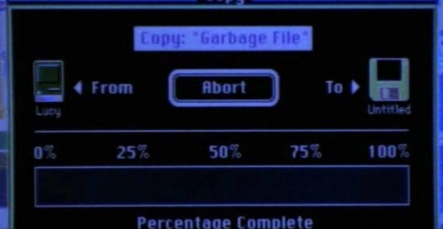
Forensics Conclusion:

Slide 45
ProTips:
Always have your OWN tool sets ready
Assume you are dealing with a compromised system
Run tools from your own USB or device
Save the output outside of the compromised system

Slide 46
ProTips:
If you have a copy of volatile memory pull the power cord
Cleaning shutting down a system may trigger scripts or programs to delete traces of a system compromise

Slide 47
ProTips:
ALWAYS!!!
use a write blocker

Slide 48
ProTips:
WIPE THE DRIVE BEFORE
you write forensics data to it

Slide 49
The End
Questions?

