Slide 1

Introduction to the OWASP TOP TEN
OWASP Omaha 2ND QTR 2021

Slide 2
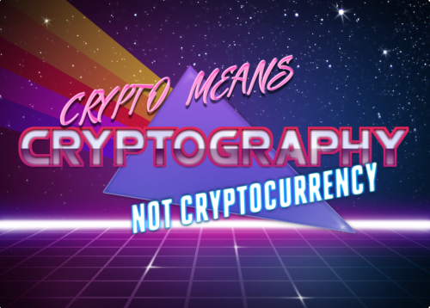
Who is CryptoJones?
Aaron K. Clark
Made the Handle in 1995 (Dial-up BBS Days)
Crypto == Cryptography
Jones == Indiana Jones
Now a Graduate Student @ RIT/WGU
cryptojones@owasp.org
linkedin.com/in/aaronkclark
twitter.com/aaronkclark
github.com/CryptoJones (<- Slide Deck Here)

Slide 3
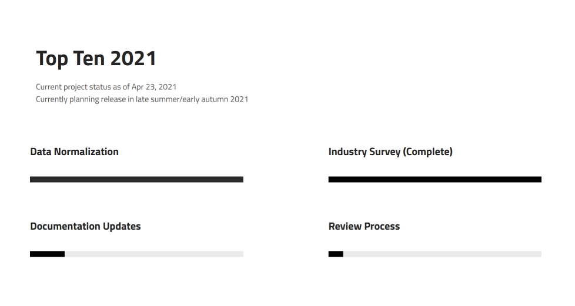
BLUF – Bottom Line Up Front
This presentation is the (2017) v.
Application Security Risks
Collective Product of feedback from security experts globally
2021 version coming Soon™ (possibly this summer, probably fall)
Brand new site https://www.owasptopten.org

Slide 4
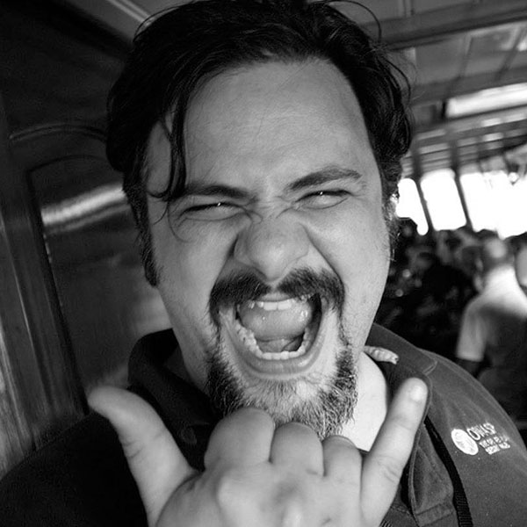

Thank you, Jim Manico!
Met him at AppSec Cali 2019
Taught me everything I know about the Top Ten
OWASP Global Leader
jim@manicode.com

Slide 5
Questions?

