Slide 1

Introduction to the OWASP TOP TEN
OWASP Omaha 2ND QTR 2021

Slide 2


Who is CryptoJones?
Aaron K. Clark
Made the Handle in 1990s (Dial-up BBS Days)
Crypto == Cryptography
Jones == Indiana Jones (Don’t judge, I was a pre-teen)
Now a Graduate Student @ RIT & WGU
cryptojones@owasp.org
linkedin.com/in/aaronkclark
twitter.com/aaronkclark
github.com/CryptoJones (<- Slide Deck Here)

Slide 3
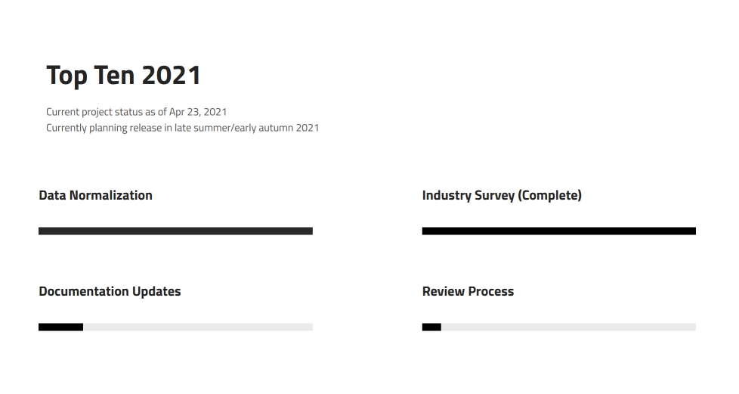
BLUF – Bottom Line Up Front
This presentation is the (2017) v.
Application Security Risks
Collective Product of feedback from security experts globally
2021 version coming Soon™ (possibly this summer, probably fall)
Brand new site https://www.owasptopten.org

Slide 4
A1:2017 – Injection
Gross boys always follow last place in sending pics
Pack my box with five dozen liquor jugs
The quick brown fox jumped of the lazy dog
Gross boys always follow last place in sending pics
Pack my box with five dozen liquor jugs
The quick brown fox jumped of the lazy dog

Slide 5
A1:2017 – Injection (Mitigations)
Gross boys always follow last place in sending pics
Pack my box with five dozen liquor jugs
The quick brown fox jumped of the lazy dog
Gross boys always follow last place in sending pics
Pack my box with five dozen liquor jugs
The quick brown fox jumped of the lazy dog

Slide 6
A1:2017 – Injection (Guidance)
Gross boys always follow last place in sending pics
Pack my box with five dozen liquor jugs
The quick brown fox jumped of the lazy dog
Gross boys always follow last place in sending pics
Pack my box with five dozen liquor jugs
The quick brown fox jumped of the lazy dog

Slide 7
A2:2017 – Broken Authentication & Session Management
Gross boys always follow last place in sending pics
Pack my box with five dozen liquor jugs
The quick brown fox jumped of the lazy dog
Gross boys always follow last place in sending pics
Pack my box with five dozen liquor jugs
The quick brown fox jumped of the lazy dog

Slide 8
A2:2017 – Broken Authentication & Session Management (Mitigations)
Gross boys always follow last place in sending pics
Pack my box with five dozen liquor jugs
The quick brown fox jumped of the lazy dog
Gross boys always follow last place in sending pics
Pack my box with five dozen liquor jugs
The quick brown fox jumped of the lazy dog

Slide 9
A2:2017 – Broken Authentication & Session Management (Guidance)
Gross boys always follow last place in sending pics
Pack my box with five dozen liquor jugs
The quick brown fox jumped of the lazy dog
Gross boys always follow last place in sending pics
Pack my box with five dozen liquor jugs
The quick brown fox jumped of the lazy dog

Slide 10
A3:2017 – Sensitive Data Exposure
Gross boys always follow last place in sending pics
Pack my box with five dozen liquor jugs
The quick brown fox jumped of the lazy dog
Gross boys always follow last place in sending pics
Pack my box with five dozen liquor jugs
The quick brown fox jumped of the lazy dog

Slide 11
A3:2017 – Sensitive Data Exposure(Mitigations)
Gross boys always follow last place in sending pics
Pack my box with five dozen liquor jugs
The quick brown fox jumped of the lazy dog
Gross boys always follow last place in sending pics
Pack my box with five dozen liquor jugs
The quick brown fox jumped of the lazy dog

Slide 12
A3:2017 – Sensitive Data Exposure(Guidance)
Gross boys always follow last place in sending pics
Pack my box with five dozen liquor jugs
The quick brown fox jumped of the lazy dog
Gross boys always follow last place in sending pics
Pack my box with five dozen liquor jugs
The quick brown fox jumped of the lazy dog

Slide 13
A4:2017 – XML External Entities (XXE)
Gross boys always follow last place in sending pics
Pack my box with five dozen liquor jugs
The quick brown fox jumped of the lazy dog
Gross boys always follow last place in sending pics
Pack my box with five dozen liquor jugs
The quick brown fox jumped of the lazy dog

Slide 14
A4:2017 – XML External Entities (XXE) (Mitigations)
Gross boys always follow last place in sending pics
Pack my box with five dozen liquor jugs
The quick brown fox jumped of the lazy dog
Gross boys always follow last place in sending pics
Pack my box with five dozen liquor jugs
The quick brown fox jumped of the lazy dog

Slide 15
A4:2017 – XML External Entities (XXE) (Guidance)
Gross boys always follow last place in sending pics
Pack my box with five dozen liquor jugs
The quick brown fox jumped of the lazy dog
Gross boys always follow last place in sending pics
Pack my box with five dozen liquor jugs
The quick brown fox jumped of the lazy dog

Slide 16
A5:2017 – Broken Access Control
Gross boys always follow last place in sending pics
Pack my box with five dozen liquor jugs
The quick brown fox jumped of the lazy dog
Gross boys always follow last place in sending pics
Pack my box with five dozen liquor jugs
The quick brown fox jumped of the lazy dog

Slide 17
A5:2017 – Broken Access Control (Mitigations)
Gross boys always follow last place in sending pics
Pack my box with five dozen liquor jugs
The quick brown fox jumped of the lazy dog
Gross boys always follow last place in sending pics
Pack my box with five dozen liquor jugs
The quick brown fox jumped of the lazy dog

Slide 18
A5:2017 – Broken Access Control (Guidance)
Gross boys always follow last place in sending pics
Pack my box with five dozen liquor jugs
The quick brown fox jumped of the lazy dog
Gross boys always follow last place in sending pics
Pack my box with five dozen liquor jugs
The quick brown fox jumped of the lazy dog

Slide 19
A6:2017 – Security Misconfigurations
Gross boys always follow last place in sending pics
Pack my box with five dozen liquor jugs
The quick brown fox jumped of the lazy dog
Gross boys always follow last place in sending pics
Pack my box with five dozen liquor jugs
The quick brown fox jumped of the lazy dog

Slide 20
A6:2017 – Security Misconfigurations (Mitigations)
Gross boys always follow last place in sending pics
Pack my box with five dozen liquor jugs
The quick brown fox jumped of the lazy dog
Gross boys always follow last place in sending pics
Pack my box with five dozen liquor jugs
The quick brown fox jumped of the lazy dog

Slide 21
A6:2017 – Security Misconfigurations (Guidance)
Gross boys always follow last place in sending pics
Pack my box with five dozen liquor jugs
The quick brown fox jumped of the lazy dog
Gross boys always follow last place in sending pics
Pack my box with five dozen liquor jugs
The quick brown fox jumped of the lazy dog

Slide 22
A7:2017 – Cross Site Scripting (XSS)
Gross boys always follow last place in sending pics
Pack my box with five dozen liquor jugs
The quick brown fox jumped of the lazy dog
Gross boys always follow last place in sending pics
Pack my box with five dozen liquor jugs
The quick brown fox jumped of the lazy dog

Slide 23
A7:2017 – Cross Site Scripting (XSS) (Mitigations)
Gross boys always follow last place in sending pics
Pack my box with five dozen liquor jugs
The quick brown fox jumped of the lazy dog
Gross boys always follow last place in sending pics
Pack my box with five dozen liquor jugs
The quick brown fox jumped of the lazy dog

Slide 24
A7:2017 – Cross Site Scripting (XSS) (Guidance)
Gross boys always follow last place in sending pics
Pack my box with five dozen liquor jugs
The quick brown fox jumped of the lazy dog
Gross boys always follow last place in sending pics
Pack my box with five dozen liquor jugs
The quick brown fox jumped of the lazy dog

Slide 25
A8:2017 – Insecure Deserialization
Gross boys always follow last place in sending pics
Pack my box with five dozen liquor jugs
The quick brown fox jumped of the lazy dog
Gross boys always follow last place in sending pics
Pack my box with five dozen liquor jugs
The quick brown fox jumped of the lazy dog

Slide 26
A8:2017 – Insecure Deserialization (Mitigations)
Gross boys always follow last place in sending pics
Pack my box with five dozen liquor jugs
The quick brown fox jumped of the lazy dog
Gross boys always follow last place in sending pics
Pack my box with five dozen liquor jugs
The quick brown fox jumped of the lazy dog

Slide 27
A8:2017 – Insecure Deserialization (Guidance)
Gross boys always follow last place in sending pics
Pack my box with five dozen liquor jugs
The quick brown fox jumped of the lazy dog
Gross boys always follow last place in sending pics
Pack my box with five dozen liquor jugs
The quick brown fox jumped of the lazy dog

Slide 28
A9:2017 - Using Components w/ Known Vulns
Gross boys always follow last place in sending pics
Pack my box with five dozen liquor jugs
The quick brown fox jumped of the lazy dog
Gross boys always follow last place in sending pics
Pack my box with five dozen liquor jugs
The quick brown fox jumped of the lazy dog

Slide 29
A9:2017 - Using Components w/ Known Vulns (Mitigations)
Gross boys always follow last place in sending pics
Pack my box with five dozen liquor jugs
The quick brown fox jumped of the lazy dog
Gross boys always follow last place in sending pics
Pack my box with five dozen liquor jugs
The quick brown fox jumped of the lazy dog

Slide 30
A9:2017 - Using Components w/ Known Vulns (Guidance)
Gross boys always follow last place in sending pics
Pack my box with five dozen liquor jugs
The quick brown fox jumped of the lazy dog
Gross boys always follow last place in sending pics
Pack my box with five dozen liquor jugs
The quick brown fox jumped of the lazy dog

Slide 31
A10:2017 – Insufficient Logging\Monitoring
Gross boys always follow last place in sending pics
Pack my box with five dozen liquor jugs
The quick brown fox jumped of the lazy dog
Gross boys always follow last place in sending pics
Pack my box with five dozen liquor jugs
The quick brown fox jumped of the lazy dog

Slide 32
A10:2017 – Insufficient Logging\Monitoring (Mitigations)
Don’t IGNORE ALERTS
Pack my box with five dozen liquor jugs
The quick brown fox jumped of the lazy dog
Gross boys always follow last place in sending pics
Pack my box with five dozen liquor jugs
The quick brown fox jumped of the lazy dog

Slide 33
A10:2017 – Insufficient Logging\Monitoring (Guidance)
Gross boys always follow last place in sending pics
Pack my box with five dozen liquor jugs
The quick brown fox jumped of the lazy dog
Gross boys always follow last place in sending pics
Pack my box with five dozen liquor jugs
The quick brown fox jumped of the lazy dog

Slide 34
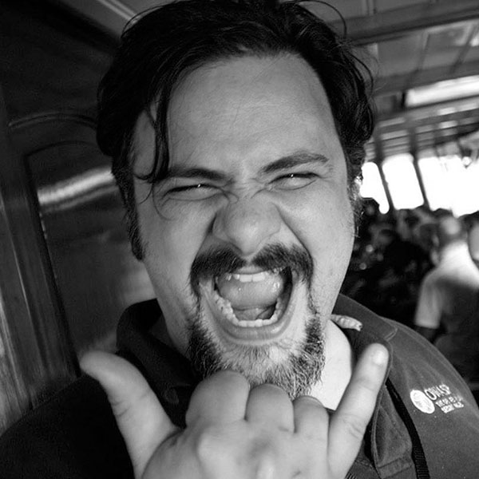

Thank you, Jim Manico!
Met him AppSec Cali 2019
OWASP Global Leader
Taught me everything I know (about the Top Ten)
jim@manicode.com
www.manicode.com
https://www.youtube.com/watch?v=SMcZ0el-9ro

Slide 35
Questions?

