Slide 1
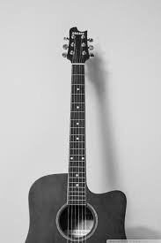
StrumMate Winnovate Systems
ASE Team 33

Slide 2

Team
CEO: Dr. Aznam Yacoub
CTO: Rahul Banerjee
Team members:
1. Srujan Oza , Project Manager
2. Chintal Raval, Technical Lead
3. Anish Patel, Quality Assurance
4. Jhanvi Vadher, Business Analyst
6. Drashti Italiya, Scrum Master
4. Harshil Lukhi , Developer
5. Pheni Patel, Developer
7. Kinjal Doshi, Developer

Slide 3

Problem
A guitarist lost a hand and he would like to play again but his prosthetic is not adaptive. So he wants a solution to play music again.

Slide 4
Mission Statement
Learning to play guitar can be very challenging, even when using both left and right hands.
Due to disability or reduced function in one hand, there are many people who may need to play guitar with one hand.
There are a few techniques which helps them play the instrument using only one hand.
However, it doesn’t give them the pleasure that they feel while playing it with both hands.
We aim to create a system that will allow differently-abled one-handed guitarist to play the guitar comfortably while allowing them to create their own rhythms.

Slide 5
Possible Solutions
Using Infrared Sensors
Using Ultrasonic Sensors
Using Push Buttons
Using Foot Pedals
Desktop Application (Virtual Guitar)

Slide 6
Recommended Solution - Using Foot Pedal
User will be provided 2 different foot pedals.
One foot pedal will be used to control the striking of the guitar. Depending on the amount of pedal pressed, user just needs to hold down the pedal.
Another foot pedal will be used to control the speed of striking. Still, if a user wishes not to control the speed, the guitar can be played at a default speed using just one foot pedal.

Slide 7
Solution Feasibility
Easy to carry around
Designed for both professional and beginner guitarists
Within budget
Comfortable to play for extended period
Comparatively easy to learn

Slide 8
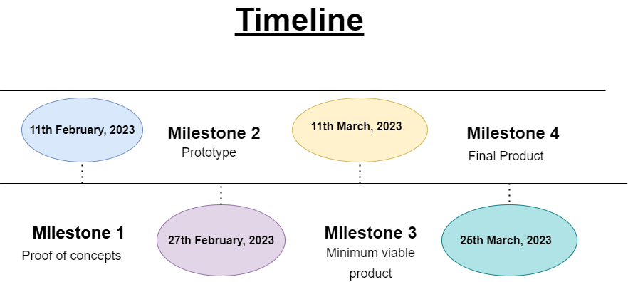

Slide 9
Guitar - 100
Arduino -100
Cables’ set (Connected with Arduino)-20
Breadboard-20
Foot Pedal/Controller-180

Slide 10
Thank you

