Slide 1

Consumer Computer Applications
MODULE 1

Slide 2
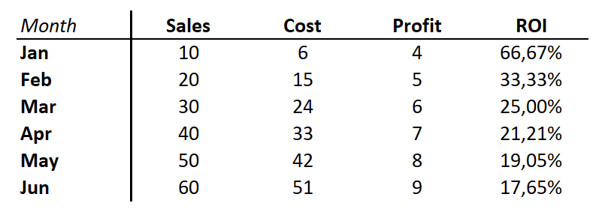
Anatomy of a chart
Series name or Variable
Data Point
Categories
Series

Slide 3
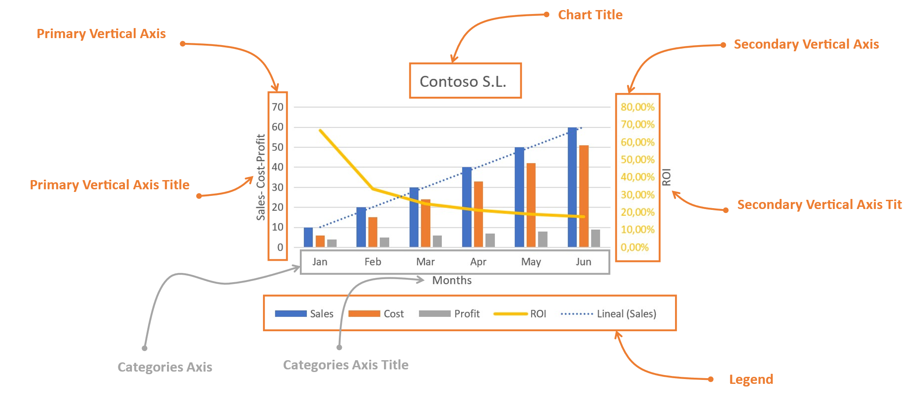
Anatomy of a chart

Slide 5




+
=

Slide 6
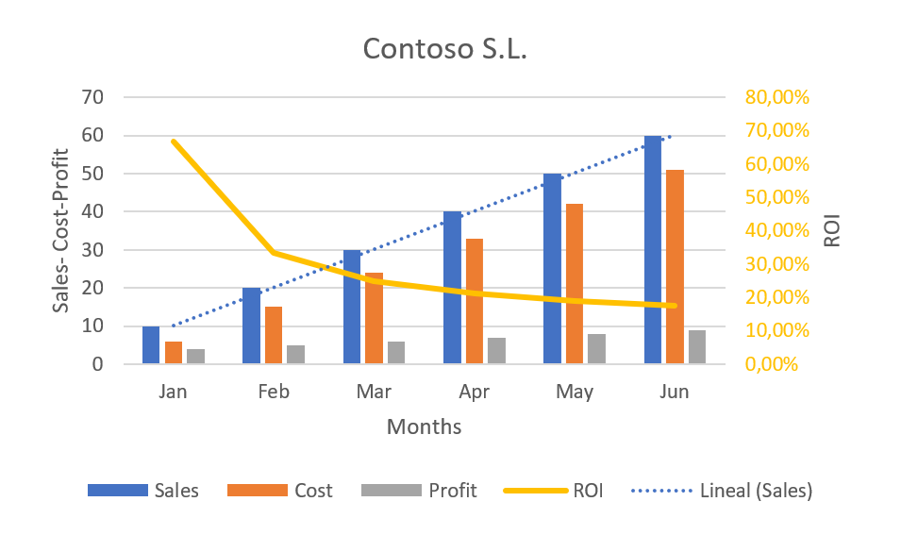
Chart Title
Primary Vertical Axis
Secondary Vertical Axis
Primary Vertical Axis Title
Secondary Vertical Axis Title
Categories Axis
Categories Axis Title
Legend

