Slide 1
Post-Quantum Zero-Knowledge and Signatures from Symmetric-Key Primitives
2019.12.13
한양대학교 수학과
권다운, 박도원
C@mp Lab.

Slide 2
Reference
[IKOS] “Zero-Knowledge from Secure Multiparty Computation (2009)”
Yuval Ishai, Eyal Kushilevitz, Rafail Ostrovsky, Amit Sahai
[GMO] “ZKBoo: Faster Zero-Knowledge for Boolean Circuits (2016)”
Irene Giacomelli, Jesper Madsen, Claudio Orlandi
[CDG] “Post-Quantum Zero-Knowledge and Signatures from Symmetric-Key Primitivies (2017)”
Melissa Chase, David Derler, Steven Goldfeder, Caludio Orlandi,
Sebastian Ramacher, Christian Rechberger, Daniel Slamanig,
Greg Zaverucha

Slide 3
Reference
“Zero-Knowledge from Secure Multiparty Computation (2009)”
  Secure Multiparty Computation을 이용해서 Zero-Knowledge proof protocol을 만들 수 있다.
“ZKBoo: Faster Zero-Knowledge for Boolean Circuits (2016)”
  2009년에 나온 논문을 토대로 실용적인 ZKBoo를 설계.
“Post-Quantum Zero-Knowledge and Signatures from Symmetric-Key Primitivies (2017)”
  ZKBoo를 최적화 하여 ZKB++로 개선 및 서명으로 변환.

Slide 4




$Σ$-protocol
Prover
Verifier
Commitment $"r"$
Challenge $"e"$
Openings $"z"$

Slide 5
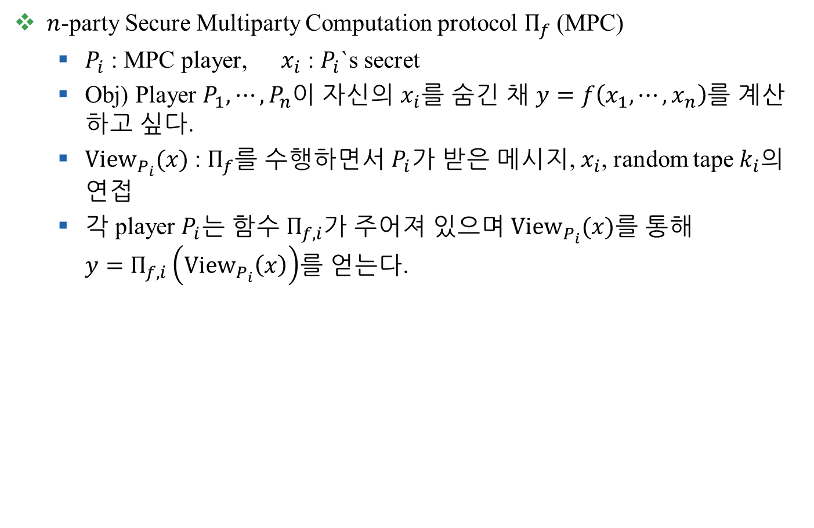
Secure Multiparty Computation (MPC)
$n$-party Secure Multiparty Computation protocol $Π_{f}$ (MPC)
  $P_{i}$ : MPC player, $x_{i}$ : $P_{i}$`s secret
  Obj) Player $P_{1},⋯,P_{n}$이 자신의 $x_{i}$를 숨긴 채 $y=f\left(x_{1},⋯,x_{n}\right)$를 계산하고 싶다.
  ${View}_{P_{i}}(x)$ : $Π_{f}$를 수행하면서 $P_{i}$가 받은 메시지, $x_{i}$, random tape $k_{i}$의 연접
  각 player $P_{i}$는 함수 $Π_{f,i}$가 주어져 있으며 ${View}_{P_{i}}(x)$를 통해
  $y=Π_{f,i}\left({View}_{P_{i}}\left(x\right)\right)$를 얻는다.

Slide 6
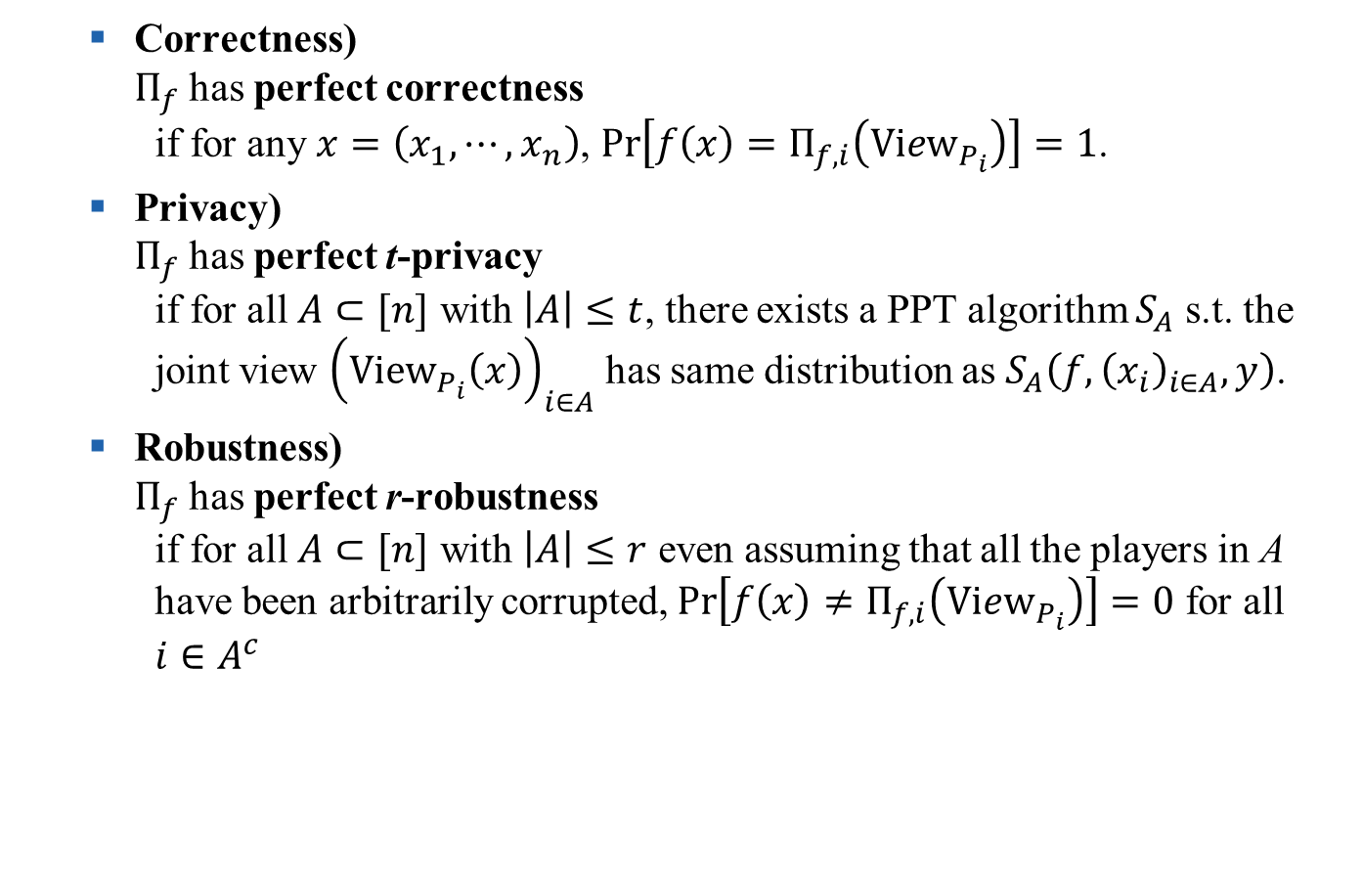
Secure Multiparty Computation (MPC)
  Correctness)
  $Π_{f}$ has perfect correctness
  if for any $x=\left(x_{1},⋯,x_{n}\right)$, $Pr\left[f\left(x\right)=Π_{f,i}\left(View_{P_{i}}\right)\right]=1$.
  Privacy)
  $Π_{f}$ has perfect t-privacy
  if for all $A⊂[n]$ with $\left|A\right|≤t$, there exists a PPT algorithm $S_{A}$ s.t. the
  joint view ${\left({View}_{P_{i}}\left(x\right)\right)}_{i∈A}$ has same distribution as $S_{A}\left(f,{\left(x_{i}\right)}_{i∈A},y\right)$.
  Robustness)
  $Π_{f}$ has perfect r-robustness
  if for all $A⊂[n]$ with $\left|A\right|≤r$ even assuming that all the players in A
  have been arbitrarily corrupted, $Pr\left[f\left(x\right)≠Π_{f,i}\left(View_{P_{i}}\right)\right]=0$ for all
  $i∈A^{c}$

Slide 7

Secure Multiparty Computation (MPC)
  ${View}_{P_{i}}(x)$ and ${View}_{P_{j}}(x)$ is consistent
  if the message reported in ${View}_{P_{j}}(x)$ as incoming from $P_{i}$ are equal to
  the outgoing message implied by ${View}_{P_{i}}(x)$.
  [IKOS] Lemma 2.3.
  All pairs of views are consistent
  $⇔$ there exists an honest execution of $Π_{f}$

Slide 8

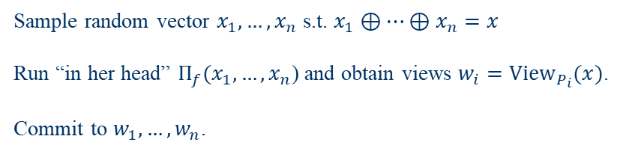



ZK from MPC
IKOS scheme
  Prover P and Verifier V know $y∈L=\left\{z :∃x s.t. R\left(z,x\right)=1\right\}$.
  P knows $x$ s.t. $R\left(y,x\right)=1$ and wants to prove that P know x .
  Prover runs “in her head” $n$-party MPC $Π_{f_{y}}$ and gets views.
  consider $f_{y}\left(x_{1},⋯,x_{n}\right)≔R\left(y,x_{1}⊕⋯⊕x_{n}\right)$
  Prover sends some views to Verifier and Verifier checks it.
$$y∈L, R\left(y,x\right)=1$$
$Π_{f}$: $n$-party MPC protocol with correctness, t-privacy, r-robustness
Prover has $y \& x$
Verifier has $y$
Sample random vector $x_{1}, …,x_{n}$ s.t. $x_{1}⊕…⊕x_{n}=x$
Run “in her head” $Π_{f}(x_{1}, …,x_{n}$) and obtain views $w_{i}=View_{P_{i}}(x)$.
Commit to $w_{1},…, w_{n}$.

Slide 9



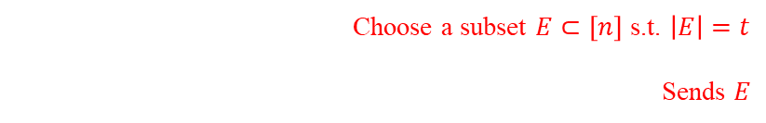


ZK from MPC
IKOS scheme
  Prover P and Verifier V know $y∈L=\left\{z :∃x s.t. R\left(z,x\right)=1\right\}$.
  P knows $x$ s.t. $R\left(y,x\right)=1$ and wants to prove that P know x .
$$y∈L, R\left(y,x\right)=1$$
$Π_{f}$: $n$-party MPC protocol with correctness, t-privacy, r-robustness
Prover has $y \& x$
Verifier has $y$
Choose a subset $E⊂\left[n\right]$ s.t. $\left|E\right|=t$
Sends $E$
Reveals $w_{e}$ for all $e∈E$

Slide 10

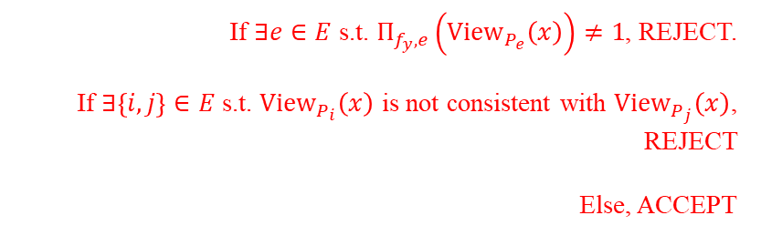


ZK from MPC
IKOS scheme
  Prover P and Verifier V know $y∈L=\left\{z :∃x s.t. R\left(z,x\right)=1\right\}$.
  P knows $x$ s.t. $R\left(y,x\right)=1$ and wants to prove that P know x .
$$y∈L, R\left(y,x\right)=1$$
$Π_{f}$: $n$-party MPC protocol with correctness, t-privacy, r-robustness
Prover has $y \& x$
Verifier has $y$
If $∃e∈E$ s.t. $Π_{f_{y},e}\left({View}_{P_{e}}\left(x\right)\right)≠1$, REJECT.
If $∃\left\{i,j\right\}∈E$ s.t. ${View}_{P_{i}}\left(x\right)$ is not consistent with ${View}_{P_{j}}\left(x\right)$, REJECT
Else, ACCEPT

Slide 11

ZK from MPC
  Completeness
  Since $Π_{f}$ is perfectly correct and views are produced by honest execution, the ZK protocol is correct.
  Zero-Knowledge
  Since $Π_{f}$ has t-privacy, Verifier cannot know about $x$.

Slide 12
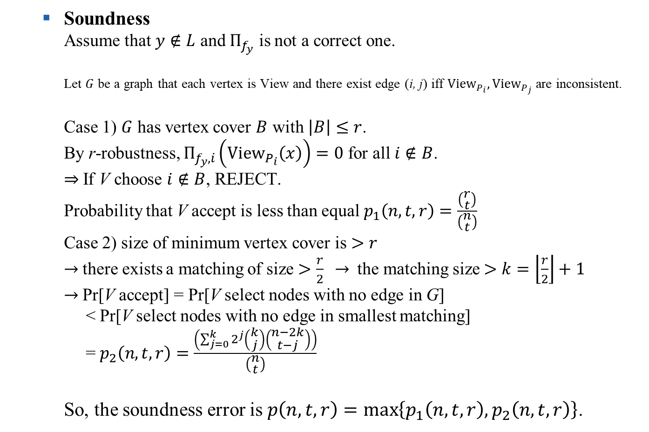
ZK from MPC
  Soundness
  Assume that $y∉L$ and $Π_{f_{y}}$ is not a correct one.
  Let $G$ be a graph that each vertex is View and there exist edge (i, j) iff ${View}_{P_{i}},{View}_{P_{j}}$ are inconsistent.
  Case 1) $G$ has vertex cover $B$ with $\left|B\right|≤r$.
  By r-robustness, $Π_{f_{y},i}\left({View}_{P_{i}}\left(x\right)\right)=0$ for all $i∉B$.
  $⇒$If V choose $i∉B$, REJECT.
  Probability that V accept is less than equal $p_{1}\left(n,t,r\right)=\frac{\left(\begin{aligned}r \\ t\end{aligned}\right)}{\left(\begin{aligned}n \\ t\end{aligned}\right)}$
  Case 2) size of minimum vertex cover is $>r$
  $→$ there exists a matching of size $>\frac{r}{2}$ $→$ the matching size $>k=\left\lfloor \frac{r}{2}\right\rfloor +1$
  $→$ Pr[V accept] = Pr[V select nodes with no edge in G]
  < Pr[V select nodes with no edge in smallest matching]
  = $p_{2}\left(n,t,r\right)=\frac{\left(\sum_{j=0}^{k}{2^{j}\left(\begin{aligned}k \\ j\end{aligned}\right)\left(\begin{aligned}n−2k \\ t−j\end{aligned}\right)}\right)}{\left(\begin{aligned}n \\ t\end{aligned}\right)}$
  So, the soundness error is $p\left(n,t,r\right)=\max\left\{p_{1}\left(n,t,r\right),p_{2}\left(n,t,r\right)\right\}$.

Slide 13
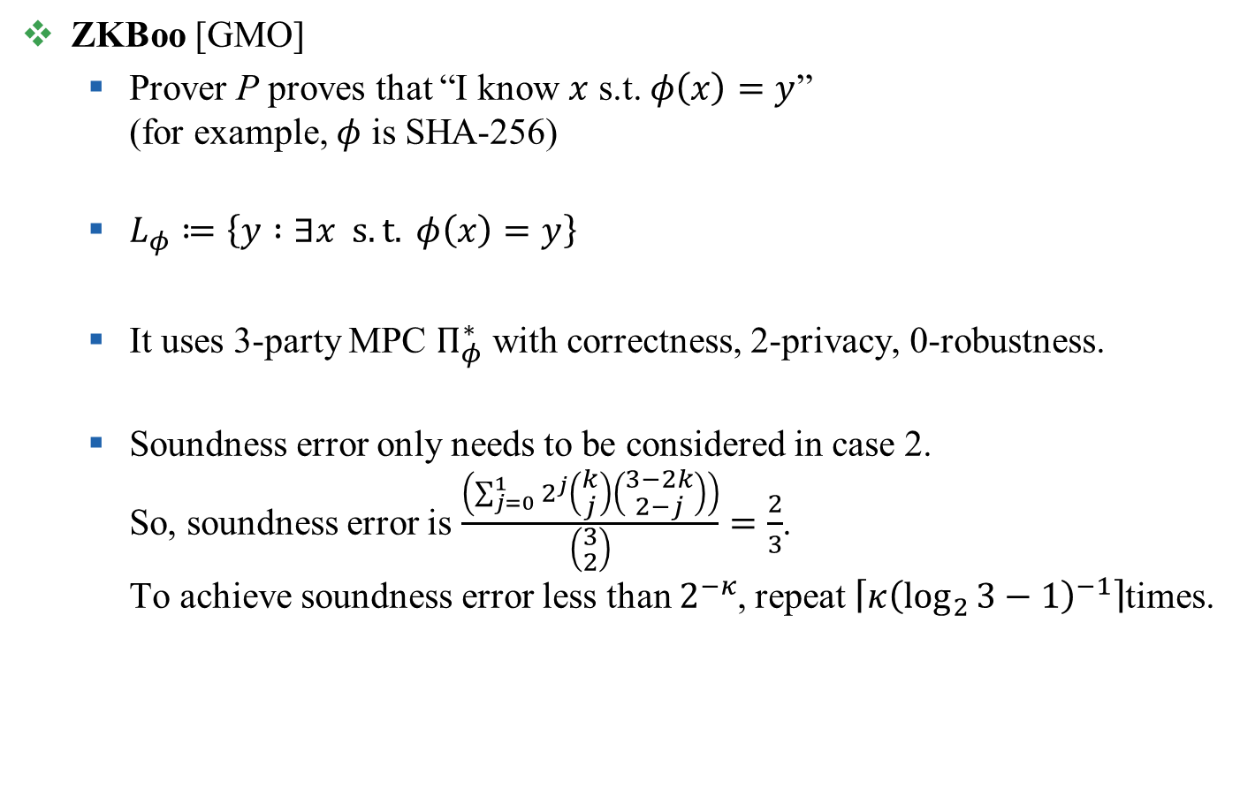
ZKBoo
ZKBoo [GMO]
  Prover P proves that “I know $x$ s.t. $φ\left(x\right)=y$”
  (for example, $φ$ is SHA-256)
  $L_{φ}≔\left\{y :∃x s.t. φ\left(x\right)=y\right\}$
  It uses 3-party MPC $Π_{φ}^{∗}$ with correctness, 2-privacy, 0-robustness.
  Soundness error only needs to be considered in case 2.
  So, soundness error is $\frac{\left(\sum_{j=0}^{1}{2^{j}\left(\begin{aligned}k \\ j\end{aligned}\right)\left(\begin{aligned}3−2k \\ 2−j\end{aligned}\right)}\right)}{\left(\begin{aligned}3 \\ 2\end{aligned}\right)}=\frac{2}{3}$.
  To achieve soundness error less than $2^{−κ}$, repeat $\left\lceil κ{\left(\log_{2}{3}−1\right)}^{−1}\right\rceil$times.

Slide 14










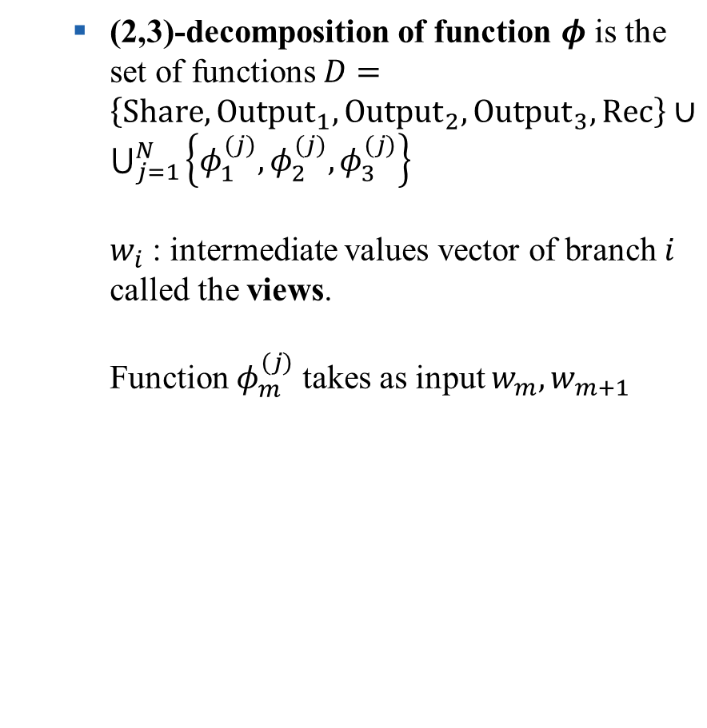




















ZKBoo
  (2,3)-decomposition of function $φ$ is the set of functions $D=\left\{Share, {Output}_{1}, {Output}_{2}, {Output}_{3}, Rec\right\}∪\bigcup_{j=1}^{N}{\left\{φ_{1}^{(j)},φ_{2}^{(j)},φ_{3}^{(j)}\right\}}$
  $w_{i}$ : intermediate values vector of branch $i$ called the views.
  Function $φ_{m}^{(j)}$ takes as input $w_{m},w_{m+1}$
$$x$$
Share
$$x_{1}$$
$$x_{2}$$
$$x_{3}$$
$$w_{1}\left[0\right]=x_{1}$$
$$w_{2}\left[0\right]=x_{2}$$
$$w_{3}\left[0\right]=x_{3}$$
$$φ_{1}^{(1)}$$
$$φ_{2}^{(1)}$$
$$φ_{3}^{(1)}$$
$$w_{1}\left[1\right]$$
$$w_{2}\left[1\right]$$
$$w_{3}\left[1\right]$$
$$φ_{1}^{(2)}$$
$$φ_{2}^{(2)}$$
$$φ_{3}^{(2)}$$
$$w_{1}\left[2\right]$$
$$w_{2}\left[2\right]$$
$$w_{3}\left[2\right]$$
…
…
…
$$w_{1}$$
$$w_{2}$$
$$w_{3}$$
$$Output_{1}$$
$$Output_{2}$$
$$Output_{3}$$
$$y_{1}$$
$$y_{2}$$
$$y_{3}$$
$$Rec$$
$$y$$

Slide 15


ZKBoo
  protocol $Π_{φ}^{∗}$
  (2,3)-decomposition is Correct if $Pr\left[φ\left(x\right)=Π_{φ}^{∗}\left(x\right)\right]=1$ for all $x$
  (2,3)-decomposition has Privacy if there exists a PPT simulator $S_{e}$ s.t. $\left(\left\{k_{e},w_{e},k_{e+1},w_{e+1}\right\},y_{e+2}\right)$ and $S_{e}\left(φ,y\right)$ have the same distribution.
Let $φ :X→Y$ be a function and $D$ a related (2,3)-decomposition
INPUT : $x∈X$
Sample random tapes $k_{1}, k_{2}, k_{3}$;
Compute $\left(x_{1},x_{2},x_{3}\right)←Share(x;k_{1},k_{2},k_{3})$;
Let $w_{1}, w_{2},w_{3}$ be vectors with $N+1$ entries;
  Initialize $w_{i}\left[0\right]=x_{i} for i∈\left\{1,2,3\right\}$;
  For $j=1,⋯,N$
    For $i=1,2,3$, Compute
    $w_{i}\left[j\right]=φ_{i}^{\left(j\right)}\left({\left(w_{m}\left[0…j−1\right],k_{m}\right)}_{m∈\left\{i,i+1\right\}}\right)$;
Compute $y_{i}=Output_{i}\left(w_{i},k_{i}\right) for i∈\{1,2,3\}$;
Compute $y=Rec(y_{1},y_{2},y_{3})$;
OUTPUT : $y∈Y$

Slide 16
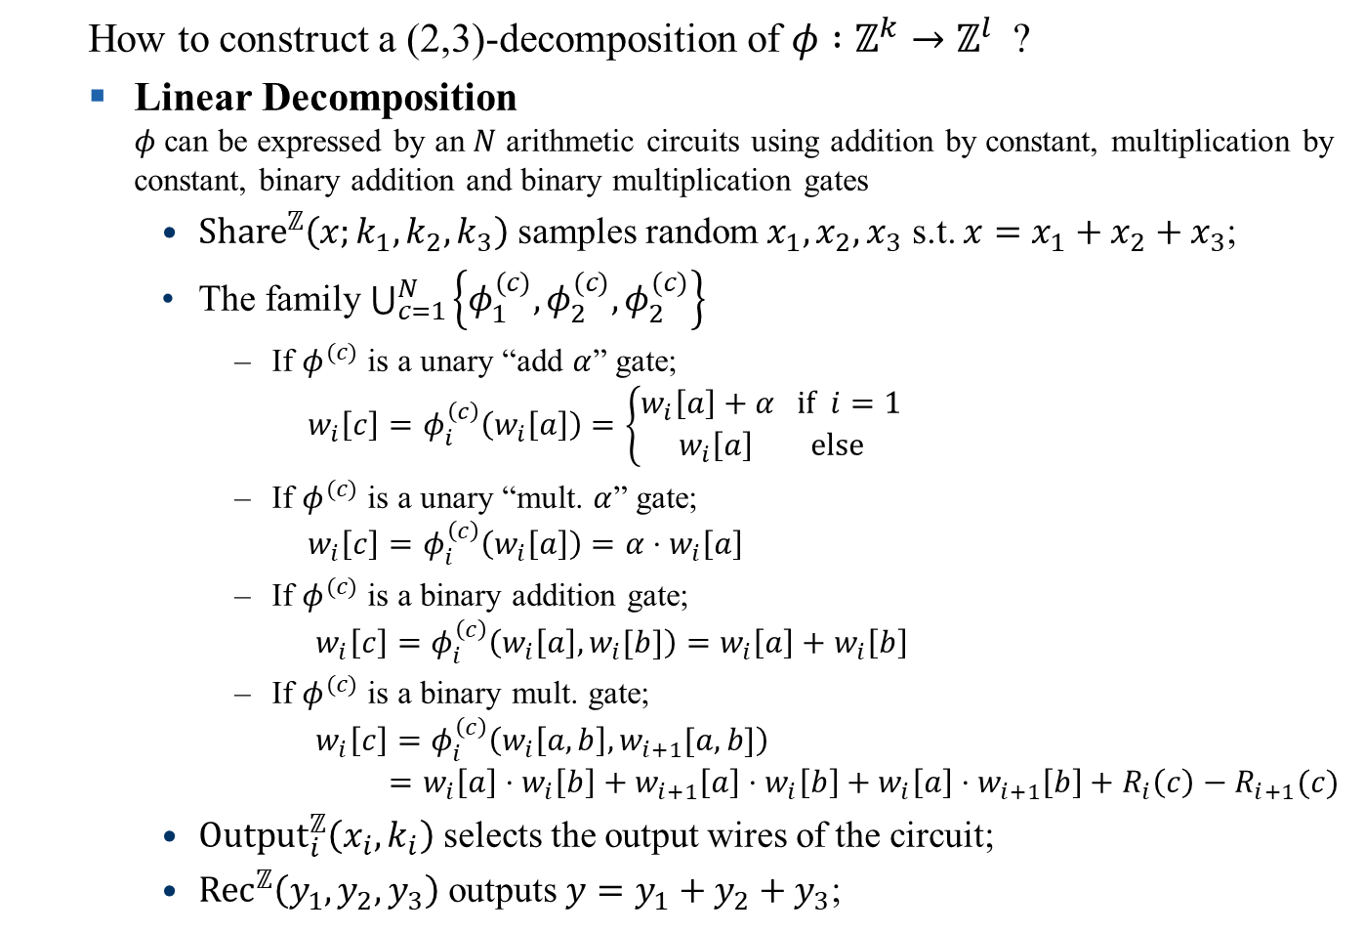
ZKBoo
  How to construct a (2,3)-decomposition of $φ :ℤ^{k}→ℤ^{l}$ ?
  Linear Decomposition
  $φ$ can be expressed by an $N$ arithmetic circuits using addition by constant, multiplication by constant, binary addition and binary multiplication gates
    ${Share}^{ℤ}\left(x;k_{1},k_{2},k_{3}\right)$ samples random $x_{1},x_{2},x_{3}$ s.t. $x=x_{1}+x_{2}+x_{3}$;
    The family $\bigcup_{c=1}^{N}{\left\{φ_{1}^{(c)},φ_{2}^{(c)},φ_{2}^{(c)}\right\}}$
      If $φ^{(c)}$ is a unary “add $α$” gate;
      $w_{i}\left[c\right]=φ_{i}^{\left(c\right)}\left(w_{i}\left[a\right]\right)=\left\{\begin{aligned}w_{i}\left[a\right]+α if i=1 \\ w_{i}\left[a\right] else\end{aligned}\right.$
      If $φ^{(c)}$ is a unary “mult. $α$” gate;
      $w_{i}\left[c\right]=φ_{i}^{\left(c\right)}\left(w_{i}\left[a\right]\right)=α⋅w_{i}\left[a\right]$
      If $φ^{(c)}$ is a binary addition gate;
      $w_{i}\left[c\right]=φ_{i}^{\left(c\right)}\left(w_{i}\left[a\right],w_{i}[b]\right)=w_{i}\left[a\right]+w_{i}\left[b\right]$
      If $φ^{(c)}$ is a binary mult. gate;
      $w_{i}\left[c\right]=φ_{i}^{\left(c\right)}\left(w_{i}\left[a,b\right],w_{i+1}[a,b]\right)$
      $=w_{i}\left[a\right]⋅w_{i}\left[b\right]+w_{i+1}\left[a\right]⋅w_{i}\left[b\right]+w_{i}\left[a\right]⋅w_{i+1}\left[b\right]+R_{i}\left(c\right)−R_{i+1}(c)$
    ${Output}_{i}^{ℤ}\left(x_{i},k_{i}\right)$ selects the output wires of the circuit;
    ${Rec}^{ℤ}\left(y_{1},y_{2},y_{3}\right)$ outputs $y=y_{1}+y_{2}+y_{3}$;

Slide 17

ZKBoo
  [GMO] Proposition 4.1.
  Linear Decomposition $D^{ℤ}$ of $φ :ℤ^{m}→ℤ^{n}$ have correctness, 2-privacy.
  Moreover, the length of each views in $D^{ℤ}$ is $\left(m+b+n\right)\log\left|ℤ\right|+κ$ bits where $b$ is the number of multiplication gates.

Slide 18


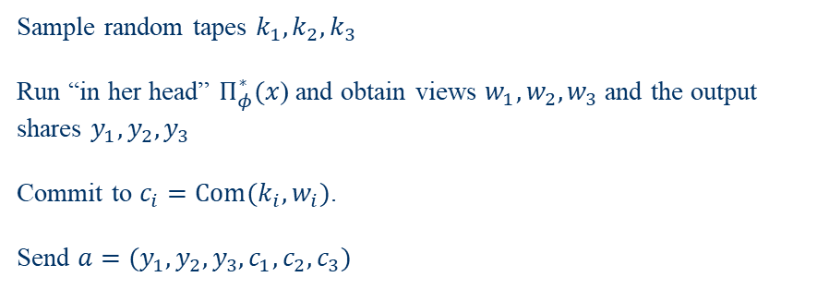

ZKBoo
ZKBoo [GMO]
  Prover P proves that “I know $x$ s.t. $φ\left(x\right)=y$”
  $L_{φ}≔\left\{y :∃x s.t. φ\left(x\right)=y\right\}$
$$y∈L_{φ}, y=φ\left(x\right)$$
A (2,3)-decomposition of $φ$ is given. $Π_{φ}^{∗}$ be a protocol related to the decomposition
Prover has $y \& x$
Verifier has $y$
Sample random tapes $k_{1},k_{2},k_{3}$
Run “in her head” $Π_{φ}^{∗}(x$) and obtain views $w_{1},w_{2},w_{3}$ and the output shares $y_{1},y_{2},y_{3}$
Commit to $c_{i}=Com(k_{i},w_{i})$.
Send $a=(y_{1},y_{2},y_{3},c_{1},c_{2},c_{3})$

Slide 19
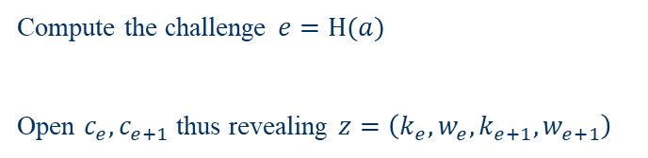
ZKBoo
ZKBoo [GMO]
  Prover P proves that “I know $x$ s.t. $φ\left(x\right)=y$”
  $L_{φ}≔\left\{y :∃x s.t. φ\left(x\right)=y\right\}$
$$y∈L_{φ}, y=φ\left(x\right)$$
A (2,3)-decomposition of $φ$ is given. $Π_{φ}^{∗}$ be a protocol related to the decomposition
Prover has $y \& x$
Verifier has $y$
Compute the challenge $e=H(a)$
Open $c_{e},c_{e+1}$ thus revealing $z=\left(k_{e},w_{e},k_{e+1},w_{e+1}\right)$
19

Slide 20

ZKBoo
ZKBoo [GMO]
  Prover P proves that “I know $x$ s.t. $φ\left(x\right)=y$”
  $L_{φ}≔\left\{y :∃x s.t. φ\left(x\right)=y\right\}$
$$y∈L_{φ}, y=φ\left(x\right)$$
A (2,3)-decomposition of $φ$ is given. $Π_{φ}^{∗}$ be a protocol related to the decomposition
Prover has $y \& x$
Compute the challenge $e^{′}=H(a)$.
If $Open\left(w_{e^{′}},k_{e^{′}}\right)= ⊥$ or $Open\left(w_{e^{′}+1},k_{e^{′}+1}\right)= ⊥$, REJECT
If $Rec\left(y_{1},y_{2},y_{3}\right)≠y$, REJECT.
If $∃i∈\left\{e′,e′+1\right\}$ s.t. $y_{i}≠{Output}_{i}\left(w_{i}\right)$, REJECT
If $∃j$ s.t. $w_{e′}\left[j\right]≠φ_{e′}^{\left(j\right)}\left(w_{e′},w_{e′+1},k_{e′},k_{e′+1}\right)$, REJECT
Else, ACCEPT
Verifier has $y$
20
Notes:
받은 테이프와 뷰를가지고 커밋했을때 그게 받은 커밋된 값과 다르면 리젝트.

Slide 21

ZKBoo
  Proof size :
  To achieve soundness error $2^{κ}$, we must repeat $t=\left\lceil κ{\left(\log_{2}{3}−1\right)}^{−1}\right\rceil$ times.
  Assume $φ :{\left(ℤ_{2^{l}}\right)}^{m}→{\left(ℤ_{2^{l}}\right)}^{n}$
  $\left|p\right|=t\left[3\left(\left|y_{i}\right|+\left|c_{i}\right|\right)+2\left(\left|w_{i}\right|+\left|k_{i}\right|\right)+\left|e\right|\right]$
  $=t\left[3\left(l⋅n+c\right)+2\left(l⋅\left(m+b+n\right)+κ\right)+\log_{2}{3}\right]$
  $=\left\lceil κ{\left(\log_{2}{3}−1\right)}^{−1}\right\rceil \left[3c+2κ+l⋅\left(5n+2m+2b\right)+\log_{2}{3}\right]$

Slide 22
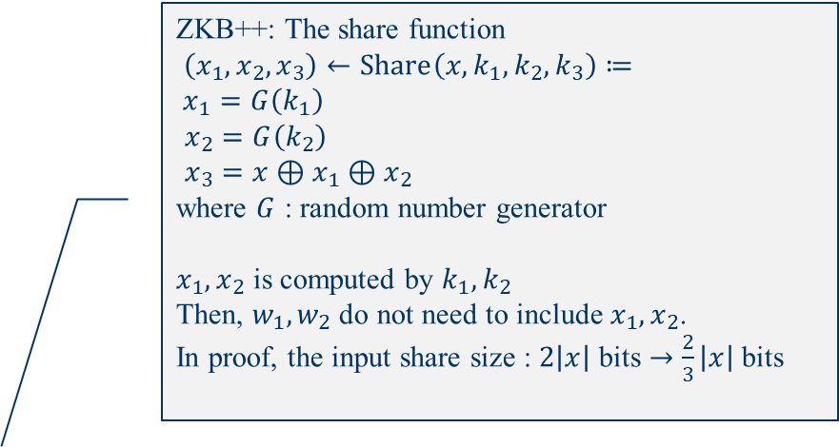

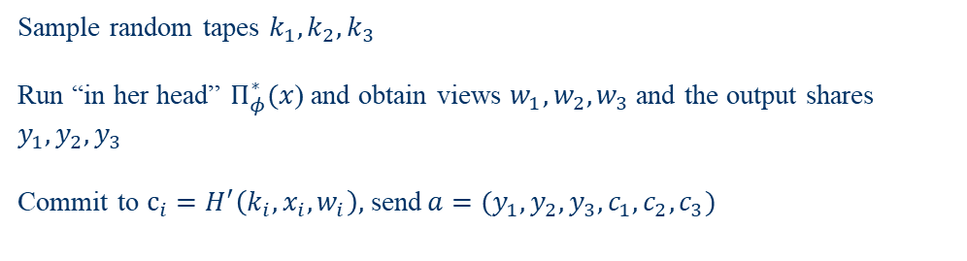


ZKBoo $→$ ZKB++
ZKB++ [CDG]
  Prover P proves that “I know $x$ s.t. $φ\left(x\right)=y$”
  $L_{φ}≔\left\{y :∃x s.t. φ\left(x\right)=y\right\}$
ZKB++: The share function
$\left(x_{1},x_{2},x_{3}\right)←Share\left(x,k_{1},k_{2},k_{3}\right)≔$
$x_{1}=G\left(k_{1}\right)$
$x_{2}=G\left(k_{2}\right)$
$x_{3}=x⊕x_{1}⊕x_{2}$
where $G$ : random number generator
$x_{1},x_{2}$ is computed by $k_{1},k_{2}$
Then, $w_{1},w_{2}$ do not need to include $x_{1},x_{2}$.
In proof, the input share size : $2\left|x\right|$ bits $→$ $\frac{2}{3}\left|x\right|$bits
$$y∈L_{φ}, y=φ\left(x\right)$$
A (2,3)-decomposition of $φ$ is given. $Π_{φ}^{∗}$ be a protocol related to the decomposition
Prover has $y \& x$
Verifier has $y$
Sample random tapes $k_{1},k_{2},k_{3}$
Run “in her head” $Π_{φ}^{∗}(x$) and obtain views $w_{1},w_{2},w_{3}$ and the output shares $y_{1},y_{2},y_{3}$
Commit to $c_{i}=H^{′}\left(k_{i},x_{i},w_{i}\right),$ send$a=(y_{1},y_{2},y_{3},c_{1},c_{2},c_{3})$

Slide 23
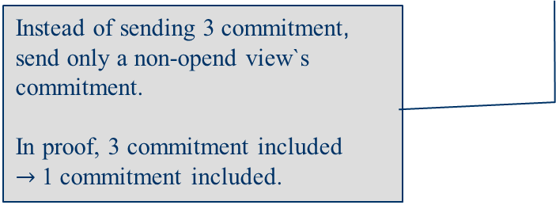

ZKBoo $→$ ZKB++
ZKB++ [CDG]
  Prover P proves that “I know $x$ s.t. $φ\left(x\right)=y$”
  $L_{φ}≔\left\{y :∃x s.t. φ\left(x\right)=y\right\}$
$$y∈L_{φ}, y=φ\left(x\right)$$
A (2,3)-decomposition of $φ$ is given. $Π_{φ}^{∗}$ be a protocol related to the decomposition
Prover has $y \& x$
Verifier has $y$
Sample random tapes $k_{1},k_{2},k_{3}$
Run “in her head” $Π_{φ}^{∗}(x$) and obtain views $w_{1},w_{2},w_{3}$ and the output shares $y_{1},y_{2},y_{3}$
Commit to $c_{i}=H^{′}\left(k_{i},x_{i},w_{i}\right),$ send $a=(y_{1},y_{2},y_{3},c_{1},c_{2},c_{3})$
Instead of sending 3 commitment, send only a non-opend view`s commitment.
In proof, 3 commitment included
$→$1 commitment included.

Slide 24
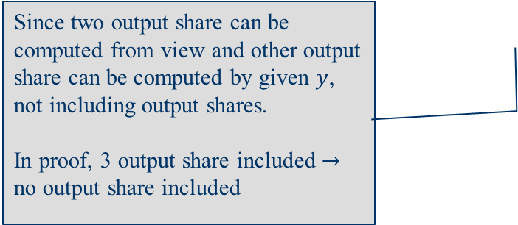
ZKBoo $→$ ZKB++
ZKB++ [CDG]
  Prover P proves that “I know $x$ s.t. $φ\left(x\right)=y$”
  $L_{φ}≔\left\{y :∃x s.t. φ\left(x\right)=y\right\}$
$$y∈L_{φ}, y=φ\left(x\right)$$
A (2,3)-decomposition of $φ$ is given. $Π_{φ}^{∗}$ be a protocol related to the decomposition
Prover has $y \& x$
Verifier has $y$
Sample random tapes $k_{1},k_{2},k_{3}$
Run “in her head” $Π_{φ}^{∗}(x$) and obtain views $w_{1},w_{2},w_{3}$ and the output shares $y_{1},y_{2},y_{3}$
Commit to $c_{i}=H^{′}\left(k_{i},x_{i},w_{i}\right),$ send $a=(y_{1},y_{2},y_{3},c_{1},c_{2},c_{3})$
Since two output share can be computed from view and other output share can be computed by given $y$, not including output shares.
In proof, 3 output share included $→$ no output share included

Slide 25
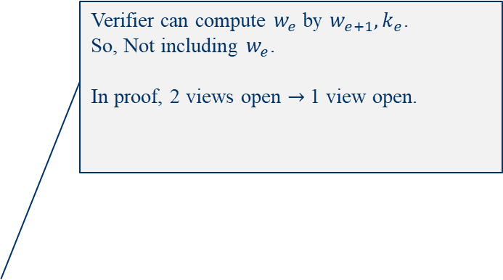
ZKBoo $→$ ZKB++
ZKB++ [CDG]
  Prover P proves that “I know $x$ s.t. $φ\left(x\right)=y$”
  $L_{φ}≔\left\{y :∃x s.t. φ\left(x\right)=y\right\}$
Verifier can compute $w_{e}$ by $w_{e+1},k_{e}$.
So, Not including $w_{e}$.
In proof, 2 views open $→$ 1 view open.
$$y∈L_{φ}, y=φ\left(x\right)$$
A (2,3)-decomposition of $φ$ is given. $Π_{φ}^{∗}$ be a protocol related to the decomposition
Prover has $y \& x$
Verifier has $y$
Compute the challenge $e=H(a)$
Open $c_{e},c_{e+1}$ thus revealing $z=\left(k_{e},w_{e},k_{e+1},w_{e+1}\right)$
25

Slide 26
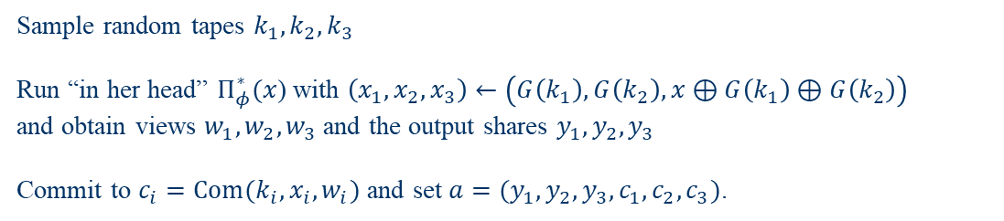
ZKB++
ZKB++ [CDG]
  Prover P proves that “I know $x$ s.t. $φ\left(x\right)=y$”
  $L_{φ}≔\left\{y :∃x s.t. φ\left(x\right)=y\right\}$
$$y∈L_{φ}, y=φ\left(x\right)$$
A (2,3)-decomposition of $φ$ is given. $Π_{φ}^{∗}$ be a protocol related to the decomposition
Prover has $y \& x$
Sample random tapes $k_{1},k_{2},k_{3}$
Run “in her head” $Π_{φ}^{∗}(x$) with $\left(x_{1},x_{2},x_{3}\right)←\left(G\left(k_{1}\right),G\left(k_{2}\right),x⊕G\left(k_{1}\right)⊕G\left(k_{2}\right)\right)$
and obtain views $w_{1},w_{2},w_{3}$ and the output shares $y_{1},y_{2},y_{3}$
Commit to $c_{i}=Com(k_{i},x_{i},w_{i})$ and set $a=(y_{1},y_{2},y_{3},c_{1},c_{2},c_{3})$.

Slide 27
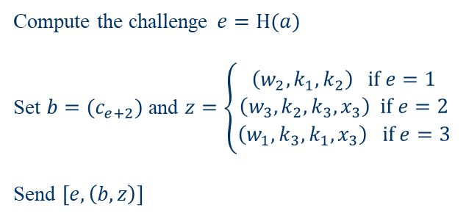
ZKB++
ZKB++ [CDG]
  Prover P proves that “I know $x$ s.t. $φ\left(x\right)=y$”
  $L_{φ}≔\left\{y :∃x s.t. φ\left(x\right)=y\right\}$
$$y∈L_{φ}, y=φ\left(x\right)$$
A (2,3)-decomposition of $φ$ is given. $Π_{φ}^{∗}$ be a protocol related to the decomposition
Prover has $y \& x$
Verifier has $y$
Compute the challenge $e=H(a)$
Set $b=(c_{e+2})$ and $z=\left\{\begin{aligned}\left(w_{2},k_{1},k_{2}\right) if e=1 \\ \left(w_{3},k_{2},k_{3},x_{3}\right) if e=2 \\ \left(w_{1},k_{3},k_{1},x_{3}\right) if e=3\end{aligned}\right.$
Send $\left[e,\left(b,z\right)\right]$
27

Slide 28


ZKB++
ZKB++ [CDG]
  Prover P proves that “I know $x$ s.t. $φ\left(x\right)=y$”
  $L_{φ}≔\left\{y :∃x s.t. φ\left(x\right)=y\right\}$
$$y∈L_{φ}, y=φ\left(x\right)$$
A (2,3)-decomposition of $φ$ is given. $Π_{φ}^{∗}$ be a protocol related to the decomposition
Set $x_{e}=\left\{\begin{aligned}G\left(k_{1}\right) if e=1 \\ G\left(k_{2}\right) if e=2 \\ x_{3} given in z if e=3\end{aligned}\right.,x_{e+1}=\left\{\begin{aligned}G\left(k_{2}\right) if e=1 \\ x_{3} given in z if e=2 \\ G\left(k_{1}\right) if e=3\end{aligned}\right.$
Obtain $w_{e+1 }$ from $z$ and compute $w_{e}$
$y_{e}=Output\left(w_{e}\right), y_{e+1}=Output\left(w_{e+1}\right), y_{e+2}=y⊕y_{e}⊕y_{e+1}$
Compute the commitment $c_{e}=Com\left(k_{e},x_{e},w_{e}\right), c_{e+1}=Com\left(k_{e+1},x_{e+1},w_{e+1}\right)$
Set $a^{′}=(y_{1},y_{2},y_{3},c_{1},c_{2},c_{3})$ and note that $c_{e+2}$ is in b
Compute the challenge $e^{′}=H\left(a^{′}\right)$. If $e=e′$, ACCEPT
Verifier has $y$
28

Slide 29

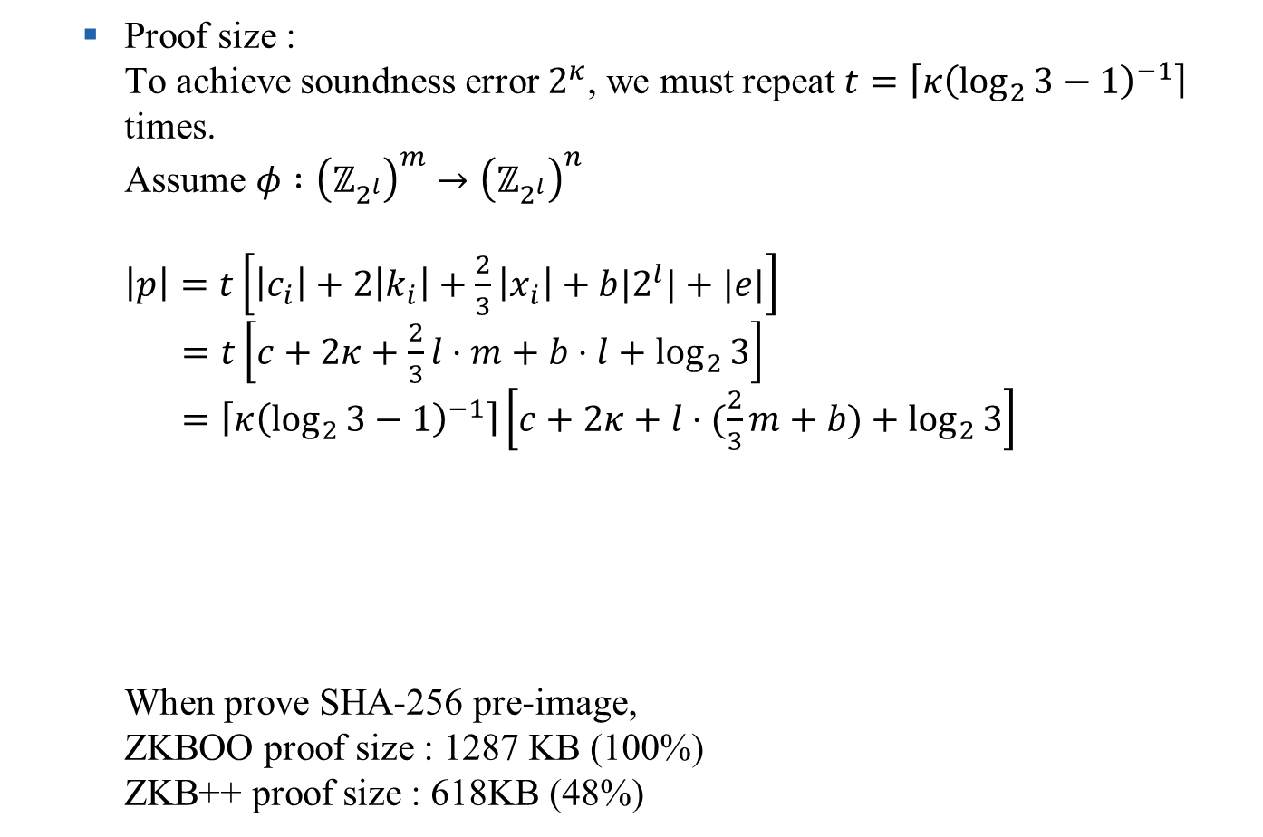
ZKB++
  Proof size :
  To achieve soundness error $2^{κ}$, we must repeat $t=\left\lceil κ{\left(\log_{2}{3}−1\right)}^{−1}\right\rceil$ times.
  Assume $φ :{\left(ℤ_{2^{l}}\right)}^{m}→{\left(ℤ_{2^{l}}\right)}^{n}$
  $\left|p\right|=t\left[\left|c_{i}\right|+2\left|k_{i}\right|+\frac{2}{3}\left|x_{i}\right|+b|2^{l}|+|e|\right]$
  $=t\left[c+2κ+\frac{2}{3}l⋅m+b⋅l+\log_{2}{3}\right]$
  $=\left\lceil κ{\left(\log_{2}{3}−1\right)}^{−1}\right\rceil \left[c+2κ+l⋅(\frac{2}{3}m+b)+\log_{2}{3}\right]$
  When prove SHA-256 pre-image,
  ZKBOO proof size : 1287 KB (100%)
  ZKB++ proof size : 618KB (48%)
ZKBOO: $t\left[3\left(\left|y_{i}\right|+\left|c_{i}\right|\right)+2\left(\left|w_{i}\right|+\left|k_{i}\right|\right)+\left|e\right|\right]$

Slide 30
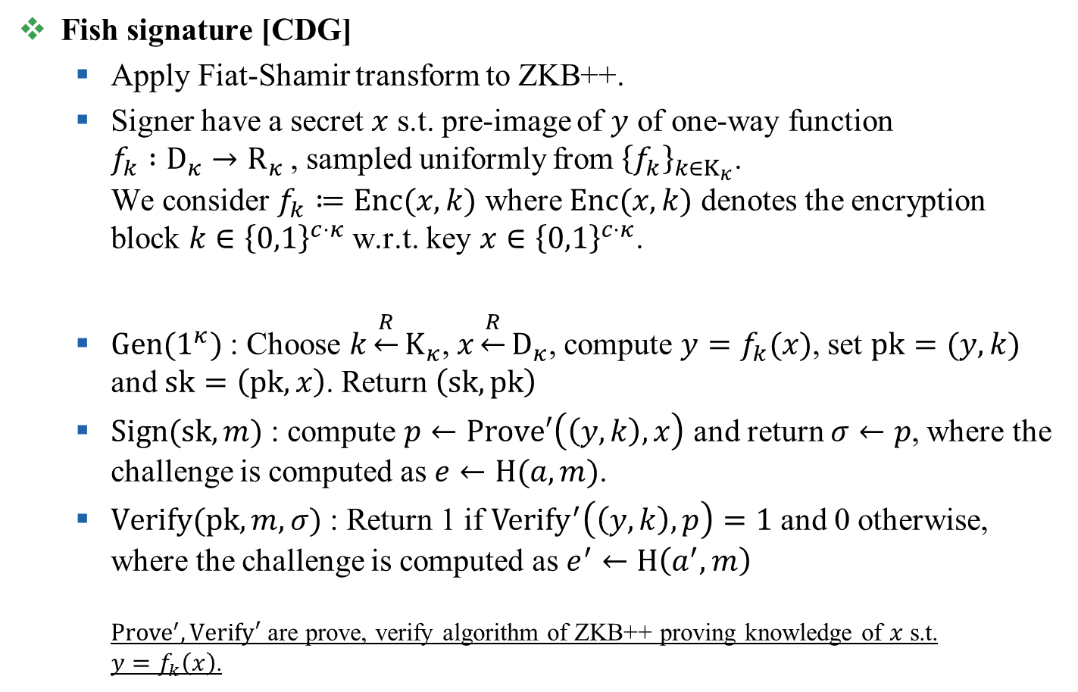
Fish signature
Fish signature [CDG]
  Apply Fiat-Shamir transform to ZKB++.
  Signer have a secret $x$ s.t. pre-image of $y$ of one-way function
  $f_{k} :D_{κ}→R_{κ}$, sampled uniformly from ${\left\{f_{k}\right\}}_{k∈K_{κ}}$.
  We consider $f_{k}≔Enc(x,k)$ where $Enc(x,k)$ denotes the encryption block $k∈{\left\{0,1\right\}}^{c⋅κ}$ w.r.t. key $x∈{\left\{0,1\right\}}^{c⋅κ}$.
  $Gen(1^{κ})$ : Choose $k\underset{←}{R}K_{κ}$,$x\underset{←}{R}D_{κ}$, compute $y=f_{k}(x)$, set $pk=(y,k)$ and $sk=\left(pk,x\right)$. Return $\left(sk,pk\right)$
  $Sign(sk,m)$ : compute $p←Prove′\left(\left(y,k\right),x\right)$ and return $σ←p$, where the challenge is computed as $e←H(a,m)$.
  $Verify(pk,m,σ)$ : Return 1 if ${Verify}^{′}\left(\left(y,k\right),p\right)=1$ and 0 otherwise, where the challenge is computed as $e^{′}←H\left(a^{′},m\right)$
  ${Prove}^{′}, Verify′$ are prove, verify algorithm of ZKB++ proving knowledge of $x$ s.t.
  $y=f_{k}\left(x\right)$.

Slide 31
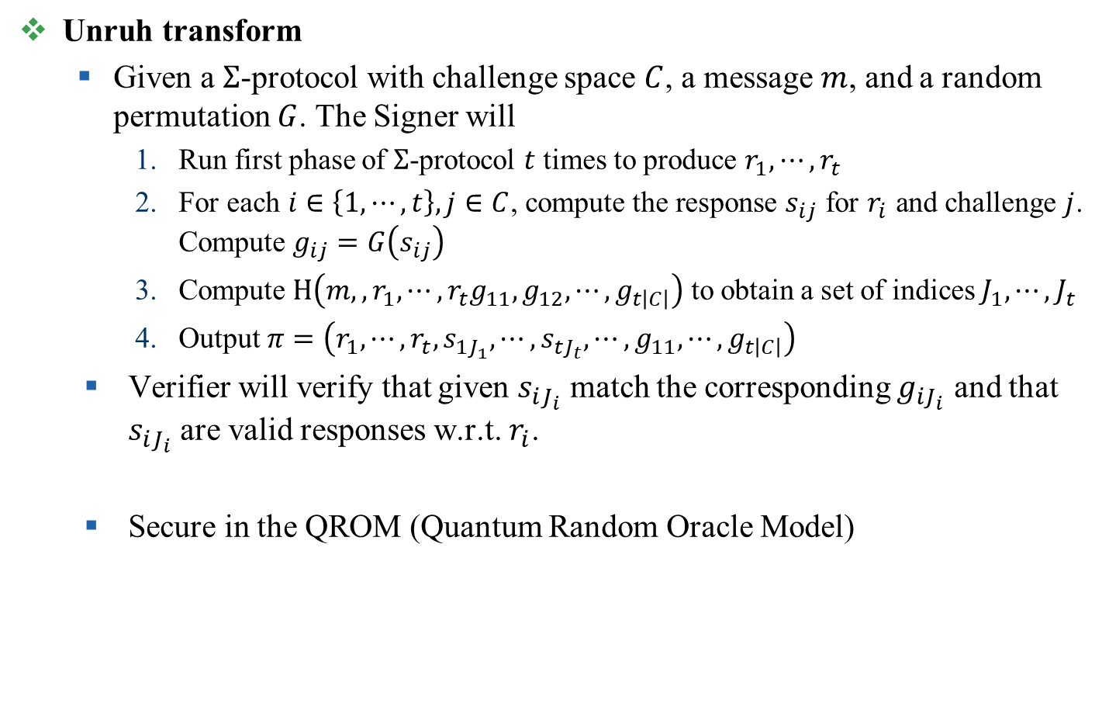
Picnic signature
Unruh transform
  Given a $Σ$-protocol with challenge space $C$, a message $m$, and a random permutation $G$. The Signer will
    Run first phase of $Σ$-protocol $t$ times to produce $r_{1},⋯,r_{t}$
    For each $i∈\left\{1,⋯,t\right\}, j∈C$, compute the response $s_{ij}$ for $r_{i}$ and challenge $j$. Compute $g_{ij}=G\left(s_{ij}\right)$
    Compute $H\left(m,,{r_{1},⋯,r_{t}g}_{11},g_{12},⋯,g_{t\left|C\right|}\right)$ to obtain a set of indices $J_{1},⋯,J_{t}$
    Output $π=\left(r_{1},⋯,r_{t},s_{1J_{1}},⋯,s_{tJ_{t}},⋯,g_{11},⋯,g_{t\left|C\right|}\right)$
  Verifier will verify that given $s_{iJ_{i}}$ match the corresponding $g_{iJ_{i}}$ and that $s_{iJ_{i}}$ are valid responses w.r.t. $r_{i}$.
  Secure in the QROM (Quantum Random Oracle Model)

Slide 32
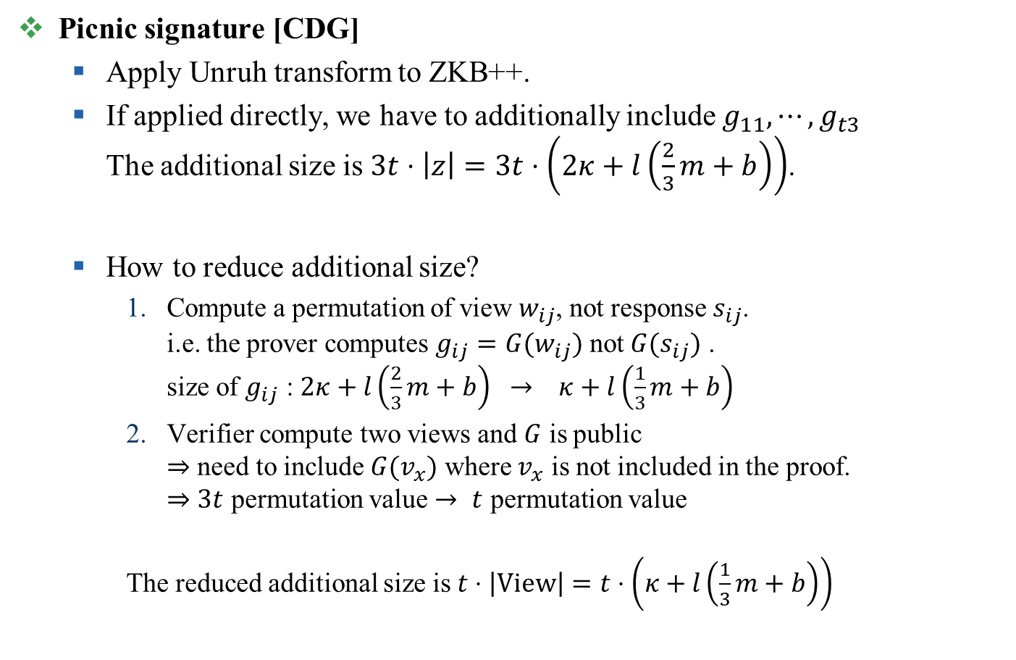
Picnic signature
Picnic signature [CDG]
  Apply Unruh transform to ZKB++.
  If applied directly, we have to additionally include $g_{11},⋯,g_{t3}$
  The additional size is $3t⋅\left|z\right|=3t⋅\left(2κ+l\left(\frac{2}{3}m+b\right)\right)$.
  How to reduce additional size?
    Compute a permutation of view $w_{ij}$, not response $s_{ij}$.
    i.e. the prover computes $g_{ij}=G(w_{ij})$ not $G(s_{ij})$ .
    size of $g_{ij}$ : $2κ+l\left(\frac{2}{3}m+b\right) → κ+l\left(\frac{1}{3}m+b\right)$
    Verifier compute two views and $G$ is public
    $⇒$ need to include $G(v_{x})$ where $v_{x}$ is not included in the proof.
    $⇒$ $3t$ permutation value $→$ $t$ permutation value
    The reduced additional size is $t⋅\left|View\right|=t⋅\left(κ+l\left(\frac{1}{3}m+b\right)\right)$

Slide 33
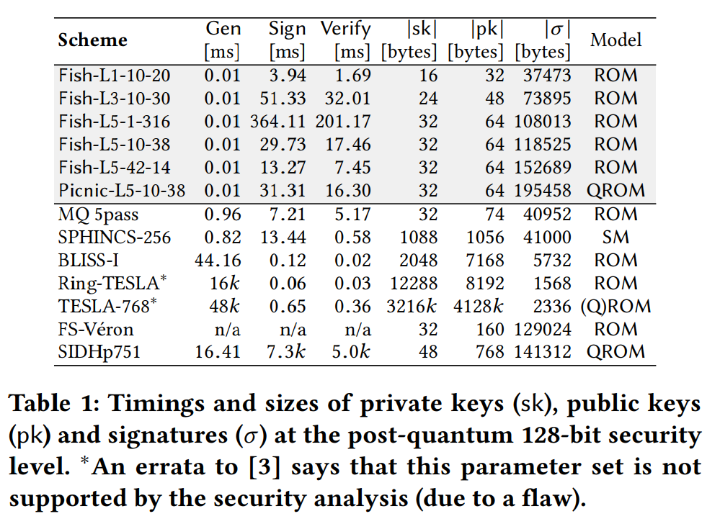
Fish / Picnic signature

Slide 34
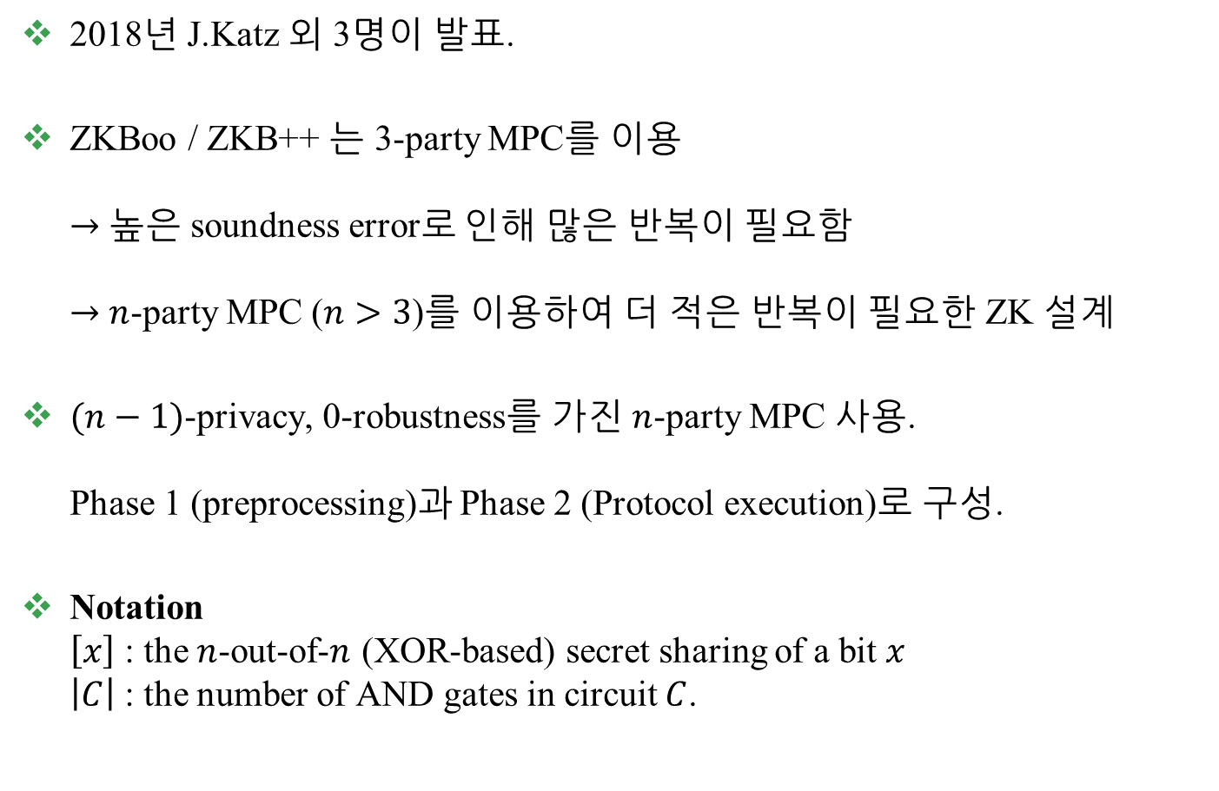
Improved NIZK [KKW18]
2018년 J.Katz 외 3명이 발표.
ZKBoo / ZKB++ 는 3-party MPC를 이용
$→$ 높은 soundness error로 인해 많은 반복이 필요함
$→$ $n$-party MPC ($n>3$)를 이용하여 더 적은 반복이 필요한 ZK 설계
$(n−1)$-privacy, 0-robustness를 가진 $n$-party MPC 사용.
Phase 1 (preprocessing)과 Phase 2 (Protocol execution)로 구성.
Notation
$\left[x\right]$ : the $n$-out-of-$n$ (XOR-based) secret sharing of a bit $x$
$\left|C\right|$ : the number of AND gates in circuit $C$.

Slide 35
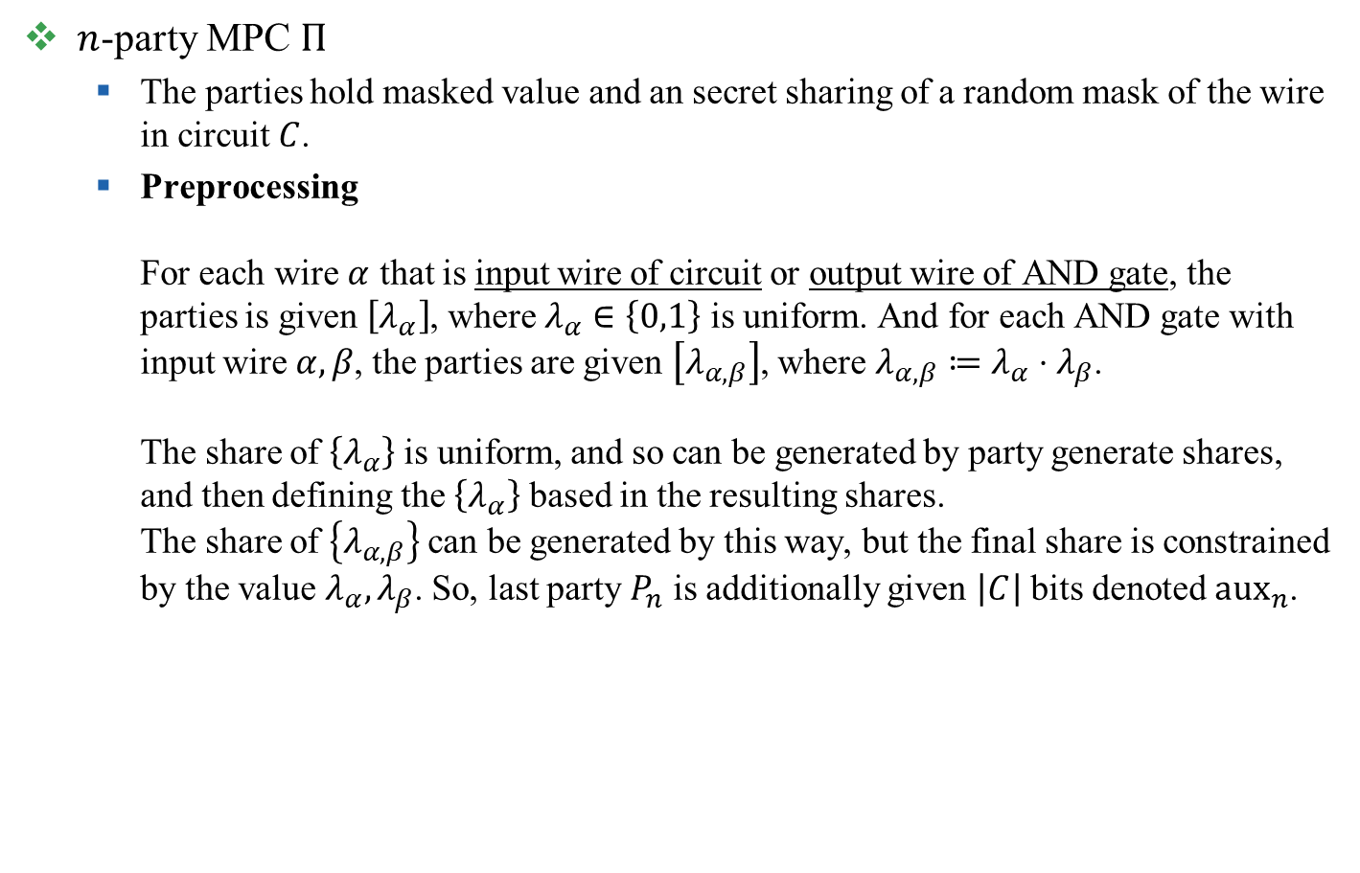
Improved NIZK [KKW18]
$n$-party MPC $Π$
  The parties hold masked value and an secret sharing of a random mask of the wire in circuit $C$.
  Preprocessing
  For each wire $α$ that is input wire of circuit or output wire of AND gate, the parties is given $\left[λ_{α}\right]$, where $λ_{α}∈\left\{0,1\right\}$ is uniform. And for each AND gate with input wire $α,β$, the parties are given $\left[λ_{α,β}\right]$, where $λ_{α,β}≔λ_{α}⋅λ_{β}$.
  The share of $\left\{λ_{α}\right\}$ is uniform, and so can be generated by party generate shares, and then defining the $\left\{λ_{α}\right\}$ based in the resulting shares.
  The share of $\left\{λ_{α,β}\right\}$ can be generated by this way, but the final share is constrained by the value $λ_{α},λ_{β}$. So, last party $P_{n}$ is additionally given $\left|C\right|$ bits denoted ${aux}_{n}$.

Slide 36
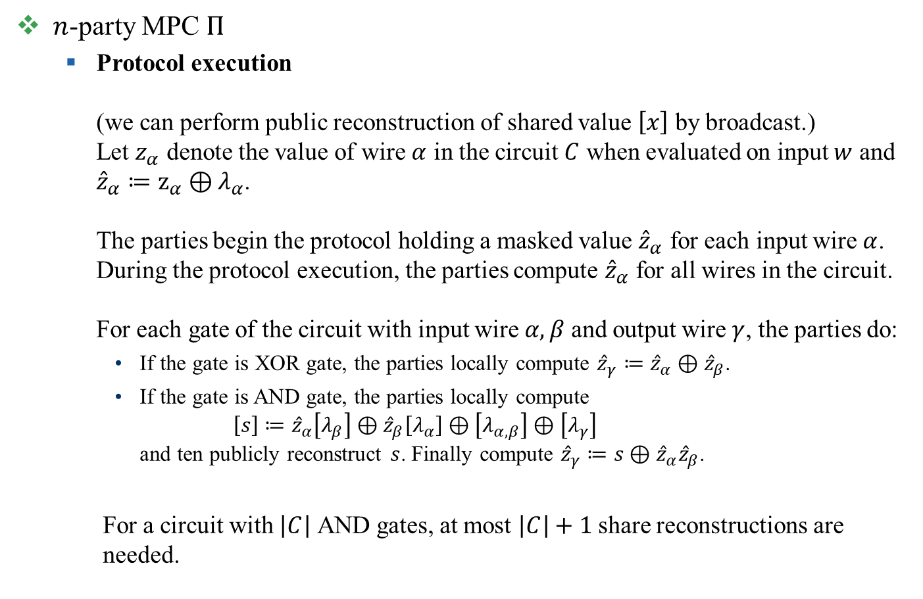
Improved NIZK [KKW18]
$n$-party MPC $Π$
  Protocol execution
  (we can perform public reconstruction of shared value $\left[x\right]$ by broadcast.)
  Let $z_{α}$ denote the value of wire $α$ in the circuit $C$ when evaluated on input $w$ and
  ${\hat{z}}_{α}≔z_{α}⊕λ_{α}$.
  The parties begin the protocol holding a masked value ${\hat{z}}_{α}$ for each input wire $α$.
  During the protocol execution, the parties compute ${\hat{z}}_{α}$ for all wires in the circuit.
  For each gate of the circuit with input wire $α,β$ and output wire $γ$, the parties do:
    If the gate is XOR gate, the parties locally compute ${\hat{z}}_{γ}≔{\hat{z}}_{α}⊕{\hat{z}}_{β}$.
    If the gate is AND gate, the parties locally compute
    $\left[s\right]≔{\hat{z}}_{α}\left[λ_{β}\right]⊕{\hat{z}}_{β}\left[λ_{α}\right]⊕\left[λ_{α,β}\right]⊕\left[λ_{γ}\right]$
    and ten publicly reconstruct $s$. Finally compute ${\hat{z}}_{γ}≔s⊕{\hat{z}}_{α}{\hat{z}}_{β}$.
  For a circuit with $\left|C\right|$ AND gates, at most $\left|C\right|+1$ share reconstructions are
  needed.

Slide 37
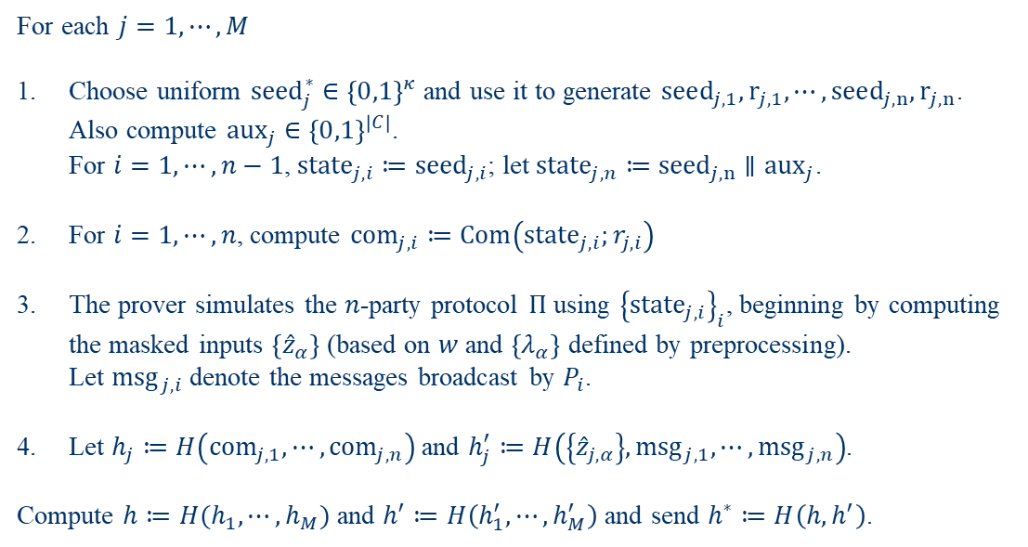
Improved NIZK [KKW18]
Prover, verifier have circuit $C$; the prover holds $w$ with $C\left(w\right)=1$.
Prover
For each $j=1,⋯,M$
Choose uniform ${seed}_{j}^{∗}∈{\left\{0,1\right\}}^{κ}$ and use it to generate $seed_{j,1},r_{j,1},⋯,seed_{j,n},r_{j,n}$. Also compute ${aux}_{j}∈{\left\{0,1\right\}}^{\left|C\right|}$.
For $i=1,⋯,n−1$, ${state}_{j,i}≔{seed}_{j,i}$; let ${state}_{j,n}≔{seed}_{j,n}∥{aux}_{j}$.
For $i=1,⋯,n$, compute ${com}_{j,i}≔Com\left({state}_{j,i};r_{j,i}\right)$
The prover simulates the $n$-party protocol $Π$ using ${\left\{{state}_{j,i}\right\}}_{i}$, beginning by computing the masked inputs $\left\{{\hat{z}}_{α}\right\}$ (based on $w$ and $\left\{λ_{α}\right\}$ defined by preprocessing).
Let ${msg}_{j,i}$ denote the messages broadcast by $P_{i}$.
Let $h_{j}≔H\left({com}_{j,1},⋯,{com}_{j,n}\right)$ and $h_{j}^{′}≔H\left(\left\{{\hat{z}}_{j,α}\right\},{msg}_{j,1},⋯,{msg}_{j,n}\right)$.
Compute $h≔H(h_{1},⋯,h_{M})$ and $h^{′}≔H\left(h_{1}^{′},⋯,h_{M}^{′}\right)$ and send $h^{∗}≔H\left(h,h^{′}\right)$.

Slide 38
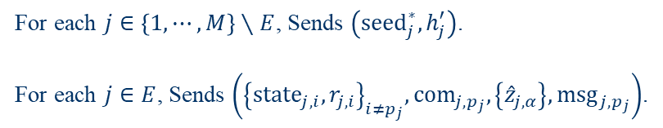
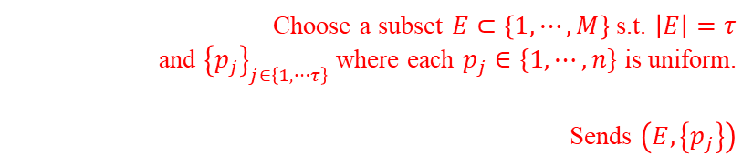
Improved NIZK [KKW18]
Prover, verifier have circuit $C$; the prover holds $w$ with $C\left(w\right)=1$.
Prover
Verifier
Choose a subset $E⊂\left\{1,⋯,M\right\}$ s.t. $\left|E\right|=τ$
and ${\left\{p_{j}\right\}}_{j∈\left\{1,⋯τ\right\}}$ where each $p_{j}∈\{1,⋯,n\}$ is uniform.
Sends $\left(E,\left\{p_{j}\right\}\right)$
For each $j∈\left\{1,⋯,M\right\}∖E$, Sends $\left({seed}_{j}^{∗}, h_{j}^{′}\right)$.
For each $j∈E$, Sends $\left({\left\{{state}_{j,i},r_{j,i}\right\}}_{i≠p_{j}}, {com}_{j,p_{j}}, \left\{{\hat{z}}_{j,α}\right\}, {msg}_{j,p_{j}}\right)$.

Slide 39
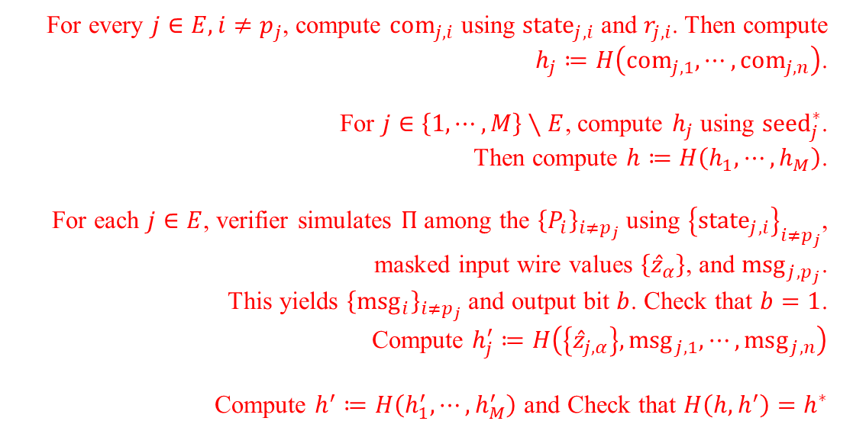
Improved NIZK [KKW18]
Prover, verifier have circuit $C$; the prover holds $w$ with $C\left(w\right)=1$.
Verifier
For every $j∈E, i≠p_{j}$, compute ${com}_{j,i}$ using ${state}_{j,i}$ and $r_{j,i}$. Then compute $h_{j}≔H\left({com}_{j,1},⋯,{com}_{j,n}\right)$.
For $j∈\left\{1,⋯,M\right\}∖E$, compute $h_{j}$ using ${seed}_{j}^{∗}$.
Then compute $h≔H\left(h_{1},⋯,h_{M}\right)$.
For each $j∈E$, verifier simulates $Π$ among the ${\left\{P_{i}\right\}}_{i≠p_{j}}$ using ${\left\{{state}_{j,i}\right\}}_{i≠p_{j}}$, masked input wire values $\left\{{\hat{z}}_{α}\right\}$, and ${msg}_{j,p_{j}}$.
This yields ${\left\{{msg}_{i}\right\}}_{i≠p_{j}}$ and output bit $b$. Check that $b=1$.
Compute $h_{j}^{′}≔H\left(\left\{{\hat{z}}_{j,α}\right\},{msg}_{j,1},⋯,{msg}_{j,n}\right)$
Compute $h^{′}≔H\left(h_{1}^{′},⋯,h_{M}^{′}\right)$ and Check that $H\left(h,h^{′}\right)=h^{∗}$

Slide 40
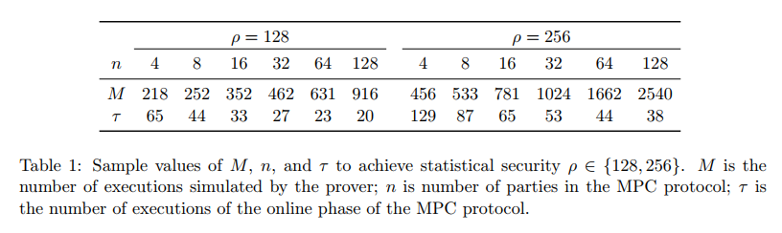

Improved NIZK [KKW18]
  If cheating prover $k≥M−τ$ correct emulations of preprocessing phase,
  then its probability of passing the first phase of proof is at most $\frac{\left(\begin{aligned}k \\ M−τ\end{aligned}\right)}{\left(\begin{aligned}M \\ M−τ\end{aligned}\right)};$
  conditioned on passing the first phase, its probability of passing the second phase is at most $\frac{1}{n^{τ−\left(M−k\right)}}$.
  So, soundness error is $ε\left(M,n,τ\right)≝\max_{M−τ≤k≤M}\left\{\frac{\left(\begin{aligned}k \\ M−τ\end{aligned}\right)}{\left(\begin{aligned}M \\ M−τ\end{aligned}\right)⋅n^{τ−M+k}}\right\}$.

Slide 41

Improved NIZK [KKW18]
  Prover sends $h^{∗}$, $\left\{{seed}_{j}^{∗}\right\},\left\{h_{j}^{′}\right\}$ for $j∉E$,
  ${\left\{{state}_{j,i}\right\}}_{i≠p_{j}}, {\left\{r_{j,i}\right\}}_{i≠p_{j}}, {com}_{j,p_{j}}, \left\{{\hat{z}}_{j,α}\right\}$ and ${msg}_{j,p_{j}}$ to verifier.
  So, the proof size of
  $2κ+τ⋅\log{\frac{M}{τ}}⋅3κ+τ⋅\left(κ\log{n}+2\left|C\right|+\left|w\right|+2κ\right)$

Slide 42
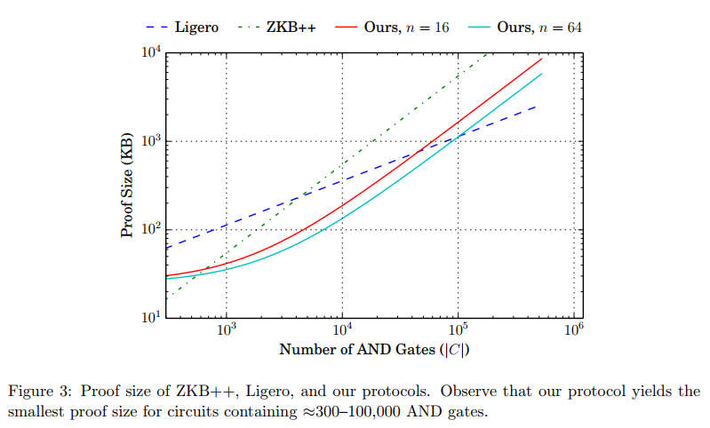
Improved NIZK [KKW18]

