Slide 1
Deep Learning Methods in Spoof Detection Challenges
Il-Youp Kwak
Chung-Ang University

Slide 2
Emergence of Voice assistants:
Samsung Bixby, Apple Siri, Amazon Alexa, etc

Slide 3
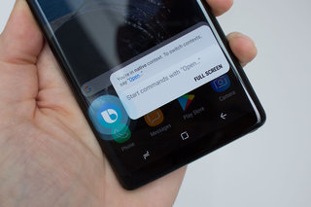

Voice assistants now support security-critical commands, making them attractive target for adversaries to exploit

Slide 4

Threat Model

Slide 5
How to solve it?
1. Voice Biometric Authentication
2. Voice Liveness Detection
3. Voice-Command based Attack Detection

Slide 6

Voice-Command based Attack Detection

Slide 7
Voice-Command based Attack Detection
Can be used as an effective complementary technology to further enhance voice attack detection accuracy

Slide 8
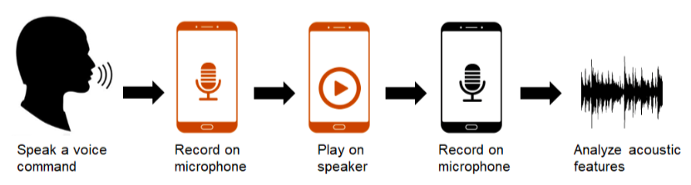
Voice Liveness Detection
Genuine
Spoof

Slide 9
Use of wearable devices, such as eyeglasses, earbuds, or necklaces, to detect voice liveness.
Their approaches check for the presence of
users’ physical body and muscle movements
Rely on users physically holding their devices
Feng et al. (2017) Continuous authentication for voice assistants.
Liu et al. (2018) Vocal Resonance: Using Internal Body Voice for Wearable Authentication.
Zhang et al. (2017) Hearing your voice is not enough: An articulatory gesture based liveness detection for voice authentication.

Slide 10
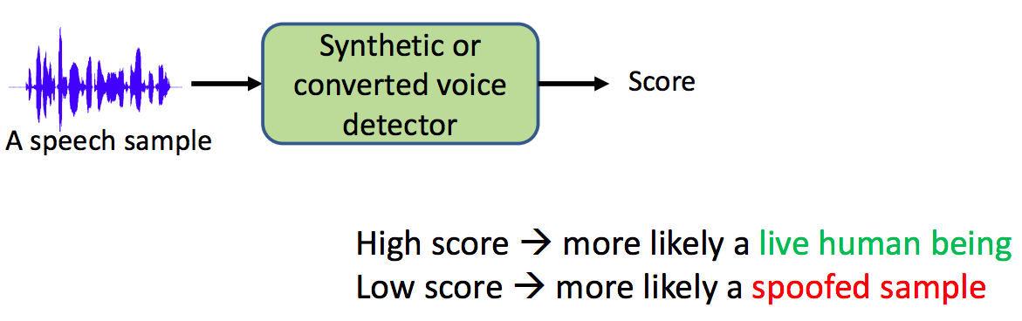
ASVspoof Challenge Task
Many researchers have proposed machine learning-based liveness detection solutions.
Wu et al. (2015) Asvspoof 2015: The first automatic speaker verification spoofing and countermeasures challenge
Kinnunen et al. (2017) The asvspoof 2017 challenge: Assessing the limits of replay spoofing attack detection
Todisco et al (2019) ASVspoof 2019: Future Horizons in Spoofed and Fake Audio Detection

Slide 11
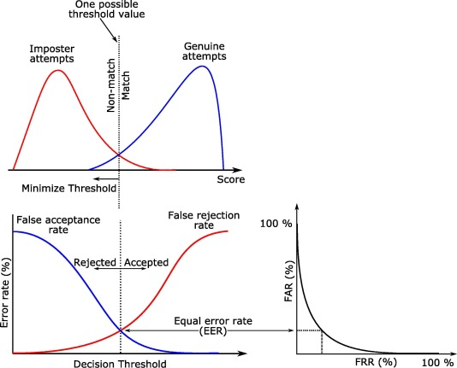
Evaluation Metric
Equal Error Rate (EER) of replay-nonreplay discrimination

Slide 12
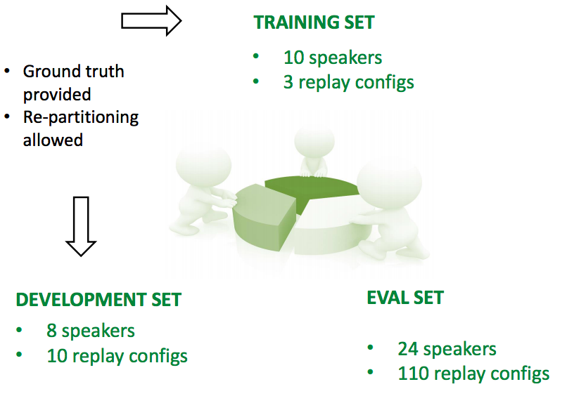
Datasets (2017)

Slide 13
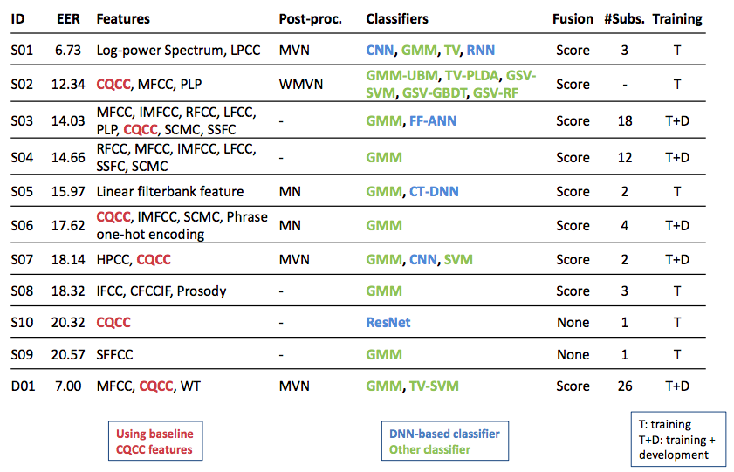
Summary of Top 10 Systems (2017)

Slide 14
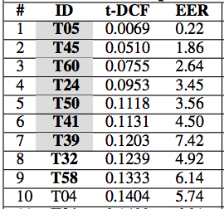
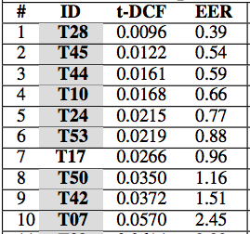
Summary of Top 10 Systems (2019)
LA scenario
PA scenario
Grey
Used Neural Networks
Bold
Used Ensemble

Slide 15
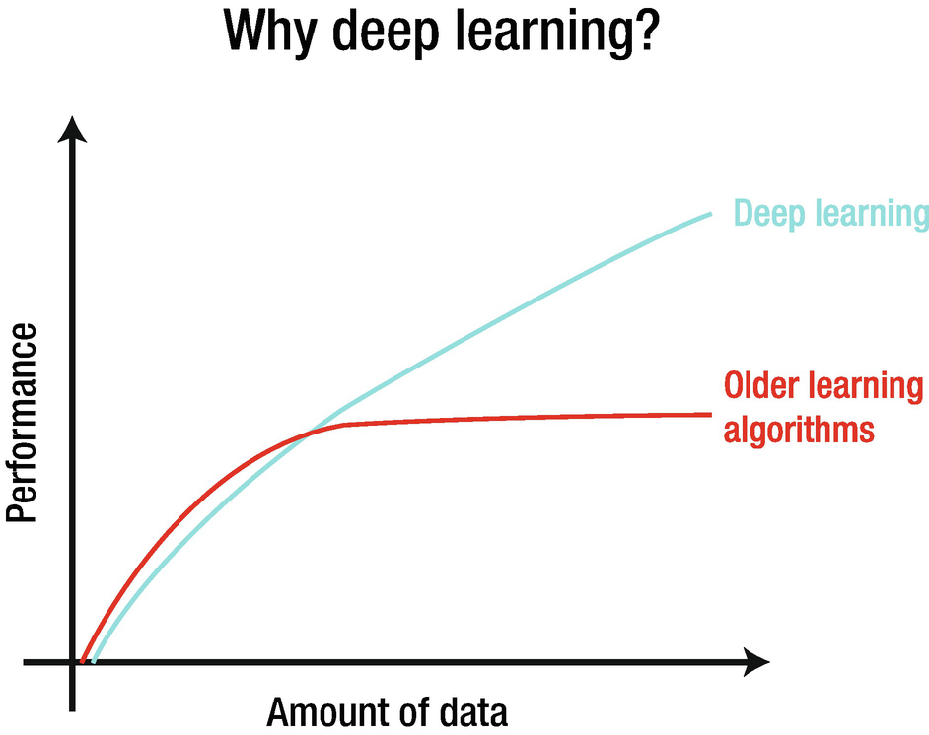

Slide 16
Top methods in ASVspoof 2019
1. LCNN using CQT and STFT
2. SENet using CQT and STFT
Lavrentyeva et al. (2019) STC Antispoofing Systems for the ASVspoof2019 Challenge
Lai et al. (2019) ASSERT: Anti-Spoofing with Squeeze-Excitation and Residual Networks

Slide 17
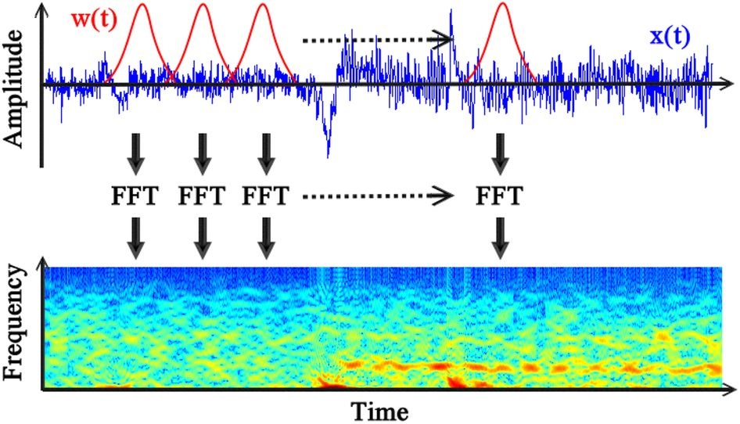
STFT Feature
https://www.youtube.com/watch?v=Cl-m4X3rwac

Slide 18
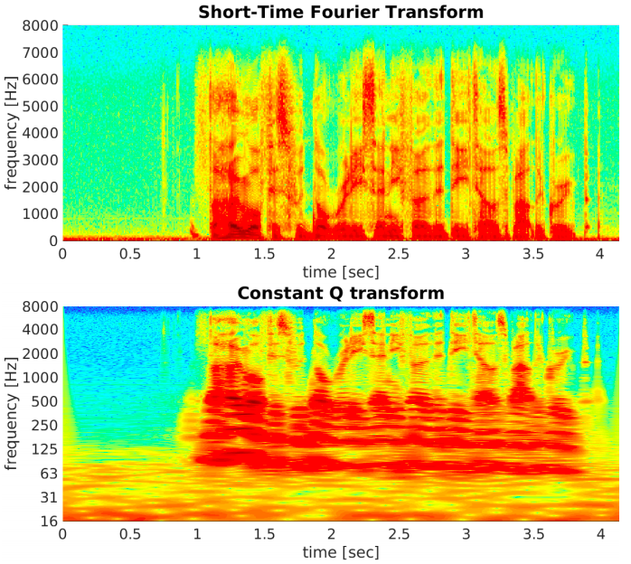
CQT Feature

Slide 19





Binary Classification
- We are Classifying Genuine or Spoof
- Dimension for x is (n_freq, n_time)
- Data:

Slide 20

Classification Model
-
-
- Objective is to minimize Cost, C($θ$), w.r.t $θ$ :

Slide 21

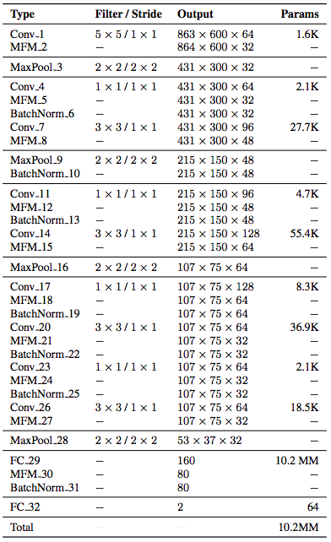
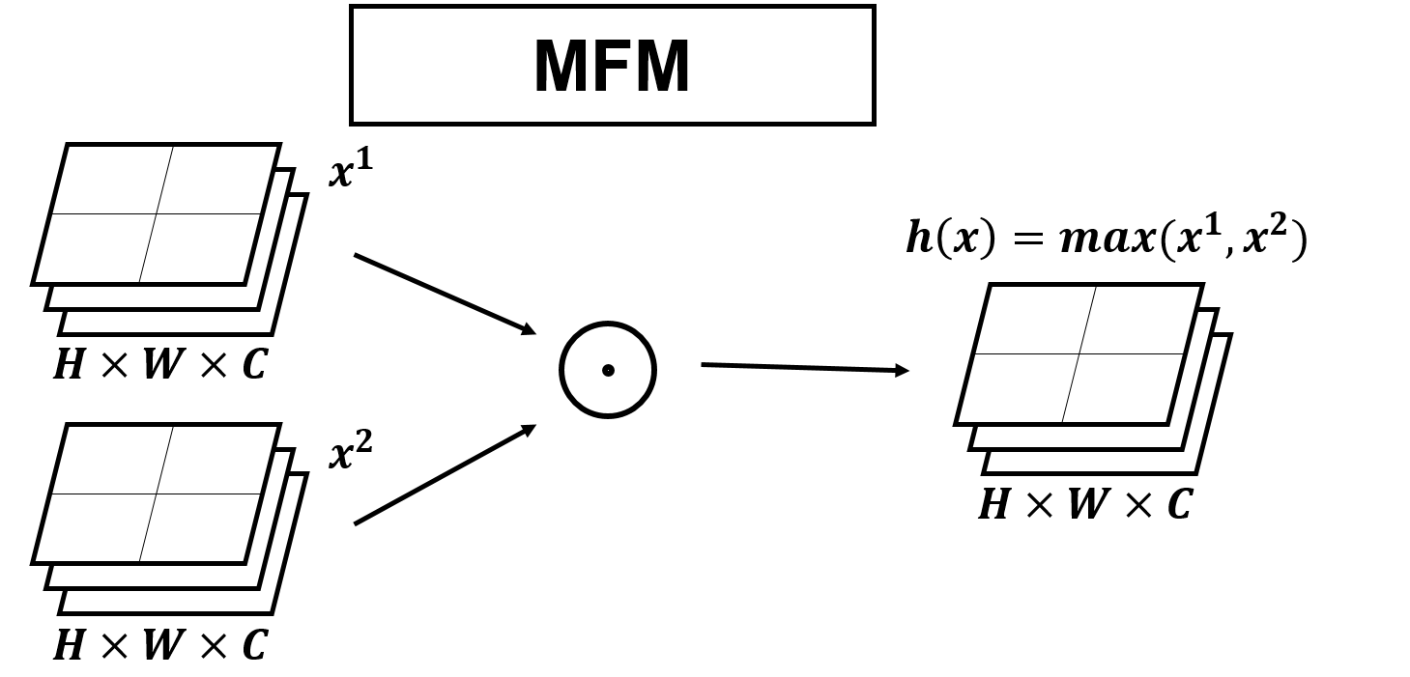
LCNN architecture for
Lavrentyeva et al. (2019) STC Antispoofing Systems for the ASVspoof2019 Challenge

Slide 22
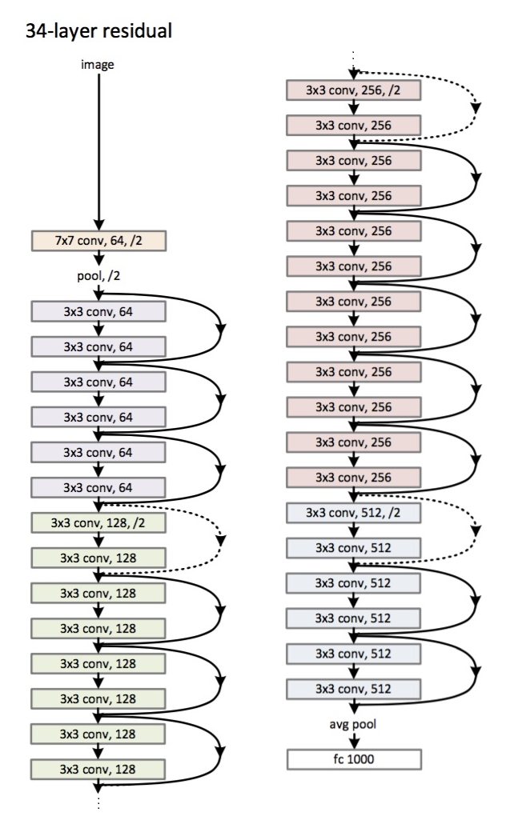


ResNet architecture for
- Skip connection network is like :
- Training F(x) is training residual
- Converges very well for DNN

Slide 23
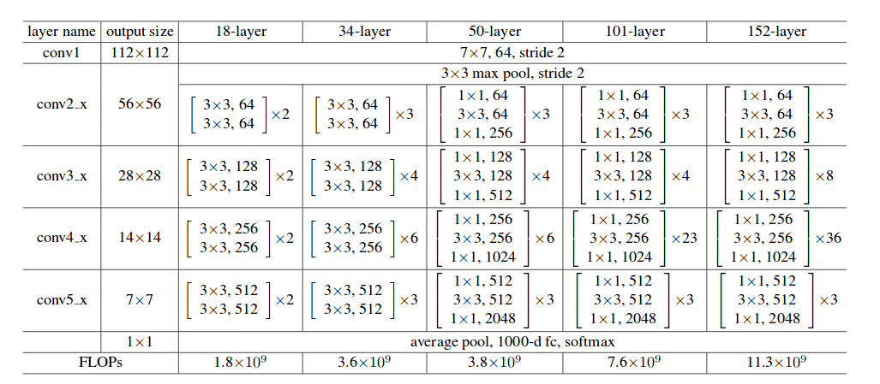
ResNet architectures

Slide 24
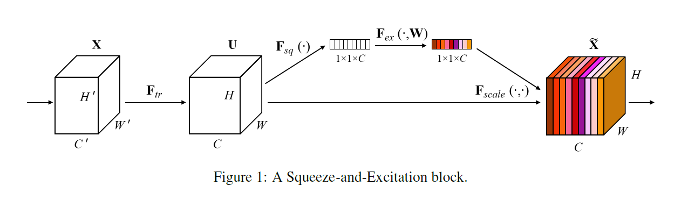
SENet architecture
- Won ILSVRC 2017 ImageNet Challenge
- SE blocks added on each ResNet blocks
Lai et al. (2019) ASSERT: Anti-Spoofing with Squeeze-Excitation and Residual Networks

Slide 25
Why CNN based methods work better than
RNN based methods in ASVspoof?

Slide 26
Implementations?

Slide 27

Easy way is to learn Tensorflow

Slide 28

Problem in training big data with complex network
- Minimize Loss w.r.t $θ$ given data
This part may suffer (memory problem)
- We can consider using mini-batch Gradient Descent, Stochastic Gradient Descent
- We may need a data generator

Slide 29
Why Gradient Descent?
- We can handle memory side better
(Control Batch Size)
- Easy calculation in backpropagation (chain rule)
- We can cover online-learning side for streaming data

Slide 30
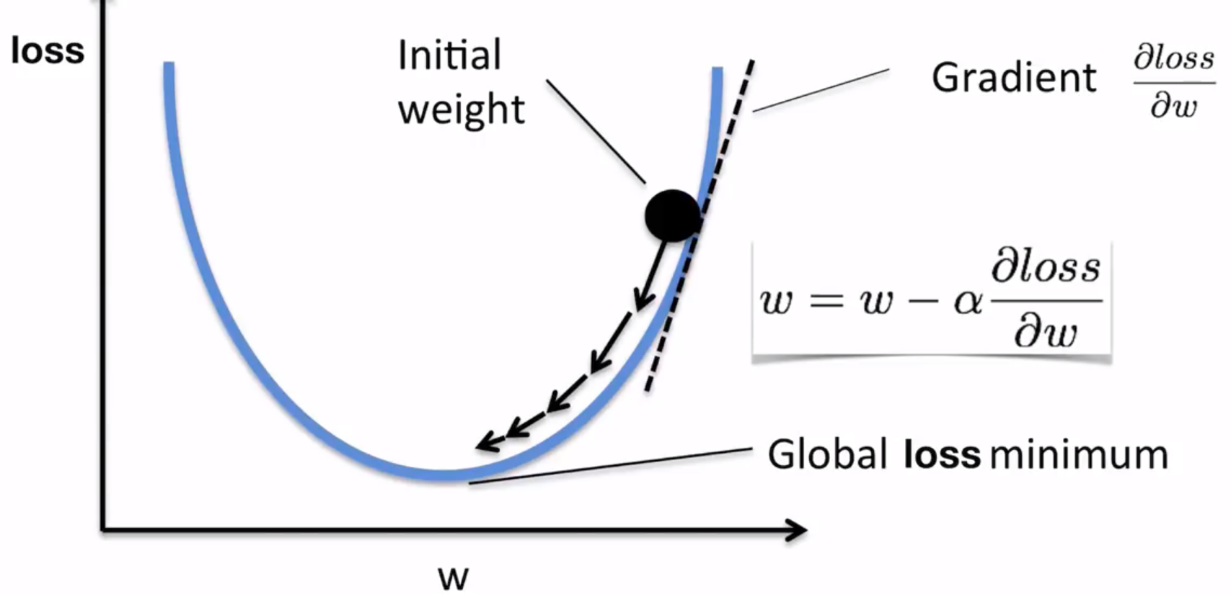
What is Gradient Descent?

Slide 31
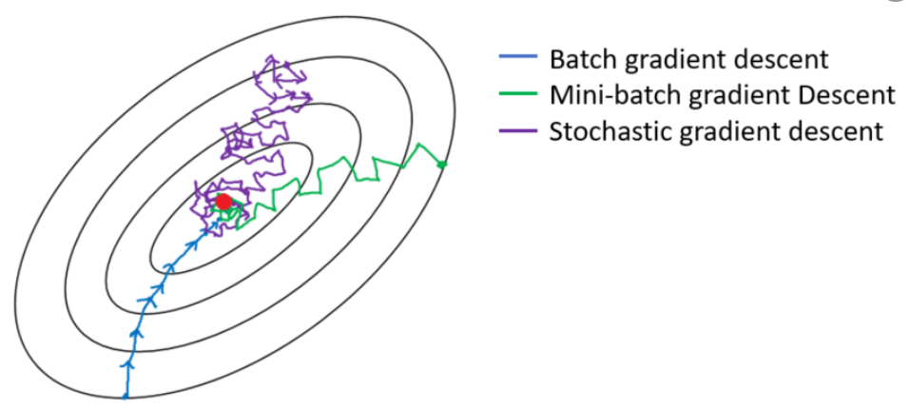
What is Stochastic Gradient Descent?
- Perform the gradient update using each sample
- Mini-batch: Perform the update Using batch samples

Slide 32
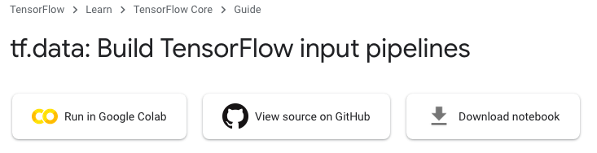
Why Generator?
- Do not load data in your memory
- In modeling, you can feed data from file using generator

Slide 33
Miscellaneous Tips

Slide 34
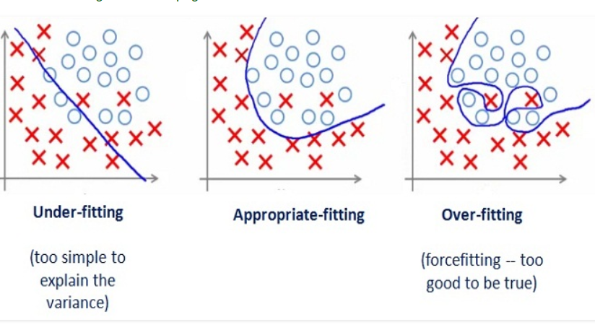
Overfitting / underfitting

Slide 35
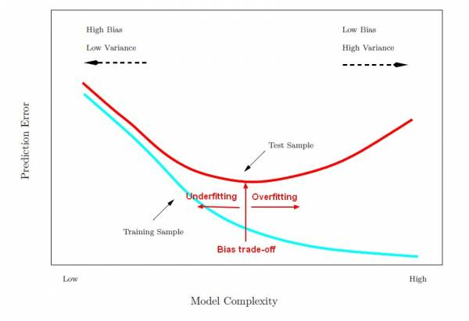
Early Stopping

Slide 36




Regularization
- Consider regularization when overfitted
- L1, L2
L1:
L2:
- Dropout

Slide 37
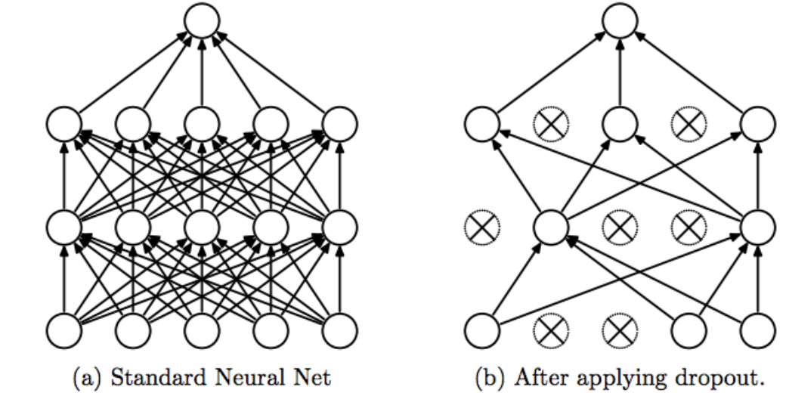
Dropout Regularization
- Reduce high dependency on few nodes (act like random forest)

Slide 38
Use learning rate decay when overfitting
is not an issue

Slide 39
Q & A
Ilyoup.kwak@gmail.com

