Slide 1
About Data Scientists
Il-Youp Kwak
Chung-Ang University

Slide 2
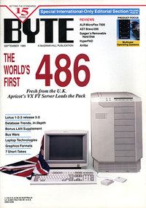
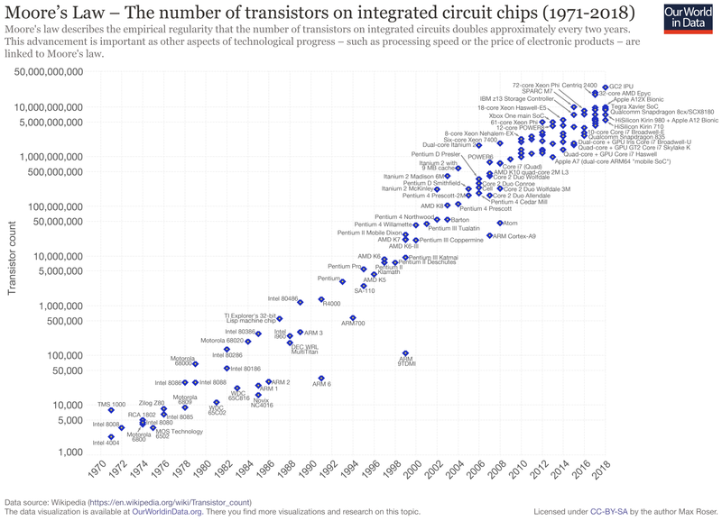
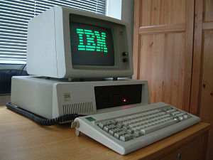
Exponential Laws of Computing Growth
Intel Pentium, i486
Getting Multiple cores
Intel 8088, IBM XT, 8bit
486
386
286

Slide 3
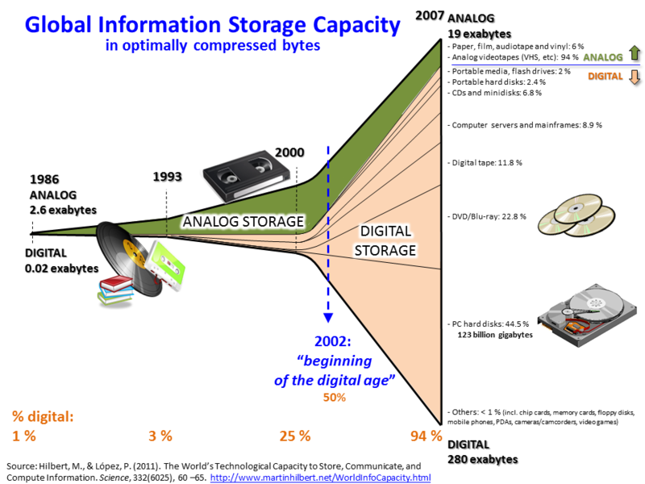
Global Information Storage Capacity also Growing

Slide 4
Computers are getting faster,
Information storage growing bigger

Slide 5


Opens Big Data Era

Slide 6
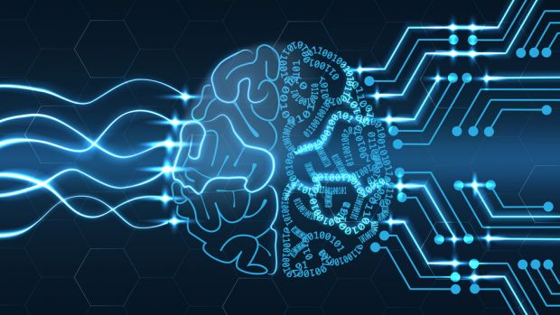
A good eco for AI

Slide 7
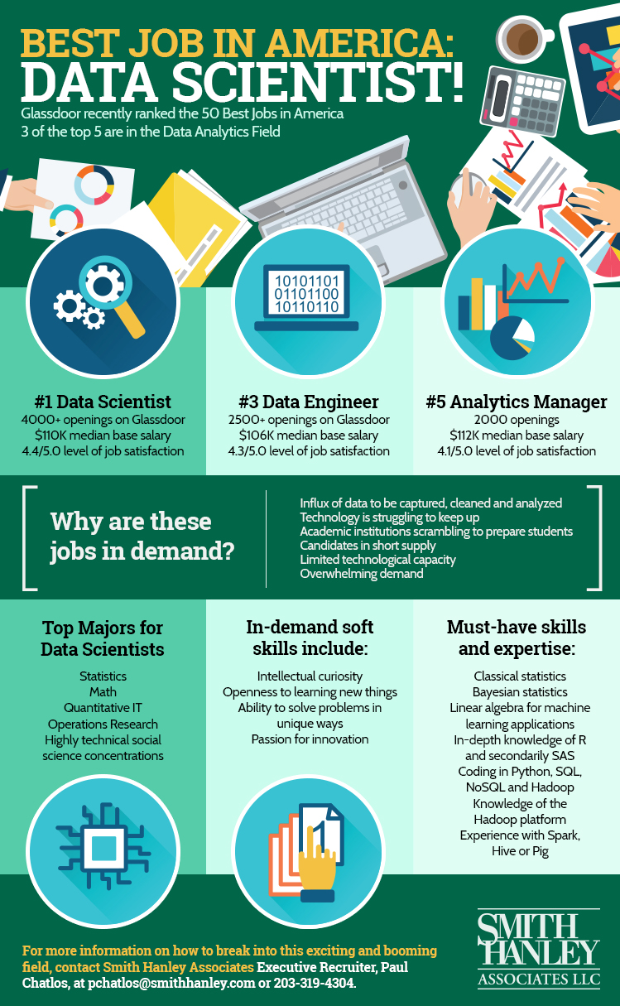
Growing need for Data Scientists

Slide 8
What is Data Scientist?
Data science is a multi-disciplinary field that uses scientific methods, processes, algorithms and systems to extract knowledge and insights from structured and unstructured data. Data science is the same concept as data mining and big data: "use the most powerful hardware, the most powerful programming systems, and the most efficient algorithms to solve problems".
Dhar, V. (2013). "Data science and prediction". Communications of the ACM. 56 (12): 64–73.
Jeff Leek (2013). "The key word in "Data Science" is not Data, it is Science". Simply Statistics

Slide 9
Big data is like teenage sex: everyone talks about it, nobody really knows how to do it, everyone thinks everyone else is doing it, so everyone claims they are doing it.
– Dan Ariely (Professor of Psychology at Duke)

Slide 10
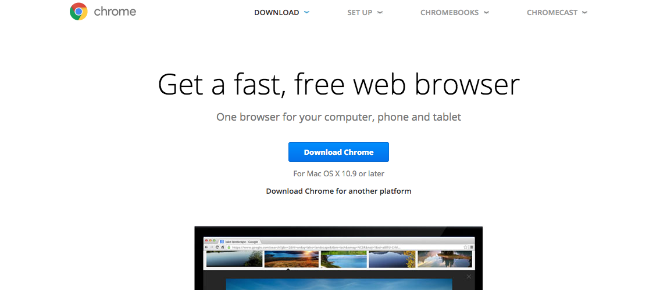
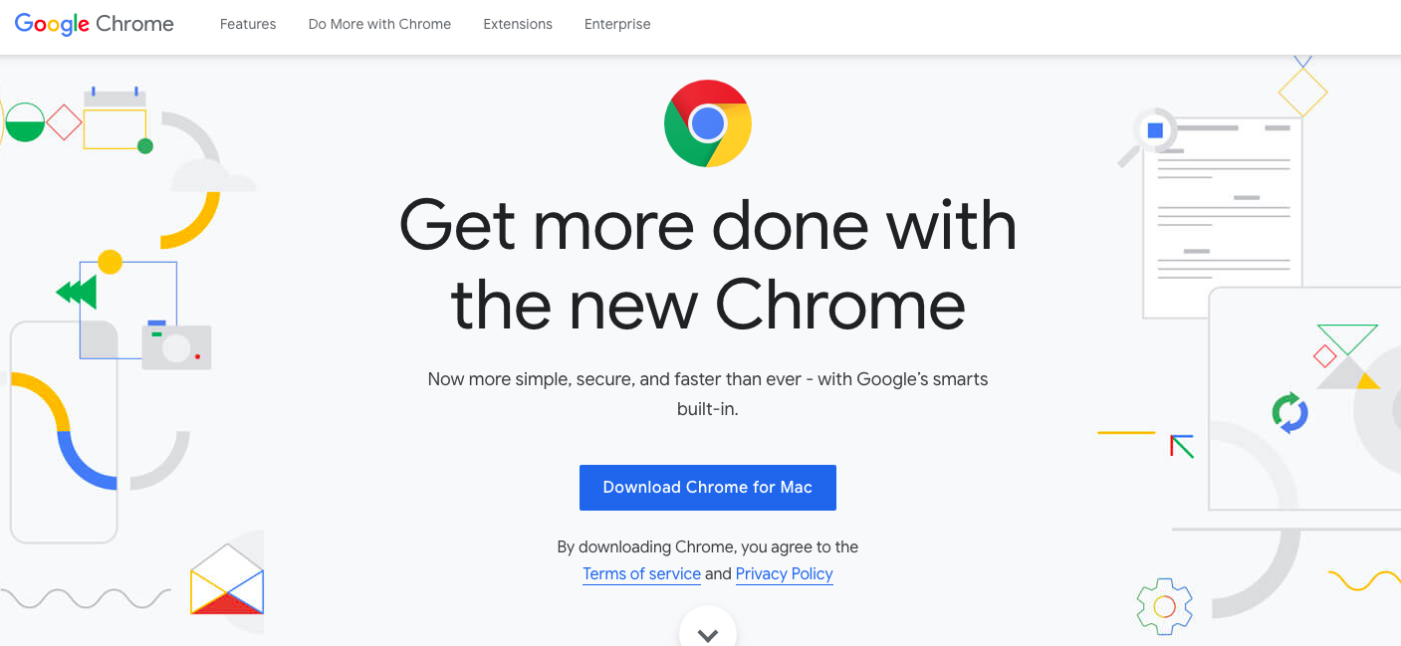
What design will you choose?
Notes:
ex

Slide 11


Searching System Objectives for e-commerce?
Profit
2. User Satisfaction
Notes:
ex

Slide 12
For a given search query, what will you show?
Derive prototype models
Notes:
ex

Slide 13
Evaluation rules for Searching System
Profit
2. Number of Clicks (from searching to buying)
3. Time spent from Users
Notes:
ex

Slide 14
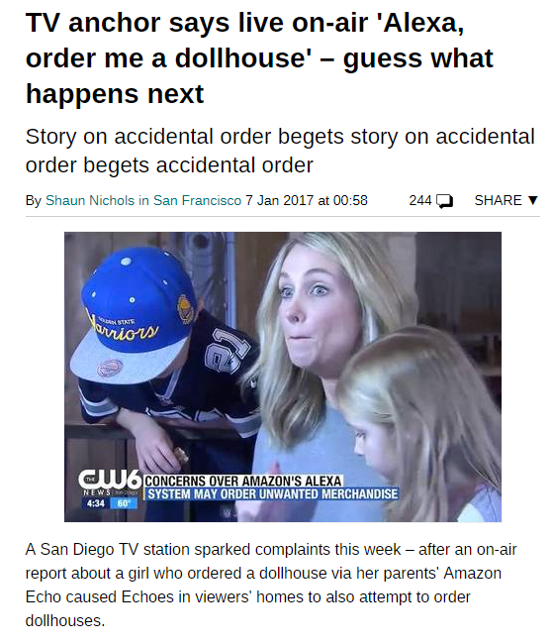
Problems of Voice Assistants

Slide 15
How to solve it?
1. Voice Biometric Authentication
2. Voice Liveness Detection

Slide 16
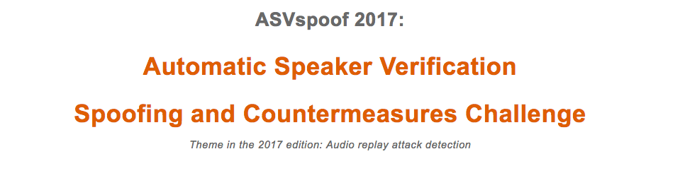

Related research and competitions

Slide 17
Why Deep Learning?
1. Automatic Feature Engineering
2. Good performance with large data

Slide 18
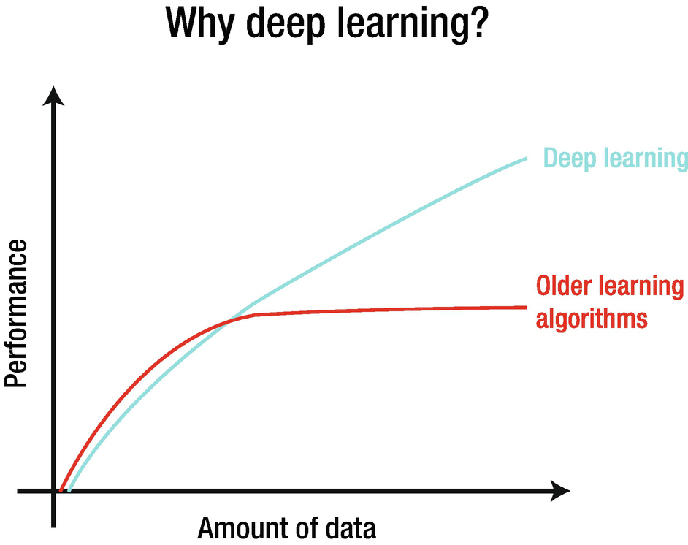

Slide 19


Deep Learning Concepts
- Use all data to maximize performance
- Higher model complexity
Ex) ,
- Make a deep non-linear model that explain the structure of data the best

Slide 20
Then, how to become a Data Scientist?
Notes:
ex

Slide 21
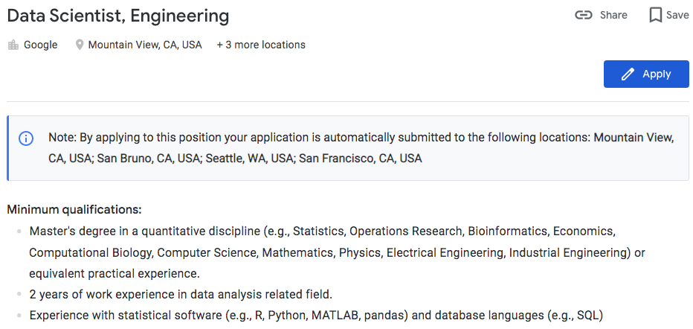
Notes:
Sales data 가 있을때, 이를 이용해서 무었을 할 수 있지?

Slide 22
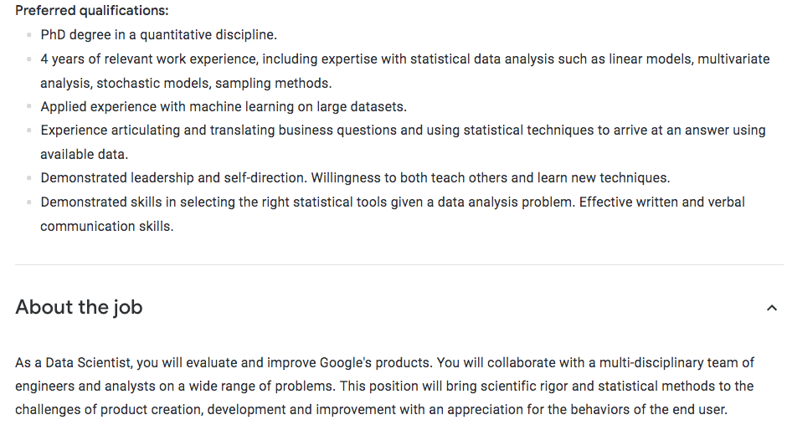
Notes:
Sales data 가 있을때, 이를 이용해서 무었을 할 수 있지?

Slide 23
Emergence of Data Science Programs
Stanford, Harvard, UC Berkeley, etc
Notes:
ex

Slide 24
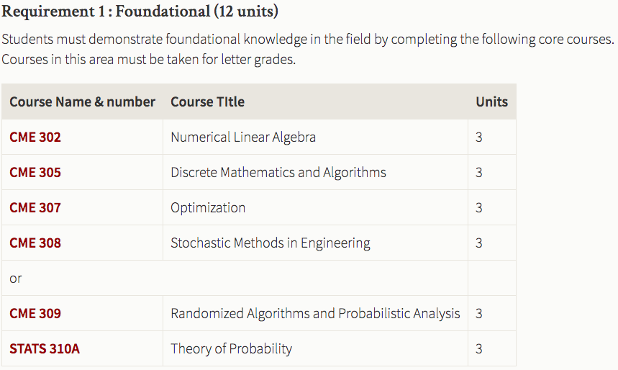
Five fundamentals in Stanford
Notes:
ex

Slide 25
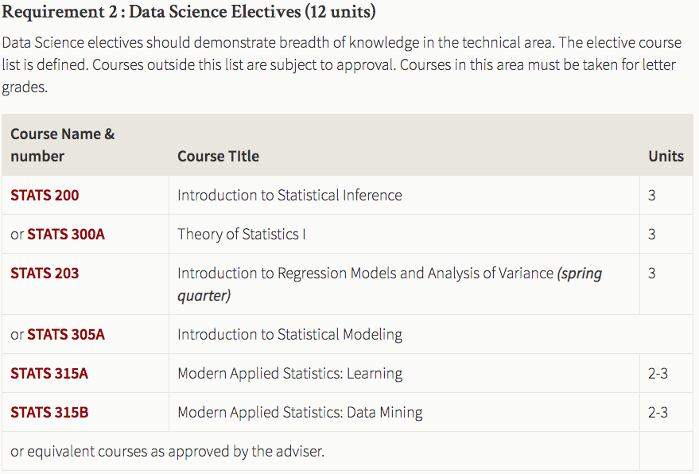
Five fundamentals in Stanford
Notes:
ex

Slide 26
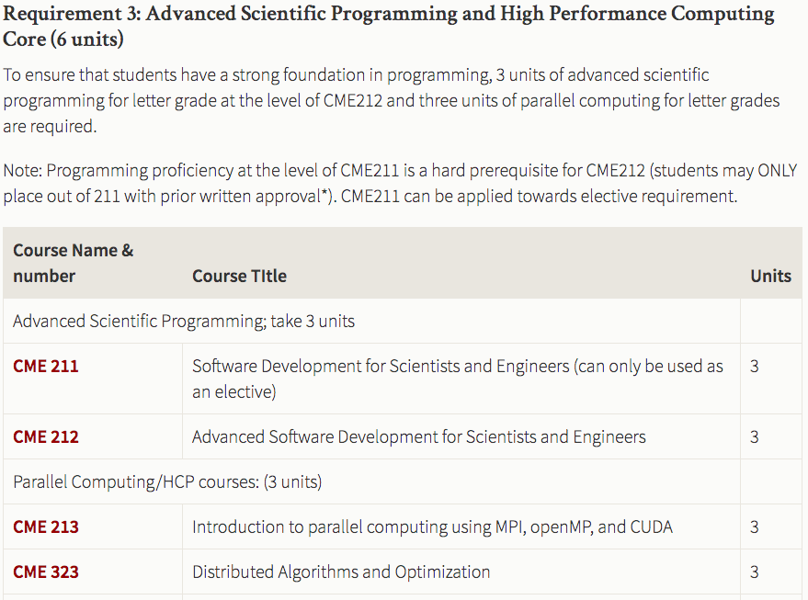
Five fundamentals in Stanford
Notes:
ex

Slide 27
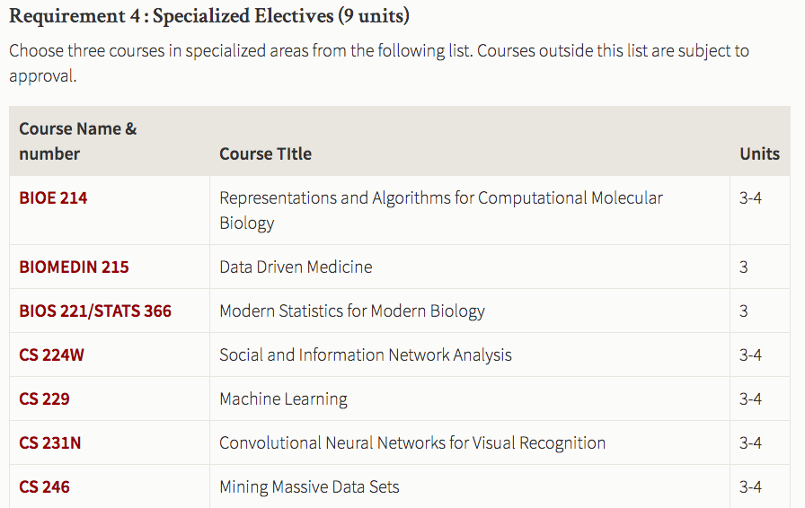
Five fundamentals in Stanford
Notes:
ex

Slide 28
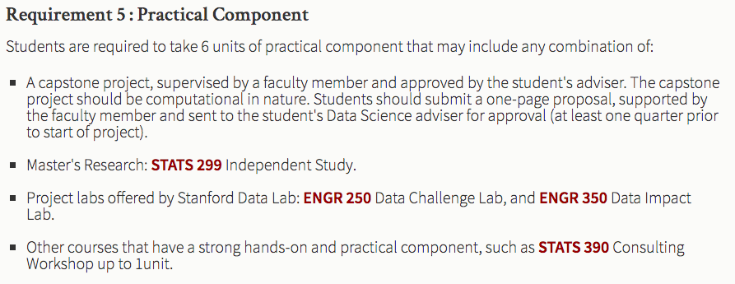
Five fundamentals in Stanford
Notes:
ex

Slide 29
Q & A
Ilyoup.kwak@gmail.com

