Slide 1
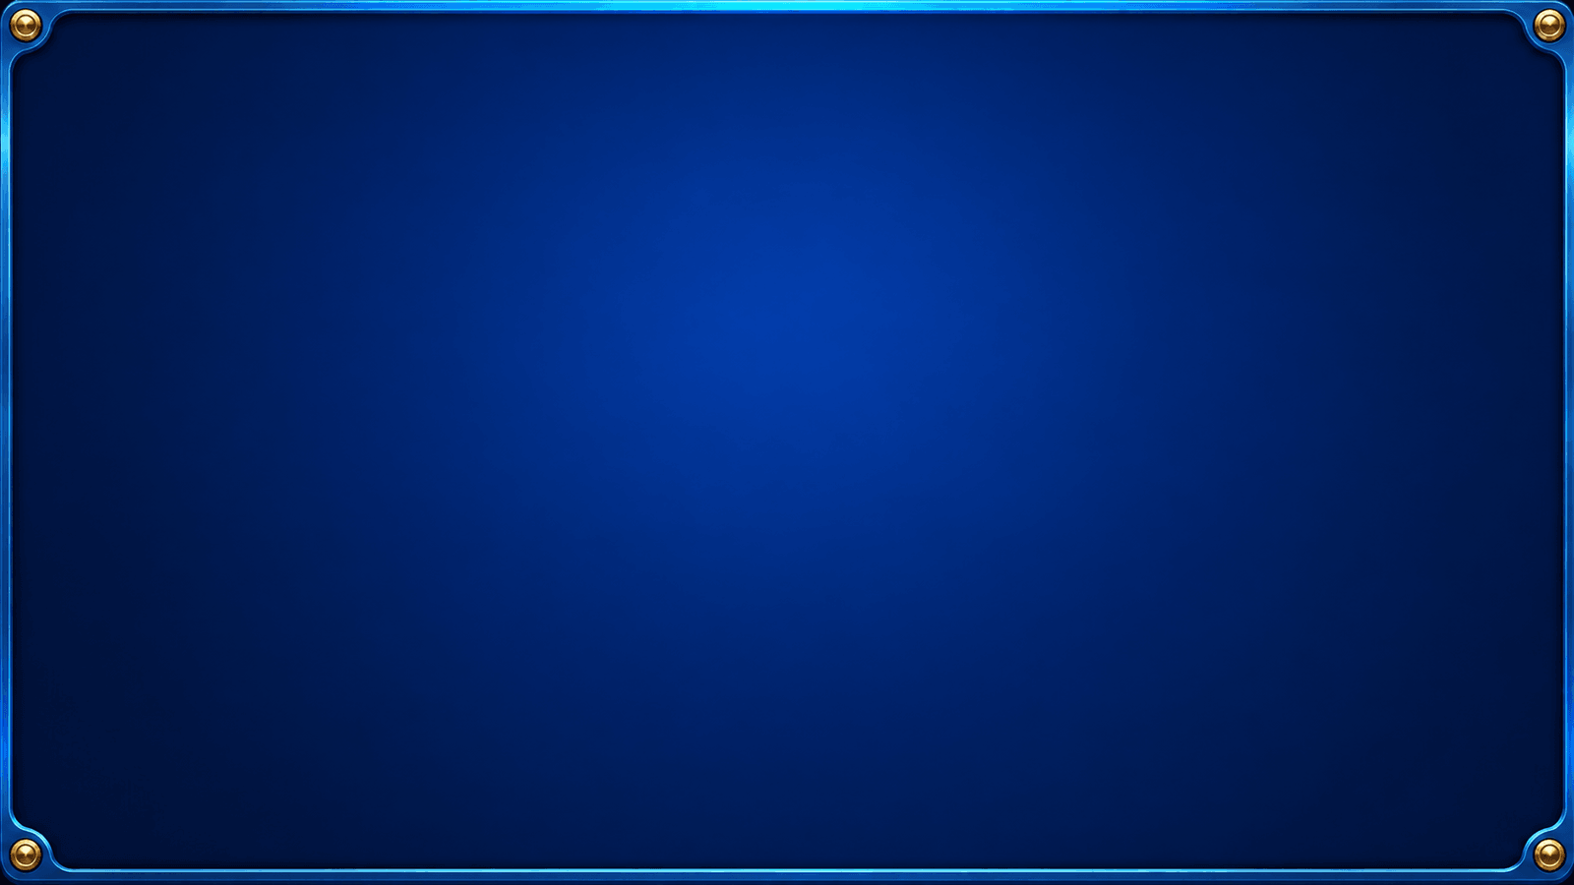

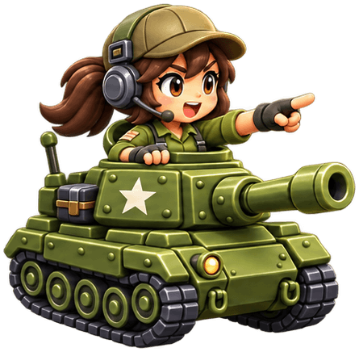
Classic tank combat,
a new battlefield
A modern remake of Battle City
for a new community of commanders.
Notes:
Player and community introduction. Battle Cities is a Unity remake of retro Battle City. The original project mascot is unchanged. Full logo supplied by the team: C:/Users/tassa/Downloads/ChatGPT Image Oct 2, 2026, 08_13_27 PM.png. It includes the tagline Build. Defend. Conquer.

Slide 2
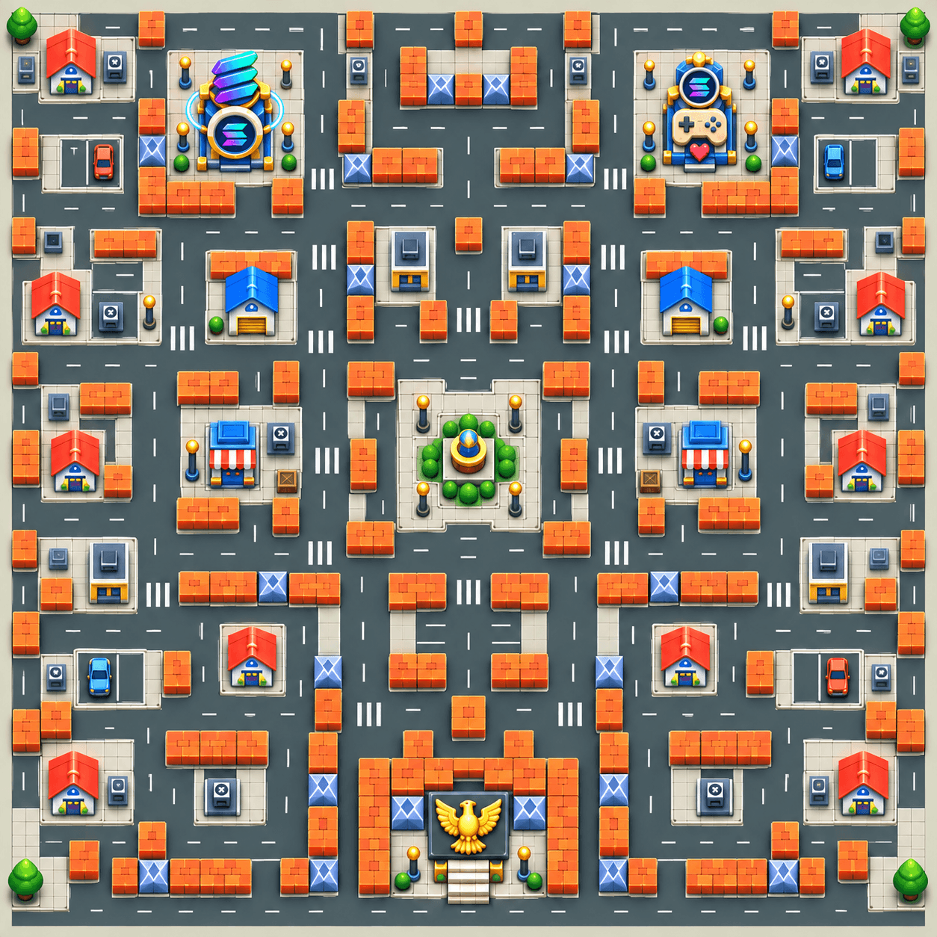
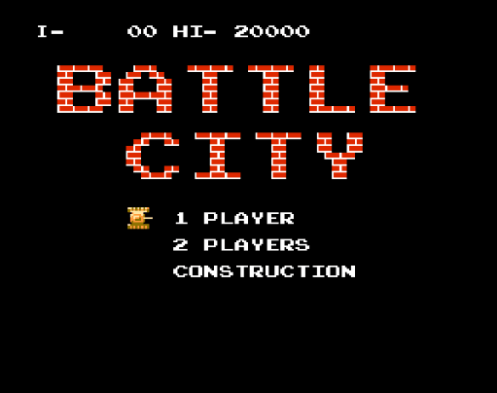
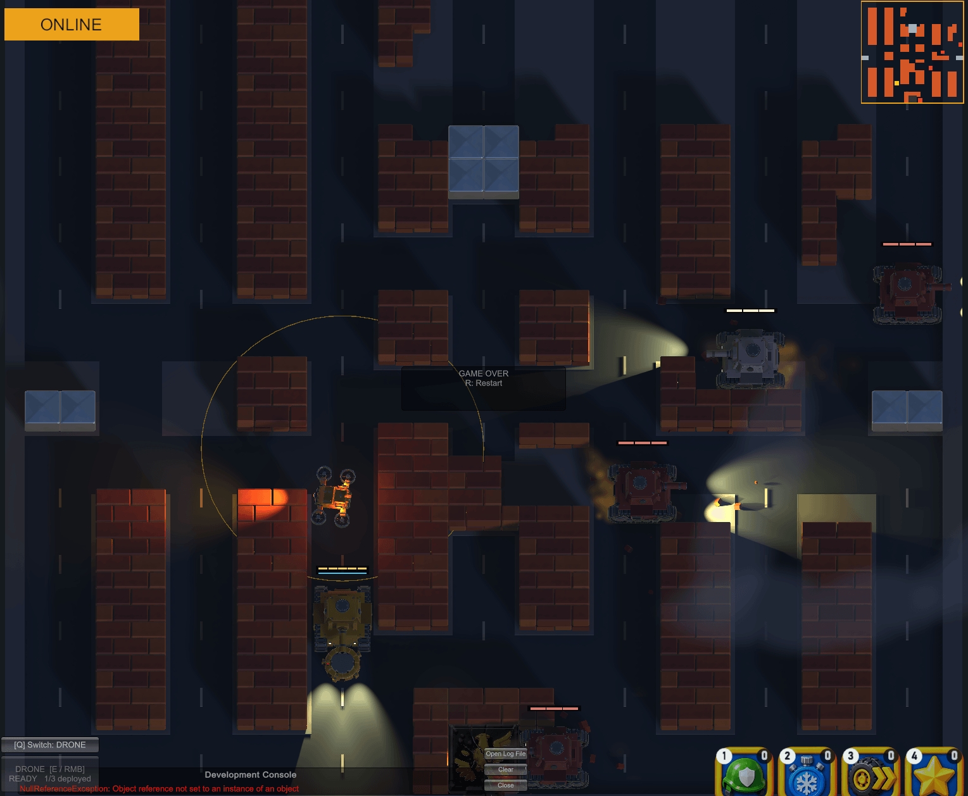
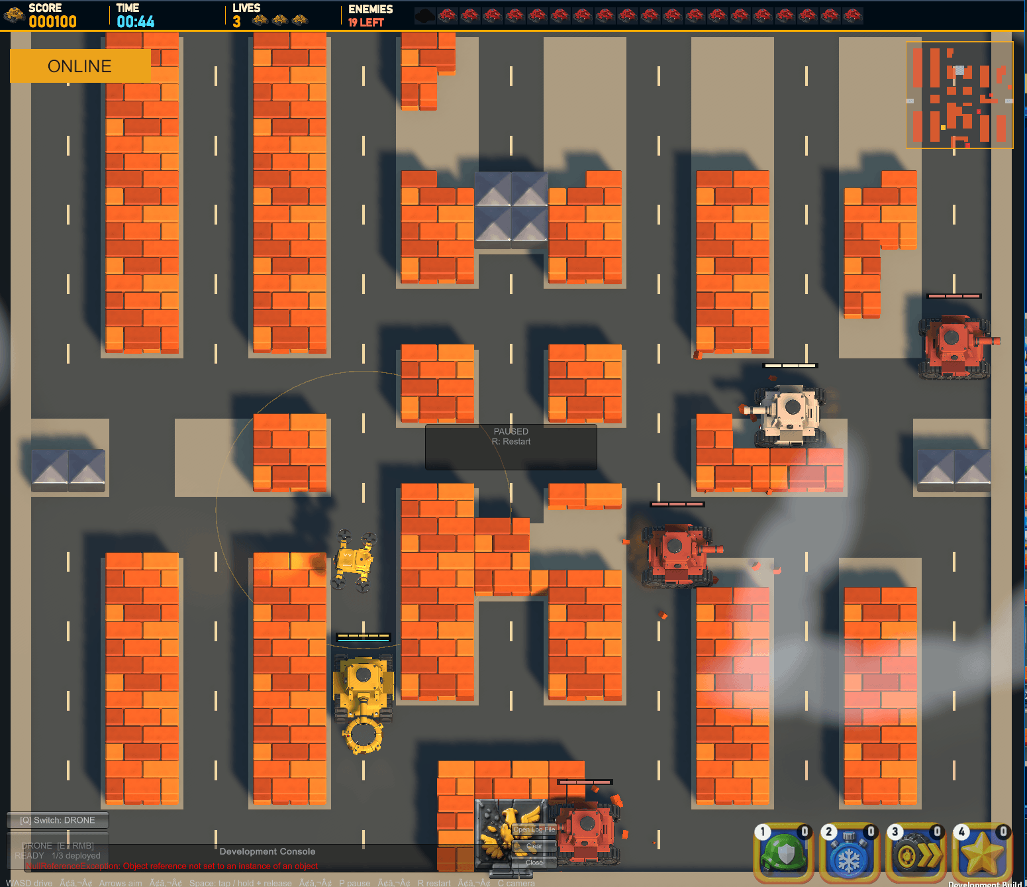
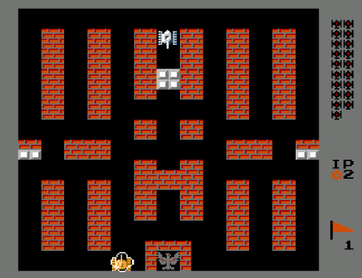
WHY BATTLE CITIES
Inspired by classic Battle City, reimagined in Unity with a modern 3D look.
OUR INSPIRATION
OUR MODERN ADAPTATION
Night combat prototype
Day combat prototype
The same base-defence challenge, with 3D tanks,
Power Shots and deployable skills.
Notes:
Battle City is the inspiration for Battle Cities, as described by the team. The two original-game screenshots and two current Unity prototype screenshots were supplied by the team. Sources: C:/Users/tassa/Desktop/utils/slides/old battle city.png; C:/Users/tassa/Desktop/utils/slides/old stage.png; C:/Users/tassa/Desktop/utils/slides/Screenshot 2026-09-25 162450.png; C:/Users/tassa/Desktop/utils/slides/Screenshot 2026-09-25 162533.png. The original screenshots show the title screen and battlefield. The adaptation screenshots show night and day combat prototypes, including development UI.

Slide 3
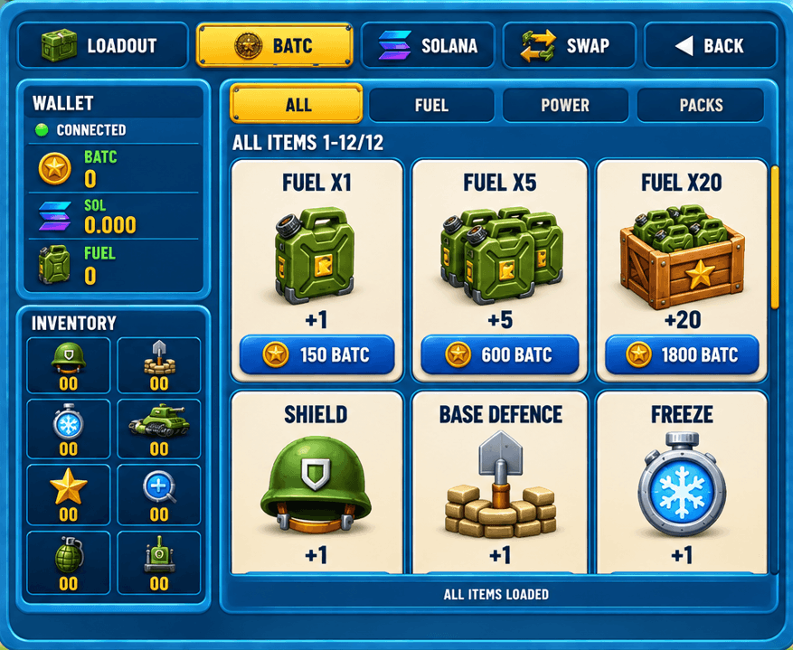
SHOP & ECONOMY
Prepare your loadout before the next run
Fuel packs
Choose 1, 5 or 20 fuel before battle.
Combat power-ups
Shield, Base Defence, Freeze and more.
Inventory & loadout
Track your items and equip your loadout.
BATC, SOL & swap
Choose a currency or use the swap tab.
Notes:
Shop screenshot supplied by the user on 2026-09-25. Displayed fuel packs: Fuel x1 150 BATC, Fuel x5 600 BATC, Fuel x20 1800 BATC. Tabs include Loadout, BATC, Solana and Swap. Screenshot replaces the decorative shop icon. Other slides preserved.

Slide 4
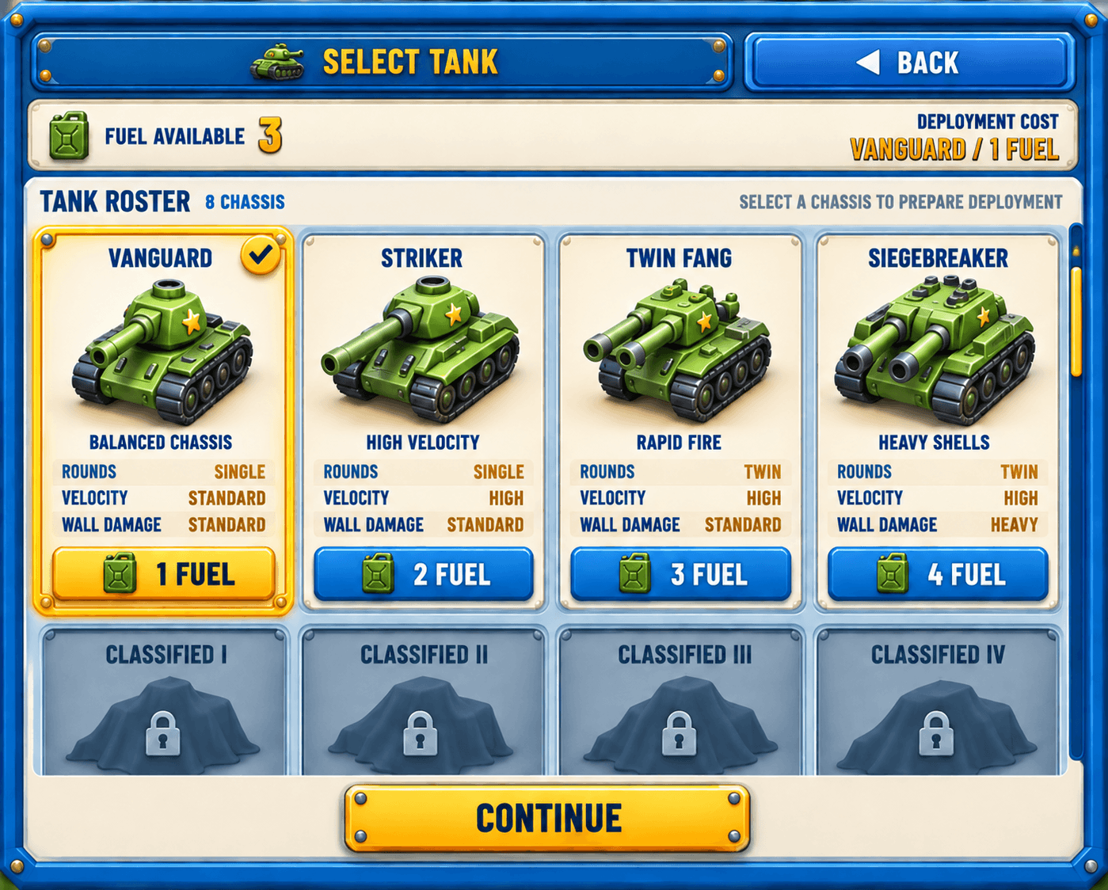
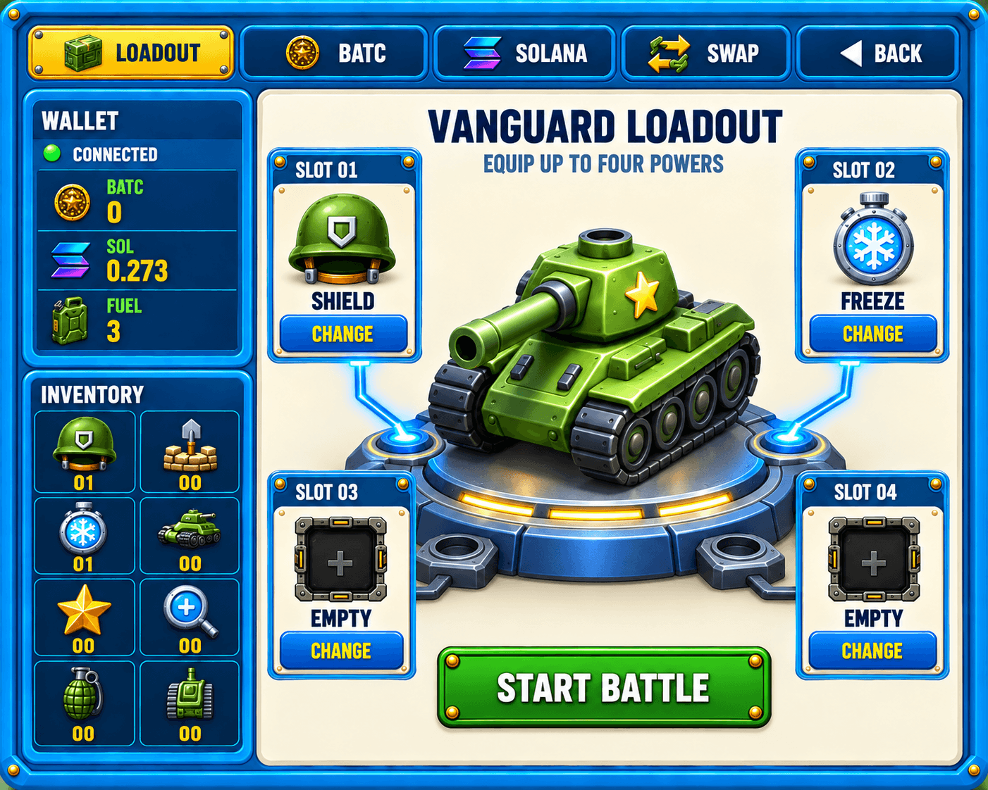
FUEL & LOADOUT
Shop purchases become fuel for deployment and powers for your loadout.
1 SELECT TANK
2 EQUIP LOADOUT
Choose a chassis; deployment uses its fuel cost.
Equip owned items in up to four slots before battle.
Notes:
The left Select Tank view is an illustrative state with 3 fuel and Vanguard selected at 1 fuel. The right-hand Loadout scene is concept artwork generated for this presentation: one three-dimensional Vanguard tank on a central podium, Shield and Freeze connected as equipped powers, and two empty slots. It reflects the four-slot loadout and purchased inventory behavior in src/webUi/ShopWebUi.ts and src/shop/ShopManager.ts. It is not a screenshot of a currently implemented loadout view. Art source: assets/loadout-vanguard-podium.png. Generation prompt: assets/loadout-vanguard-podium.prompt.txt.

Slide 5
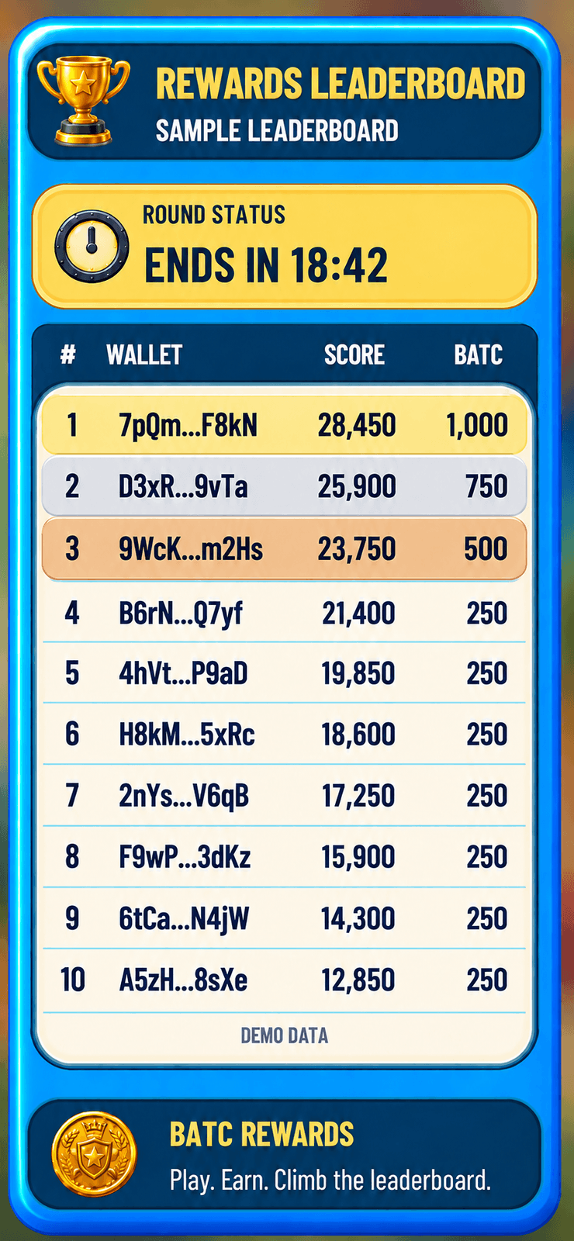



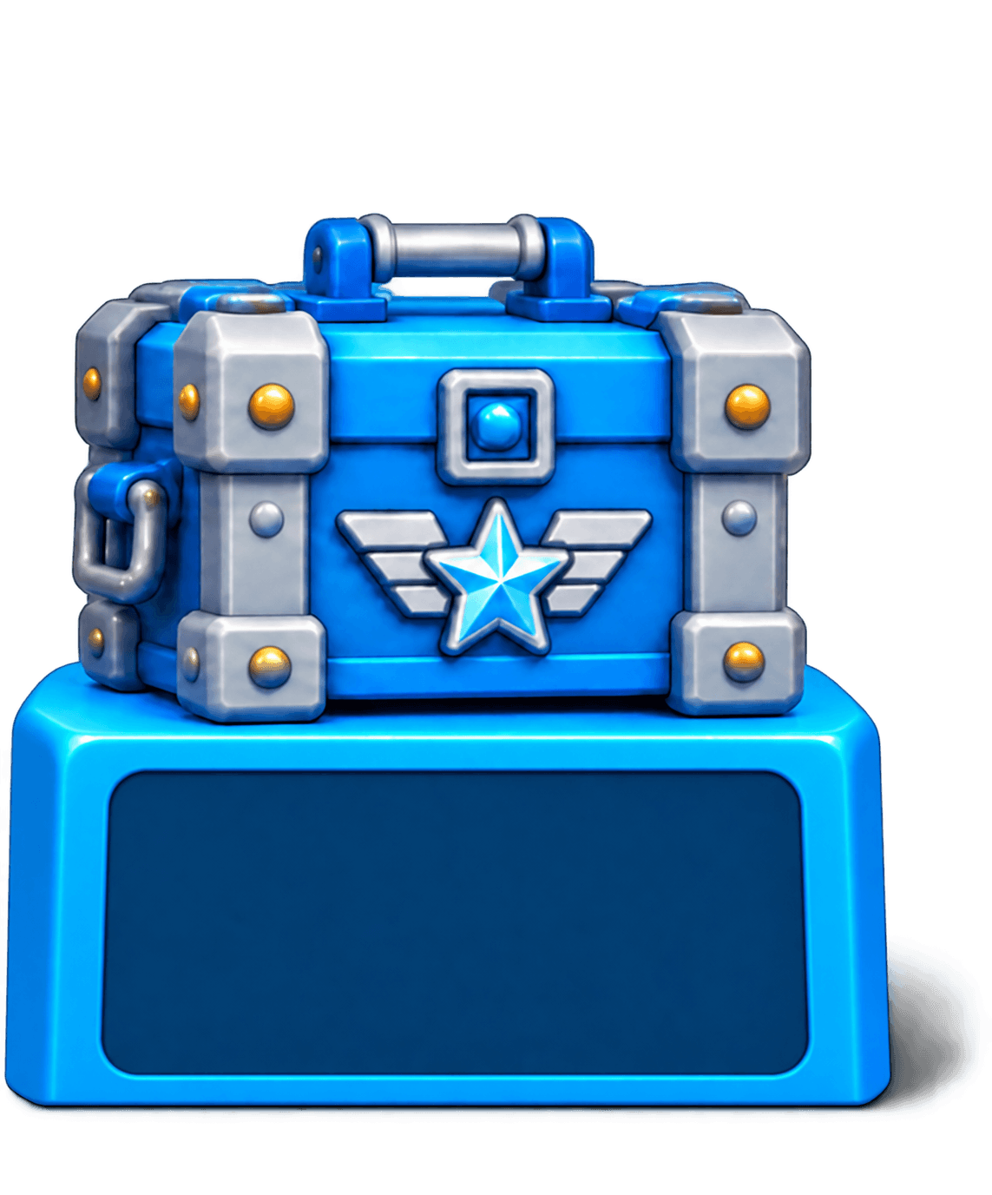
RANKING & REWARDS
Play a round. Build your score.
Challenge the top 10.
30-MINUTE ROUNDS
Finish in the top 10 before the round closes.
2ND
1ST
3RD
4TH–10TH
750 BATC
1,000 BATC
500 BATC
250 BATC
Sample wallets and scores. Current reward design.
Live rules and eligibility apply.
Notes:
The leaderboard uses fictional abbreviated Solana wallet addresses and demonstration scores. Source UI supplied by the team: C:/Users/tassa/AppData/Local/Temp/codex-clipboard-c4899264-c543-42fb-96ce-eb25301dfd5f.png. Sample panel: assets/leaderboard-wallet-sample.png. Sample rows (rank, abbreviated wallet, score, BATC): 1 7pQm...F8kN 28450 1000; 2 D3xR...9vTa 25900 750; 3 9WcK...m2Hs 23750 500; 4 B6rN...Q7yf 21400 250; 5 4hVt...P9aD 19850 250; 6 H8kM...5xRc 18600 250; 7 2nYs...V6qB 17250 250; 8 F9wP...3dKz 15900 250; 9 6tCa...N4jW 14300 250; 10 A5zH...8sXe 12850 250. Sample countdown is 18:42. Reward amounts and 30-minute round design follow the team-provided main-menu artwork. These are not live results or guaranteed payouts. Crate sources: Unity Assets/BattleCities/UI/Art/reference-style-v2/main-menu/rewards/reward-silver.png, reward-gold.png, reward-bronze.png and reward-cyan.png.

Slide 6
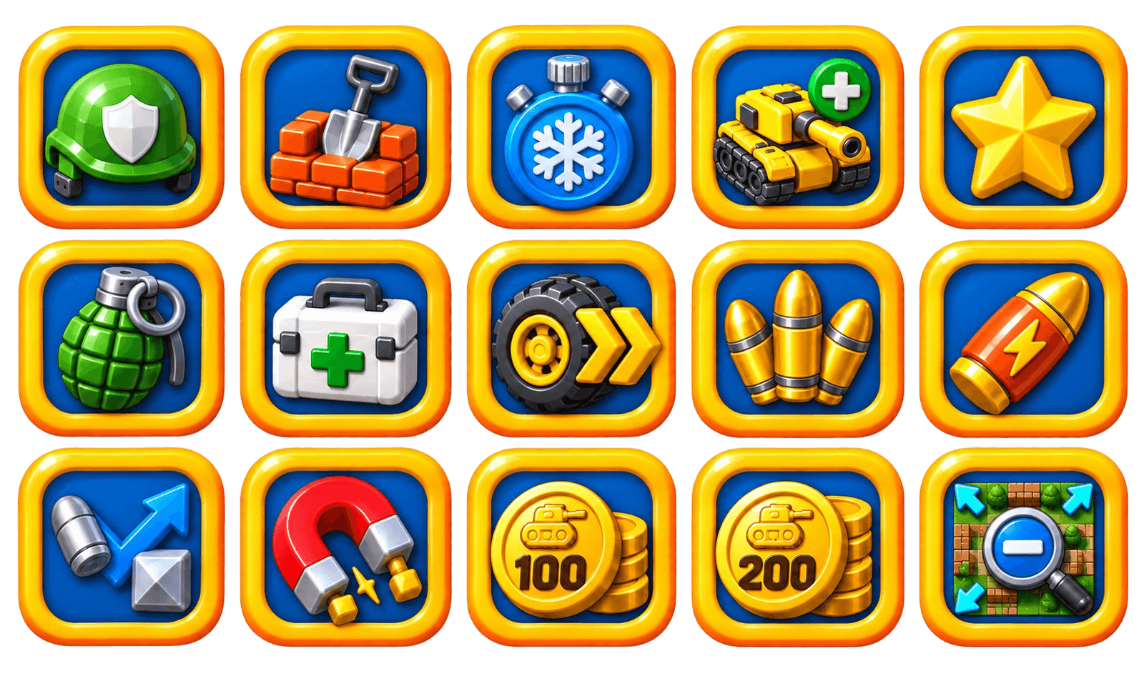
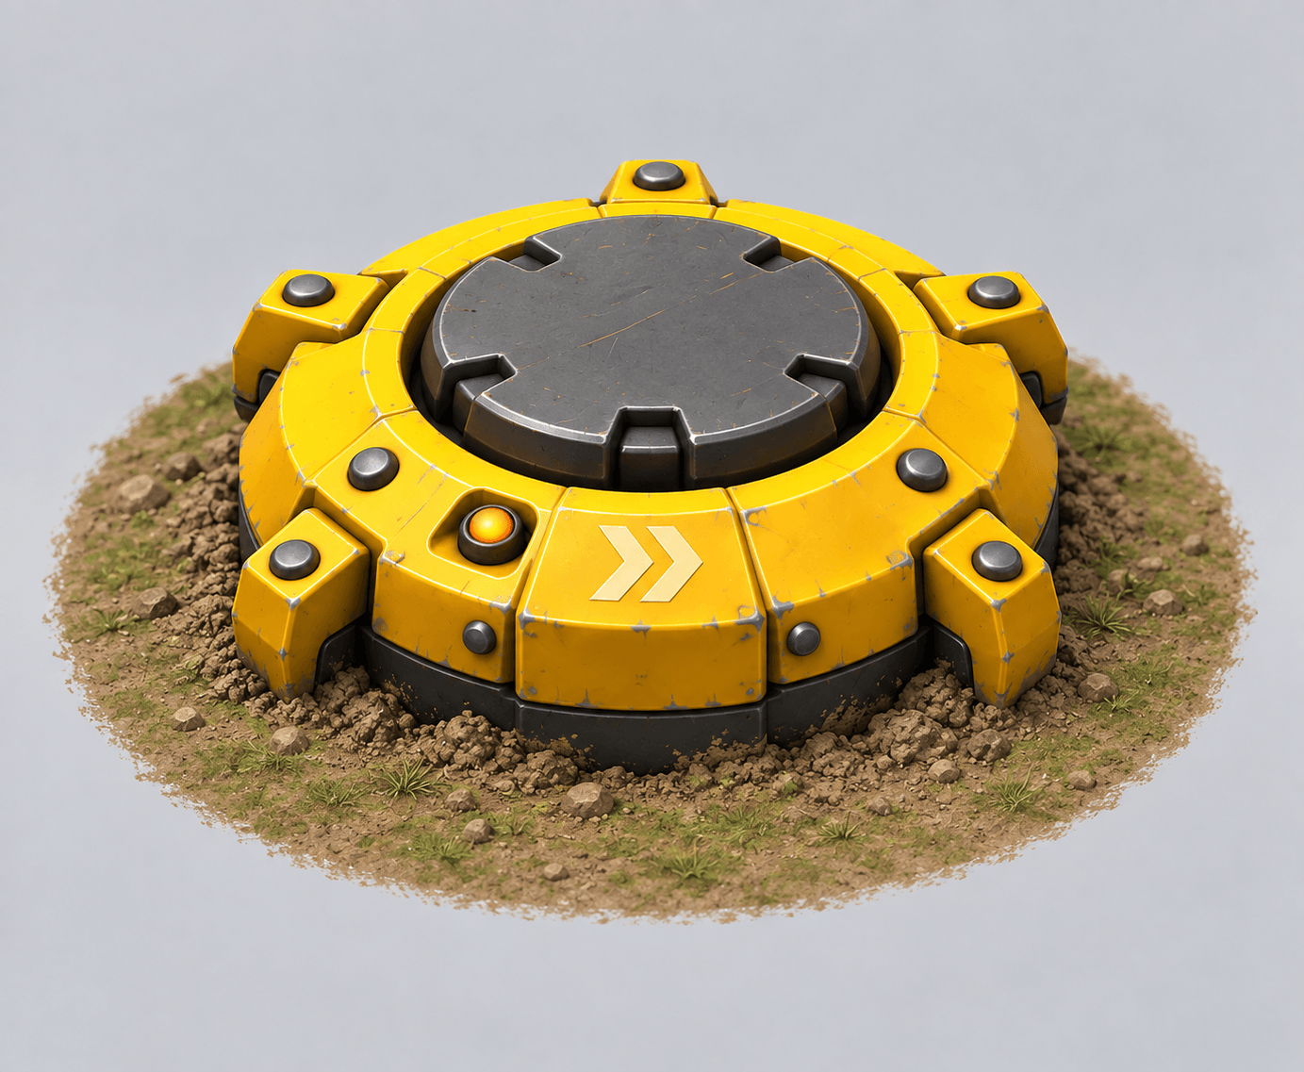
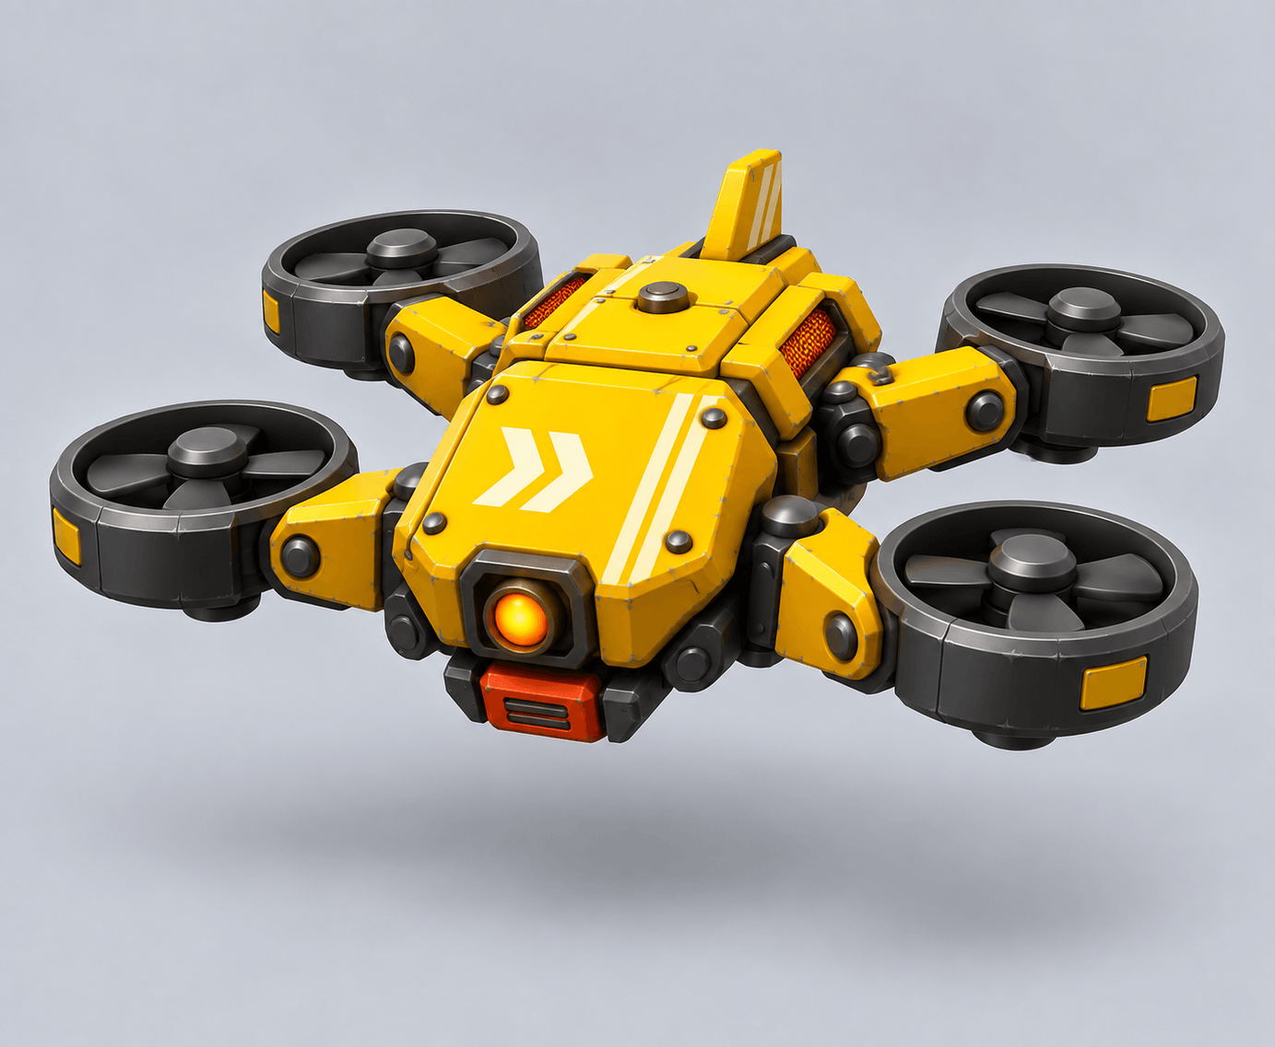
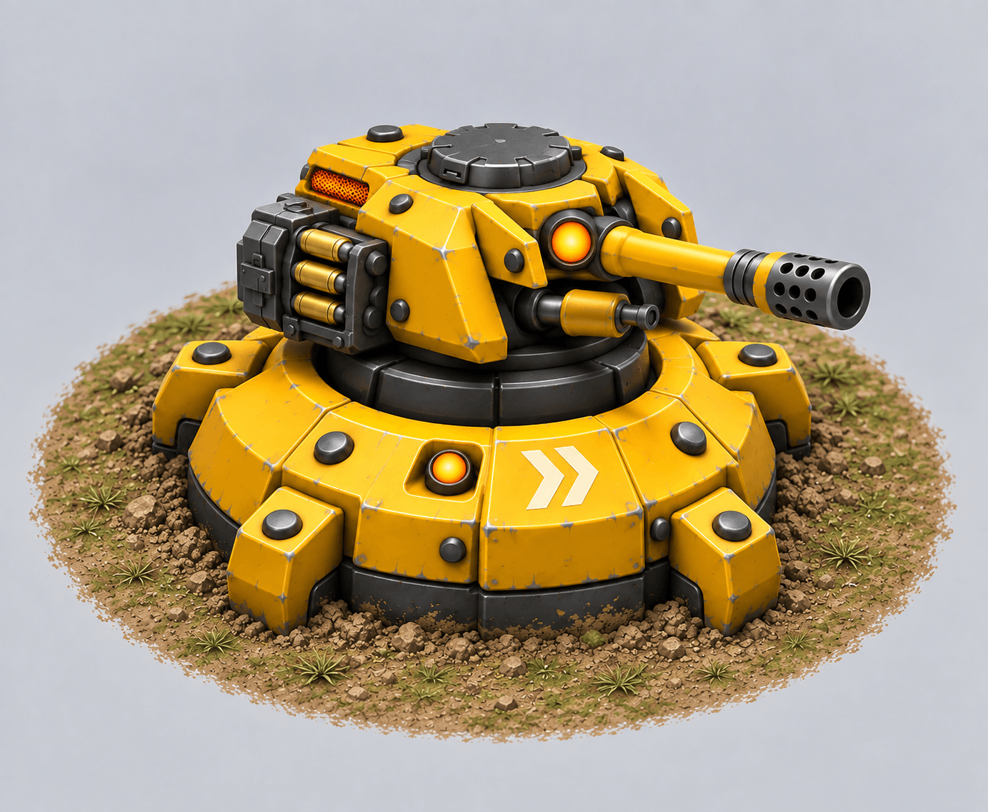
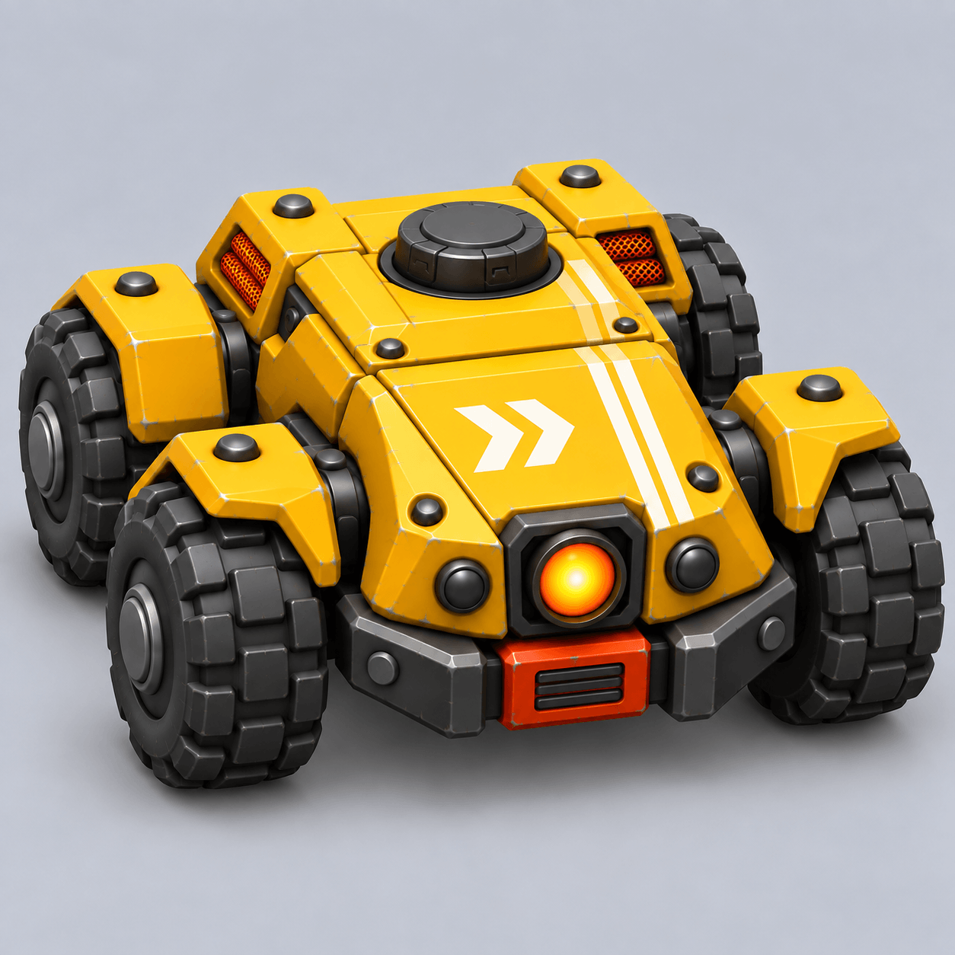
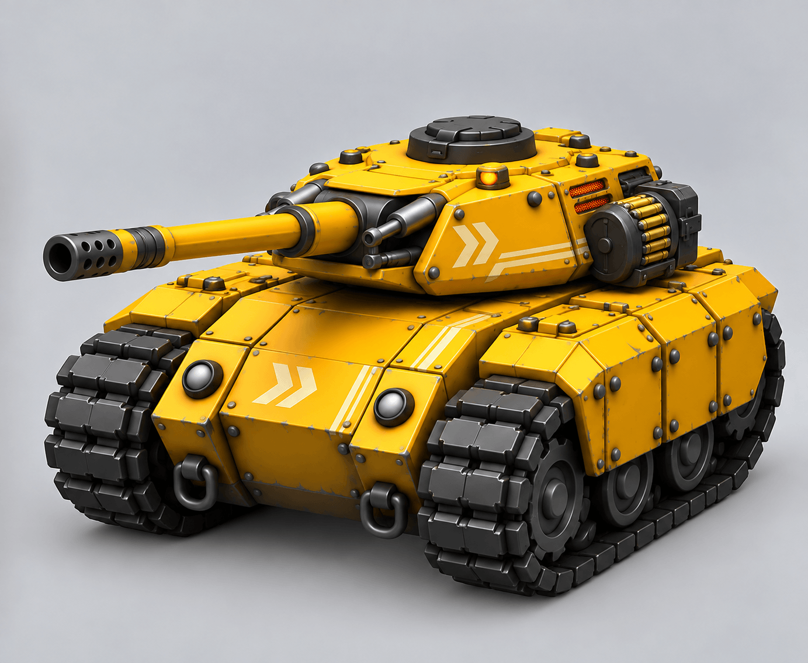
TANKS, POWER-UPS & SKILLS
POWER-UPS & PICKUPS
DEPLOYABLE SKILLS
Shield
Base Defence
Freeze
Extra Life
Upgrade
Mines
Patrol Drone
Wipeout
Speed
Zoom Out
100 BATC
200 BATC
TANK TYPES
A Standard B Fast
C Power D Armored
Ground Turret
Land Drone
Enemy tiers A–D
POWER SHOT
Charge 1 second. Triple damage.
Breaks steel.
Player upgrades: faster shots and reload
Notes:
Visuals reused from original generated Battle Cities assets, not regenerated. Power-up sprites are presentation crops of the Unity atlas at Assets/BattleCities/Art/Powerups/atlas.png. Deployables: output/art/powerups/planted-ground-mine.png, attack-drone.png, ground-sentry/ground-sentry-concept.png, land-drone/land-attack-drone-precise.png. Tank concept: output/art/tanks/fast-shooter-tank-concept.png. The tank image illustrates the design language; names A–D describe enemy tiers and do not imply four rendered variants. Power Shot icon is illustrative from the atlas. Gameplay definitions from Unity BattleSimulation.cs and ChargedFireInput.cs. BATC pickups from src/powerup/PowerupType.ts.

