Slide 1

Information Hiding: Watermarking and Steganography
Content may be borrowed from other resources.
See the last slide for acknowledgements!
Amir Houmansadr
CS660: Advanced Information Assurance
Spring 2015

Slide 2
Principles of assurance: CIA
Confidentiality
Keeping data and resources hidden
Integrity
Data integrity (integrity)
Origin integrity (authentication)
Availability
Enabling access to data and resources
Notes:
Confidentiality: a good example is cryptography, which traditionally is used to protect secret messages. But cryptography is traditionally used to protect data, not resources. Resources are protected by limiting information, for example by using firewalls or address translation mechanisms.
Integrity: a good example here is that of an interrupted database transaction, leaving the database in an inconsistent state (this foreshadows the Clark-Wilson model). Trustworthiness of both data and origin affects integrity, as noted in the book’s example. That integrity is tied to trustworthiness makes it much harder to quantify than confidentiality. Cryptography provides mechanisms for detecting violations of integrity, but not preventing them (e.g., a digital signature can be used to determine if data has changed).
Availability: this is usually defined in terms of “quality of service,” in which authorized users are expected to receive a specific level of service (stated in terms of a metric). Denial of service attacks are attempts to block availability.

Slide 3
Confidentiality
Encryption is the main tool
But, sometimes it is not enough!
Examples:
Drug dealer
Military scenario
Whistleblower
Etc.

Slide 4
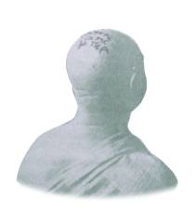
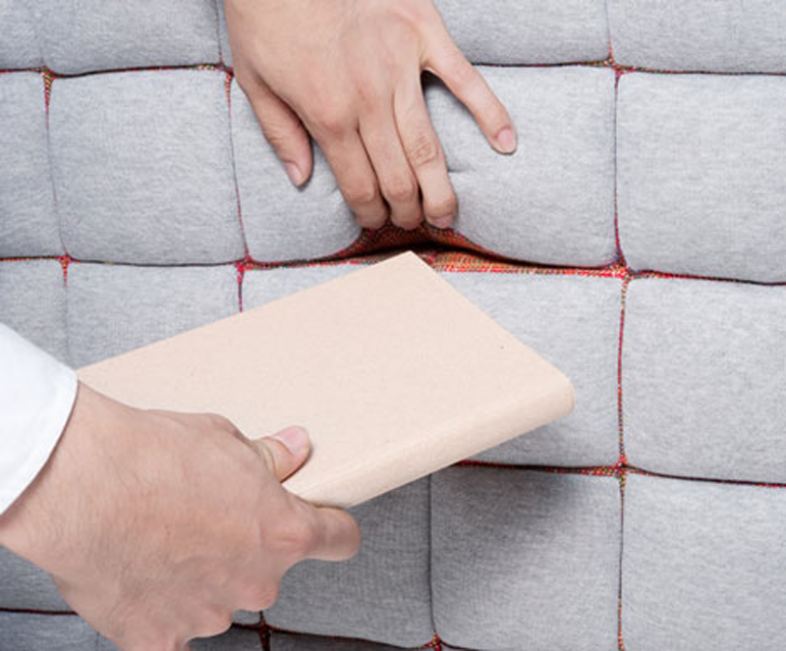
Information Hiding
IH dates back to ancient Greece and Persia
Well, not this type of hiding
Notes:
Ancient Chinese wrote messages on fine silk, which was then crunched into a tiny ball and covered in wax. The messenger then swallowed the ball of wax.
In the sixteenth century, the Italian scientist Giovanni Porta described how to conceal a message within a hard-boiled egg by making an ink from a mixture of one ounce of alum and a pint of vinegar, and then using ink to write on the shell. The ink penetrated the porous shell, and left the message on the surface of the hardened egg albumen, which could be read only when the shell was removed.
Special “inks” were important steganographic tools even during Second World War.
During Second World War a technique was developed to shrink photographically a page of text into a dot less than one millimeter in diameter, and then hide this microdot in an apparently innocuous letter. (The first microdot has been spotted by FBI in 1941.)

Slide 5
(Digital) Information Hiding
Definition: Concealing the very existence of some kind of information (e.g., a series of data bits, the identity of the communicating party, etc.) for some specific purpose (e.g., to prove ownership, to remain untraceable, etc.)

Slide 6
Information confidentiality protection
IH does not intend to hide the contents of information
Encryption
Information confidentiality protection tools can be combined with information hiding techniques

Slide 7
Applications, or why we need to hide information
Improve confidentiality by hiding the very existence of messages
Prove ownership on digital media
Fingerprint media for trace back
Blocking resistance
Forensics
…

Slide 8
Classes of Information Hiding
Steganography
Digital watermarking
Covert channels
Anonymous communication
Protocol obfuscation
Not a class of information hiding:
Encryption
There are various classifications

Slide 9
Steganography
Embedding some information (stegotext) within a digital media (covertext) so that the digital media looks unchanged (imperceptible) to a human/machine

Slide 10
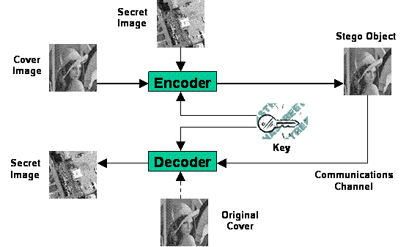
General model

Slide 11
Why can we hide?
Because there are unused/redundant data bits in digital media, that changing them will be imperceptible
E.g., image compression significantly reduces the size of an image by removing some of the redundant information bits.
The unused/redundant data can be used to hide some digital information

Slide 12
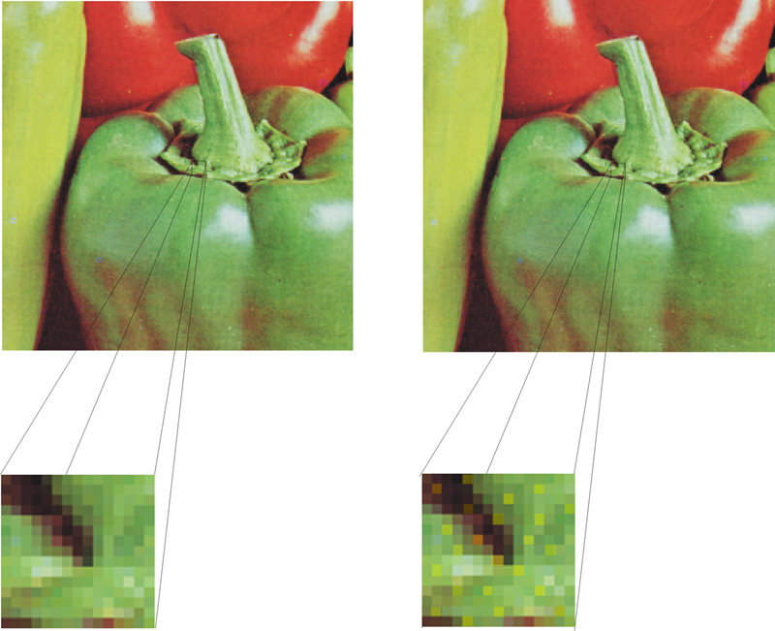
Example
Notes:
The human visual and auditory systems are not perfect.

Slide 13
Types of Cover Media
We can hide information in pretty much any digital media:
Audio
Image
Video
Graphics
Text files
Software
Digital events (e.g., timings)
Network traffic

Slide 14
Classes of Information Hiding
Steganography
Digital watermarking
Covert channels
Anonymous communication
Protocol obfuscation
Not a class of information hiding:
Encryption
There are various classifications

Slide 15
Digital watermarking
Embedding some information (watermark) within a digital media (covertext) so that the digital media looks unchanged (imperceptible) to a human/machine

Slide 16
Watermarking vs. Steganography
Watermarking:
The hidden information itself is not important by itself (no secure), it says something about the covertext
Steganography:
The covertext has no value, it is only there to convey the stegotext. Stegotext is the valuable information, and is independent of covertext.

Slide 17
Applications: Watermarking vs. Steganography
Watermarking:
Authenticity: proof of ownership
Fingerprinting: piracy tracking
Integrity: tamper detection
Data augmentation: add meta-data
Steganography
Stealthy communication of messages
Watermarking usually needs lower data capacity

Slide 18
Attacks: Watermarking vs. Steganography
Attacker’s objective:
Watermarking: remove the watermark without distorting the covertext, or change the covertext without distoring the watermark
Steganography: detect the presence of the hidden message, and extract it

Slide 19
Types of watermarking/steganography
Fragile vs. robust
Fragile is expected to destroy with modifications. Robust is expected to survive noise.

Slide 20
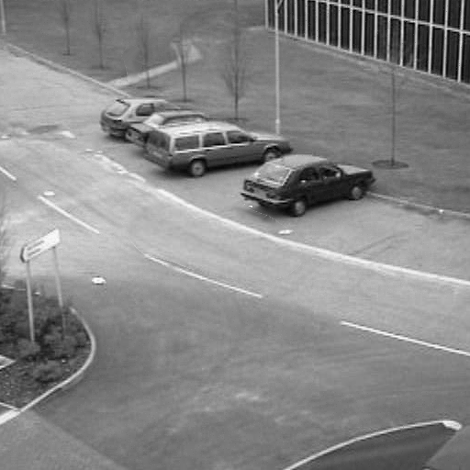
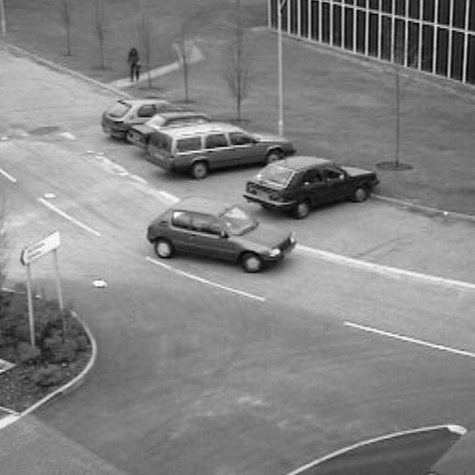
Example application: tamper detection
Original Image
Tampered Image

Slide 21
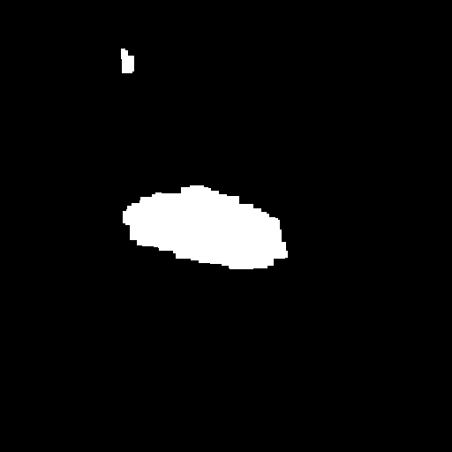
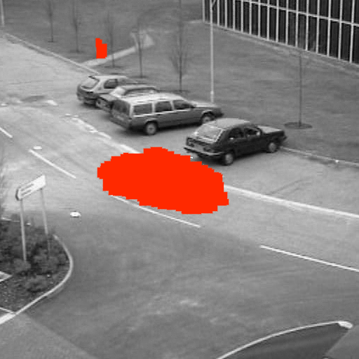
Example application: tamper detection

Slide 22
Types of watermarking/steganography
Fragile vs. robust
Fragile is expected to destroy with modifications. Robust is expected to survive noise.
Blind vs. semi-blind vs. non-blind
Blind needs the original covertext for detection. Semi-blind needs some information from the insertion, but not the whole covertext.

Slide 23
A blind scheme

Slide 24
Types of watermarking/steganography
Fragile vs. robust
Fragile is expected to destroy with modifications. Robust is expected to survive noise.
Blind vs. semi-blind vs. non-blind
Blind needs the original covertext for detection. Semi-blind needs some information from the insertion, but not the whole covertext.
Pure vs. secret key vs. public key
Pure needs no key for detection. Secret key schemes needs a secret key for both embedding and detection. Public key schemes use a secret key for embedding, a secret key for detection.

Slide 25
Pure vs. secret key vs. public key

Slide 26
Example Steganography scheme
LSB-based image steganography

Slide 27
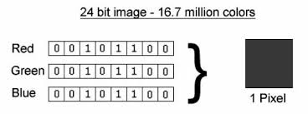
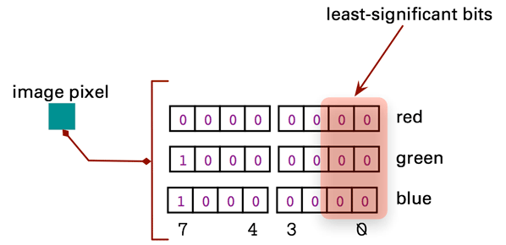
A digital image

Slide 28
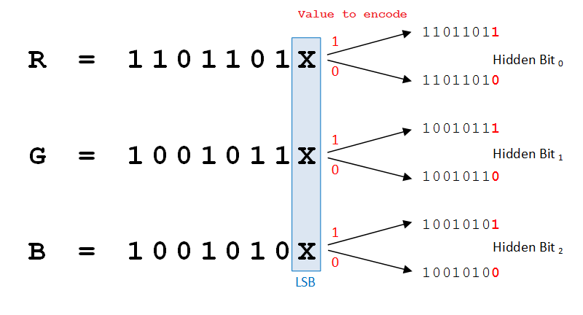
LSB-based steganography

Slide 29
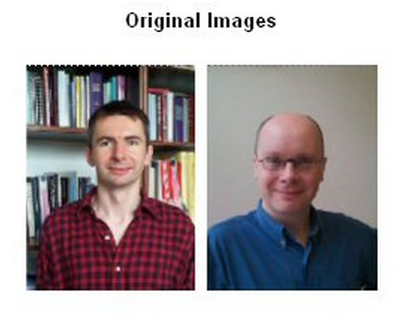

Slide 30
Using multiple bits
Bits used=1
Host pixel: 10110001
Secret pixel: 01100110
Resulted pixel: 10110000
Bits used=4
Host pixel: 10110001
Secret pixel: 01100110
Resulted pixel: 10110110

Slide 31
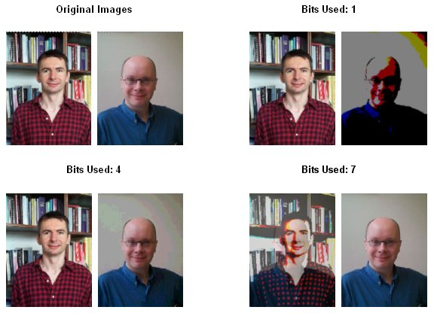
Example scheme: LSB-based steganography

Slide 32
Transform-domain schemes
This is fragile!
Sources of noise: compression, resizing, cropping, rotating, AWGN, etc.
For robust watermarking, embed into transform domains
DWT
DCT

Slide 33
Watermarking model
Consider an image I, a watermark key k, and a watermark signal w produced by a watermark generated algorithm, e.g., a pseudorandom generator
Watermark is embedded as I_{w}=F⁻¹(F(I)*w)
Detector should detect the presence of the watermark from the noisy image:
I_{N}=(F⁻¹(F(I)*w))#N
Sources of noise: compression, resizing, cropping, rotating, AWGN, etc.

Slide 34
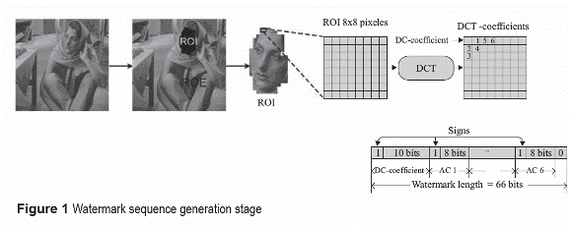
DCT-based watermark

Slide 35
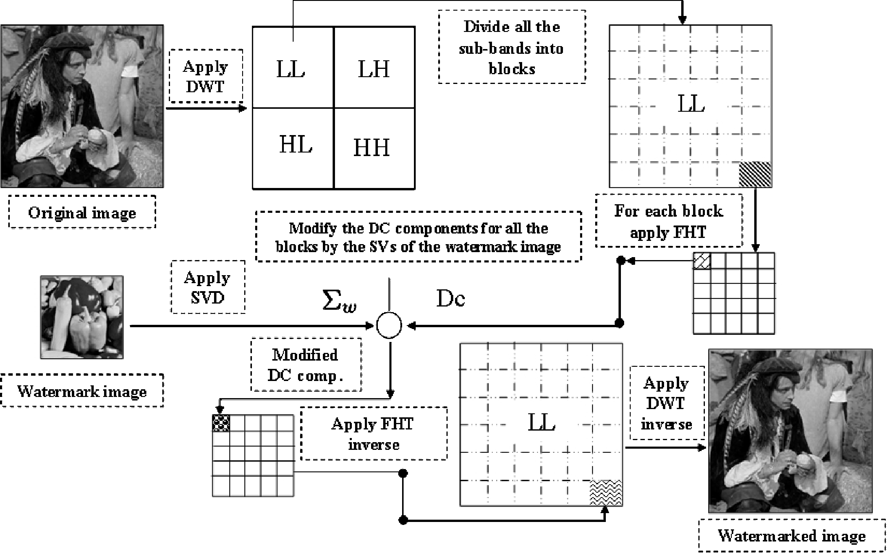
Wavelet-based watermark

Slide 36
Why is it more robust?

Slide 37
Watermark attacks
Robustness attacks: remove or diminish the presence of watermark
Presentation attacks: modify the content so that detector can not find the hidden watermark
Interpretation attacks: prevent assertion of ownership, e.g., re-watermarking

Slide 38
Practical challenges of watermarks?

Slide 39
Classes of Information Hiding
Digital watermarking
Steganography
Covert channels
Anonymous communication
Protocol obfuscation

Slide 40
Acknowledgement
Some of the slides, content, or pictures are borrowed from the following resources, and some pictures are obtained through Google search without being referenced below:
https://www.cs.bham.ac.uk/~mdr/teaching/modules03/security/students/SS5/Steganography.htm
http://poseidon.csd.auth.gr/LAB_SEMINARS/DigDays/Lectures/Information_Hiding.ppt

