Slide 1
Privacy and Anonymity Using Mix Networks*
Slides borrowed from Philippe Golle, Markus Jacobson

Slide 2
Contents
Mix Network (Mixnet)
Mixnet Applications
Mixnet Requirements
Robustness of Mixnets
Checking a Mixnet’s Robustness

Slide 3
Definition: Mix Server
Mix Server
?
Inputs
Outputs
A mix server:
  Receives inputs
  Produces “related” outputs
  The relationship between inputs and outputs is secret
Notes:
a mix server receives a set of inputs and produces related outputs so that the relationship between inputs and outputs can not be learned by anyone but the mix server.

Slide 4
Definition: Mix Network
Mix network
A group of mix servers that operate sequentially.
Server 1
Server 2
Server 3
?
?
?
Inputs
Outputs
Notes:
a mix server receives a set of inputs and produces related outputs so that the relationship between inputs and outputs can not be learned by anyone but the mix server.

Slide 5
Applications
Hide: ➔ “who voted for whom?” ➔ “who paid whom?”
➔ “who said what?”
Good for protecting privacy for
election and communication
Used as a privacy building block

Slide 6

Electronic Voting Demonstration
“Who do you like best?”
Put your ballot into
an WHITE envelope
and put again in a RED one and sign on it
  Washington
  Lincoln
  Roosevelt
Jerry

Slide 7

Electronic Voting Demo. (Cont’d)
Administrators will
Verify signatures together
1st Admin. shuffles and opens RED envelopes
Send them to 2nd Admin.
2nd Admin. shuffles again and opens WHITE envelopes
Count ballots together

Slide 8
A real system for elections
Sign _{voter 1} (encr(encr (vote₁)))
Sign _{voter 2} (encr(encr (vote₂)))
.
.
.
Sign _{voter n} (encr(encr (vote_{n})))
vote₁
vote₂
vote₃
.
.
vote_{n}
Mix
Net
Mix
Net
  Washington
  Lincoln
  Roosevelt
Jerry

Slide 9
Electronic Payment Demo.
“Choose one person you like to pay $5”
Put your ballot into
an WHITE envelope
and put again in a RED one and sign on it
  Name of the person
  ( ___________ )
Jerry

Slide 10

Electronic Voting Demo. (Cont’d)
Administrators will
Verify signatures together
Deduct $5 from each account
1st Admin. shuffles and opens RED envelopes
Send them to 2nd Admin.
2nd Admin. shuffles again and opens WHITE envelopes
Credit $5 to recipients

Slide 11
For payments
Sign _{payer 1} (encr(encr (payee₁)))
Sign _{payer 2} (encr(encr (payee₂)))
.
.
.
.
.
Sign _{payer n} (encr(encr (payee_{n})))
payee₁
payee₂
payee₃
.
.
payee_{n}
D
E
D
U
C
T
Mix
Net
Credit
  Name
  (________ )
Jerry

Slide 12

For email communication
.
.
.
encr (email₁, addressee₁)
encr (email₂, addressee₂)
.
.
.
encr (email_{n}, addressee_{n})
Mix
Net
  To: Jerry
  Don’t forget to have lunch.
Deliver

Slide 13
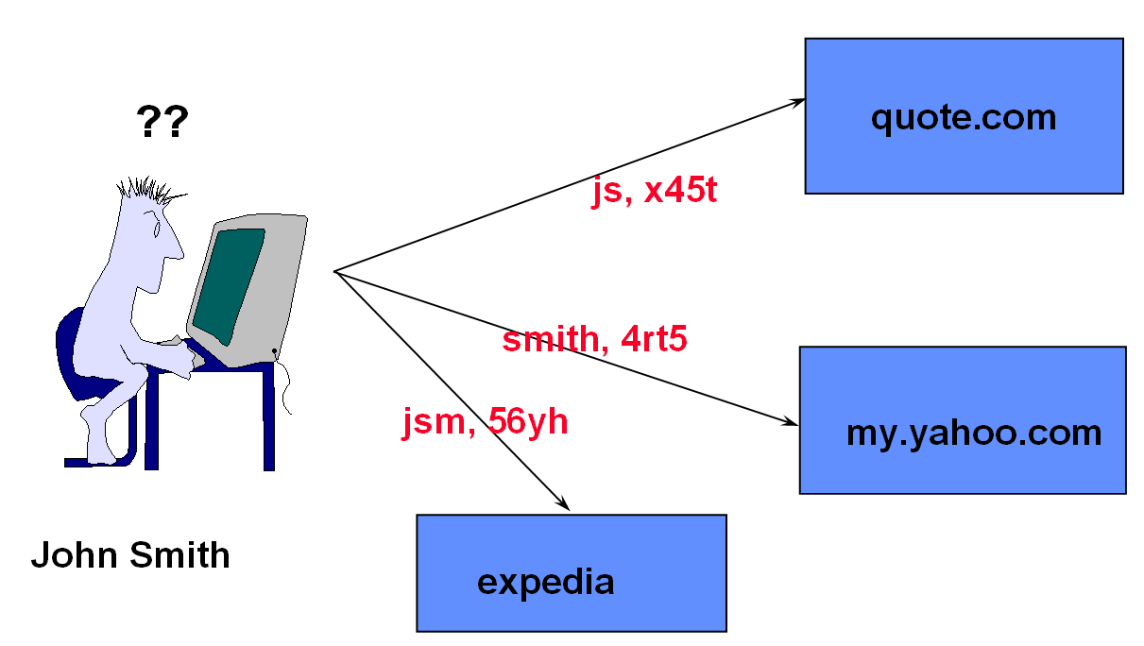
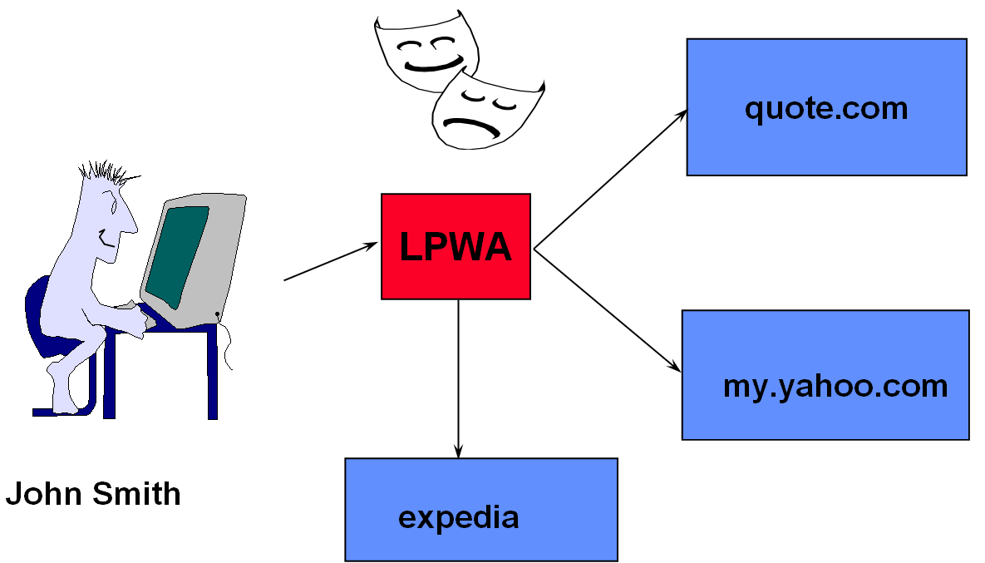
Other uses
Anonymous web browsing
(LPWA Anonymizer)
From LPWA homepage

Slide 14
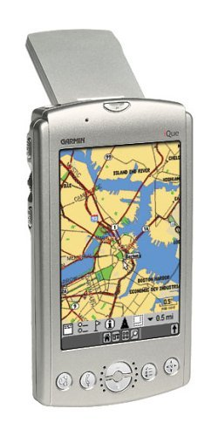
Other uses (Cont’d)
Location privacy for cellular devices
  Location-based service is GOOD !
    Landline-phone calling to 911 in the US, 112 in Europe
    All cellular carrier by December 2005
  RISK !
    Location-based spam
    Harm to a reputation

Slide 15
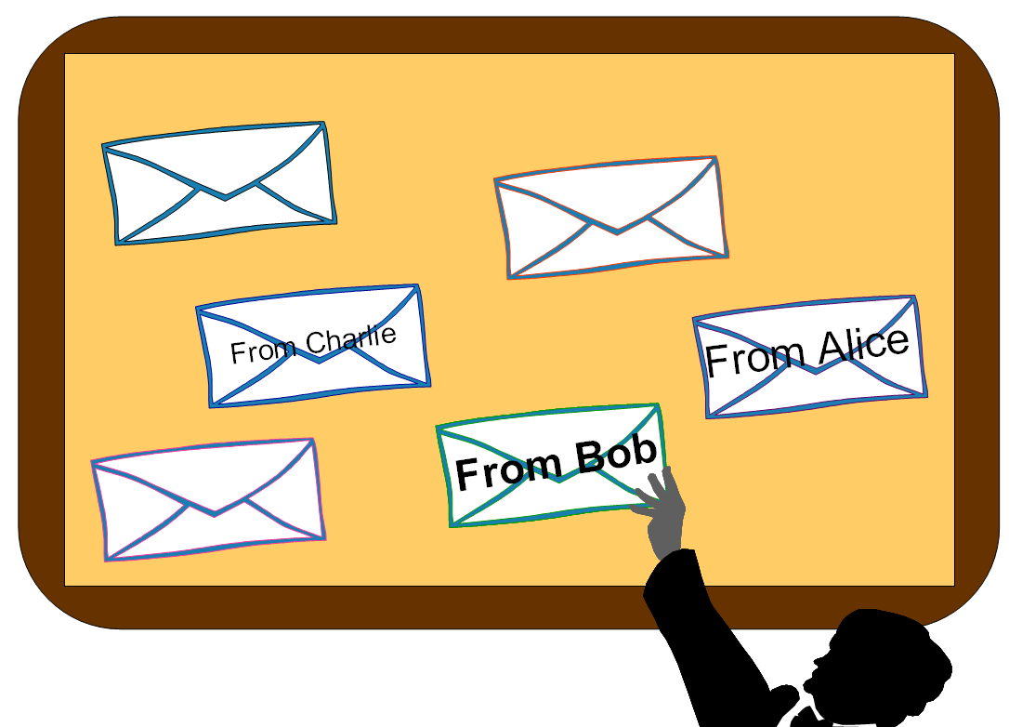
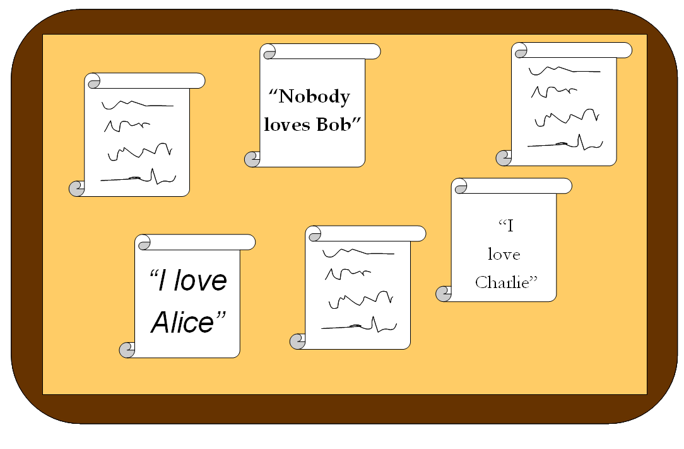
Other uses (Cont’d)
Anonymous bulletin boards
Mix
From A. Juels at WOTE’01

Slide 16
Other uses (Cont’d)
Sometimes abuses
Avoid legislation (e.g., piracy)

Slide 17
Other Used
RFID Privacy

Slide 18
Principle
Chaum ’81
server 1
server 2
server 3
Message 1
Message 2
Issues :
Privacy
Efficiency
Trust
Robustness

Slide 19
But what about robustness?
I ignore his output
and produce my own
encr(Berry)
encr(Kush)
encr(Kush)
Kush
Kush
Kush
STOP
There is no robustness!

Slide 20
Requirements
Privacy Nobody knows who said what
Efficiency Mixing is efficient (= practically useful)
Trust How many entities do we have to trust?
Robustness Will replacement cheaters be caught?

Slide 21
Zoology of Mix Networks
?
Inputs
Outputs
Decryption Mix Nets [Cha81,…]:
  Inputs: ciphertexts
  Outputs: decryption of the inputs.
Re-encryption Mix Nets[PIK93,…]:
  Inputs: ciphertexts
  Outputs: re-encryption of the inputs

Slide 22
First Solution
Chaum ’81, implemented by Syverson, Goldschlag
Not robust
(or: tolerates 0 cheaters for correctness)
Requires every server to participate
(and in the “right” order!)

Slide 23
Re-encryption Mixnet
0. Setup: mix servers generate a shared ElGamal key
1. Users encrypt their inputs:
Pub-key
Input
Input
2. Encrypted inputs are mixed:
Server 1
Server 2
Server 3
re-encrypt
& mix
re-encrypt
& mix
re-encrypt
& mix
Proof
Proof
Proof
3. A quorum of mix servers decrypts the outputs
Output
Priv-key
Output

Slide 24
Recall: El Gamal encryption
Public parameters: q is a prime
p = 2^{k}q+1 is a prime
g generator of Gp
Secret key of a user: x (where 0 < x < q)
Public key of this user: y = g^{x} mod p

Slide 25
El Gamal Encryption (encrypt m using y)
For message (or “plaintext”) : m
Pick a number k randomly from [0…q-1]
Compute a = y^{k}. m mod p b = g^{k} mod p
Output (a,b)
Decryption technique (to decrypt (a,b) using x)
Compute m a / b^{x} (= y^{k}. m = g^{xk}. m)
(g^{k})^{x} g^{kx}

Slide 26
Re-encryption technique
Input: a ciphertext (a,b) wrt public key y
Pick a number α randomly from [0…q-1]
Compute a’ = y^{α} . a mod p b’ = g^{α} . b mod p
Output (a’, b’)
Same decryption technique!
Compute m a’ / b’^{x} (= y^{k}. y^{α} . m = g^{x (k+α)}. m)
(g^{k} . g^{α} )^{x} g ^{(k+α)x}

Slide 27
A simple mix
R
E
-
E
N
C
R
Y
P
T
R
E
-
E
N
C
R
Y
P
T
(a₁, b₁)
(a₂, b₂)
.
.
.
(a_{n}, b_{n})
(a’₁,b’₁)
(a’₂,b’₂)
.
.
.
(a’_{n},b’_{n})
(a’’₁,b’’₁)
(a’’₂,b’’₂)
.
.
.
(a’’_{n},b’’_{n})
Note: different cipher text,
different re-encryption exponents!

Slide 28
And to get privacy… permute, too!
(a₁, b₁)
(a₂, b₂)
.
.
.
(a_{n}, b_{n})
(a’’₁,b’’₁)
(a’’₂,b’’₂)
.
.
.
(a’’_{n},b’’_{n})

Slide 29
Problem
Mix servers must prove correct re-encryption
  Given n El Gamal ciphertexts E(m_{i})as input
  and n El Gamal ciphertexts E(m’_{i}) as output
  Compute: E(Π mi) and E(Π=m’i)
  Ask Mix for ZK proof that these ciphertexts decrypt to same plaintexts

