Slide 1


Review-2 on Building a Secure Digital Signature System
Review-4 on CryptoGuard File Protector
DILEEP REDDY _ 2010030416
K. DIMPLE _ 2010030436
K. SIRISHA _ 2010030438
M. ROSHAN _ 2010030441
Under the Guidance of
Dr. S. Balaji
Professor
Computer Science and Engineering Department
KL Hyderabad Off Campus, Aziz Nagar ,Hyderabad
DILEEP REDDY _ 2010030416
K. DIMPLE _ 2010030436
K. SIRISHA _ 2010030438
M. ROSHAN _ 2010030441
Under the Guidance of
Dr. S. Balaji
Professor
Computer Science and Engineering Department
KL Hyderabad Off Campus, Aziz Nagar ,Hyderabad

Slide 2
Overview:
Introduction
Literature Review
Problem Statement
Objectives of the project
Proposed Methodology/Architecture/Algorithm/Technique/etc
Output Screenshots

Slide 3
INRODUCTION:
Ensure the utmost security for your digital assets with CryptoGuard File Protector. Using advanced encryption, secure authentication, and real-time alerts, this user-friendly tool empowers you to safeguard and manage your sensitive files effortlessly. Trust CryptoGuard for military-grade protection in an intuitive, cross-platform solution. Elevate your data security practices with confidence and simplicity.

Slide 4
LITERATURE SURVEY:
TITLE | AUTHOR | PUBLISHED YEAR | SUMMARY
Analyze encryption and public key infrastructure (PKI) | Vincent Lozupone | 2018 | In this paper syas In cloud platforms, TLS with PKI is a better solution because it allows cryptographically secured methods of authentication in environments that are unsafe.
A Brief Introduction to Modern Cryptography | By Springer Science | 2006 | Cryptographic Algorithms Were been explained like RSA diffie hellman.

Slide 5
Security Evaluation of Different Hashing Functions with RSA for Digital Signature | Mahmoud Badawy | 2023 | RSA manifests superior efficiency and robust security, making it a viable candidate for deployment in IoT networks.

Slide 6
Problem Statement:
CryptoGuard File Protector emerges from the necessity to provide a user-friendly, cross-platform solution that combines military-grade encryption, secure authentication, and real-time monitoring for comprehensive file protection. This project aims to bridge the gap in file security by offering an accessible yet powerful tool for users to encrypt and decrypt their files securely.

Slide 7
OBJECTIVES :
Enhanced Data Security: Implement robust file encryption to ensure the confidentiality and privacy of sensitive information.
User-Friendly Experience: Provide an intuitive interface for seamless file selection, encryption, and decryption operations, prioritizing user convenience.
Authentication and Key Management: Establish a secure authentication system and flexible key management to prevent unauthorized access.
Real-Time Monitoring: Integrate real-time alerts to keep users informed about encryption and decryption activities, enhancing situational awareness.

Slide 8
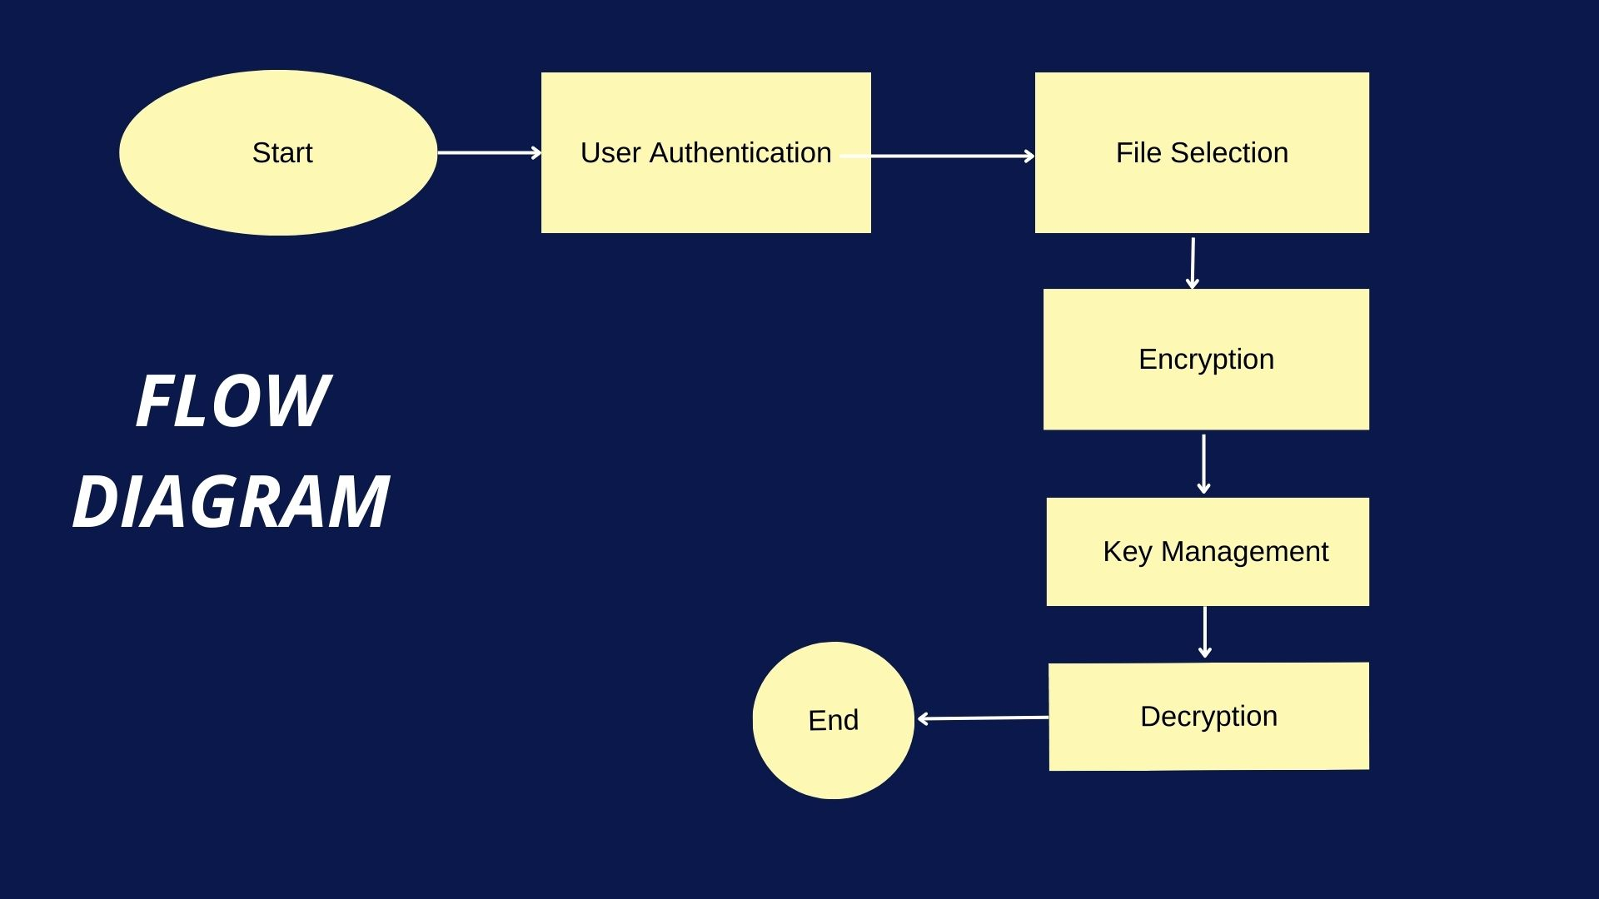
Proposed Methodology/Architecture/Algorithm/Technique/etc:

Slide 9
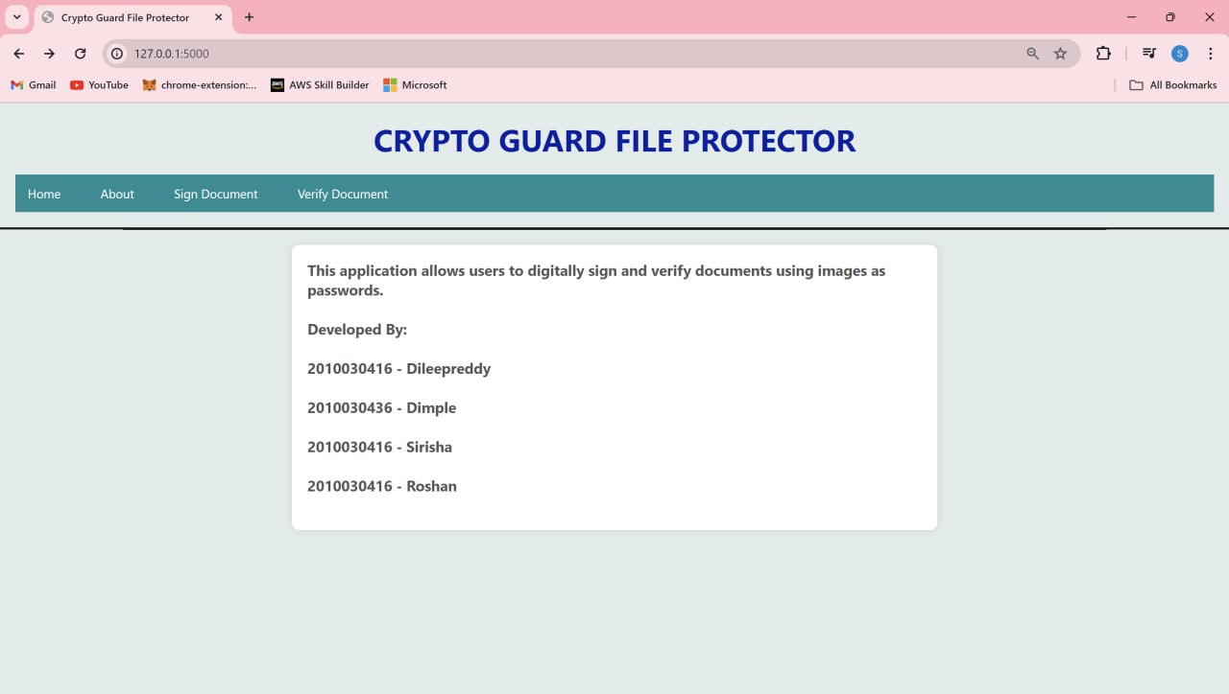
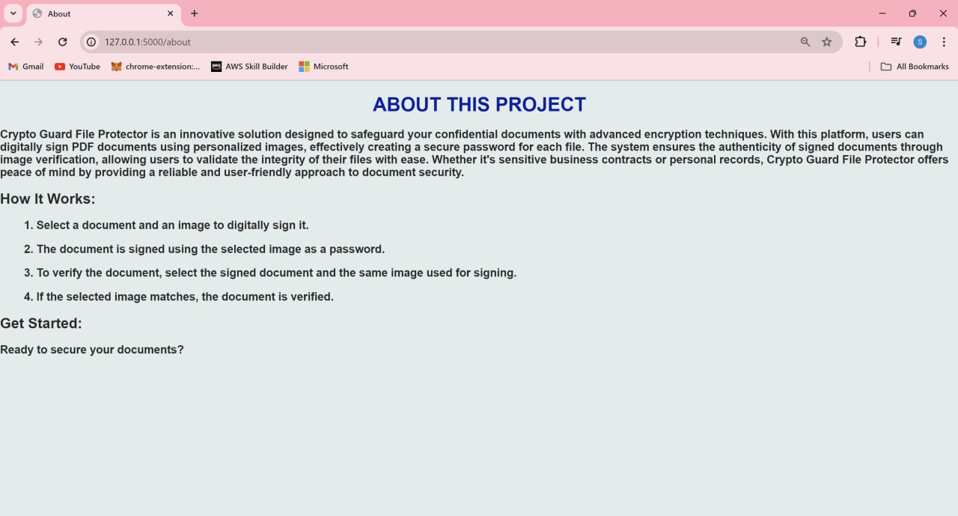
Output Screenshots:

Slide 10
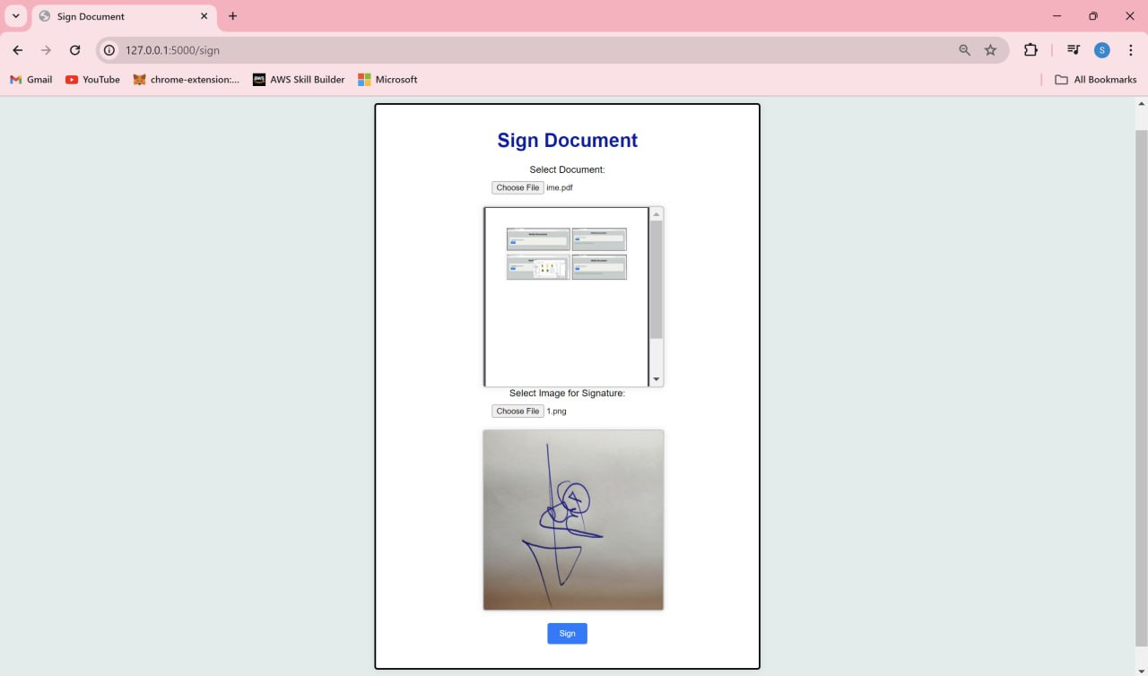
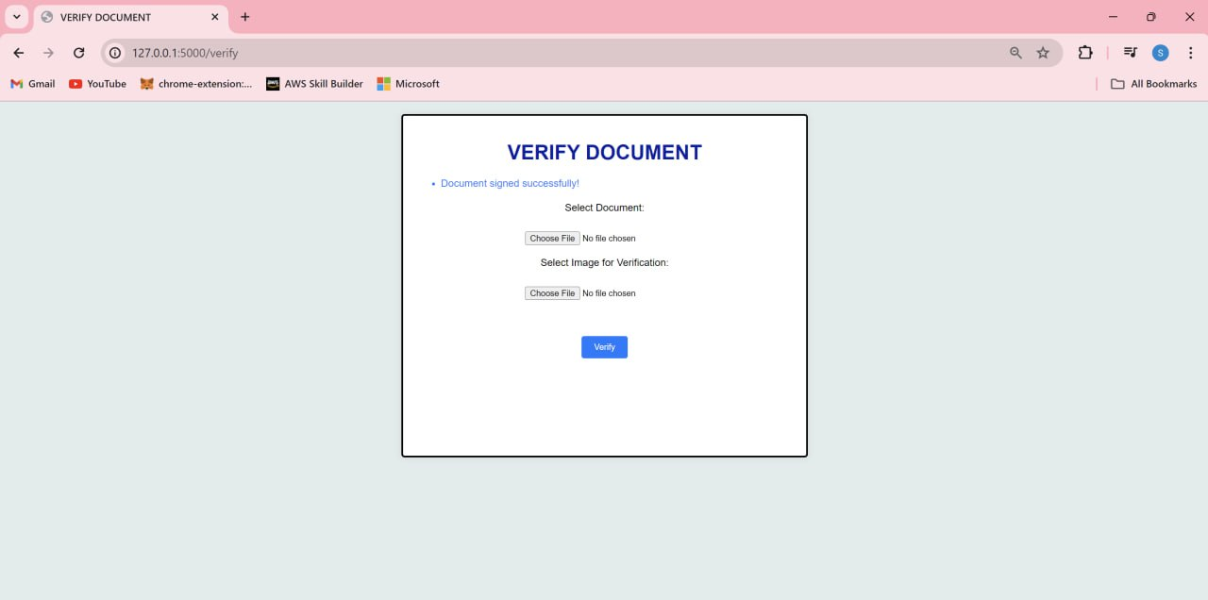

Slide 11
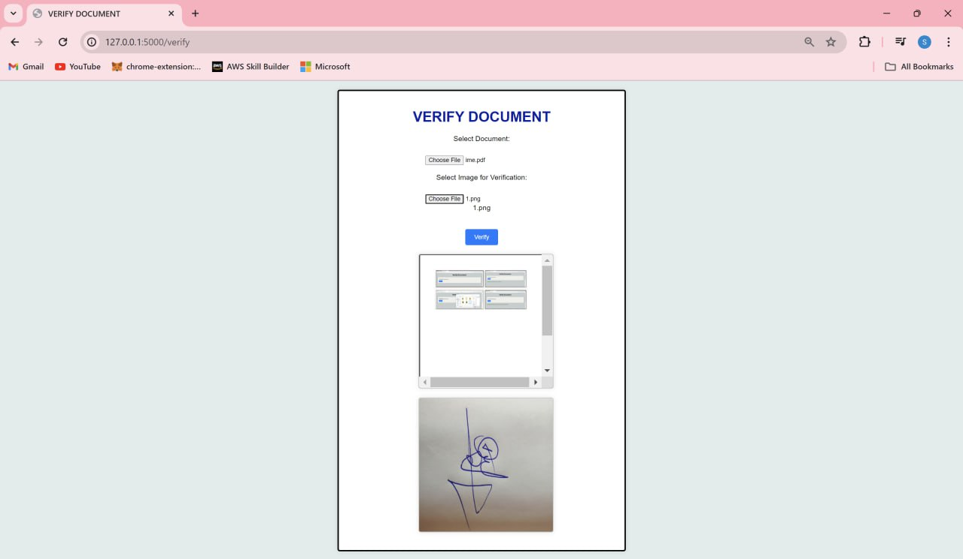
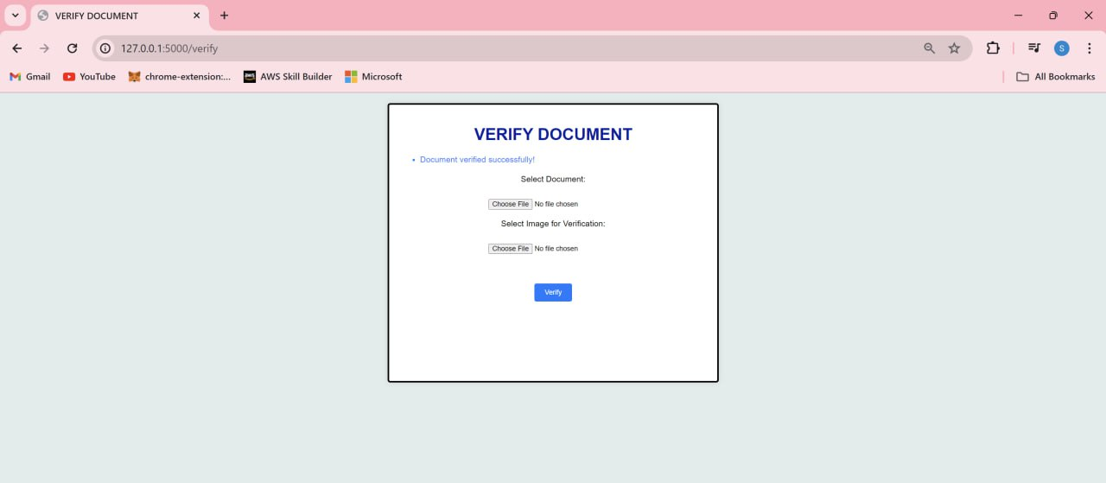
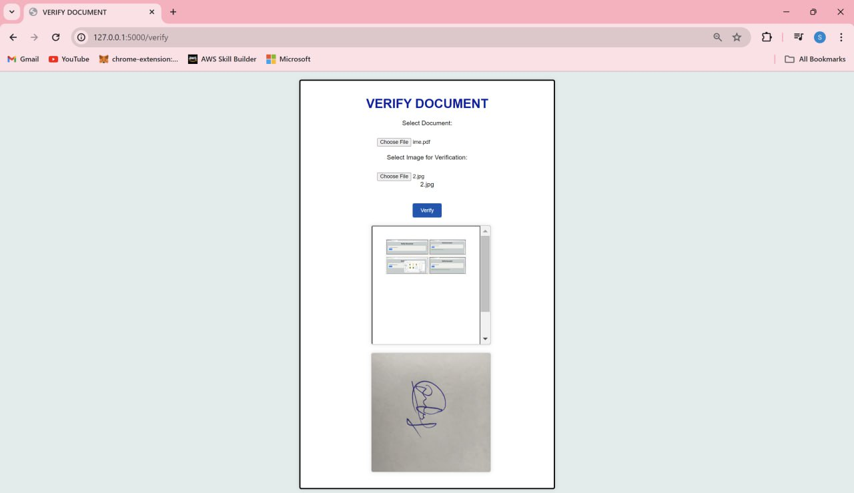
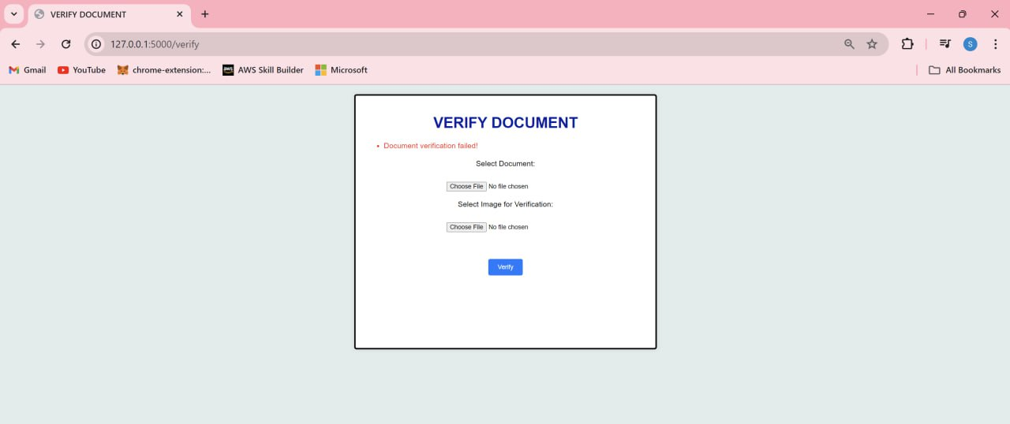

Slide 12
Thank YOU

