Slide 1
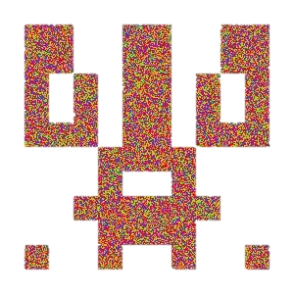
Cryptopyxies
Binance Hackaton

Slide 2






CryptoPyxies = Crypto + Python + Pixies*
The project started out as a simple avatar generator. It’s generated algorithmically NFT (like CryptoPunks)
CryptoPyxies is Generative Media like CryptoPunks, Art Blocks (Ethereum)
* Pixies - mythical creature of British folklore

Slide 3
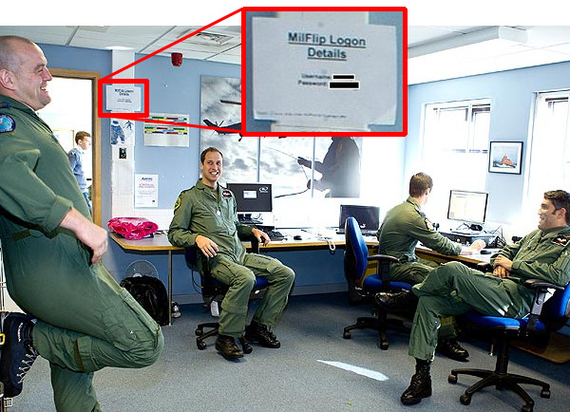


User-cases. Epic fails
1
Simple password
2
Storing password
3
Fishing sites
Q | W | E | R | T | Y
1 | 2 | 3 | 4 | 5 | 6
1 | Q | 2 | E | 3 | R
1 | 2 | 3 | 1 | 2 | 3
Photo of UK’s Prince William reveals password for Royal Air Force login
Need new approach to cryptography

Slide 4


CryptoPyxies is #CodeCreatedNFT
Public key
Hash-function
Enter parameters
For example:
Size: 300 px Name: cryptopyxie
Privat key
Color key
Color key has punlic key (figure), public key (colors) and control line.
Also it may contain link for browser for easy login

Slide 5
What is Cryptopyxies
Public key
12 x 12 big pixels symmetric image
1 color (only HTML Color Names)
Limit on filling in the field: 40-75%
Color key
11 x 5 x N х L – pixels
N – determines the difficulty level (Now N = 25, image 300 x 300 pixels)
L – Limit on filling in the field
Many HEX colors (excluding HTML Color Names, Now – 5 colors)
Cryptopyxies must be in uncompressed format

Slide 6

Color key is more protected than BTC private key
5HpHagT65TZzG1PH3CSu63k8DbpvD8s5ip4nEB3kEsreAnchuDf
1,16E+77
20-35 symbols
SHA-256 (using 160 letters and digits)
∞
#FFA500#663399#FF0000#FFA500#0000CD#00FF7F…
550 – 1 031 pixels (for image 300 x 300)
16,7 mln colors (6 symbols, 16 bit)
Creation of quantum computers will require strengthening of cryptographic protection

Slide 7

CryptoPyxies. Rewriting protection
You can write this…
… but how write this?
#1Gh3dy6kb74-&12Njkco_366TvVsp74
Special software is required for reading

Slide 8

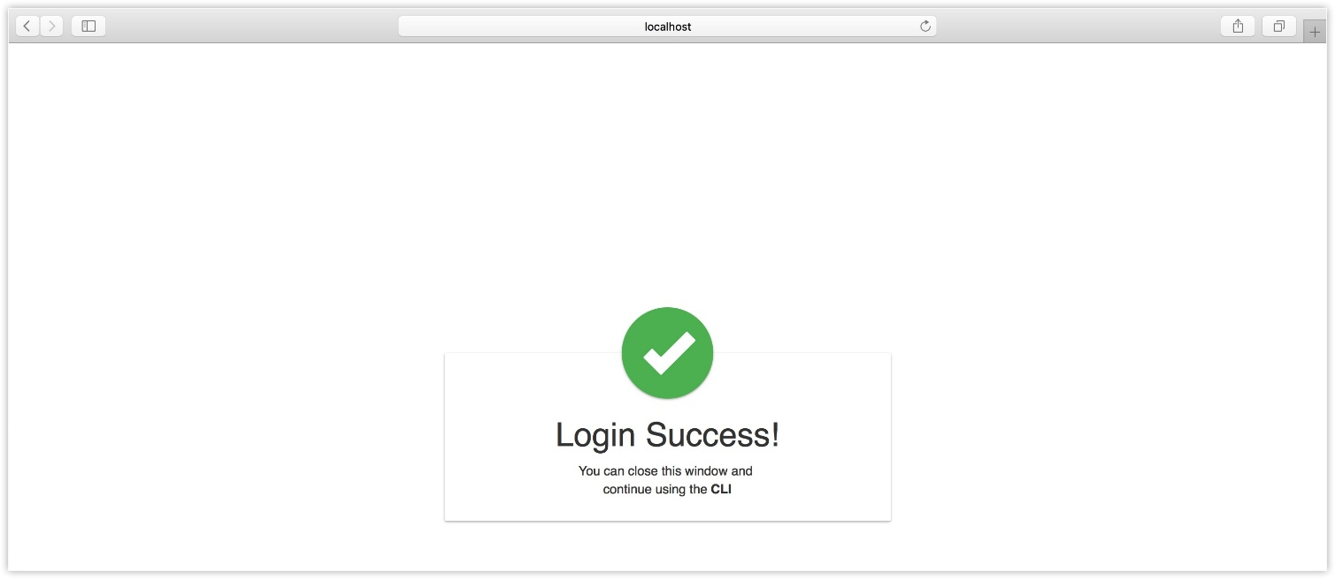
CryptoPyxies. Anti-fishing protection
Browser extension for reading CryptoPyxies

Slide 9
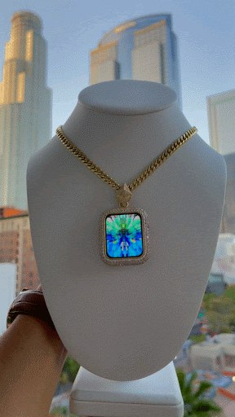


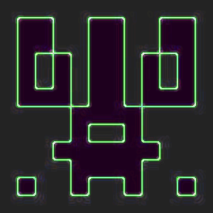
Using CryptoPyxies
SCAN NOW
Jewelry @Gambitvvs
Watch
Scanner for login / payment
And at the end…

Slide 10
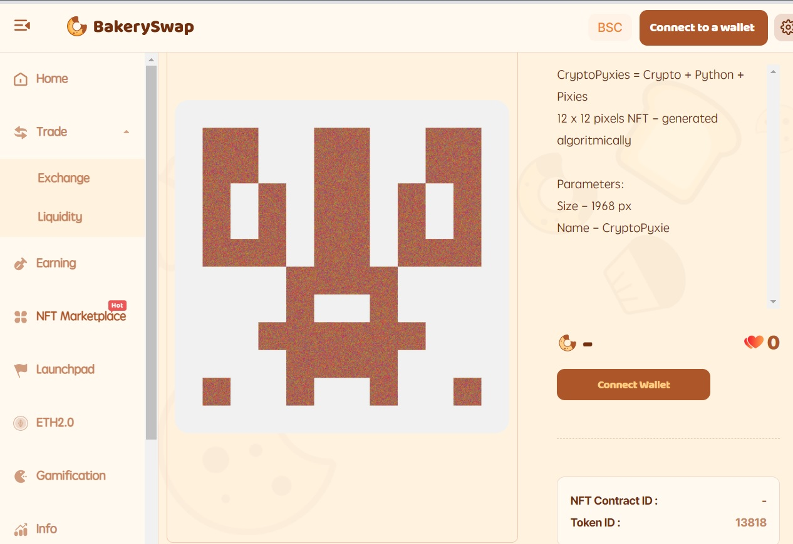
NFT Giveaway
The first CryptoPyxie has already been posted on BakerySwap
Vote and win*
Thаnk you!
* The winner will be determined among those who voted for CryptoPyxies by using a random number generator

