Slide 1
Application to maximize crypto-currency investment or trade using Greedy Algorithms.

Slide 2
Application to maximize crypto-currency investment or trade using Greedy Algorithm
Maximize your profits by considering the decisions made by the application for investment or trade.
Choose from over 31 cryptocurrencies.
All decisions made using previous 30 days performance of various crypto-currencies.
Shuffle between buying and selling.

Slide 3
How to use the Application:
Choose target value
Choose currencies(optional)
Get results
Choose between buying or selling

Slide 4
What is crypto currency?
A brief introduction

Slide 5
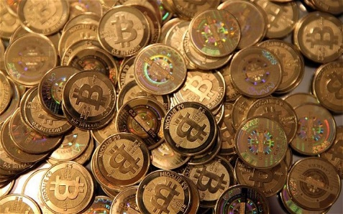
Crypto-Currency
Cryptocurrency is a form of digital money that is designed to be secure and, in many cases, anonymous.
It is a currency associated with the internet that uses peer-to-peer technology.
It uses cryptography, the process of converting legible information into an almost uncrack-able code, to track purchases and transfers.
The first cryptocurrency was Bitcoin, which was created in 2009 and is still the best known.
There are more than 900 available crypto-currencies on the internet.
Crypto-Currency was born out of need for secure communication in WW2.
It has evolved in the digital era with the help of mathematical theory.

Slide 6
Basic Terminologies in cryptocurrency:
Crypto – Crypto means cryptography, and is ultimately the method on how algorithms are secured.
Mining – A computer that processes algorithms.
Miner – A person or computer who is using hardware(CPU/GPU) to mine.
Hash – A measure on how powerful a computer is for mining.
Blocks – An imaginary “block” of algorithms that miners are trying to solve.
Blockchain – A public ledger of all the transactions any user has ever done.
Proof of Work(POW) – Currencies that use proof-of-work schemes require miners to spend computation resources to solve a block.
Proof of Stake(POS) – Currencies that use proof-of-stake schemes accept verification votes for each block from members of the network, based on how much of the currency each member controls.

Slide 7
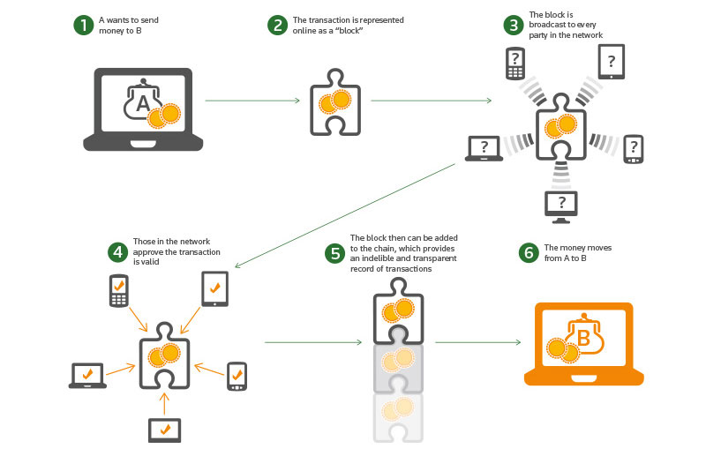
How do Crypto-Currencies work?

Slide 8
The 6 most important cryptocurrencies other than Bitcoin
Litecoin(LTC) – Created by MIT Graduate, Charlie Lee, can be mined using a CPU.
Ethereum(ETH) – Created by Mihai Alisie, Anthony Di Iorio, Charles Hoskinson, can be mined using a CPU.
Zcash(ZEC) – Created by Zooko Wilcox-O’Hearn, can be mined using a CPU.
Dash – Can be mined using CPU or GPU
Ripple(XRP) – Low cost international payments. Doesn’t require mining
Monero(XRP) – Secure, private, untraceable currency.

Slide 9
What is a Greedy Algorithm?
A brief introduction

Slide 10
Greedy Algorithm
A greedy algorithm is an algorithmic strategy that makes the best optimal choice at each small edge with the goal of this eventually leading to a globally optimum solution.
This means that the algorithm picks the best solution at the moment without regard of consequences. It picks the best immediate output, but does not consider the big picture, hence it is considered greedy.
Examples of problems that can be solved using a greedy algorithm:
Minimum Spanning Tree Problem
Shortest Path Problem(e.g. Dijikstra’s Algorithm)
Fractional Knapsack Problem
Huffman’s Tree for data compression
Optimal Merging
Topological Sort
Internal Scheduling

Slide 11
Specifics:
A candidate set, from which a solution is created.
A selection function, which chooses the best candidate to be added to the solution.
A feasibility function, that is used to determine if a candidate can be used to contribute to a solution.
An objective function, which assigns a value to a solution, or a partial solution, and
A solution, which will indicate when we have discovered a complete solution

Slide 12
How this application works
Working of the application

Slide 13
Flowchart of working of the application
Takes input from user about BUY or SELL
Takes input the threshold amount
Takes input the currencies
Fetches previous 30 days performance of the chosen currencies from trusted datasets
Assigns weight and profit to each chosen currency based on previous 30 days performance
Activates the function that calculates the best currencies to buy OR
Activates another function that distributes the threshold amount between various chosen currencies
Returns result (currencies and profit)

Slide 14
Technologies stack:
Python programming language v3.6.3
Tkinter library
BeautifulSoup4 library
Numpy library
Requests library

