Slide 1

Literature Review
Dynamic pricing in smart grids
Z.P.Chen, Y.L.Cai,
L.Y.Cai , Y.L.Chen
Speaker : Z.P.Chen
Affiliation: School of Intelligent Systems Engineering, Sun Yat-sen University, Guangzhou, China
Contact: chenzhp57@mail2.sysu.edu.cn

Slide 2
目 录
CONTENTS
01
03
Literature search
Introduction
02
04
Conclusion
Literature review

Slide 3
01
Introduction

Slide 4
Demand ? supply
Demand ? Supply

Slide 5
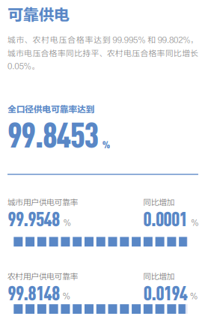
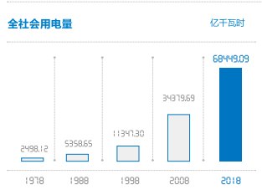
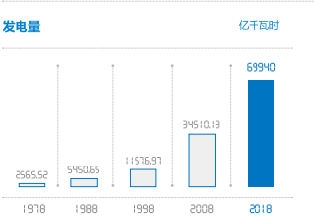
Demand ? Supply
供给相对充足
需求增长迅速

Slide 6
Smart grids
Demand ? Supply
Smart grids

Slide 7
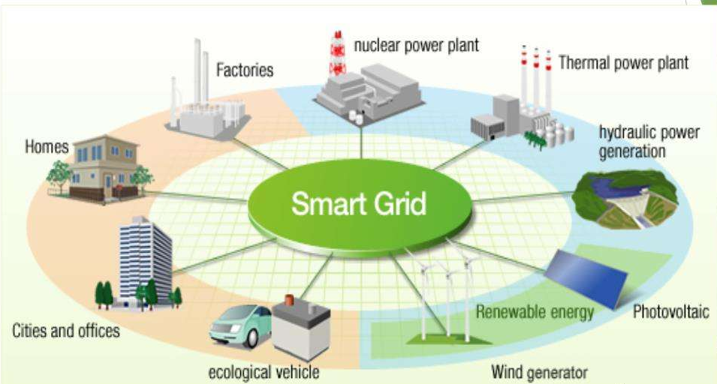
Smart grids
A smart grid is an electrical grid which includes a variety of operation and energy measures including smart meters, smart appliances, renewable energy resources, and energy efficient resources. Electronic power conditioning and control of the production and distribution of electricity are important aspects of the smart grid
智能电网，一种现代化的输电网络。利用信息及通信技术，以数字或模拟信号侦测与收集供应端的电力供应状况，与使用端的电力使用状况。再用这些信息来调整电力的生产与输配，或调整家电及企业用户的耗电量，以此达到节约能源、降低损耗、增强电网可靠性的目的。智能电网雏型是20世纪产生，是由一些中心发电机向大量用户传输电能的电网的简单升级。在传统电网的基础上，电能的传输拓扑网络更加优化以满足更大范围的各种用电状况，如在用电量低的时段给电池充电，然后在高峰时反过来给电网提供电能。

Slide 8
Dynamic pricing
Dynamic pricing
Demand ? Supply
Smart grids

Slide 9
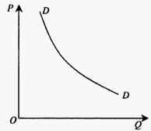
Dynamic pricing
O.2
价格影响需求
用电价格在一定程度上影响用电量

Slide 10
How
Dynamic pricing
Demand ? Supply
How
Smart grids

Slide 11
How
O.2
？

Slide 12
02
Literature search

Slide 13
02
Literature search
keywords
Keywords
Smart grids
Dynamic Pricing
Real-Time Pricing
Personalized pricing
Other related keywords
Demand-side management
Load Forecasting

Slide 14
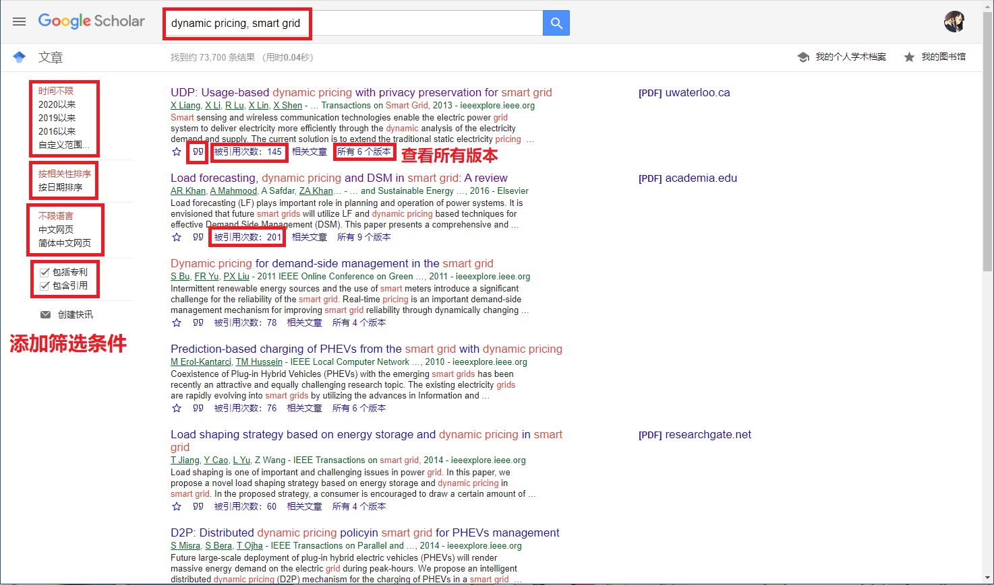
02
Literature search
Google Scholar
Notes:
左侧可以添加筛选条件。

Slide 15
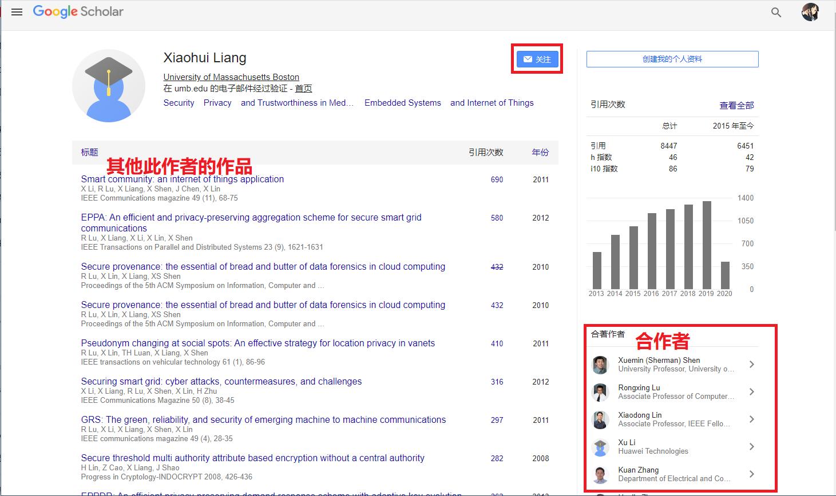
02
Literature search
Google Scholar
Notes:
可以跟踪作者

Slide 16
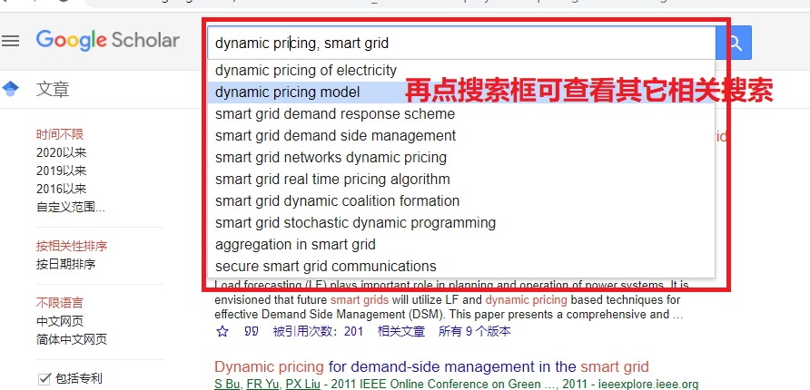
02
Literature search
Google Scholar

Slide 17
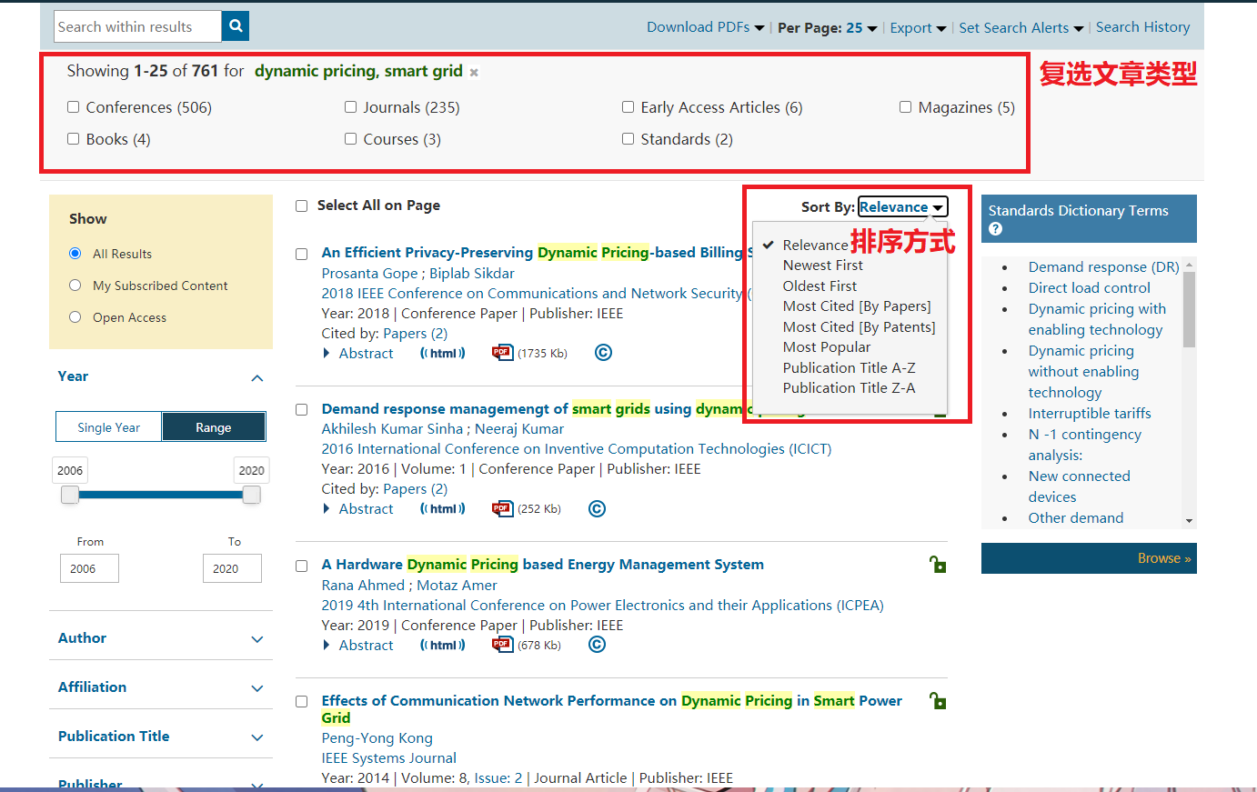
02
Literature search
IEEE Xplore

Slide 18
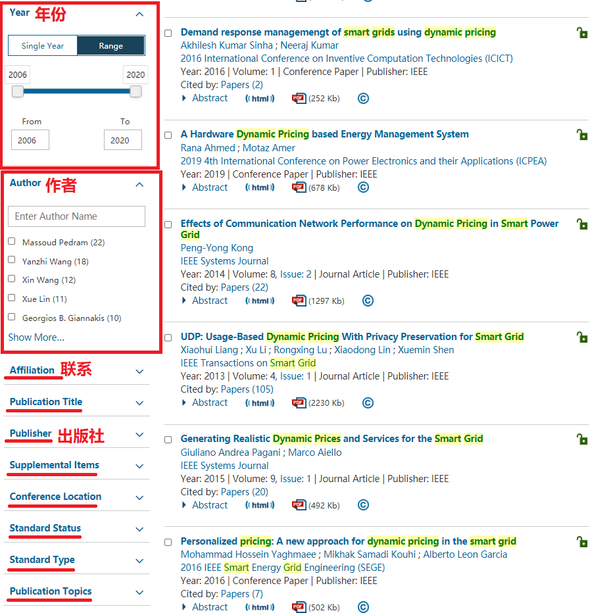
02
Literature search
IEEE Xplore

Slide 19
03
Literature review

Slide 20
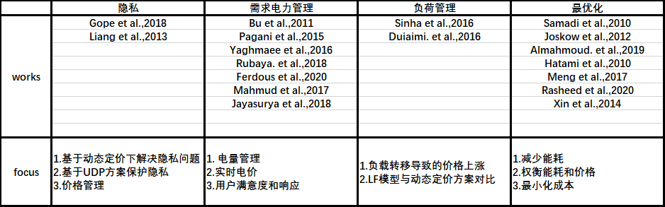
Literature review
literature

Slide 21
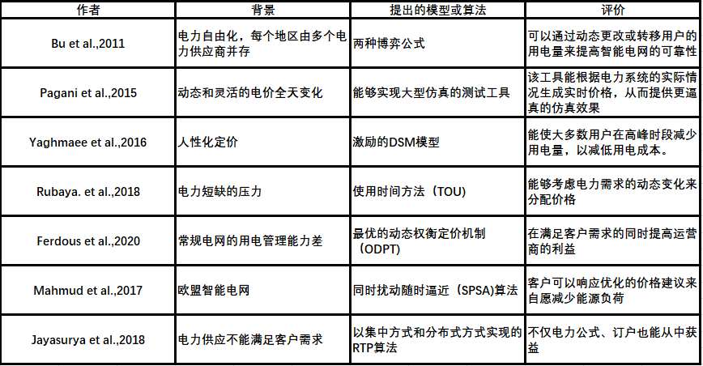
Literature review
需求电量管理

Slide 22
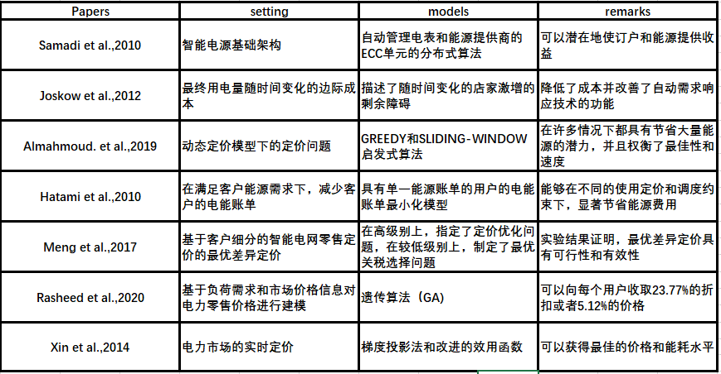
Literature review
最优化

Slide 23
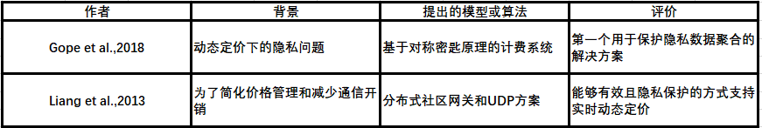
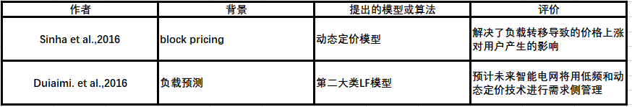
Literature review
隐私、负荷管理

Slide 24
Literature review
最优化

Slide 25
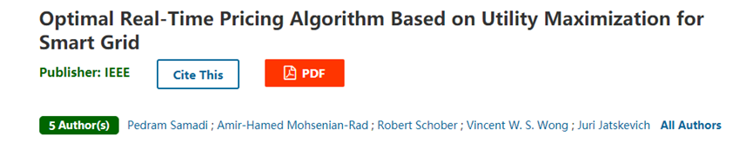
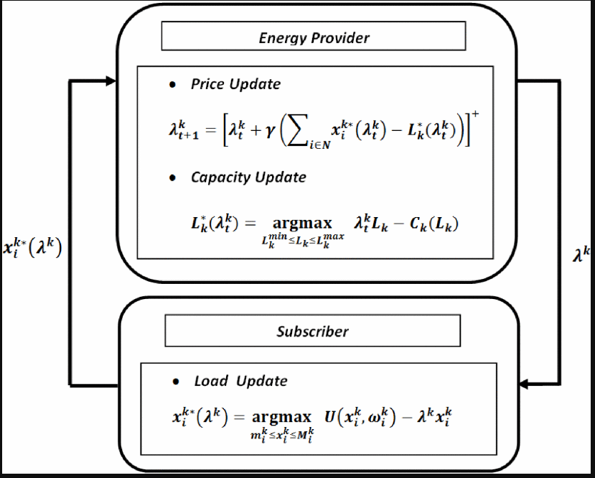
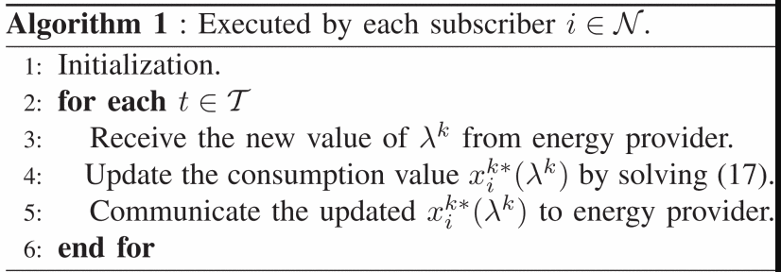
Literature review
Samadi et al., 2010

Slide 26
04
Conclusion

Slide 27
Conclusion
Steps
Directions:
价格:
使用时间方法（TOU）(Rubaye et al., 2018)
公平的电价
仿真: (Pagani et al., 2015)
生成实时价格
客户用电量
能源提供商利益
权衡定价:
基于最优差异定价（Meng et al., 2017）
GREEDY和SLIDING-WINDOW启发性算法
分布式:
分布式RTP算法（Jayasurya et al., 2018）
价格管理

Slide 28
Reference
[1] P. Gope and B. Sikdar, "An Efficient Privacy-Preserving Dynamic Pricing-based Billing Scheme for Smart Grids," 2018 IEEE Conference on Communications and Network Security (CNS), Beijing, 2018, pp. 1-2, doi: 10.1109/CNS.2018.8433191.
[2] X. Liang, X. Li, R. Lu, X. Lin and X. Shen, "UDP: Usage-Based Dynamic Pricing With Privacy Preservation for Smart Grid," in IEEE Transactions on Smart Grid, vol. 4, no. 1, pp. 141-150, March 2013, doi: 10.1109/TSG.2012.2228240.
[3] S. Bu, F. R. Yu and P. X. Liu, "Dynamic pricing for demand-side management in the smart grid," 2011 IEEE Online Conference on Green Communications, New York, NY, 2011, pp. 47-51, doi: 10.1109/GreenCom.2011.6082506.
[4] G. A. Pagani and M. Aiello, "Generating Realistic Dynamic Prices and Services for the Smart Grid," in IEEE Systems Journal, vol. 9, no. 1, pp. 191-198, March 2015, doi: 10.1109/JSYST.2014.2320800.
[5] M. H. Yaghmaee, M. S. Kouhi and A. L. Garcia, "Personalized pricing: A new approach for dynamic pricing in the smart grid," 2016 IEEE Smart Energy Grid Engineering (SEGE), Oshawa, ON, 2016, pp. 46-51, doi: 10.1109/SEGE.2016.7589498.
[6] P. Samadi, A. Mohsenian-Rad, R. Schober, V. W. S. Wong and J. Jatskevich, "Optimal Real-Time Pricing Algorithm Based on Utility Maximization for Smart Grid," 2010 First IEEE International Conference on Smart Grid Communications, Gaithersburg, MD, 2010, pp. 415-420, doi: 10.1109/SMARTGRID.2010.5622077.

Slide 29
Reference
[7] Joskow, Paul L., and Catherine D. Wolfram. 2012. "Dynamic Pricing of Electricity." American Economic Review, 102 (3): 381-85.DOI: 10.1257/aer.102.3.381
[8] A. K. Sinha and N. Kumar, "Demand response managemengt of smart grids using dynamic pricing," 2016 International Conference on Inventive Computation Technologies (ICICT), Coimbatore, 2016, pp. 1-4, doi: 10.1109/INVENTIVE.2016.7823253.
[9] Z. Almahmoud, J. Crandall, K. Elbassioni, T. T. Nguyen and M. Roozbehani, "Dynamic Pricing in Smart Grids Under Thresholding Policies," in IEEE Transactions on Smart Grid, vol. 10, no. 3, pp. 3415-3429, May 2019, doi: 10.1109/TSG.2018.2825997.
[10] S. Al-Rubaye, A. Al-Dulaimi, S. Mumtaz and J. Rodriguez, "Dynamic Pricing Mechanism in Smart Grid Communications Is Shaping Up," in IEEE Communications Letters, vol. 22, no. 7, pp. 1350-1353, July 2018, doi: 10.1109/LCOMM.2018.2822798.
[11] Load forecasting, dynamic pricing and DSM in smart grid: A review ,February 2016
[12] S. Hatami and M. Pedram, "Minimizing the Electricity Bill of Cooperative Users under a Quasi-Dynamic Pricing Model," 2010 First IEEE International Conference on Smart Grid Communications, Gaithersburg, MD, 2010, pp. 421-426, doi: 10.1109/SMARTGRID.2010.5622080.
[13] F. Meng, B. Kazemtabrizi, X. Zeng and C. Dent, "An optimal differential pricing in smart grid based on customer segmentation," 2017 IEEE PES Innovative Smart Grid Technologies Conference Europe (ISGT-Europe), Torino, 2017, pp. 1-6, doi: 10.1109/ISGTEurope.2017.8260255.

Slide 30
Reference
[14] J. Ferdous et al., "Optimal Dynamic Pricing for Trading-Off User Utility and Operator Profit in Smart Grid," in IEEE Transactions on Systems, Man, and Cybernetics: Systems, vol. 50, no. 2, pp. 455-467, Feb. 2020, doi: 10.1109/TSMC.2017.2764442.
[15] M. B. Rasheed, M. A. Qureshi, N. Javaid and T. Alquthami, "Dynamic Pricing Mechanism With the Integration of Renewable Energy Source in Smart Grid," in IEEE Access, vol. 8, pp. 16876-16892, 2020, doi: 10.1109/ACCESS.2020.2967798.
[16] A. S. M. A. Mahmud and P. Sant, "Real-time price savings through price suggestions for the smart grid demand response model," 2017 5th International Istanbul Smart Grid and Cities Congress and Fair (ICSG), Istanbul, 2017, pp. 65-69, doi: 10.1109/SGCF.2017.7947603.
[17] Xin Song and Jiayu Qu, "An improved real-time pricing algorithm based on utility maximization for smart grid," Proceeding of the 11th World Congress on Intelligent Control and Automation, Shenyang, 2014, pp. 2509-2513, doi: 10.1109/WCICA.2014.7053118.
[18] S. M. Jayasurya and S. Varun Kumar, "Smart grid Infrastructure for Efficient Power Consumption Using Real Time Pricing Algorithm and Distributed Algorithm," 2018 International Conference on Recent Trends in Electrical, Control and Communication (RTECC), Malaysia, Malaysia, 2018, pp. 173-175, doi: 10.1109/RTECC.2018.8625670.

Slide 31
Thanks

