Slide 1
⚡ APPLIED PROMPT ENGINEERING & LLMs
AI Mock Interviewer &
Dynamic Interview Evaluator
An End-to-End Multimodal Assessment Platform powered by Role Prompting, STAR Method Rubrics, and Strict JSON Schema Enforcement.
Project Track
Prompt Techniques
Core Deliverables
• Topic: #4 AI Mock Interviewer
• Tech: Python, Flask, Web Speech API
• Engine: GPT-4o + Smart Heuristics
• Persona-driven Role Prompting
• Few-Shot Calibration & JSON Rubrics
• 3-Phase Context Routing Matrix
• Real-time S2S Room & Captions
• STAR Evaluation & Rubric Scores
• AI Benchmark & 30-Day Roadmap

Slide 2
TEAM & PROJECT GOVERNANCE
Project Team & Work Contribution Breakdown
Annimesh Sasmal
230301120173
Swapnajit Sahoo
230301120179
Payal Nanda
230301120130
• Prompt Engineer & LLM Architect
• Designed multi-persona Role System Prompts (Tech Lead, Mentor, Executive, HR).
• Engineered the 4-Vector Evaluation Rubric (Technical Depth, STAR, Clarity, Confidence).
• Crafted JSON schema constraints for deterministic machine-parsable LLM responses.
• Formulated anti-gibberish & lexical diversity guardrails against repetitive filler answers.
• Backend Systems & API Integration Lead
• Architected Flask RESTful backend with session memory store and 0ms question preloader.
• Built the hybrid AI Engine integrating OpenAI GPT-4o with smart heuristic fallback.
• Implemented PDF/DOCX resume parser extracting 50+ tech stack competencies.
• Engineered dynamic final committee dossier & 30-day mastery roadmap synthesis.
• Frontend & Multimodal Experience Engineer
• Designed the glassmorphism UI layout, design system, and sleek dark/light themes.
• Implemented Speech-to-Speech HUD with natural neural voices and live closed captions.
• Built interactive AI Benchmark sample drawer, stage proceed banners & exit controls.
• Created real-time scorecards, competency bar charts, and printable dossiers.

Slide 3
FOUNDATION & MOTIVATION
Problem Statement & Industry Motivation
The Challenge with Traditional Prep
Our AI Prompt-Engineered Solution
• Static Question Banks: Traditional platforms rely on static question lists that fail to adapt dynamically to candidate responses.
• Absence of Actionable Feedback: Candidates receive binary pass/fail outcomes without deep rubric diagnostics on communication clarity or STAR structuring.
• High Cost of Human Mock Interviews: Professional human mock interviewers cost $150–$300/hour, creating a steep accessibility barrier for students.
• Unpreparedness for Spoken Pressure: Text-only drills leave candidates unprepared for real-world verbal communication and vocal pacing.
• Structured 3-Phase Simulation: Systematically progresses through Resume Verification, Domain Technical Rigor, and HR & Future Vision.
• Multi-Persona Interviewers: Switch seamlessly between Supportive Mentor, Rigorous Tech Lead, and Demanding Executive personas.
• Objective STAR Rubric Scoring: Breaks down answers into Technical Depth, Structure, Communication, and Confidence metrics.
• Zero-Friction Multimodal Voice: Integrated Web Speech API enables real-time spoken interview practice with live closed captions.

Slide 4
SYSTEM ARCHITECTURE & PROCESS FLOW
3-Phase Interview Pipeline & Architecture Flow
1. Resume Parser & Setup
2. 3-Phase Prompt Engine
3. Speech-to-Speech Room
4. Final Committee Dossier
• PDF / DOCX / TXT Ingestion
• Automated Skill Extraction
• Persona Configuration
• 3/6/9 Round Select (Even Phase Split)
• Zero-Latency Background Preload
• Phase 1: Resume Verification
• Phase 2: Domain Technical Rigor
• Phase 3: HR & Future Vision
• Strict JSON Schema Output
• STAR Benchmark Answer Synthesis
• Continuous Voice Dialogue
• Natural Neural Voice Synthesizer
• Live Real-Time Captions Stream
• Instant AI Model Answer Popover
• Lexical Diversity & Spam Filter
• Hiring Verdict & Summary
• 3-Phase Competency Bars
• Grounded Strengths & Gaps
• 30-Day Mastery Roadmap
• Printable Evaluation Dossier

Slide 5
PROMPT METHODOLOGY
Key Prompt Engineering Concepts Applied
1. Role Prompting & Persona Calibration
2. Structured Output Enforcement (JSON Schema)
• Injects explicit system roles with distinct behavioral heuristics.
• Example: Tech Lead prioritizes edge cases; Executive prioritizes ROI & brevity.
• Eliminates generic AI assistant tone and enforces rigorous hiring committee standards.
• Enforces strict JSON schema for scores (0-100), verdicts, and actionable tips.
• Guarantees deterministic, machine-parsable responses for the web UI.
• Zero regex parsing failures or Markdown formatting breakdowns.
3. Evaluation Prompts & Rubric Grounding
4. Context Engineering & Progressive Rigor
• Explicit 4-pillar rubric: Technical Depth, STAR Structure, Clarity, Confidence.
• Forces grounding with exact quotes/evidence extracted from user answers.
• Defensive filters: Penalizes low lexical diversity & repetitive filler babble.
• Maintains rolling multi-turn dialogue history across interview rounds.
• Generates contextual follow-up probes based on previous gaps.
• Pre-caches question matrix for instantaneous, zero-latency turn-taking.

Slide 6
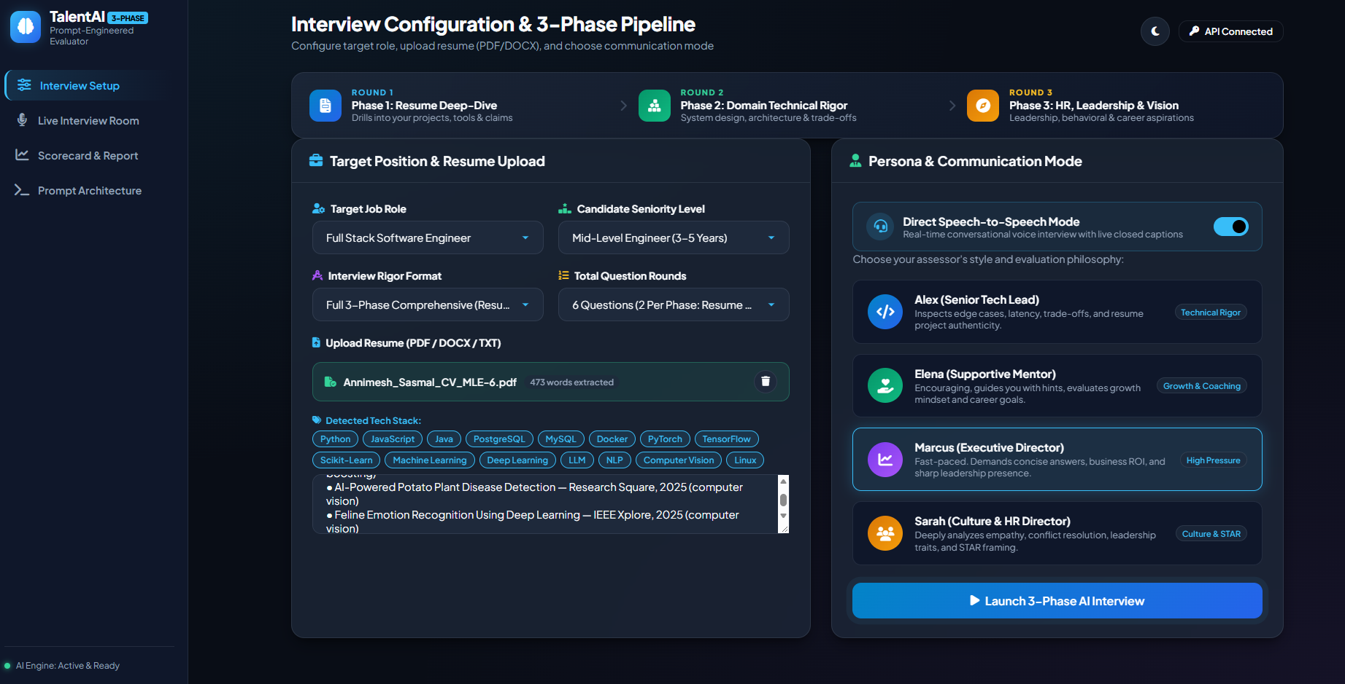

Slide 7
SUMMARY & ROADMAP
Conclusion, Future Horizons & Live Q&A
Project Accomplishments
Future Engineering Roadmap
• Delivered end-to-end 3-Phase AI Mock Interviewer with voice, text, and adaptive questioning.
• Demonstrated mastery of Role Prompting, Evaluation Prompts, and Schema Enforcement.
• Implemented multimodal Speech-to-Speech HUD with real-time closed captions and AI benchmark answers.
• Built-in offline intelligent engine guarantees 100% uptime without API dependencies.
• Pre-generates question matrix for zero-latency turn-taking and produces 30-day mastery roadmaps.
• Computer Vision Integration: Real-time eye contact, posture, and micro-expression analysis via WebRTC.
• Live Code Execution Sandbox: Real-time Python/JS compiler evaluating algorithm time/space complexity.
• ATS & LMS Integration: Enterprise dashboard for university placement cells and hiring teams.
• Fine-Tuned Specialized Evaluators: Llama-3 / Mistral LoRA adapters fine-tuned on real FAANG hiring rubrics.

