Slide 1
MONTHLY REPORT
LIQUEFIED PETROLEUM GAS
(COOKING GAS)PRICE,JULY 2024

Slide 2

AVERAGE PRICE OF COOKING GAS IN THE MONTH OF JULY 2024 -5KG
N4,072.87
N5,974.55
N6,966.03
JULY 2023
JUNE 2024
YOY = 46.69%
MOM = -14.23 %
There was an increase in the average price of cooking gas compared to the same period last year
In July, people paid less for cooking gas across the country than in june
JULY 2024
Source : National Bureau of Statistics

Slide 3
States with the highest average price of cooking gas -5KG
Borno
Yobe
Sokoto
The average price of cooking gas in Borno is N7,088.59, making it the state with the highest average price in the entire country.
It experienced a -1.36% decline in its price compared to the previous month.
However, compared to the same period last year, Borno saw a notable 87.27% increase in price
Position: Second
Avg price: N6,935.50
MoM: 14.40%
YoY: 68.12%
Position: Third
Avg price: N6,750.00
MoM: -3.57%
YoY: 61.23%
Benue
Bauchi
Position: Fourth
Avg price: N6,491.00
MoM: -11.52%
YoY: 41.73%
Position: Fifth
Avg price: N6,395.00
MoM: -8.64%
YoY: 51.24%
Source : National Bureau of Statistics

Slide 4
States with the lowest average price of cooking gas -5KG
Delta
Zamfara
Kogi
The average price of cooking gas in Delta is N5,392.86 making it the state with the lowest average price of cooking gas in the entire country.
It recorded a -21.65% decline in its price when compared to the previous month.
However, compared to the same period last year, Delta saw a notable 53.26% increase in price
Position: Second
Avg price: N5,431.25
MoM: -21.17%
YoY: 15.67%
Position: Third
Avg price: N5,560.63
MoM: -23.18%
YoY: 20.32%
Edo
Bayelsa
Position: Fourth
Avg price: N5,572.22
MoM: -28.10%
YoY: 56.70%
Position: Fifth
Avg price: N5,572.22
MoM: -14.60%
YoY: 20.41%
Source : National Bureau of Statistics

Slide 5
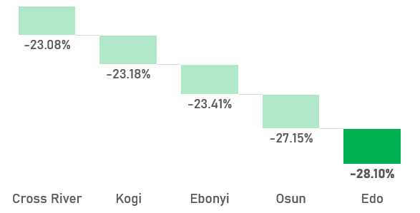
Percentage difference (increase & decrease) across States -5Kg
The Year-over-Year analysis shows a strong increase in the average price of cooking gas across these top five states in July 2024 compared to July 2023
The Month-over-Month analysis shows a strong decrease in the average price of cooking gas across these top five states in July 2024 compared to July 2023
Source : National Bureau of Statistics

Slide 6

THANK YOU

