Slide 1
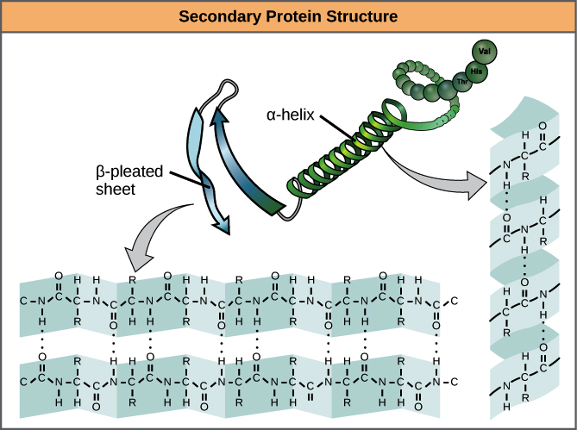
Assignment of protein secondary structure

Slide 2
Summary
1. Secondary protein structure
2.DSSP method
3. Data preparation
4. Program
5. Results

Slide 3
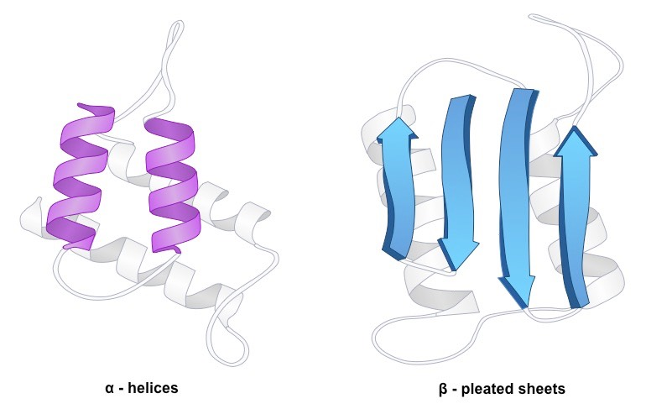
Secondary Protein Structure

Slide 4
DSSP method
DSSP is an algorithm
Secondary structure assignment through H-bonds
No prediction from secondary structure
Output 8 differents secondary structures

Slide 5
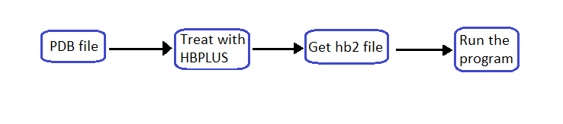
Data preparation
PDB = Protein
Data Bank
HBPLUS recognizes H-bond and
creates new file

Slide 6
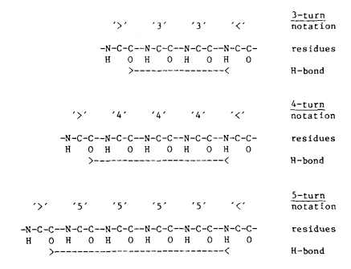
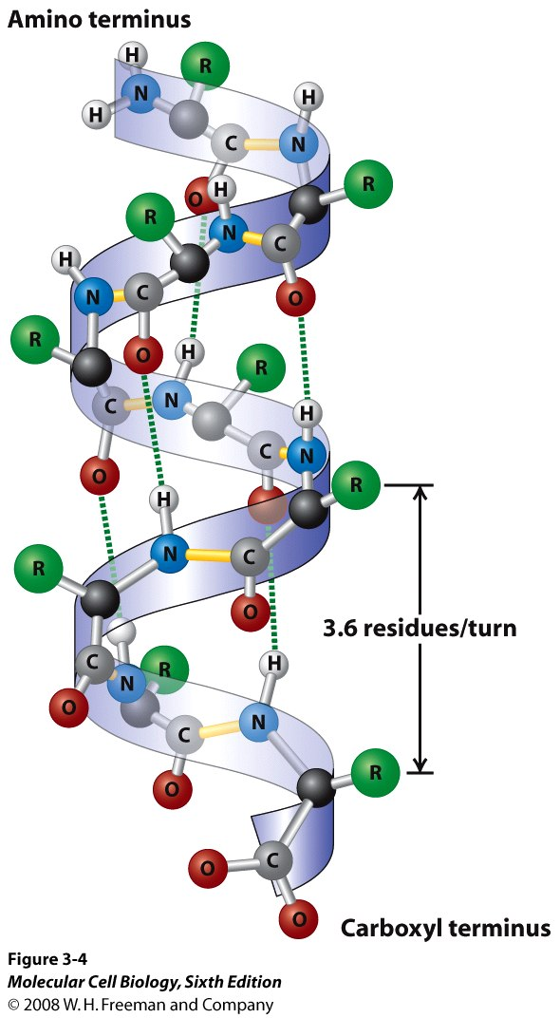
Program : definition of turn and helix
An helix is a succession of N-turn
A turn is an H-bond between a residue and a second one located at 3, 4 or 5 residues further down the chain

Slide 7
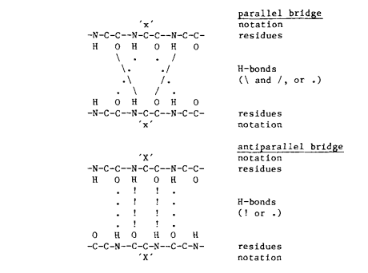
Program : definition of bridge
Define a donnor residue (i) and an acceptor residue (j)
Parallel bridge is H-bond (i-1, j) and H-bond (j, i+1), or H-bond (j-1, i) and H-bond (i, j+1)
Anti-parallel bridge is H-bond (i, j) and H-bond (j, i), or H-bond (i-1, j+1) and H-bond (j-1, i+1)

Slide 8
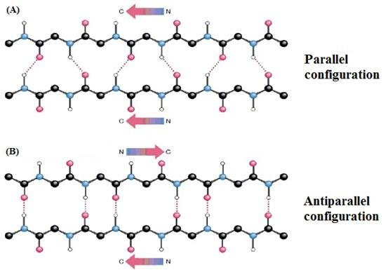
Program : definition of ladder and sheet
A ladder is succession of one or more bridges
A sheet is one or more ladders connected by shared residues

Slide 9
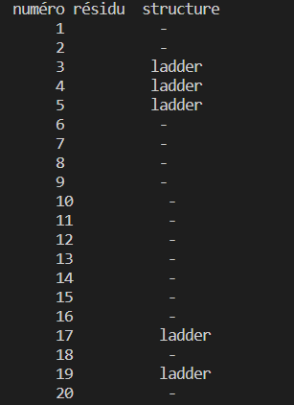
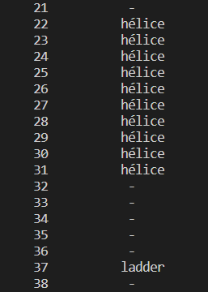
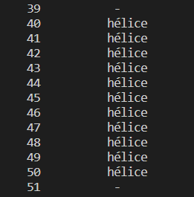
My results
My program will insign an structure to a residue if it did find one

Slide 10
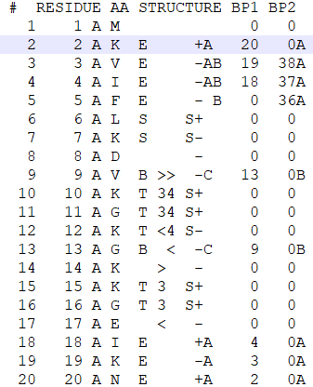
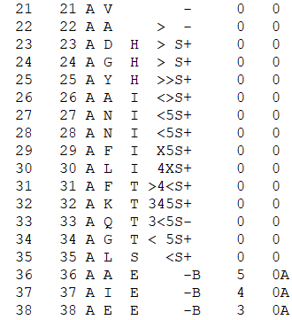
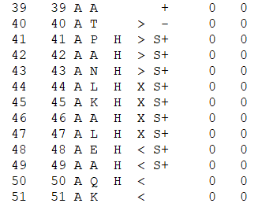
DSSP results
You can compare my output with DSSP output

Slide 11

Thank you for your attention

