Slide 1
Exploring trends in billboard top 100 charts using spotify’s dataset
DSC 478 Final Project REPORT
CONTRERAS, CRYSTAL
SOTIRIN-MILLER, TAVIS

Slide 2
PROJECT INTENT
We used Billboard’s top 100 charts on 5 different genres (country, jazz, latin, pop, r&b), over the last 20 years, using Spotify’s audio feature dataset. We attempted to:
Predict the popularity of a track
Classify songs by genre
Predict chart rank of popular songs

Slide 3
data

Slide 4
Data ACQUISITION
We wrote a script to scrape the top Billboard tracks for the last 20 years
We wrote another script to pull those tracks from Spotify’s database & unpopular songs as well
The final count of popular songs with valid data was 5654, with breakdowns of:
1448 country,
627 jazz,
1198 latin,
617 pop,
1728 r&b
Unpopular songs gathered totaled 17473, with total song breakdowns of:
4739 country,
4288 jazz,
4709 latin,
4158 pop,
5233 r&b

Slide 5
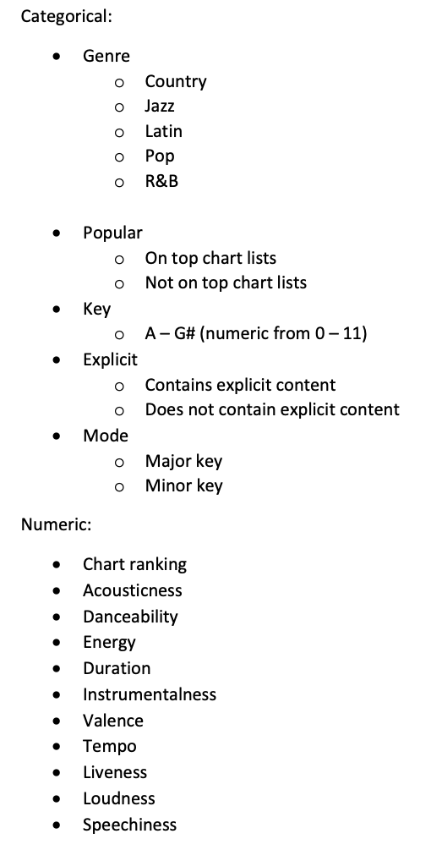
DATA CLEANUP
We normalized the duration, tempo, & loudness features using min-max normalization.
Categorical features were converted to dummy variables.
Release date was intended to be used, however, after retrieval was deemed not informative enough.
Notes:
We intended to use release date, however, Spotify was missing most of the values. So instead of fabricating the missing data with an average date, we opted to drop that feature from the set.

Slide 6
METHODS
Classification
Clustering
PREDICTION

Slide 7
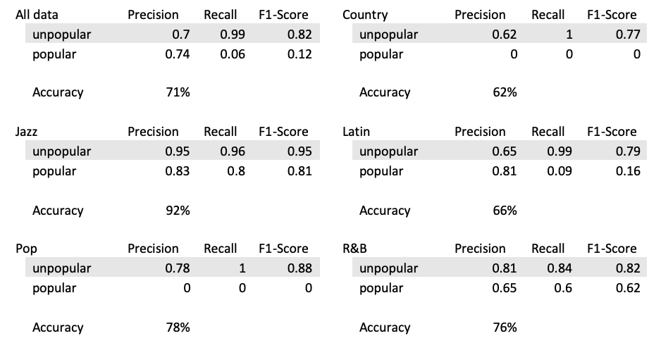
Classification decision trees
DTs were tested on different model parameters using a grid search, and 5-fold cross validation.
We ran DTs on all tracks for popularity prediction, then predicted popularity per genre.
Results across the board were poor, except for jazz prediction.
Notes:
We started with Decision Trees to get a sense of how valuable certain features were.

Slide 8
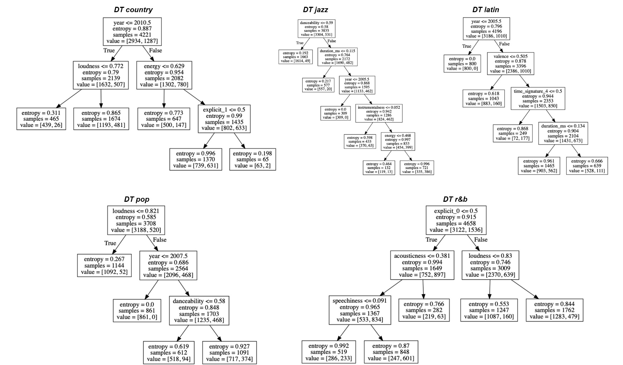
Notes:
Here we have an example of the trees generated per genre.

Slide 9
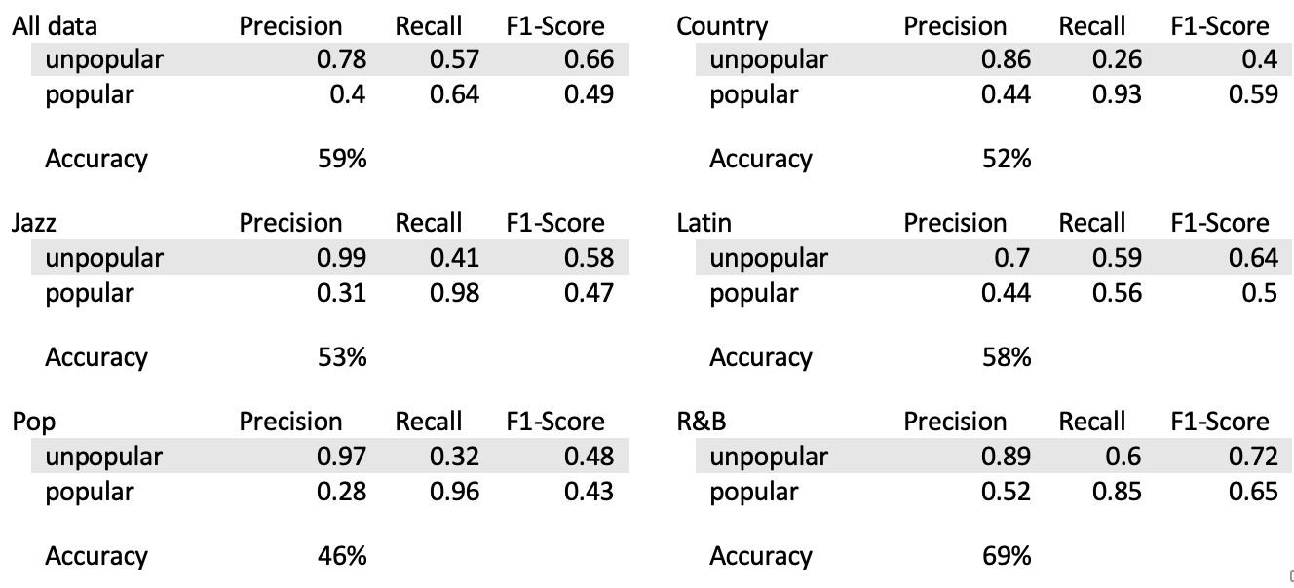
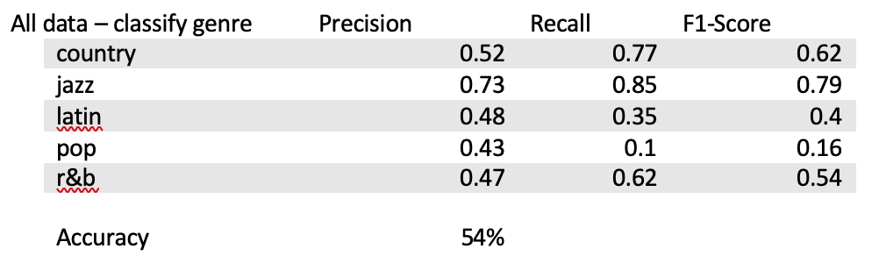
Classification Naïve Bayes
The Naïve Bayes models were tested on different model parameters using a grid search, and 5-fold cross validation.
We ran it on all tracks for popularity prediction, then on all genres for popularity prediction, lastly on all tracks for genre classification.
Naïve Bayes outperformed our DTs in terms of f-score, however, its accuracy score was worse, averaging at 55%.

Slide 10
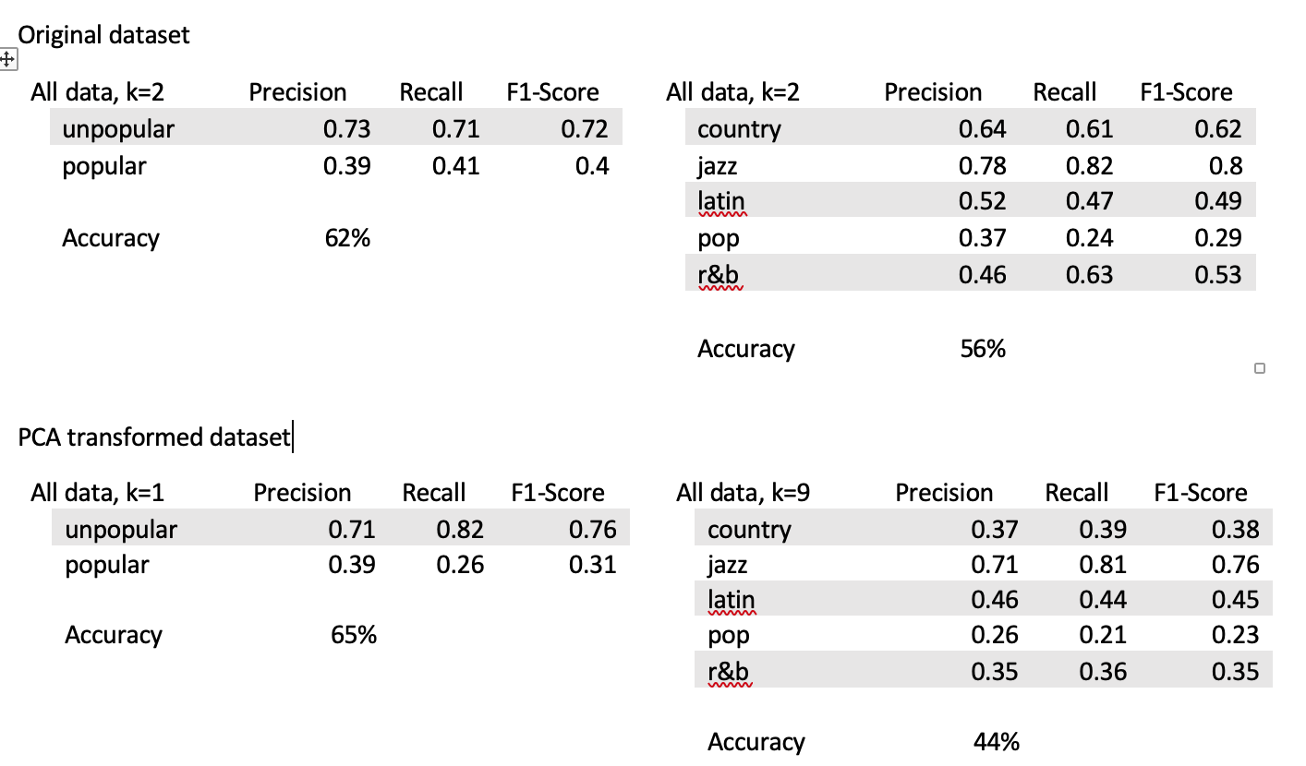
Classification K Nearest Neighbors
K Nearest Neighbors used Euclidean distance as the distance measure.
A grid search was done for k neighbors between 1 and 20, with scoring based on ‘recall’ for popularity prediction and ‘accuracy’ for genre prediction.
We ran the model on all tracks, then on our PCA transformed dataset.
Notes:
‘Accuracy’ was used as the scoring method for genre prediction due to its non-binary nature. We were still able to evaluate recall score in our classification report.

Slide 11
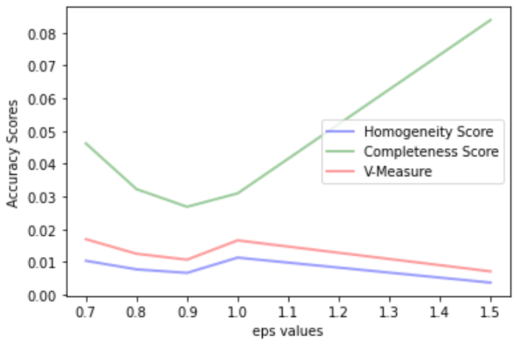
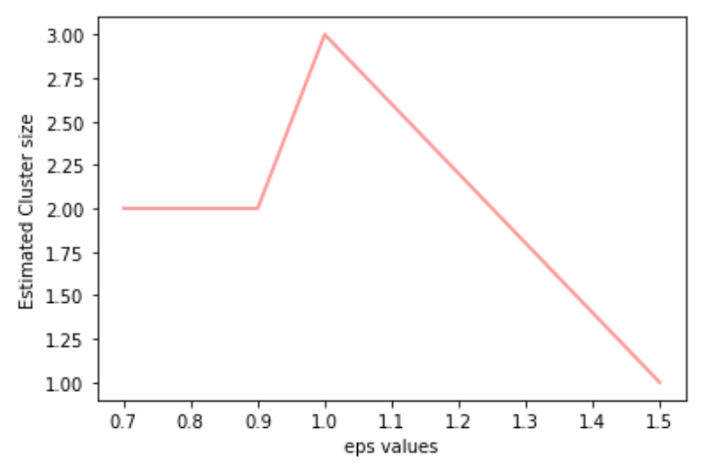
Clustering DBSCAN
We ran various epsilon values and min sample sizes to get an optimal completeness and homogeneity score.
We ran the model on all tracks, then on the PCA transformed dataset.
Predicted cluster sizes were either too small (averaging around 2), or too large (averaging around 50), with all homogeneity & completeness scores resulting in < 0.1.
Original test dataset on min samples = 100

Slide 12
Clustering kMeans
Running on the original:
produced clusters of sizes 1388, 9421, 5478, 1555, 2776, compared to genre data of sizes 4221, 3835, 4196, 3708, 4658.
The homogeneity and completeness scores were 0.102 and 0.117.
Running on PCA:
created clusters of sizes 6622, 7827, 1250, 742, 4177.
The homogeneity & completeness scores were 0.182 and 0.218.
We ran the model on k = 5.
We ran the model on all tracks, then on the PCA transformed dataset.
Notes:
Running on the original dataset, we produced the following cluster sizes.
Although our scores improved on the PCA transformed data, it was not significant enough to validate our theory.

Slide 13
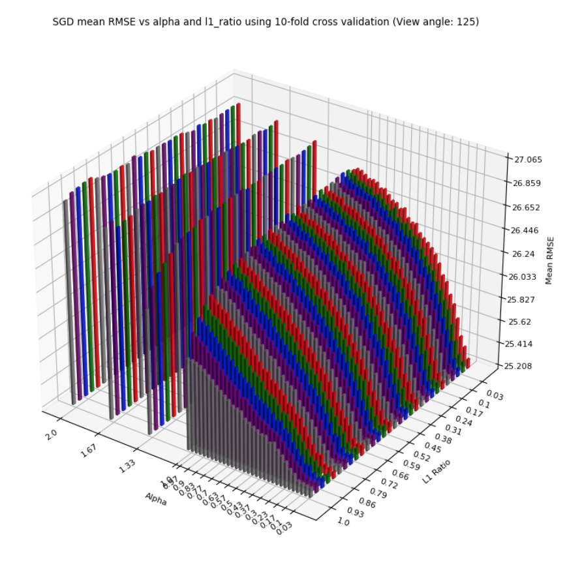
Linear regression
We ran 3 different types of regression models: Ridge, Lasso, & Stochastic Gradient Descent using a grid search for alpha & l1 ratio parameters.
Our models were run on all data & genre breakdowns. Each dataset had 4 variants:
No correlation
No duration
Only recent data
PCA
RMSE for alpha & l1 ratio grid search on all data.

Slide 14
Linear regression RESULTS
The average RMSE for any model was around 26, with the best being about 25 and the worst about 31.
Data variants had little impact on results, except for using the recent 3 years, which performed markedly worse.
Breaking the data by genre also performed worse than when combined in every tested example.

Slide 15
CONCLUSION

Slide 16
conclusion
Results strongly indicated that there is no trend in the data among popular vs. unpopular songs
No strong trend between genres
No trend among popular songs and their chart rank

