Slide 1
Historical Data Analysis of Stock Volatility & Correlation
A Financial Risk Management Project
By Crystal Andrea Dsouza

Slide 2

Objective
Calculate daily returns & volatility
Compare volatility (1Y, 6M, 90D, 30D)
Compute correlation between stock pairs
Visualize results with charts & dashboards
Reflect on volatility & portfolio risk

Slide 3









Companies Selected
Infosys, HDFC Bank, HUL, Tata Motors, Reliance,
Sun Pharma, Tata Steel, Bharti Airtel,
Nestle, Asian Paints
Mix of Cyclical (Tata Motors, Tata Steel)
and Defensive (HUL, Nestle, Asian Paints).

Slide 4



Data & Tools
Data: Bloomberg Terminal, SXC Mumbai
Tools: Excel & Power BI
Period: July 2024 – July 2025
&

Slide 5
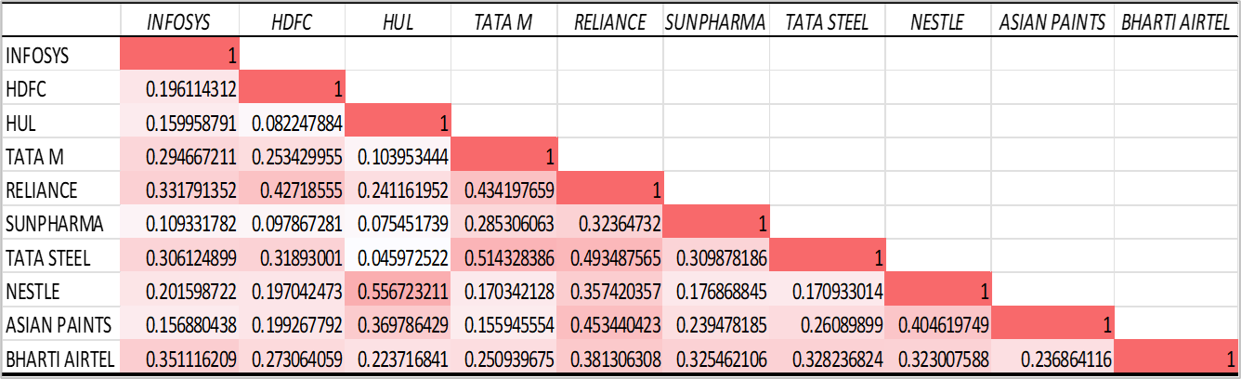
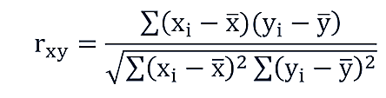
Correlation Analysis Correlation Matrix | EXCEL
High correlation: HUL–Nestle, Tata Motors–Tata Steel
Low correlation: Infosys–Sun Pharma, HUL–Tata Steel
High correlation = less diversification| Low correlation = better risk reduction

Slide 6
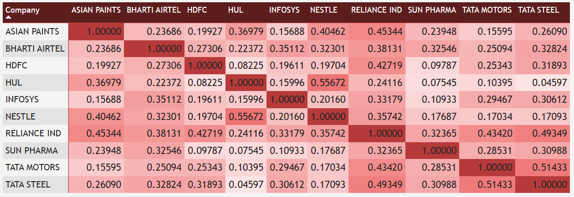
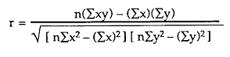
Correlation Analysis Correlation Matrix | Power BI
High correlation: HUL–Nestle, Tata Motors–Tata Steel
Low correlation: Infosys–Sun Pharma, HUL–Tata Steel
High correlation = less diversification| Low correlation = better risk reduction

Slide 7
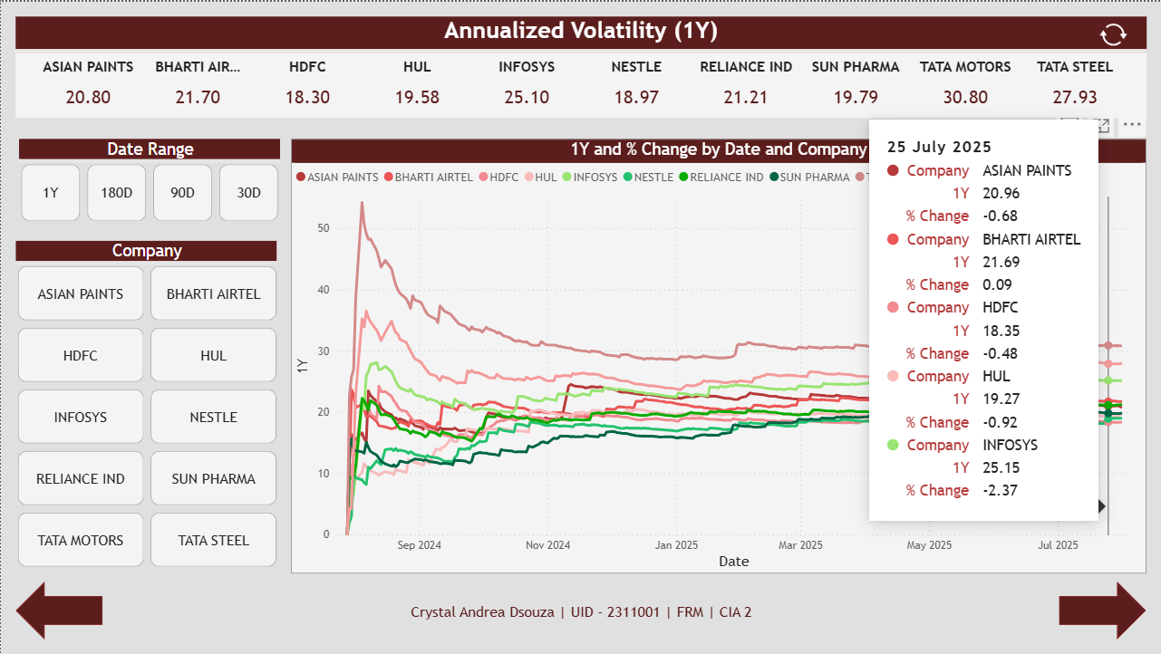
Volatility Analysis
Power BI
Volatility measured using Std. Dev (σ)
Annualized: multiplied by √252
Tata Motors & Tata Steel: High volatility (>27%)
HDFC, Nestle, HUL: Lower volatility (~18-19%)

Slide 8
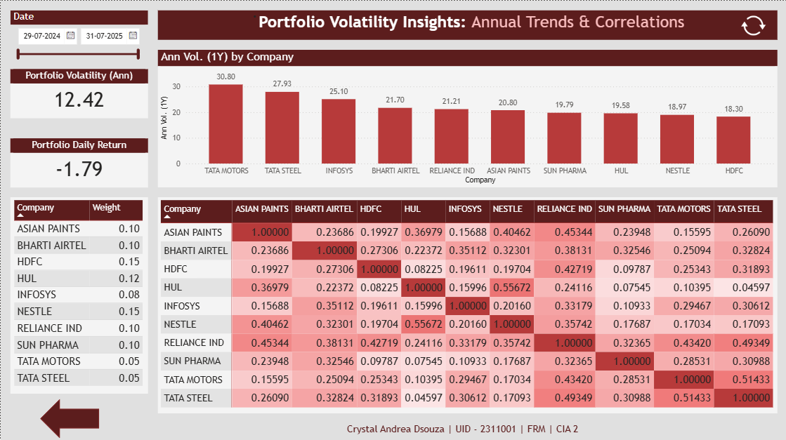
Portfolio Volatility
Power BI
Weights assigned to companies
Portfolio volatility: 12.42%
Lower than individual stocks due to diversification
Daily return: -1.79 (slight underperformance)

Slide 9

Key Learnings
Cyclical stocks = higher risk & volatility
Defensive stocks = stability
Correlation impacts diversification benefits
Diversification reduces overall portfolio risk
Real events can explain spikes in volatility

Slide 10
THANK YOU!
Present By: Crystal Andrea Dsouza
UID-RNO: 2311001-01
SEM 5 - FRM CIA 2

