Slide 1
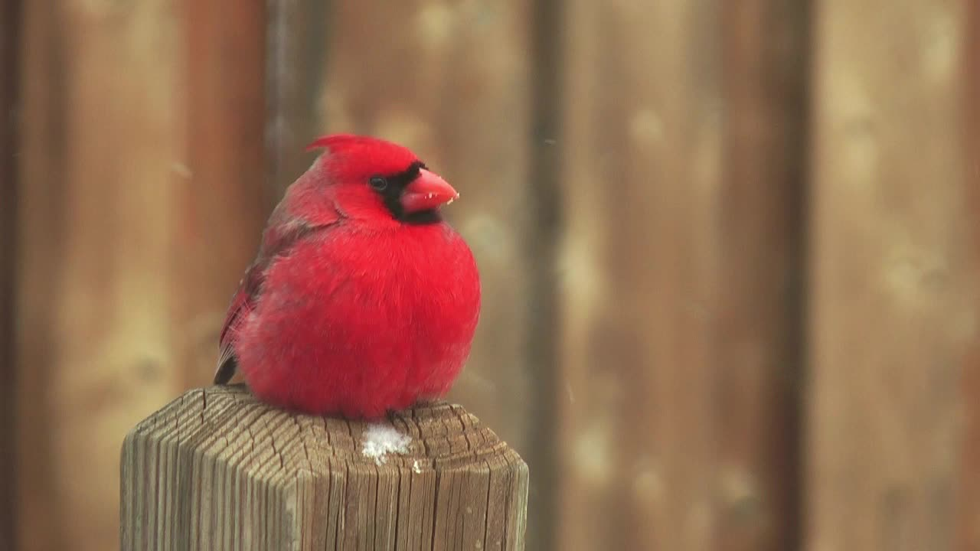
Houston Birds
Rice Data Science and Visualization Bootcamp
Alicia Starko
Jennifer Cockerill
Crystal Ho
Rekha Basra
Meenakshi Suryanarayanan

Slide 2
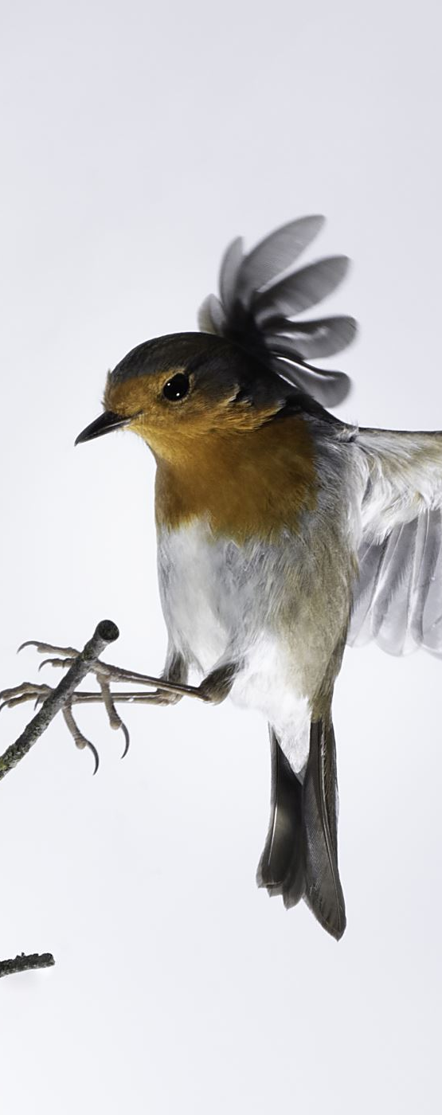
Goal of Project
Create a model along with visualization to be able to identify local Houston birds
Project Metholdogy
Identify Local Birds in the Houston Area
01
Obtain and Clean Dataset
02
Determine and Evaluate Model
03
Create Website and Visualization
04

Slide 3
Dataset
Use the Flickr API to create dataset of birds
Clean Dataset
Photos were then uploaded to google drive for processing
Predefine List of Birds Native to Houston Area
Define Size and Location for Photos to Download to

Slide 5
Model Methodology
Mounted Google Drive to Google Colab for Model
Experimented with Data Augmentation and rescaling techniques
Iterated Through Various Train/Test Splits
Experimented with number of photos
Ran model with various epochs
Added/Removed Numerous Layers

Slide 6
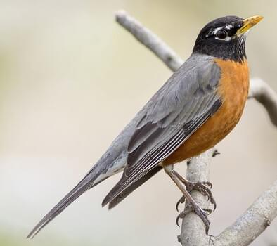
Final Model
x4
μ ≈ 0
σ ≈ 1
Input
Convolution
Pooling
Batch Normalization
Spatial Dropout
Flatten
Dense (ReLu)
Batch Normalization
Output
μ ≈ 0
σ ≈ 1
American Robin

Slide 7
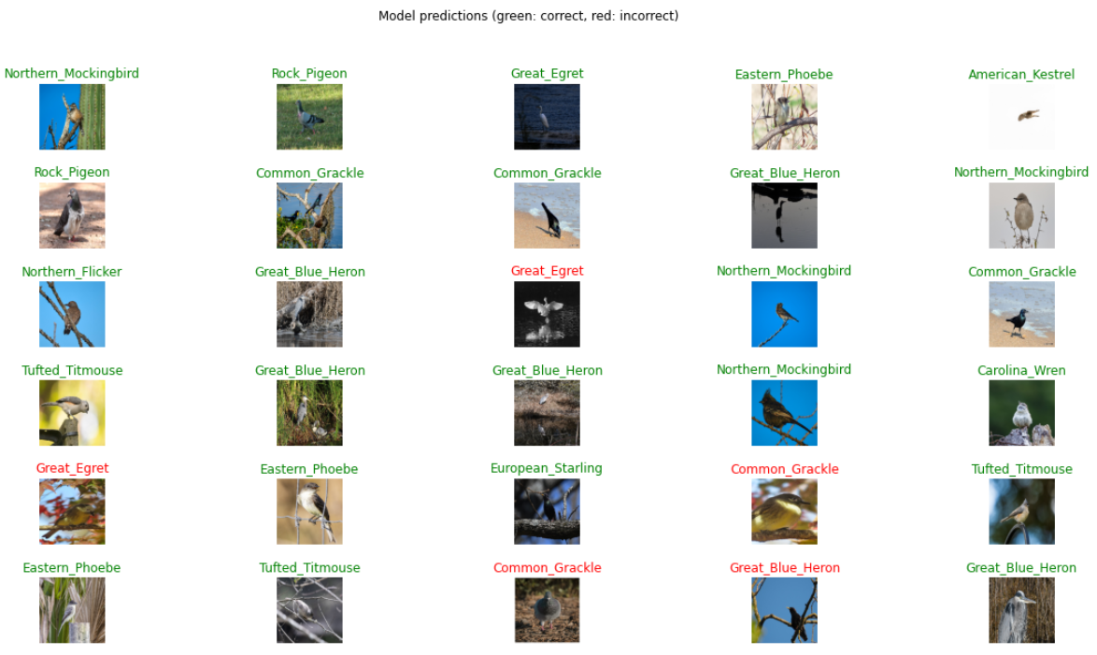
Model Accuracy
Notes:
To visualize the model accuracy, we are able to look at the data in the validation data set and add a color to the label to advise whether the bird was accurately identified.

Slide 8
Website Demo
Click me!

Slide 9
Conclusion
Successfully created model to identify birds in the Houston area
Model Accuracy Increased when more photos were added to data set
Website displays findings and is interactive allowing for photo upload

Slide 10
Way Forward / Next Steps
Increase the Number of Birds Trained
Increase the accuracy of model by increase number of photos
Make the model smarter – aka identify if it is likely not a bird
Increased Background removal testing and Augmention

Slide 11
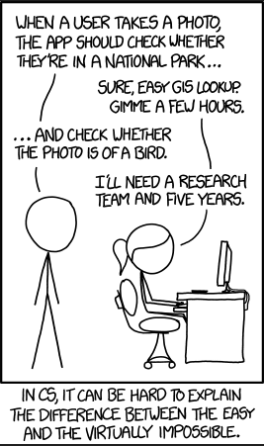
Questions?

Slide 12
Challenge
Dataset from Flickr was not clean
Had to obtain more photos than what was used to train the model
Ran out of GPUs

Slide 13
Seven Layers
Suitable for all categories business and personal presentation.
Insert Title
Suitable for all categories business and personal presentation.
Insert Title
Suitable for all categories business and personal presentation.
Insert Title
Suitable for all categories business and personal presentation.
Suitable for all categories business and personal presentation.
Insert Title
Insert Title
Suitable for all categories business and personal presentation.
Suitable for all categories business and personal presentation.
Insert Title
Insert Title

