Slide 1
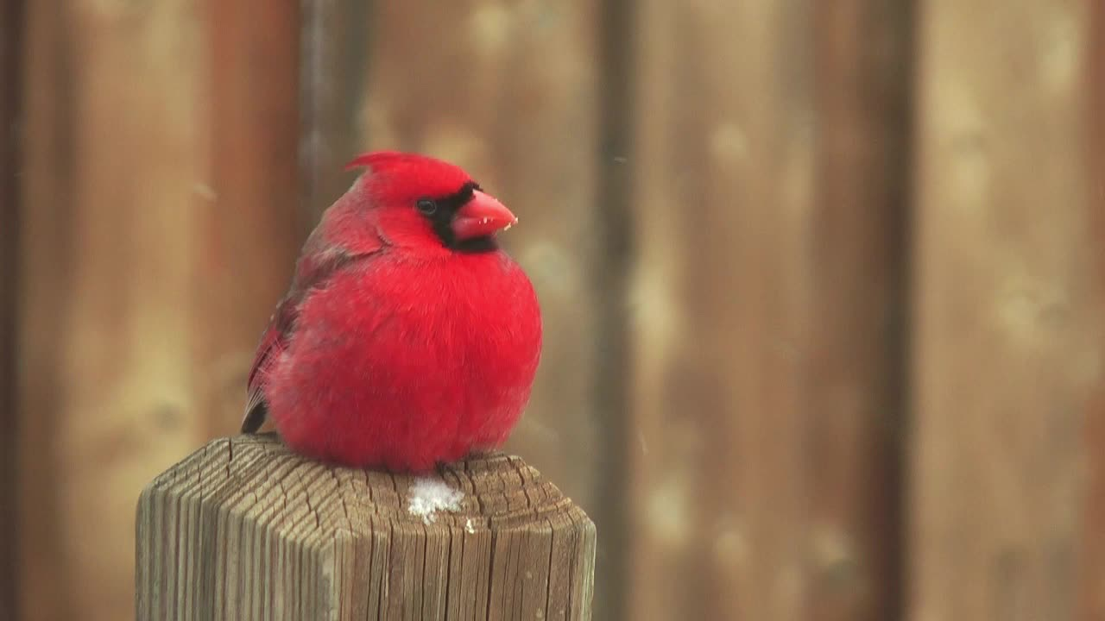
Houston Birds
Rice Data Science and Visualization Bootcamp
Alicia Starko
Jennifer Cockerill
Crystal Ho
Rekha Basra
Meenakshi Suryanarayanan

Slide 2
Goal of Project
Create a neural model to be able to identify local Houston birds and develop an interactive visualization
Project Methodology
Identify local birds in the Houston Area
Obtain and Clean the Dataset
Step
One
Step Two
Create and Evaluate Model
Step Three
Create Website and Visualization
Step
Four

Slide 3
Data Set
Prepare
Research
Obtain
Modify
Finalize
Predefine list of Birds native to the Houston Area
Determine appropriate size of photos and dataset
Use the FlickrAPI to download dataset
Clean dataset
Upload for Processing
Process was repeated throughout the analysis

Slide 4
Model Methodology
Mounted Google Drive to Google Colab for Model
Experimented with data augmentation and
rescaling techniques
Modified splits for training
and testing datasets
Insert Title
Modified the total number of photos used in model
Varied loss and optimizer values
Insert Title
Insert Title
Iterated model with
varying epochs
Added and removed numerous layers

Slide 5
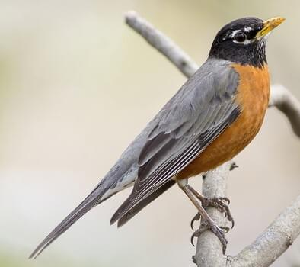
Final Model
x4
μ ≈ 0
σ ≈ 1
Batch
Normalization
Spatial Dropout
Input
Convolution
Pooling
American Robin
μ ≈ 0
σ ≈ 1
Flatten
Dense (ReLu)
Batch
Normalization
Output

Slide 6
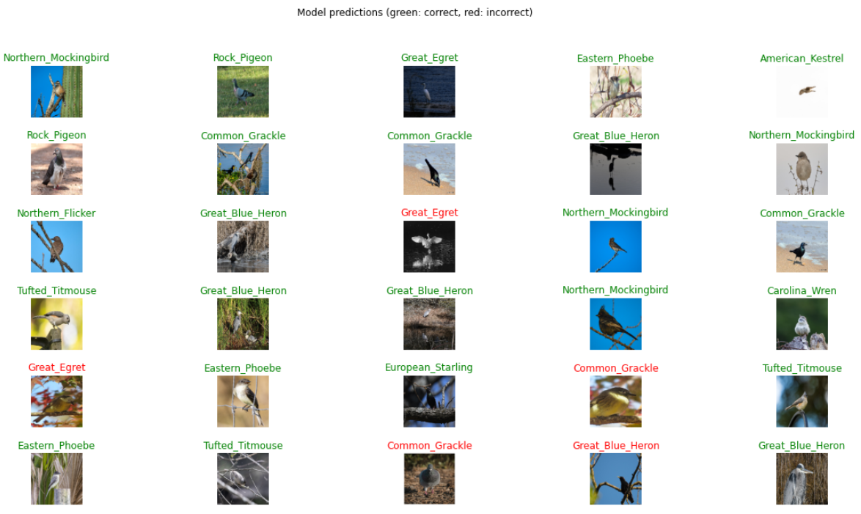
Model Accuracy
Notes:
To visualize the model accuracy, we are able to look at the data in the validation data set and add a color to the label to advise whether the bird was accurately identified.

Slide 7
Website Demo
Click me!

Slide 8
Conclusion & Way Forward
Created interactive website that displays findings and allows for user to upload a photo
Created and modified a unique dataset from scratch
Successfully created model to identify birds in the Houston area
Model Accuracy Increased when more photos were added to data set
Model Accuracy
Data Quality
Increase Categories of Birds Trained
Be able to identify non birds
Review and Improve photo selection
Increase Categories of Birds Trained
Data augmentation and background removal
Increase number of photos in Dataset

Slide 9
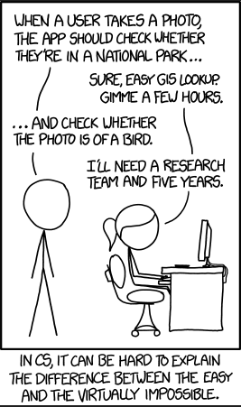


Questions?

Slide 10
Challenge
Dataset from Flickr was not clean
Had to obtain more photos than what was used to train the model
Ran out of GPUs

Slide 11
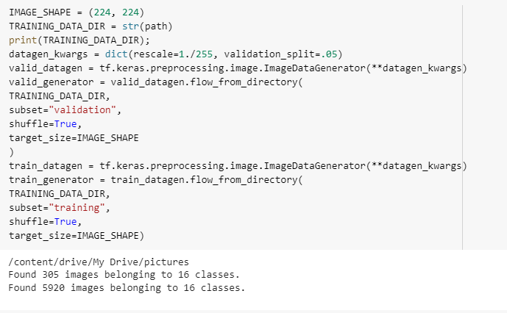
Train/Test Split

Slide 12
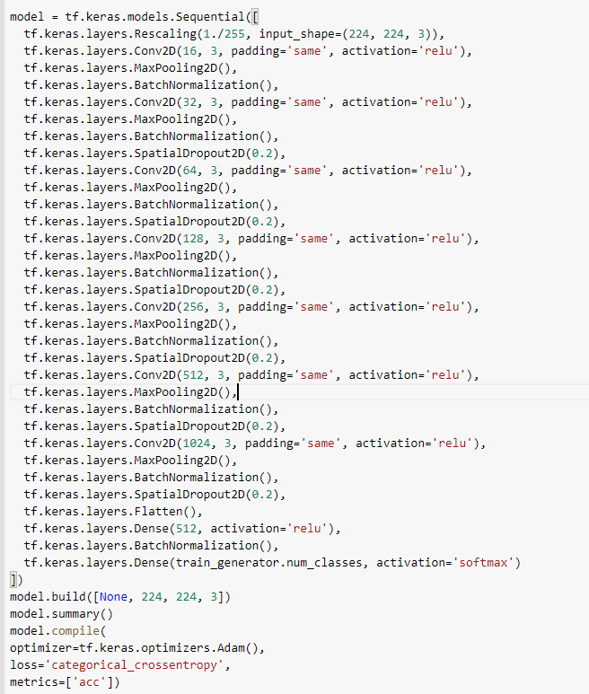
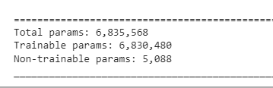
Model

Slide 13
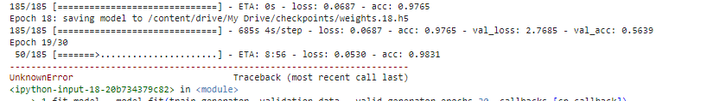
Epoch

Slide 14
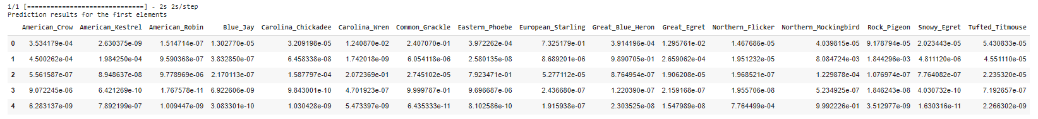
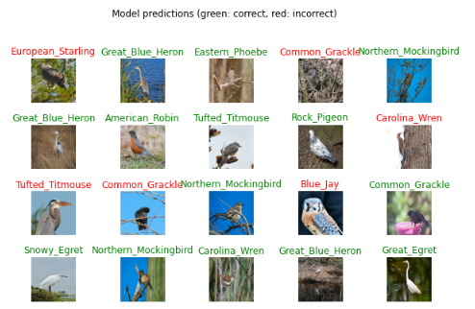
Prediction

