Slide 1
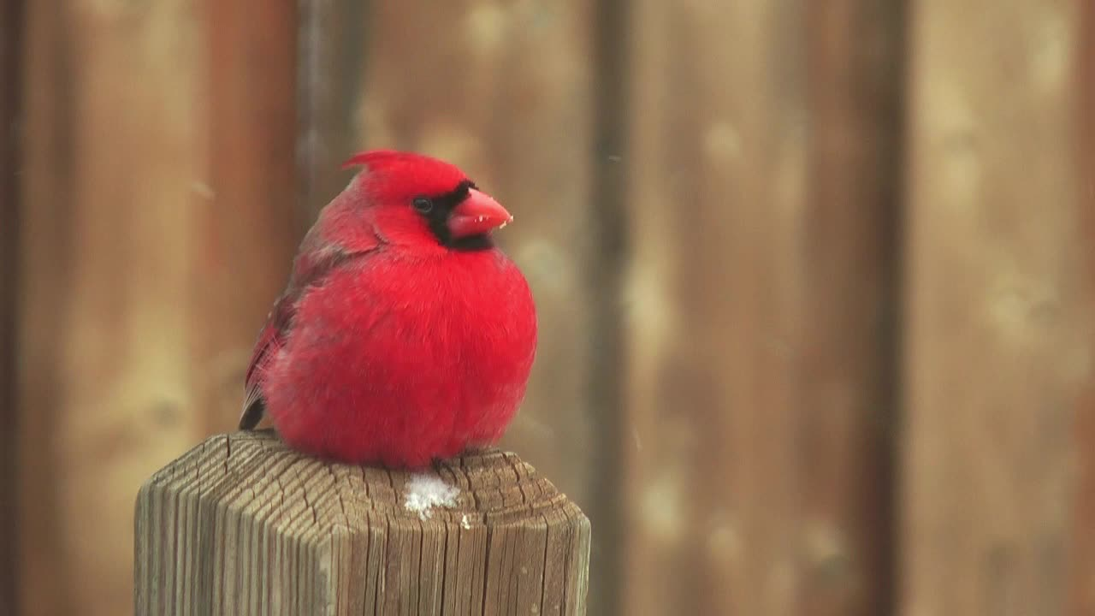
Houston Birds
Rice Data Science and Visualization Bootcamp
Alicia Starko
Jennifer Cockerill
Crystal Ho
Rekha Basra
Meenakshi Suryanarayanan

Slide 2
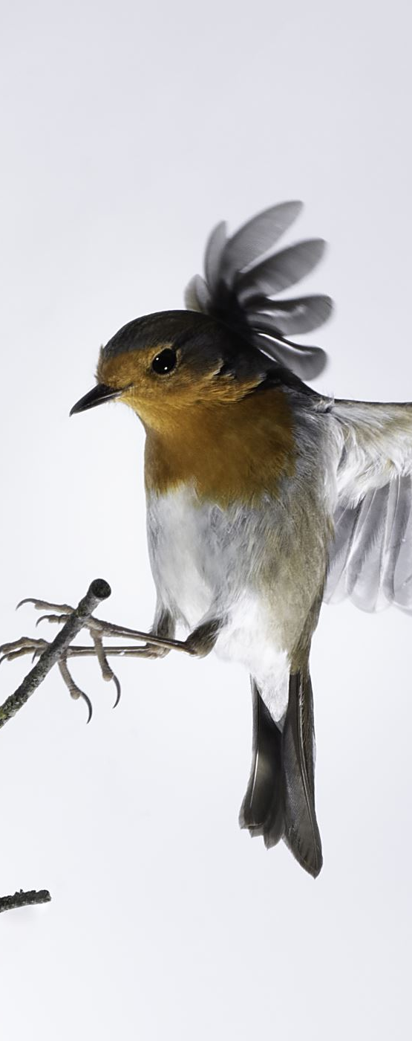
Goal of Project
Create a model along with visualization to be able to identify local Houston birds
Project Outline
Identify Local Birds in the Houston Area
01
Obtain and Clean Dataset
02
Determine and Evaluate Model
03
Create Website and Visualization
04

Slide 3
Dataset
Use the Flickr API to create dataset of birds
Clean dataset to remove nonrelevant photos and photos where birds are too small to be easily identified
Photos were then uploaded to google drive for processing
Predefine List of Birds Native to Houston Area
Define Size and Location for Photos to Download to

Slide 4
Model
Mounted Google Drive to Google Colab for Model
Created Sequential Model with 10 Layers
Used Rescaling Layer to Standardize RGB Channel Values
Performed Feature Analysis with Conv2D and MaxPooling2D Layers
Flattened into 1D and Ran Through Dense Layer
Created Output with Bird Probabilities

Slide 5
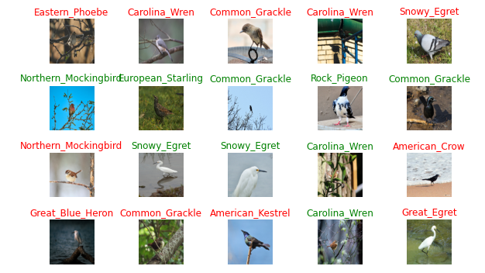
Model Accuracy

Slide 6
Website Demo

Slide 7
Way Forward / Next Steps
Increase the Number of Birds Trained
Make the model smarter – aka identify if it is likely not a bird

Slide 8
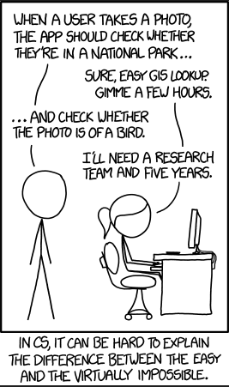
Questions?

Slide 9
Challenge
Dataset from Flickr was not clean
Had to obtain more photos than what was used to train the model
Ran out of GPUs

