Slide 1
Chinese remainder theorem
PROJECT
Shannon Stienmetz, Tri Nguyen, crystin Vanwagenen
category
Scheduler
AN alternative scheduler

Slide 2
Motivation
The Purpose/Motivation
To create an algorithm that is biased for un-busy CPU’s and busy Threads
We created the algorithms using Java
We decided to create a full computer simulator to test our scheduler
OTHER THAN TO GET A GOOD GRADE FOR OPERATING SYSTEMS

Slide 3

The Algorithm
How It Works
Initially no schedule so just do Round Robin to sample.
Sample CPU idle and thread use time
Take CPU times and shift to nearest prime numbers
CPUS/Threads
Recall CRT requires relatively prime values
Sole the CRT for x
Time Sampler
Compute start time of each thread as a factor of x mod the largest thread duration
Assign CPU times to vertices
(CRT) Initial Schedule
(Graph) Optimal Schedule
Use Dijkstra to find “optimal” paths (relaxing edges into the closest vertex)
This effectively assigns each thread (time needed) to the closest CPU (time available)

Slide 4
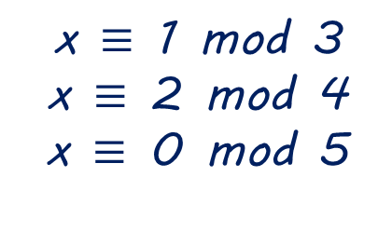
CHINESE REMAINDER THEOREM
What is the Chinese Remainder Theorem
Allows you to find a linear congruence.
That is; a common solution to a set of moduli.
We know our possible x solution must be from 0 to 59 since
3*4*5 = 60
Forget the math for a second, lets eyeball what common solution looks like…
BY SHANNON

Slide 5
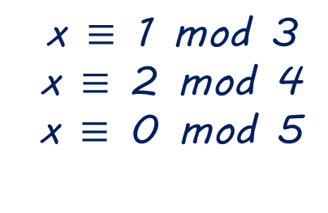
CHINESE REMAINDER THEOREM
What is the Chinese Remainder Theorem
First, x must be a factor of 5 since x = 5k + 0
So we know we must deal with
0, 5, 10, 15, 20, 25, 30, 35, 40, 45, 50, 55
(x must also be a factor of 3n + 1)
so remove things that can’t possibly be of the form 3n+1
0, 5, 10, 15, 20, 25, 30, 35, 40, 45, 50, 55
(x must also be factor of 4n + 2)
so remove things that aren’t possibly of the form 4n+2
0, 5, 10, 15, 20, 25, 30, 35, 40, 45, 50, 55
So the answer is x = 10
BY SHANNON

Slide 6
CHINESE REMAINDER THEOREM
What is the Chinese Remainder Theorem
How do we use this?
The CPU idle time creates “theoretical” intervals on average which are moduli.
The threads are treated as remainders (processing time)
The solution to the CRT provides a factor to generate a virtual schedule out into the future.
BY SHANNON

Slide 7
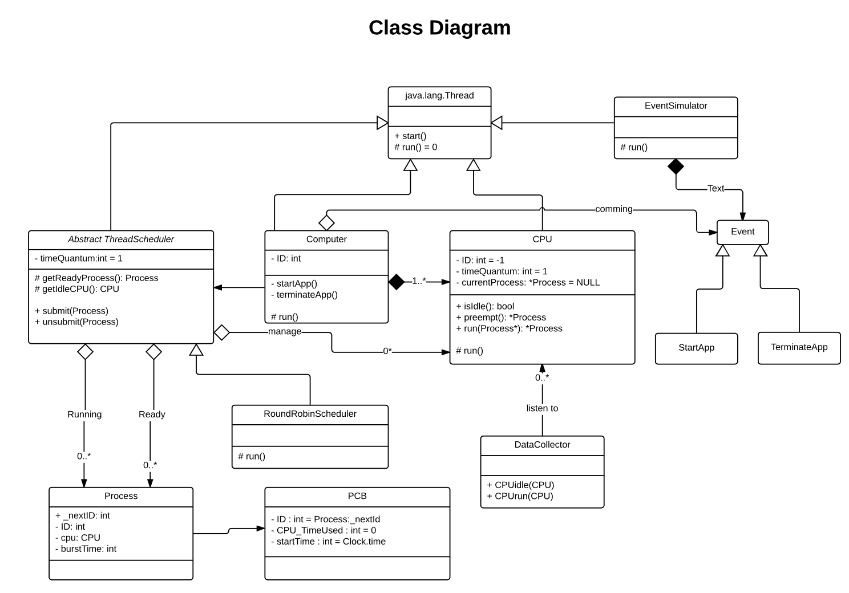
simulator DESIGN
by TRI

Slide 8
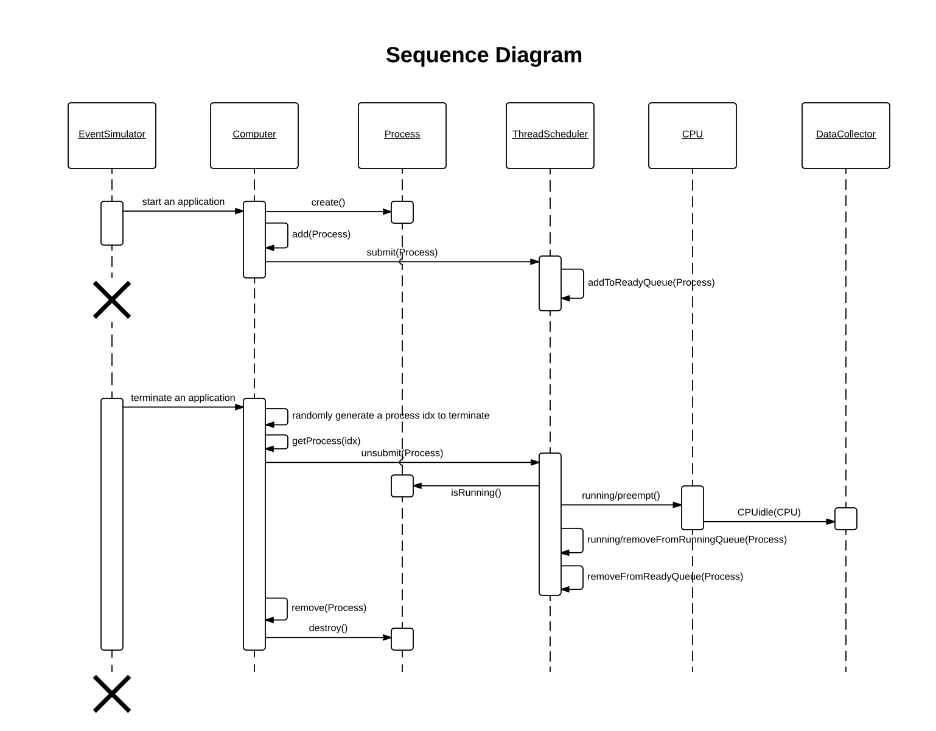
simulator DESIGN
by TRI

Slide 9
Weighted directed acyclic graph
Why Dijkstra?
Dijkstra fixes a single node as the "source" node and finds shortest paths from the source to all other nodes in the graph
Runtime
Dijkstra = O(V log V + E)
Bellman Ford = O(|V||E|)
Floyd-Warshall’s = (V³)
by Crystin

Slide 10
Pseudocode
time[s] ←0 (time to source vertex is zero)
for all v ∈ V–{s}
do time[v] ←∞ (set all other times to infinity)
S←∅ (S, set of visited vertices - initially empty)
Q←V (Q, queue initially contains all vertices)
while Q ≠∅ (while the queue is not empty)
do u ← minTime(Q, time) (get element of Q with the min time)
S←S∪{u} (add u to list of visited vertices)
for all v ∈ neighbors[u]
do if time[v] > time[u] + w(u, v) (if new shortest path found)
then d[v] ←d[u] + w(u, v) (set new value of shortest path)
(if desired, add traceback code)
return time

Slide 11

Graph Example

Slide 12
STEP BY STEP

Slide 13

Input t0 output

Slide 14
Analysis
How did we analyze?
Created a simulation scenario that tested Round Robin against our algorithm.
Tapped into the Algorithm time and CPU use
Ran tests from 1 CPU to 64 CPUs averaging 15 threads per CPU.
Generated CSV files for CPU #, Idle Time and Algorithm, Processing Time
Generated some graphs …
by SHAnnon

Slide 15
Algorithm Performance
Slightly faster than RR because it finds first CPU and runs
Slower than RR
Slower than RR
Ave 56us (CRT) 23us (Round Robin)

Slide 16
Algorithm Efficiency (Graphs of Idle Times)
CRT Spikes On Certain CPU’s
CRT Equals RR
CRT Leaves other CPU’s Unused while
RR Evenly Allocates
Note: These are Idle times of many cycles CPUs 0 - 63

Slide 17
Clear Evidence of efficiency
CPU vs Idle Time (64 CPUs 15 threads)
Note: This is the Idle times of 1 cycle of CPUs 0 - 63
Note: The RR algorithm (Left) dishes out processing in order
Our algorithm (right) more evenly distributes the processing based upon unused CPU cycles

Slide 18
CONTRIBUTIONS
Developed a fully functional scheduling algorithm
Developed a computer simulator capable of CPU’s, threads, processes etc.
Developed a comprehensive graph engine.
Developed a technique using CRT that predicts a schedule
Developed a fairly fast scheduler algorithm that appears to even distribute tasks to idle CPUs

Slide 19
DRAWBACKS
Using simulated hardware has drawbacks
Would have been nice to fully analyze diverse types of schedulers beyond the RR.
Did not have time to do another full optimization pass to improve performance.
The algorithm does not serve purpose under 1-2 CPUs.
As CPU’s increase our algorithm becomes slower.

Slide 20
Questions

