Slide 1

ILLNESS DIAGNOSIS SYSTEM

Slide 2
INTRODUCTION

Slide 3
In The Next 10 Years, Data Science And Software Will Do More For Medicine Than All The Biological Sciences Together.
- VINOD KHOSLA

Slide 4
BIG CONCEPT
With so many diseases showing similar symptoms, a well-trained system can certainly aid in accurate diagnosis of diseases.

Slide 5
ILLNESS DIAGNOSIS SYSTEM
In a field like medicine, it’s crucial to apply every bit of emerging technology that can be used to save lives.
Machine learning is the ability of a machine to learn things like humans do.
Disease identification and diagnosis is at the forefront of machine larning applications and research.

Slide 6
Breakthrough in the field of tech and medicine.
An algorithm developed by a team of researchers at Stanford University managed to produce the same results based on images as a team of highly skilled dermatologists.
Boston based company Berg is using AI to research and develop diagnostics and therapeutic treatments in multiple areas, including oncology.
Google’s DeepMind Health in partnership with Moorfield's Eye Hospital from London that is working on developing technology to address macular degeneration in aging eyes.

Slide 7
ILLNESSES THAT WE WILL TARGET
Common Flu
Migraines
Food Poisoning
Fractures
Vitamin Deficiencies
Alcohol Poisoning
Eating Disorders
Dehydration
Common Infections
Diarrhoea
Water intoxication

Slide 8
CURRENT SOLUTIONS

Slide 9
COMPARING DATA
 | Babylon Health | Practo | WebMD Symptom checker (Beta) | Illness Diagnosis System
Disease Prediction | Yes | No | Yes | Yes
Age restriction | 18+ | 18+ | All ages | All ages
Free? | In-app payment | In-app payment | Yes | Yes
Prescription | Yes | Yes | No. | No. Homemade remedies only.

Slide 10
TIMELINE

Slide 11
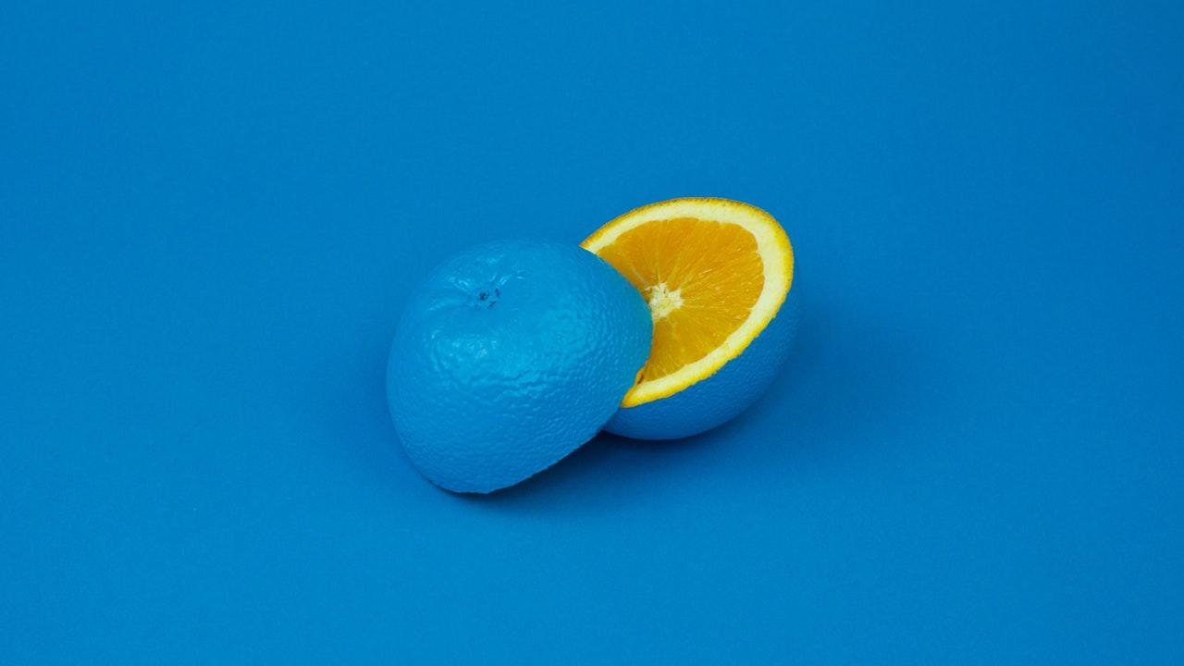
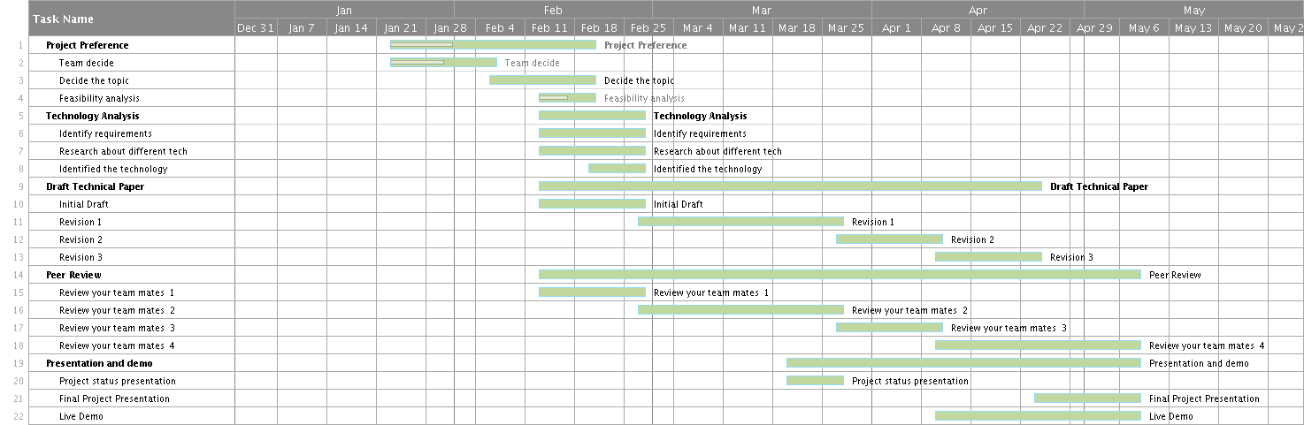

Slide 12
STEPS

Slide 13
OUR PROCESS IS EASY
First
User enters list of symptoms
Second
System asks further questions to narrow down the result
Last
Machine makes an accurate diagnosis of the illness

Slide 14
Obtaining Dataset
UML diagrams
Deciding Algorithms
Training Dataset
Testing
Documentation

Slide 15
PROJECT REQUIREMENTS

Slide 16
1. USER INTERFACE
Our application’s design decision is a combination of Activity-focused and User-focused design.
Simple
Detailed
Easy to navigate
Techy
Activity focused design focuses on users’ activities.
By researching the specifics, we get important insights that help improve the design.
User-focused design conducts the most user research, looking beyond just the activities.
This design style is a high-end approach and is necessary if we are looking to create an excellent experience overall.

Slide 17
2. USER MANAGEMENT
Login, logout
Creation of user profile
Updating and deleting records
Deleting user profile
3. ALGORITHMS AND TESTING
Choosing the right algorithms
Obtaining dataset
Training the algorithm
Testing

Slide 18
ARCHITECTURE

Slide 19
SVM
SVM is a supervised machine learning algorithm which can be used for classification and regression based problems.

Slide 20
SVM
Given two classes, we will plot both classes on a 2-dimensional graph and draw a decision boundary that best separates the two classes. This line is called
hyperplane and SVM creates this hyperplane for us.

Slide 21
SVM

Slide 22
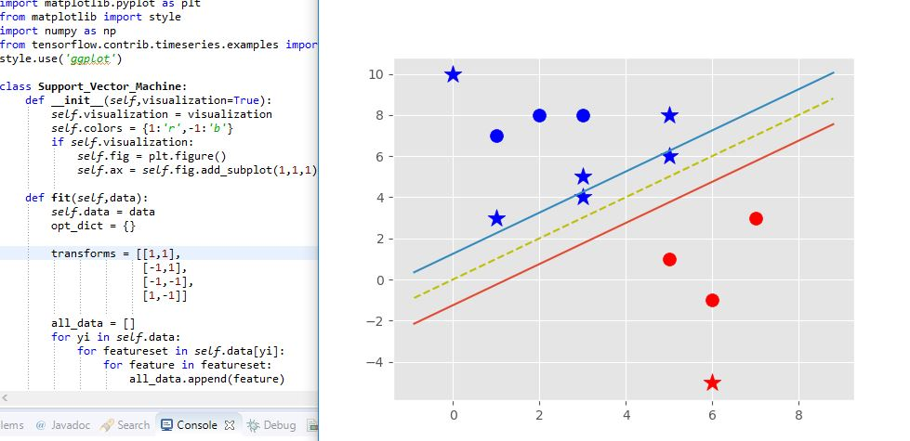

Slide 23



OUR SOLUTION
Aesthetically
pleasing UI
Interactive
Secure
Simple UI that is easy to navigate.
User can ask questions and answer questions asked by the chatbot.
Protection of data provided by the users.

Slide 24
User Stories & Test Cases
Project requirements and testing phase

Slide 25
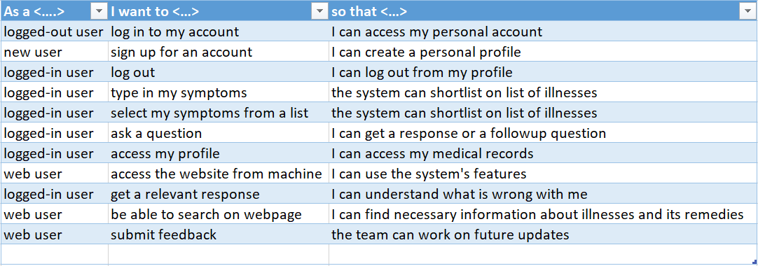
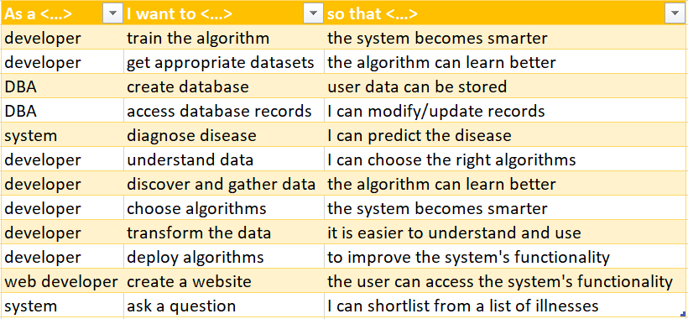

Slide 26
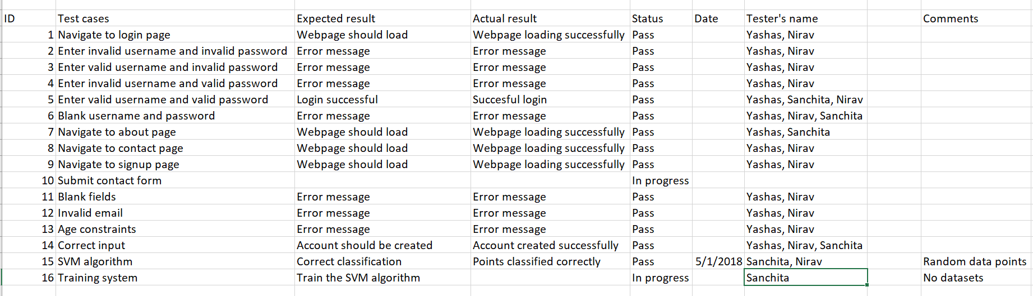

Slide 27
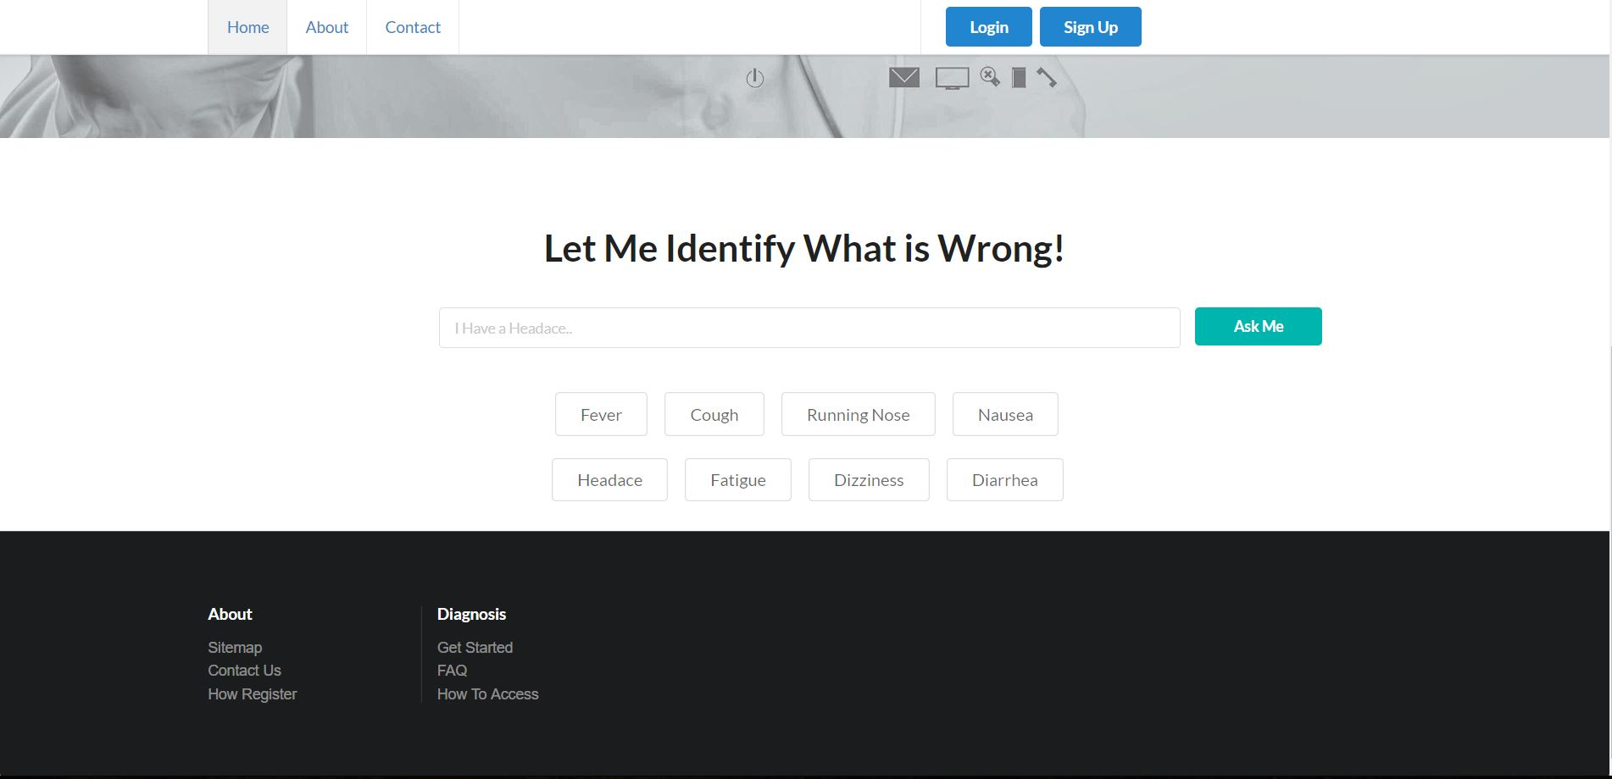
WEBSITE
REACT
SQL
MACHINE LEARNING
PYTHON

Slide 28
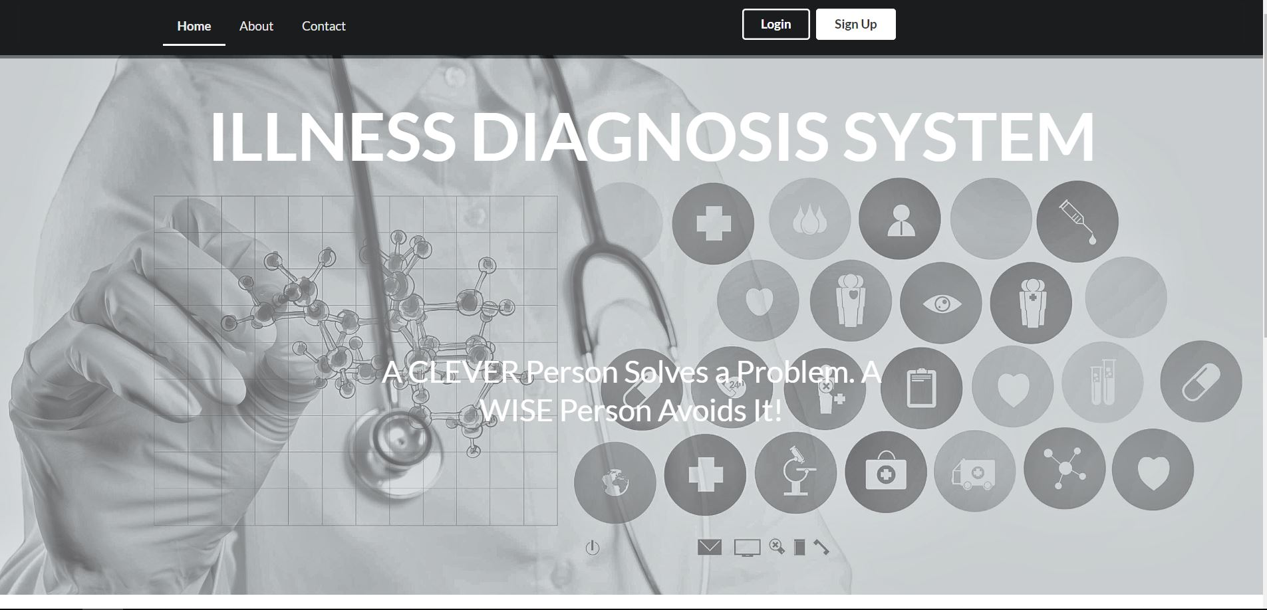

Slide 30
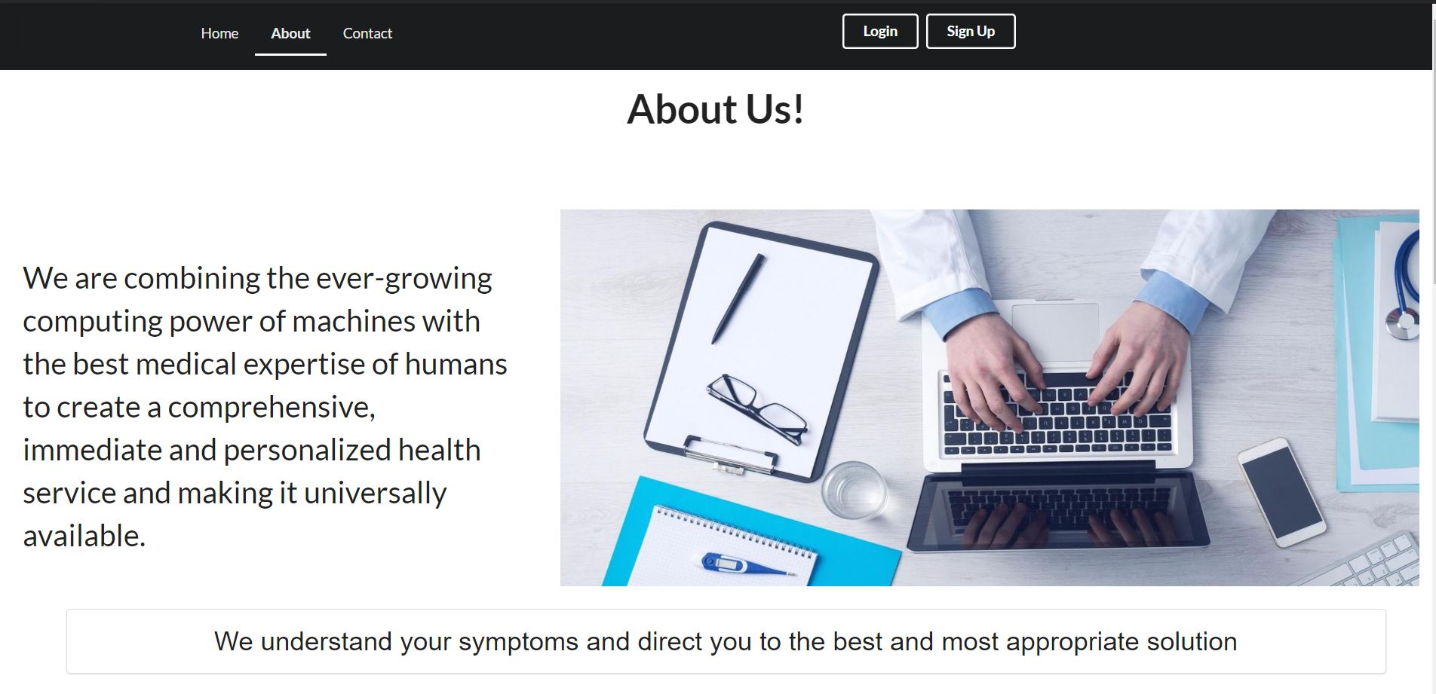

Slide 31
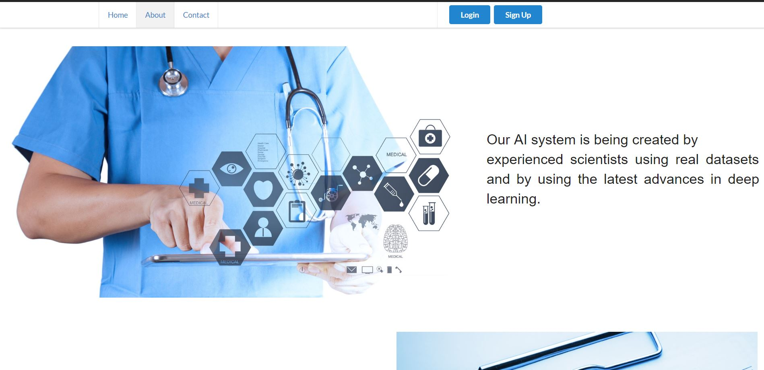

Slide 32
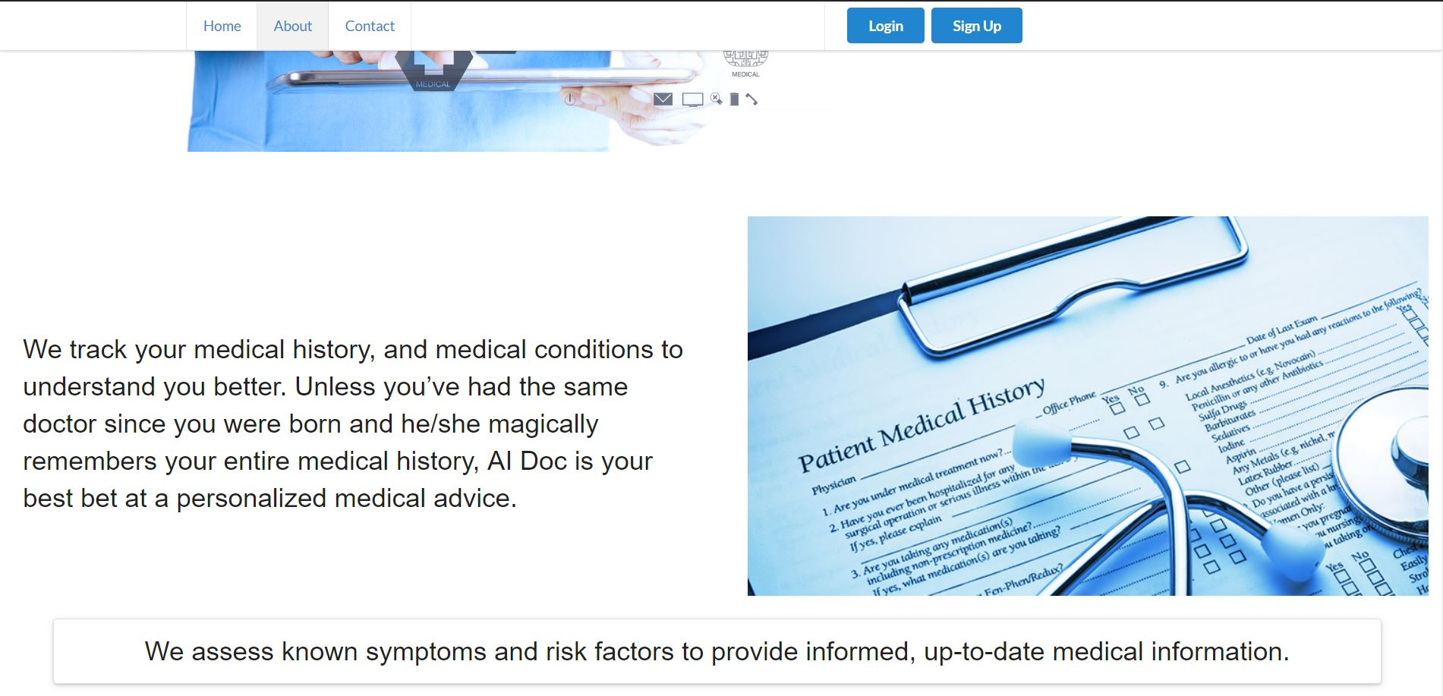

Slide 33
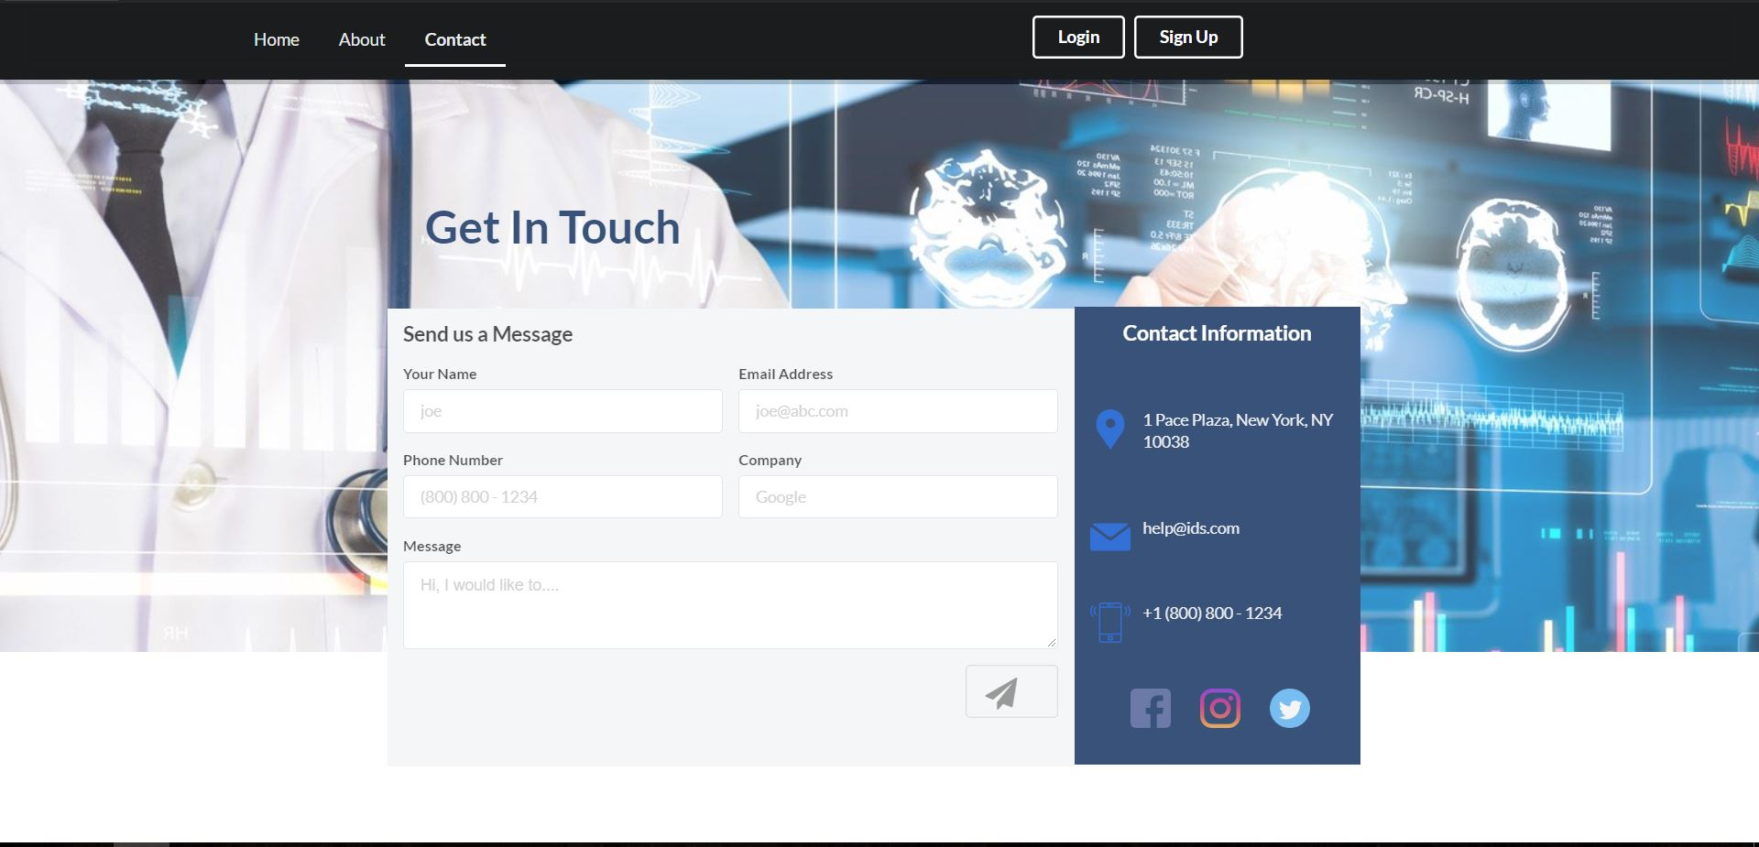

Slide 34
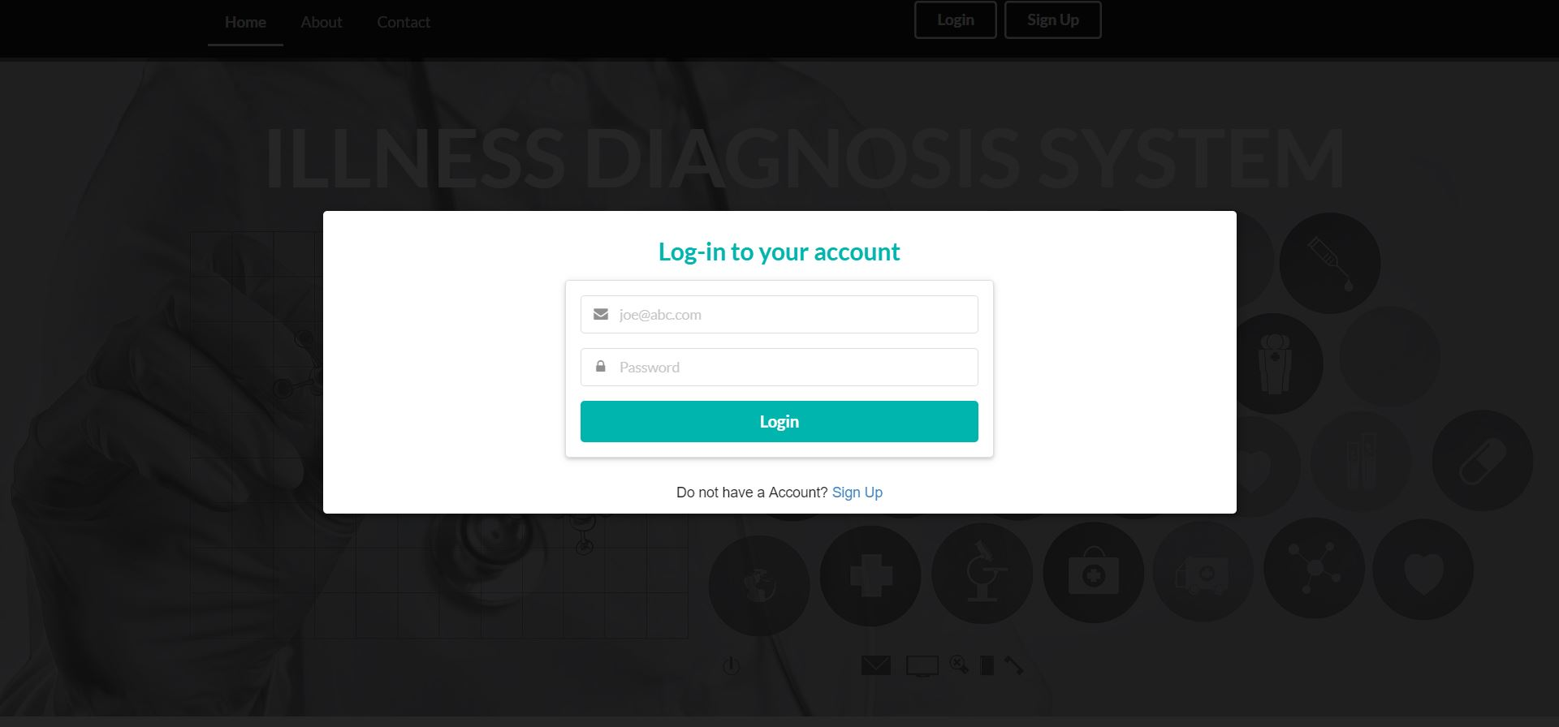

Slide 35
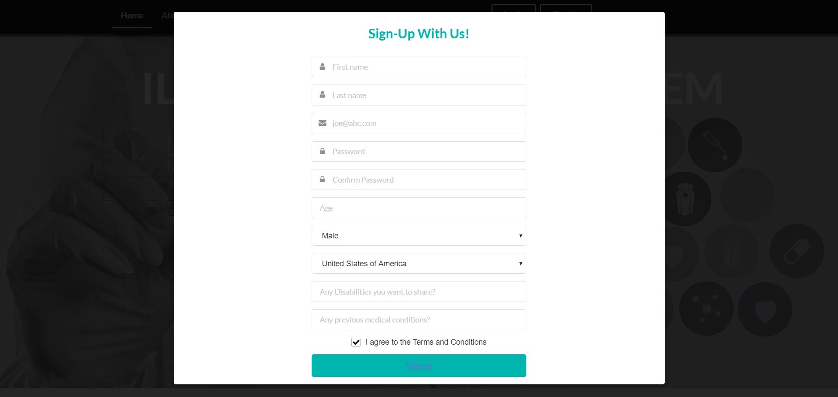

Slide 36
Future work

Slide 37
Next semester
Finding the appropriate datasets
Chat-bot
Main focus on making the application interactive and smart.
UI
Work on bettering the UI.
Obtaining the correct datasets has been our biggest challenge.

Slide 38

THANKS!
Any questions?

