Slide 1
Maison De Parfum
Made by: Csaba albók, róbert varga-ádám

Slide 2





About The Project
Name of the project: Maison De Parfum (MDP)
Technologies we used to make the project: Angular (v19), Bootstrap (v5), node.js (v20.18.0), Express.js (v5.2.1), Sequelize (v6.37.7), MySQL
The split of the project:
Frontend: Róbert Varga-Ádám
Backend, Database, Software Testing: Csaba Albók

Slide 3
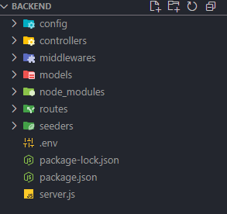
Backend
File Structure
Config: Jwt and Db connection
Controllers: Marketing logic
Middlewares: JWT control
Models: db tables, defines connections
Router: API endpoints
Seeders: Uploading defined datas
.env: local variables
Server.js: Imports, Server starts

Slide 4
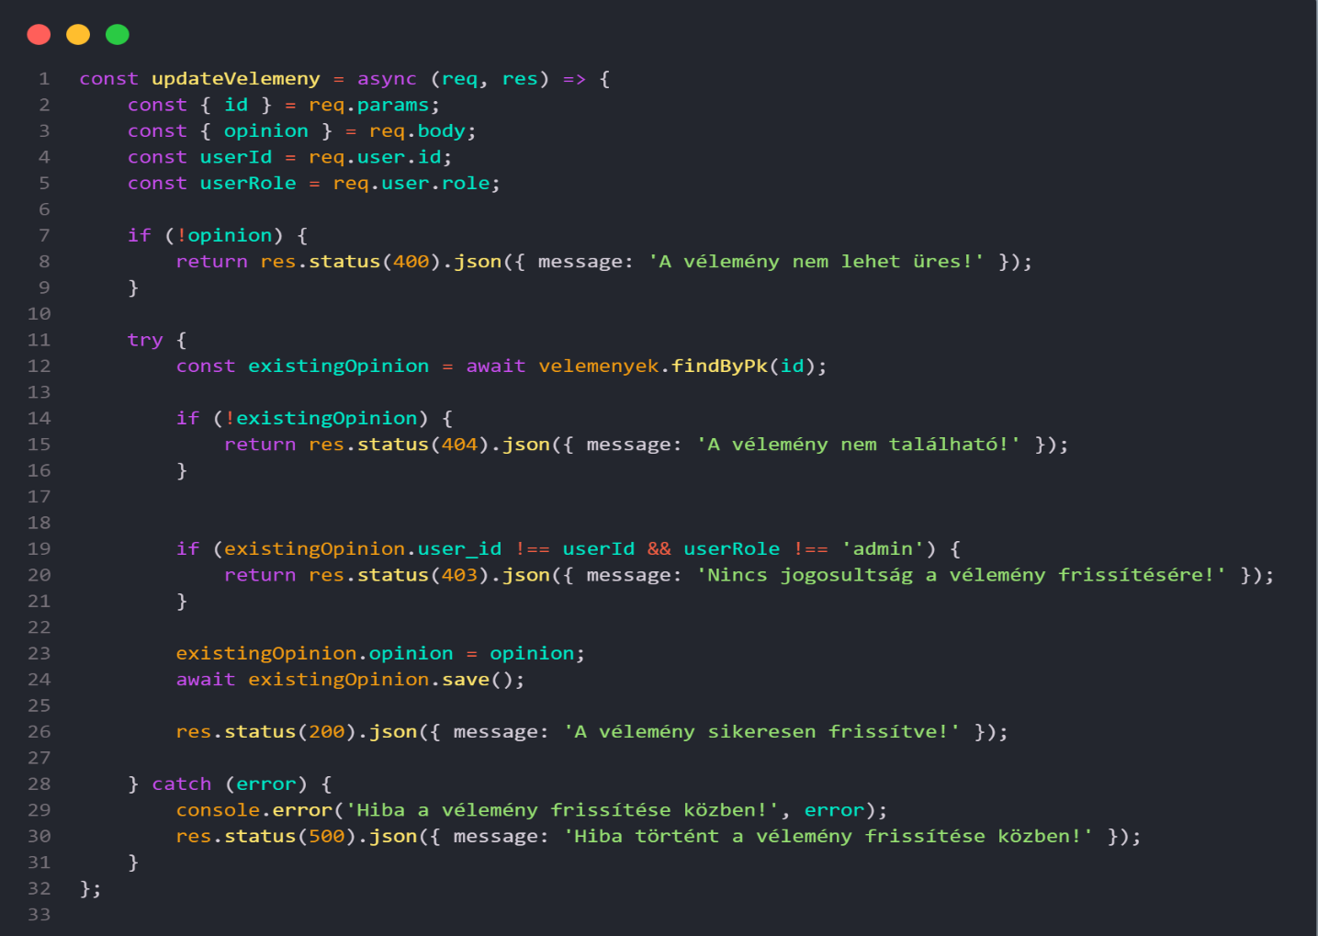
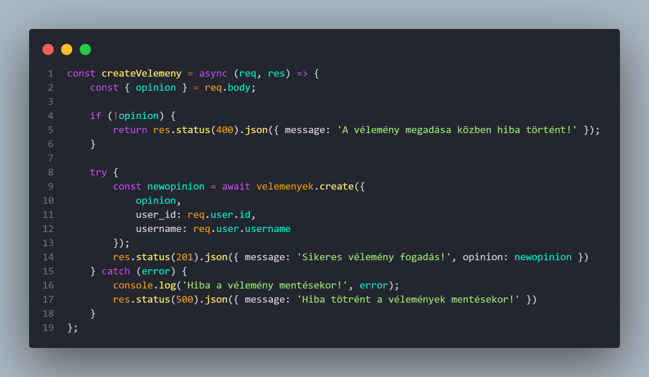
Opinions Controller
The most importand function on the website is the opinions logic
CRUD operations
POST: create the opinion
DELETE: delete the opinion by id
UPDATE: update the opinion by id
GET: get all the opinions

Slide 5
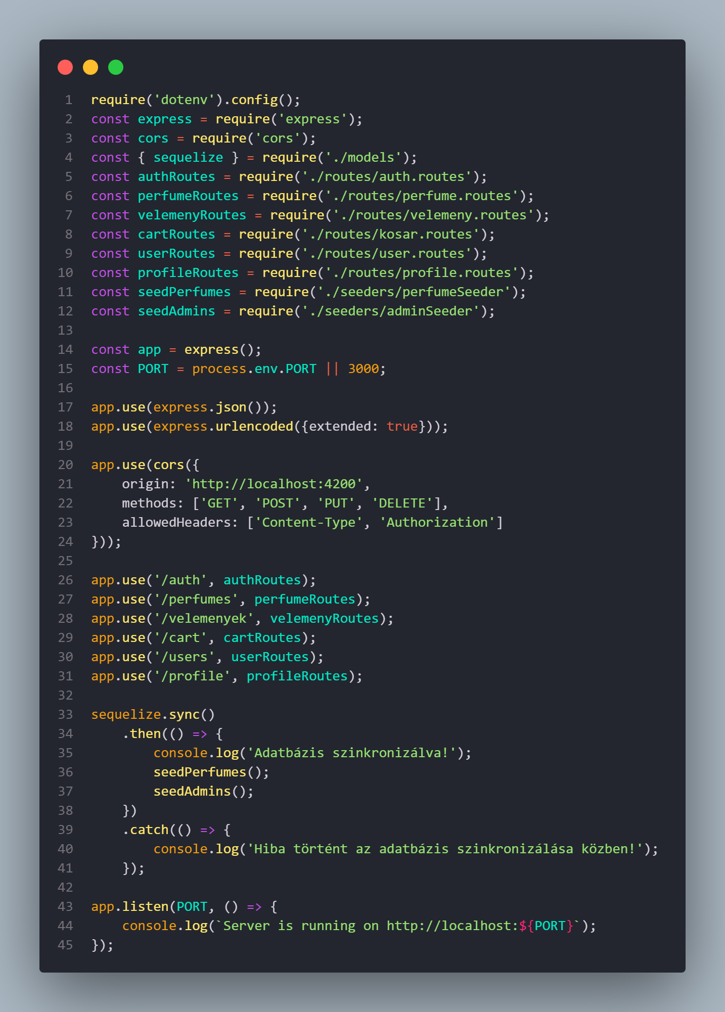
Server.js
All the imports are here.
Perfumes, and Admin seed.
Server starts

Slide 6
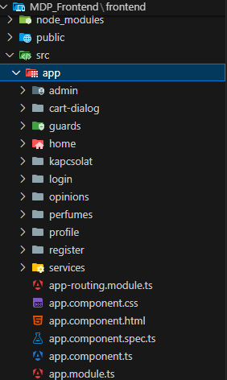
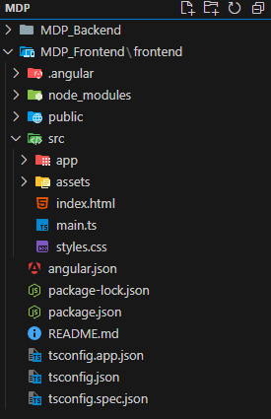
Frontend
File structure
Assets/images: pictures used for the website
Admin->Register: component
Guards:controlls user activities
Services: http requests

Slide 7
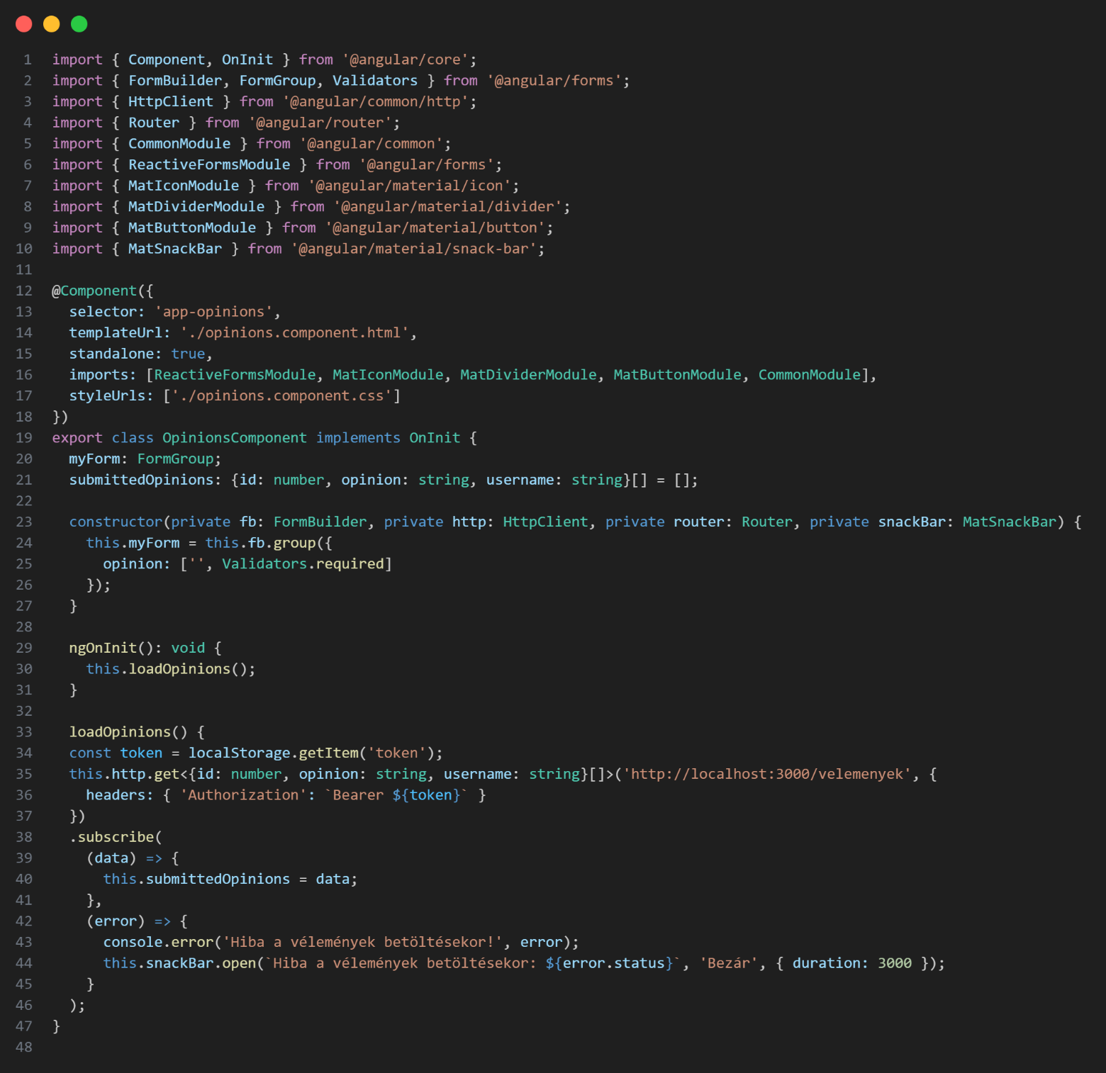
Opinions methods
This code defines an Angular service that handles review-related data from a local backend server via HTTP requests. It allows reviews to be retrieved, added, deleted, and modified, ensuring full data synchronization between the interface and the database.

Slide 8
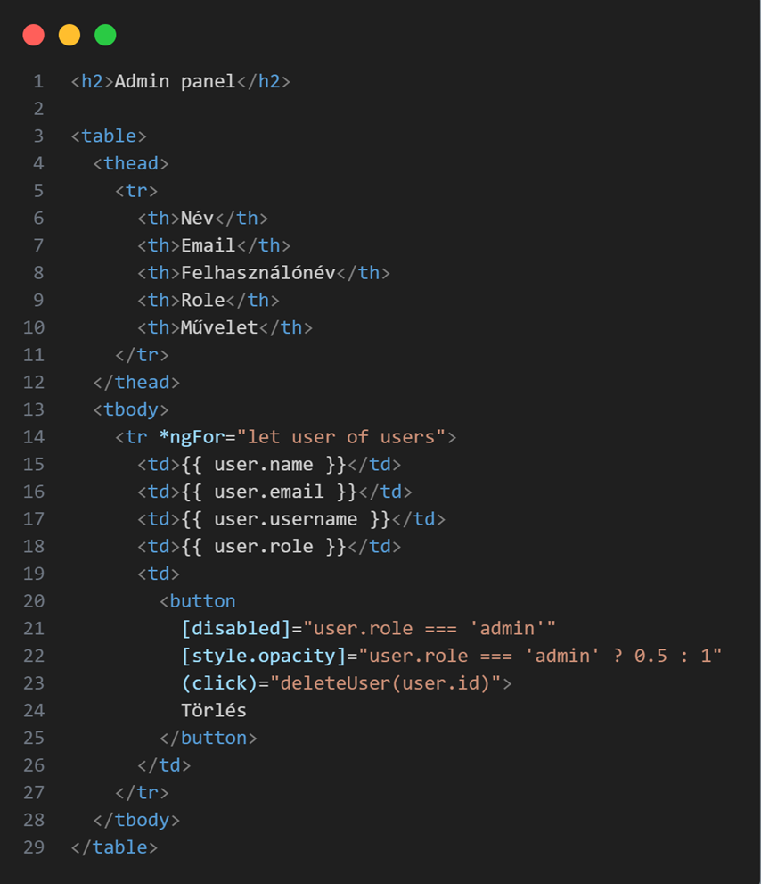
Admin dashbord
This HTML code creates an administration interface where the data of registered users (name, email, username, and role) are displayed in a table.
The interface includes an important security feature: each row in the table has a delete button, but the system prevents users with the "admin" role from being deleted, thus preventing accidental self-deletion or loss of privileges.

Slide 9
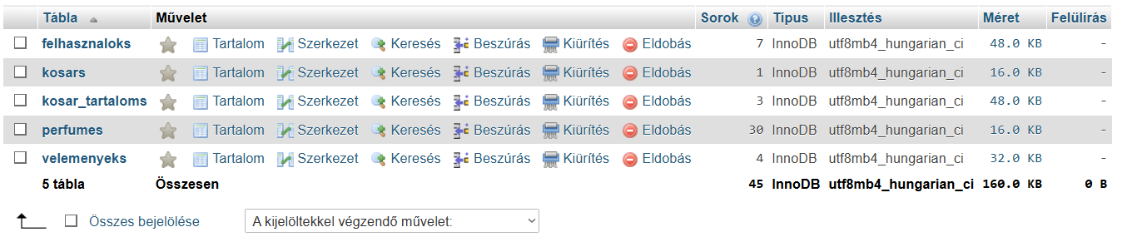
Database
Database name: maisondb
Character coding: UTF-8_hungarian_ci
5 tables

Slide 10
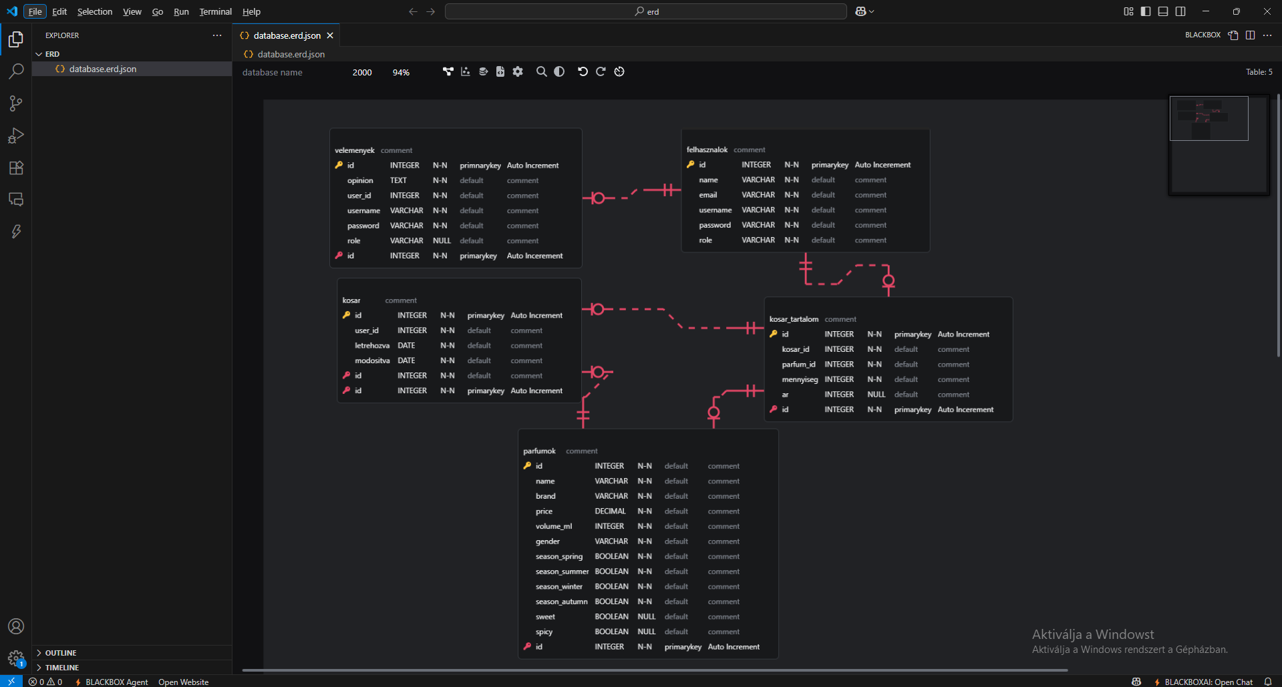
Visual representation of database

Slide 11
Software Testing
During the test phasing we used the „Shift Left” method.
"I utilized VS Code's built-in features to identify and fix semantic errors.
Besides that I used 4 testing strategies:
Unit Testing: testing methods and code modules izolated.
Integrating test: To test the frontend-backend and database connection.
White-box testing: To test the code inner structure, and logic.
Black-box testing: To test everyting from the users view.

Slide 12
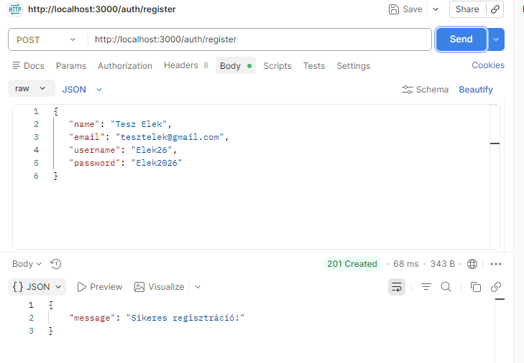
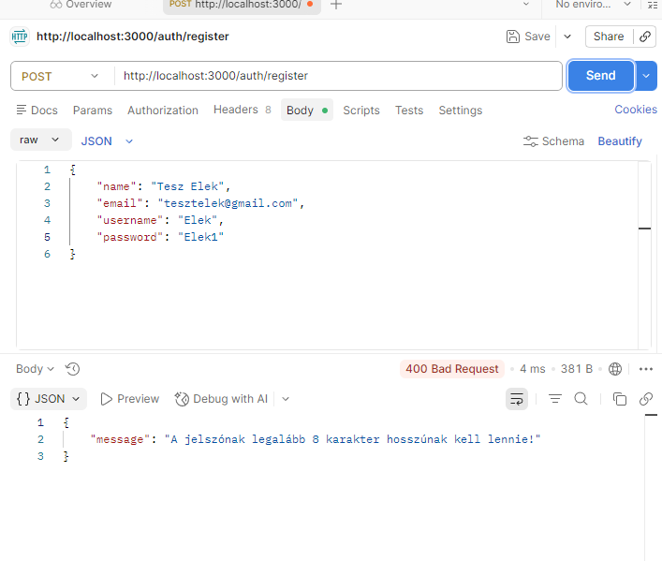

Slide 13
Plans for the future
We would like implement Nodemailer on the server side (backend) so that we can send emails to users.
There will be payment option on the website.
Generation of electronic invoices on the site and linking to an electronic invoice generator site. (E.g.: Billingo)
Updating and expanding the database. In case of an order, e.g. (pending, accepted, declined)
Option for users to add a profile picture.

Slide 14
Thank you for the attention!

