Slide 1

Open Source Software vs Application Software
Pros and Cons Comparison

Slide 2


Slide 3
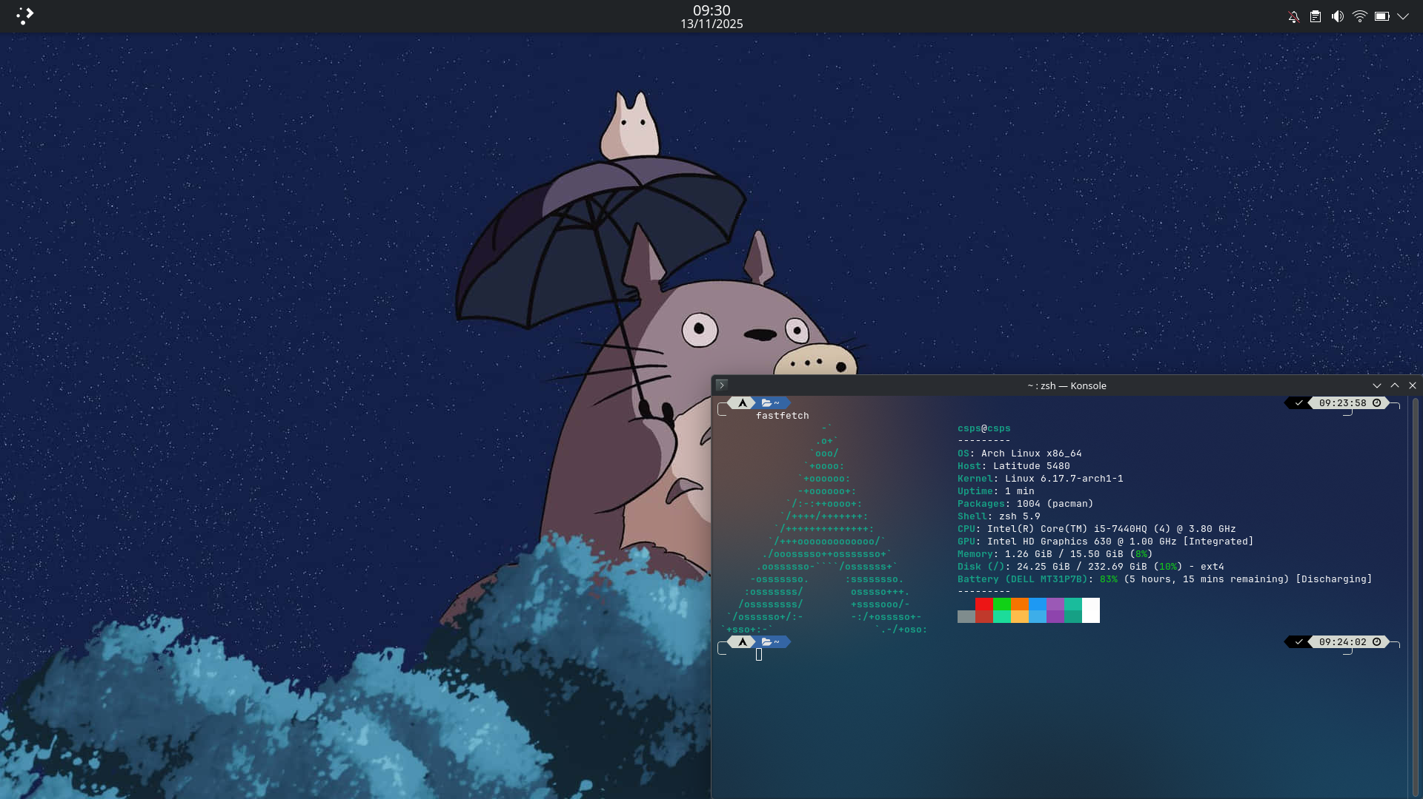
What is Open Source Software?
Examples: Linux, Chromium, LibreOffice, VSCodium, OpenSSH, etc.
Software with source code publicly available
Allows modification and distribution

Slide 4

Typically free or low-cost
Highly customizable
Transparent and secure through community review
Community-driven development leads to quick improvements
Platform compatibility
Requires technical expertise
Limited formal support, mostly community-based
Potential security risks if poorly managed
Possible compatibility and functionality limitations
Maintenance and legal complexities

Slide 5
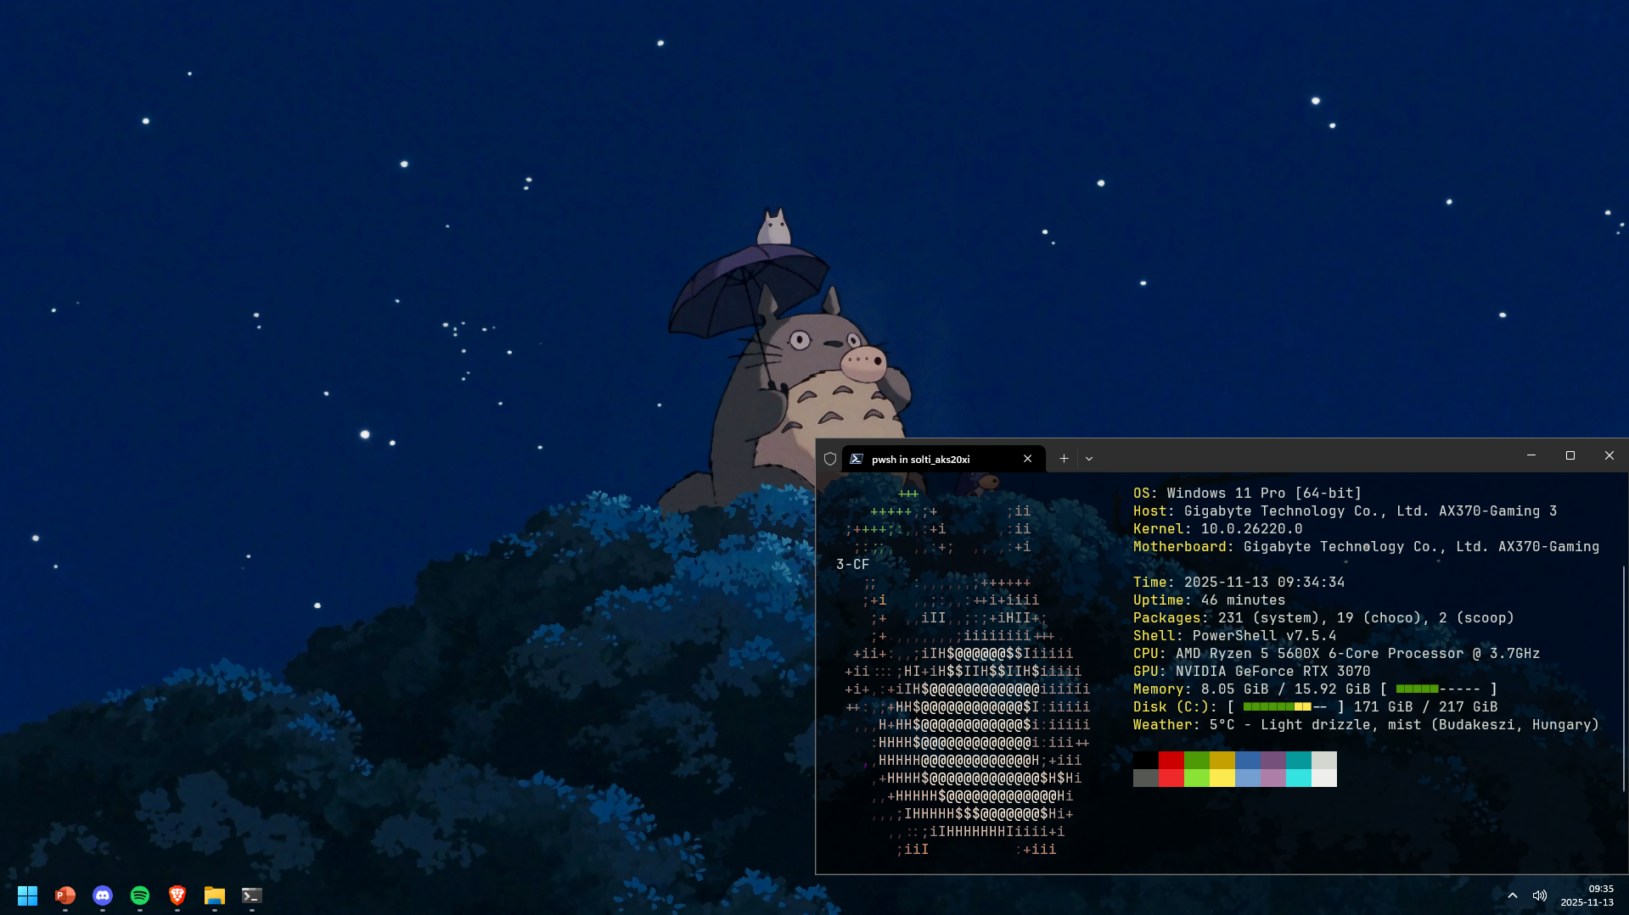
What is Application Software?
Software designed for specific user tasks
Can be open source or proprietary
Examples: Office, Adobe, Teams, Windows, macOS, VSCode, Google Chrome

Slide 6

Designed for specific user needs with rich features
Professional support and regular updates
Built-in security and compliance features
Collaboration and scalability capabilities
Streamlines workflow and automates tasks
Licensing/subscription costs
Integration challenges with older or niche systems
Learning curve for new users
Security risks if not updated or managed properly
Vendor lock-in and reduced flexibility

Slide 7

Non-Open Source but Moddable Software
Software that is proprietary but supports user modifications or extensions
Customizability without full source access, enhances user experience
Limited by proprietary restrictions, possible instability, risk of violating terms of service
Examples: Spicetify, Vencord, Steam Millennium

Slide 8


Slide 9

Questions

